Slide 1
Strategic pillars of AgriforLife to foster the development of an agriculture that has as a vital component sustaining human life.
Agriculture for Life
Seek solutions to ensure that cultivated foods meet high standards of taste, food safety, nutritional value, and other quality characteristics.
Foster technologies that aim to minimize environmental impacts, promote biodiversity, and contribute to the preservation of global ecological balance.
Projects that transcend the usual objectives of production and profitability, with the conscious purpose of creating a positive social impact.
Agri for
Food
Agri for
Energy
Agri for
Profitability
Agri for Wholesome Food
Agri for
Social
Impact
Provide new technologies aimed at fostering the planet's food security
Leverage agricultural resources to meet energy demands in a sustainable manner.
Agri for
Planet
Development of projects that prioritize economic profitability, focusing on financial efficiency and economic success in agriculture.

Slide 2
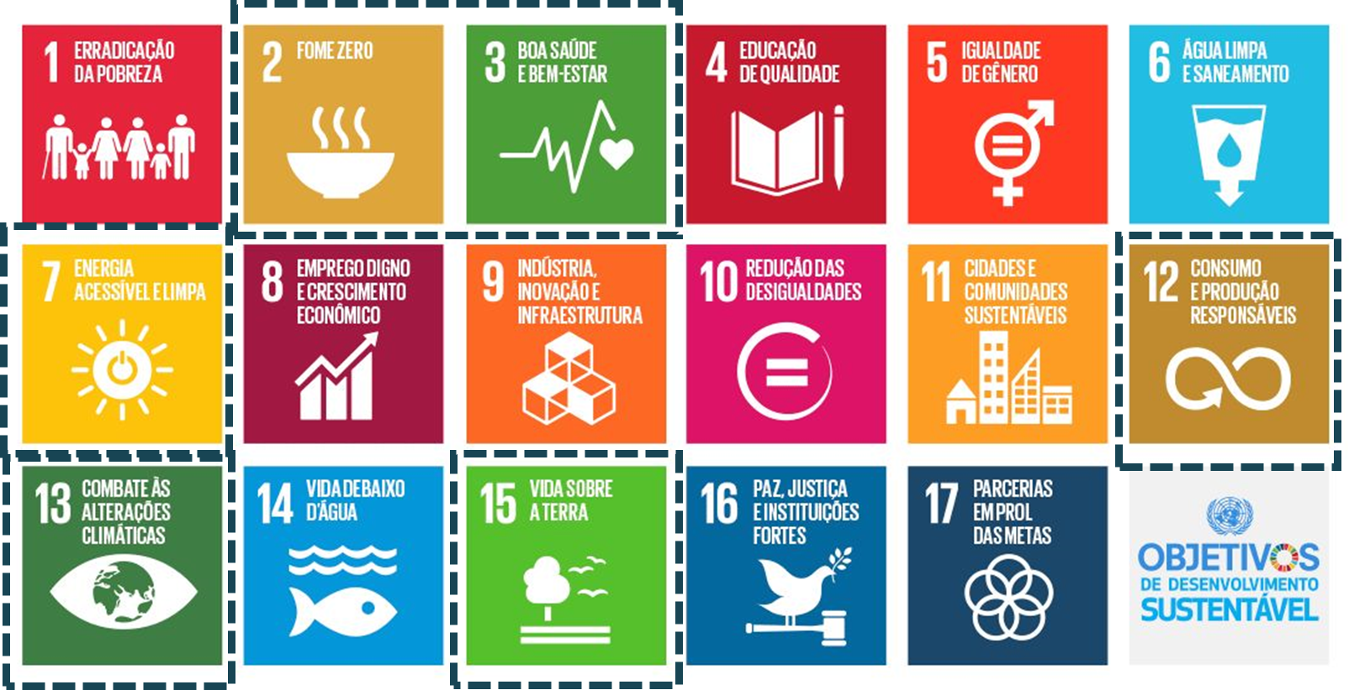
Our pillars are aligned with 6 of the 17 United Nations Sustainable Development Goals.

Slide 3
Key initiatives of AgriforLife to foster the development of effective, profitable, and sustainable agriculture.
Knowledge Dissemination
Develop training programs and knowledge dissemination initiatives that promote transformation in agriculture.
Unite ideas. Build the future.
Collaborate in the development of new technologies for agriculture, actively participating in an innovation ecosystem (startups) aimed at making a difference in people's lives.
Promoting Sustainable Agriculture
Work on communication actions aimed at accelerating the adoption of sustainable agricultural practices
Partnerships that Transform
Collaborate with companies, universities, and governments on projects that promote societal transformation and have significant social impact.
Co-Creating AgriforLife
Collaboratively work on the technological development of new, disruptive products and services that enhance a more effective, profitable, and sustainable agribusiness.
Intelligence in Sustainable Practices
Utilize indicators that assist in the management of crops, focusing on regeneration and the better use of resources.

