Slide 1

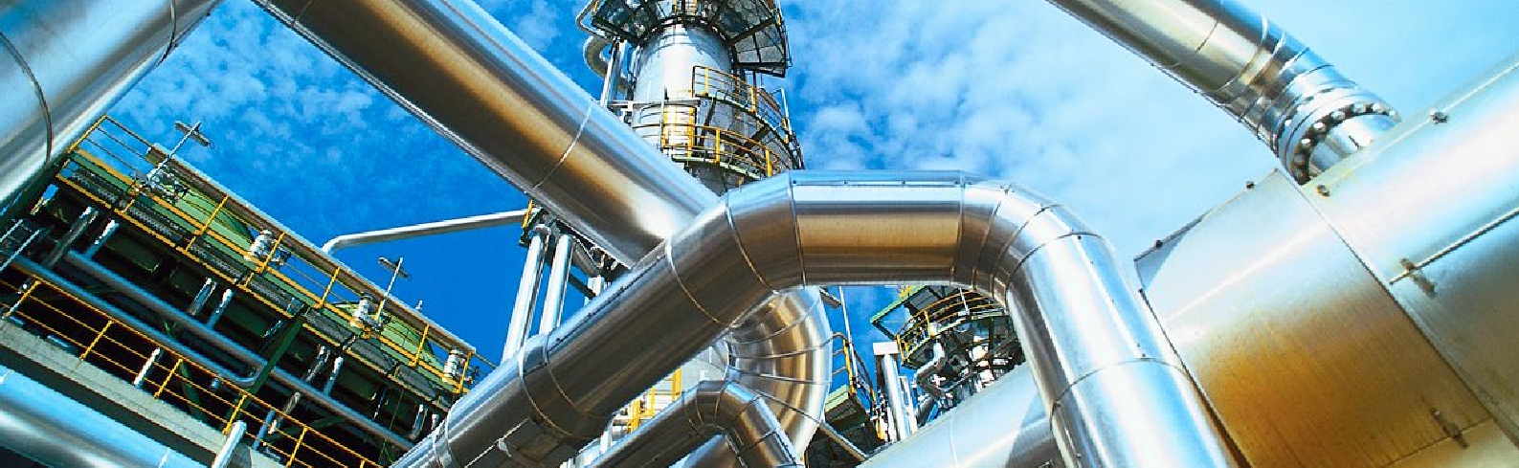
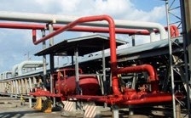
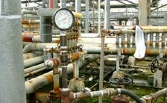
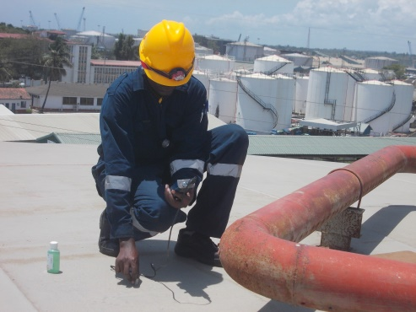
API 570
PIPING INSPECTION AND CERTIFICATION
murban
INSPECTION
This code covers inspection, repair, alteration, and rerating procedures for in-service metallic piping systems.
It establishes requirements and guidelines that allow owner/users of piping systems to maintain the safety and mechanical integrity of systems after they have been placed into service.
This may be used, where practical, for any piping system.
Piping inspectors are certified to API 570 as a well known inspection company with a high value on professional skills, Murban Inspection Services Co., Ltd, provide API 570 Pipeline Inspection and Certification services within Kenya and around the world.
Accuracy is ensured by the use of high technology data acquisition equipment giving certainty of data integrity.
In addition all data will be collected in the database and handed to clients for further monitoring by themselves to aid with future planning by giving an inspection timeline.
www.murban-eng.com

