Slide 1


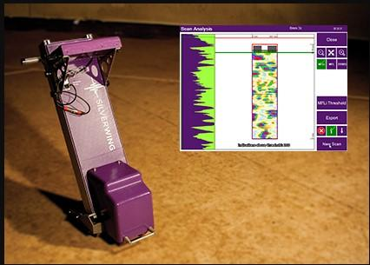

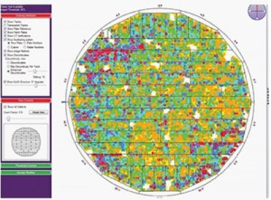
MFL (Magnetic Flux Leakage)
Advanced tank floor inspection
murban
INSPECTION
Murban provides tank bottom floor and annular plate inspection by advanced NDT methods Floormap 3DiM with Magnetic Flux Leakage Technology where magnetic field passes between poles through the bottom plate and detects the flux leakage from the defect.
The Floormap3Di-R is fastest tank bottom inspection system with scanning speeds variable up to 1 m/s. The Floormap will improve your inspection efficiency whilst improving accuracy and data quality.
High resolution sensor provides excellent probability of detection down to indications that measure 2mm in diameter. This coupled with advanced signal processing and defect classification tools significantly improves the corrosion detection and sizing capability.
Murban uses powerful and efficient reporting software SIMS to create high quality reports on tank condition and archiving of inspection results for traceability. SIMS imports data form Floormap3Di and automatically positions each of the separate plate files together to produce a CAD Drawing of the entire tank floor showing the location and severity of all corrosion over specific
Benefits of Floormap MFL:
Advanced defect sizing and classification tools
Auditable inspection data
Full tank floor mapping
Full data recording
High probability of detection
Field proven durability & reliability
www.murban-eng.com

