Slide 1
Cover page (main info).
Title:The Mexican Polymer Society Journal(MPSJ)
. (Motto:
The JMPS elevates Polymer Science and empowers Mexico's New era

Slide 2



Back cover
The JMPS elevates Polymer Science and empowers Mexico's New era.
Editor in chief: Dr. Ramiro Guerrero-Santos
EDITORIAL BOARD
Dr. Dámaso Navarro Rodríguez(CIQA)
Dr. José Bonilla(CIMAV)
Dr. Felipe Avalos (UA de Coah.)
Dr. Ángel Licea (ITTijuana
Dr. Rubén González Núñez.
Dr. Antonio Martínez Richa(Universidad de Guanajuato)
Dr. Rubén González Núñez(universidad de Guadalajara)
J. Betzabe González Campos(universidad michoacana)
EDITORIAL COMMITEE.
Dr. Dámaso Navarro Rodríguez(CIQA)
Dr. José Bonilla(CIMAV)
Dr. Felipe Avalos (UA de Coah.)
Dr. Ángel Licea Claveríe
Dr. Rubén González Núñez
Dr. Antonio Martínez Richa(Universidad de Guanajuato)
Dr. Rubén González Núñez(universidad de Guadalajara)
J. Betzabe Gonzalez Campos(universidad michoacana)
Dr. Victor Lechuga Islas
Dr. Roberto Yañez
Dr. Tania Lara Ceniceros
JMPS, vol. 6, núm 12, septiembre 2023-febrero 2024, es una revista académica digital de acceso libre y publicación cuatrimestral editada por el Centro de Investigacion en Química Aplicada(CIQA-Conacyt), Blvd. Enrique Reyna Hermosillo, núm. 140, Col. San Jose de los Cerritos, C. P. 25294, Saltillo Coahuila en colaboración con la Sociedad polimerica de Mexico(), Tel. +52 (664) 631 6344, Tel. (444) 811 01 01. Contacto: encartesantropologicos@ciesas.edu.mx. Directora de la revista: Dra. Odilia Perez Camacho. Alojada en la dirección electrónica https: Responsable de la última actualización de este número: Arthur Temporal Ventura. Fecha de última modificación: 21 de septiembre de 2023

Slide 3
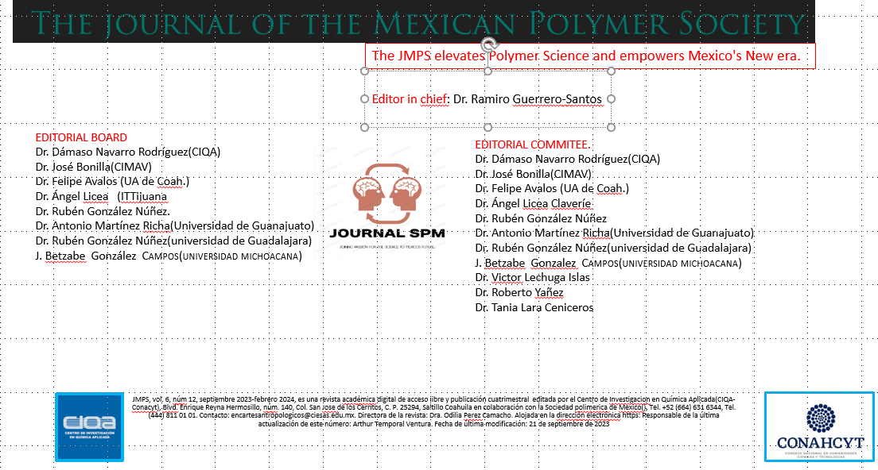

Slide 4
scope
The Journal of the Polymer Mexican Society (JPMS) aims to be a leading international publication dedicated to advancing the knowledge and understanding of polymers and polymer science. The journal serves as a platform for scientists, researchers, academicians, and industry professionals to share their original research, reviews, and perspectives on various aspects of polymers.

Slide 5


Examples of e journals

Slide 6
Polymer Synthesis and Characterization:
Novel synthesis methods and strategies for polymerization
Advanced characterization techniques for polymer structure and properties
Polymer functionalization and modification approaches
Polymer Processing and Manufacturing:
Polymer melt processing, extrusion, and molding techniques
Additive manufacturing and 3D printing of polymers
Polymer processing for specific applications (e.g., films, fibers, coatings)
Polymer Properties and Applications:
Structure-property relationships in polymers
Mechanical, thermal, electrical, and optical properties of polymers
Applications of polymers in various fields (e.g., biomedical, energy, packaging, electronics)
Polymer Composites and Nanotechnology:
Polymer matrix composites and their fabrication techniques
Nanocomposites and their characterization
Polymer-based nanomaterials and their applications
Polymer Physics and Theory:
Polymer dynamics and rheology
Polymer modeling and simulation
Polymer self-assembly and phase behavior
Biopolymers and Sustainable Polymers:
Biodegradable and bio-based polymers
Sustainable synthesis and processing of polymers
Environmental impact and life cycle assessment of polymers
Polymer Engineering and Design:
Design and optimization of polymer materials for specific applications
Structure-property relationships for engineering polymers
Polymer processing and design for improved performance and functionality
Polymer Characterization Techniques:
Spectroscopic techniques (e.g., FTIR, NMR, Raman) for polymer analysis
Thermal analysis techniques (e.g., DSC, TGA) for polymer characterization
Microscopy and imaging techniques (e.g., SEM, AFM) for polymer study
JPMS encourages submissions of original research articles, reviews, and perspectives that present significant contributions to the field of polymer science. The journal welcomes interdisciplinary research that combines polymer science with other scientific disciplines such as chemistry, materials science, physics, biology, and engineering.
JPMS is committed to maintaining high scientific standards and rigor in the peer-review process to ensure the publication of high-quality and impactful research. The journal aims to foster collaboration and exchange of ideas among researchers and professionals in the polymer community, promoting the advancement and innovation in the field.
Note: The scope of the Journal of the Polymer Mexican Society can be further refined or expanded based on the specific objectives and focus of the society

