Slide 1
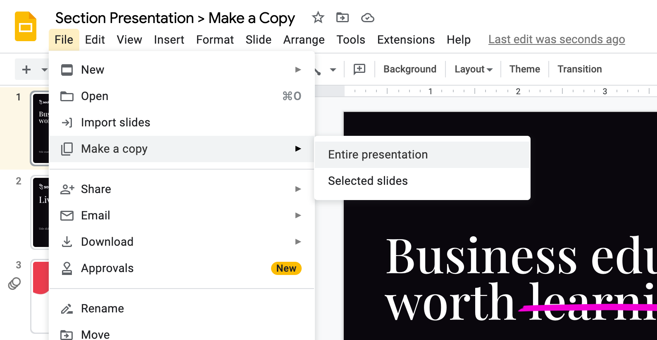
Template: Identify AI projects to optimize your workflows
To get started, make a copy of this presentation for your own personal use.

Slide 2
Identify AI projects to optimize your workflows
HOW TO USE THIS TEMPLATE
If you want to use AI to optimize your existing business – make your internal efforts more efficient – you’ll first need to brainstorm projects. This template is designed to help you identify org- or department-wide projects you could undertake to improve your internal workflows and do work faster and more affordably, while maintaining similar quality.
Use this template to:
Understand generative AI’s superpowers
Identify existing workflows that leverage these superpowers
Prompt GPT or another conversational AI to help you brainstorm
See how recruiting startup Dover saved $500K by using AI to automate candidate triage

Slide 3



The three operating modes for generative AI
OPTIMIZE
Make your internal efforts more efficient
ACCELERATE
Make your existing product or service better
TRANSFORM
Create a new product or service line

Slide 4
Map generative AI’s superpowers to your workflows
– which workflows require these superpowers?
Generative AI Superpowers
1
Generate text, code, images, or video
2
Synthesize text, code, images or video
3
Generate ideas
4
Complete tasks
5
Interact with users

Slide 5
Optimize: List your existing internal
workflows that require these superpowers
Generate text, image, video, or code | Process text, image, video, or code | Generate ideas | Complete tasks | Interact with users
<List workflows here> | <List workflows here> | <List workflows here> | <List workflows here> | <List workflows here>
Notes:
Some ways to do this:
1. have each functional team look at their existing processes and identify pain points - where do tasks take a long time. then ask how could AI help us do this
2. have company/department look at the end-to-end customer journey and what we're doing internally at important points. then ask how could AI help us do this
Three months ago, we sat down and did this - and if we did it today, we would probably have more use cases, based on our team using these tools ourselves every day - for example our head of Studio, Nelson, has changed (improved) their workflow building websites and landing pages using a new AI-powered feature inside of Figma - saving hours every week.
So this framework I think you need to use and revisit every 90 days - at least update it.

Slide 6
AI Prompt: Brainstorming Ideas to Optimize
INSTRUCTIONS: Input this prompt into ChatGPT, Bard, Claude, or another conversational AI to use AI to brainstorm ideas to optimize your business. Remember, it works best when you have a conversation! Ask AI to go deeper on it’s suggestions or for feedback on your own ideas.
PROMPT: You're my advisor and I'm a leader at a [company description]. My company sells [product description] to [buyer description]. I'm brainstorming ways to use generative AI to optimize my organization, making our internal processes more efficient. I want ideas in five buckets:
1) Ways I can use generative AI's capabilities to generate code, text, images, or video
2) Ways I can use generative AI's capabilities to process or synthesis text, image, video, data, or audio
3) Ways I can use generative AI's capabilities to generate ideas or be a thought partner
4) Ways I can use generative AI's capabilities to complete tasks as a copilot
5) Ways I can use generative AI's capabilities to interact with users
Can you brainstorm ideas in each of the following categories for me?

Slide 7
Sample completed frameworks

Slide 8
Case study: Section
Key
Ideas from Section team
Ideas from prompting Chat GPT-4
Generate text, image, video, or code | Process text, image, video, or code | Generate ideas | Complete tasks | Interact with users
Personalized marketing or sales email outreach (mktg, sales) Build SEO-optimized product descriptions and blog posts (mktg) Generate framework visuals and metaphors (creative, GPT) Write web copy and Slack course copy (ops) Write first draft of course scripts (edu., GPT) | Deep research and speaker prep for events (mktg, edu.) Create course post mortems (data) Generate transcripts & captions (ops, GPT) Tag and segment video content (GPT) Grade student projects (GPT) | Generate frameworks for courses (edu.) Build additional case studies or examples (edu.) Source enterprise leads or contacts (sales) Develop courses for new curriculum topics (edu.) Generate ideas for TikTok campaigns (GPT) | Handle customer support tasks (GPT) Handle tasks for TAs – TA copilot (GPT) Process resumes for hiring applications (GPT) | Onboard new members into Section (GPT) Vet and qualify sales prospects on website (GPT)

Slide 9
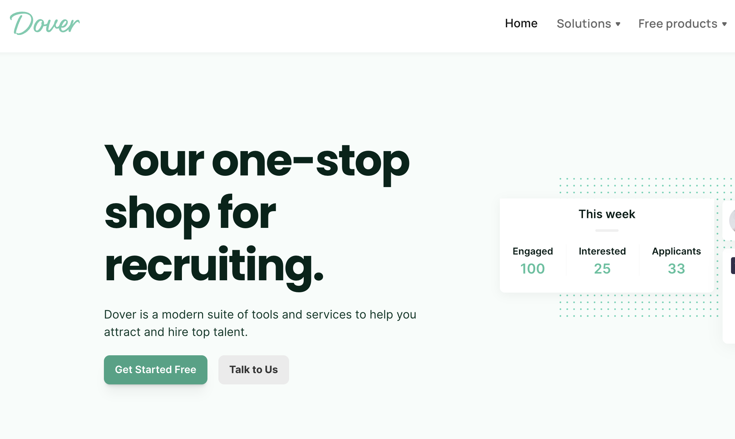
Case Study: Dover
Dover is an recruiting startup that uses technology to source candidates and move them through the interview process for clients.
Internal workflow:
Dover’s platform receives 1000s of emails per day from prospective candidates that need to be triaged into one of 8 buckets for next steps
Dover’s existing automation could triage 60% of candidate emails
40% of emails were still processed manually through a support queue
AI superpower: Synthesizing text
Solution: A fine-tuned model leveraging GPT-4 to categorize the other 40% of emails with 95%+ accuracy
4-week proof-of-concept phase (feasibility)
2-week prototyping phase
Results
Saved ~$500k on manual staffing costs
Faster resolution for clients (real-time triaging = faster response times)
Email categorization
Business Problem: A ton of time early days in dover to reach out the right candidates - candidate responds, now what - tried to ID how to triage emails effectively and get to the right bucket
Not just a yes /no
Do they have a question, if so does that go to Dover, or odes that go to client
Had a rules based system that did 60% of categoirzaiton automatically - had a long tail that couldn’t automate – some human was going through and bucketing into 8 buckets
  Que based so delayed, whereas now it’s real time
Tried with GPT-3, did not work (wasn’t sophisticated enough – better at creative work than precise work
Tried again with GPT-4, spent about a month (feasibility - could it work) - spent a few more weeks then getting into production
  Had to break questions into much smaller questions (hits API 3x to make a final decision)
  Had to be 99.9% good – needed high fidelity
Saved about $500k a year
Notes:
Other notes:
Tried with GPT-3 a few months ago and couldn’t get the model to be accurate enough – they needed this to be high fidelity “99.9% accurate” – tried again with GPT-4 for 4 weeks and were successful

