Slide 1
Brand colour palette
Primary colours
Secondary colours
Dark blue:
Red: 7
Green: 26
Blue: 56
#071A38
Orange:
Red: 231
Green: 133
Blue: 34
#E78522
Light Grey:
Red: 147
Green: 153
Blue: 149
#939995
White:
Red: 255
Green: 255
Blue: 255
#FFFFFF
Bright Blue:
Red: 28
Green: 107
Blue: 183
#1C6BB7
Dark Grey:
Red: 75
Green: 79
Blue: 78
#4B4F4E

Slide 2
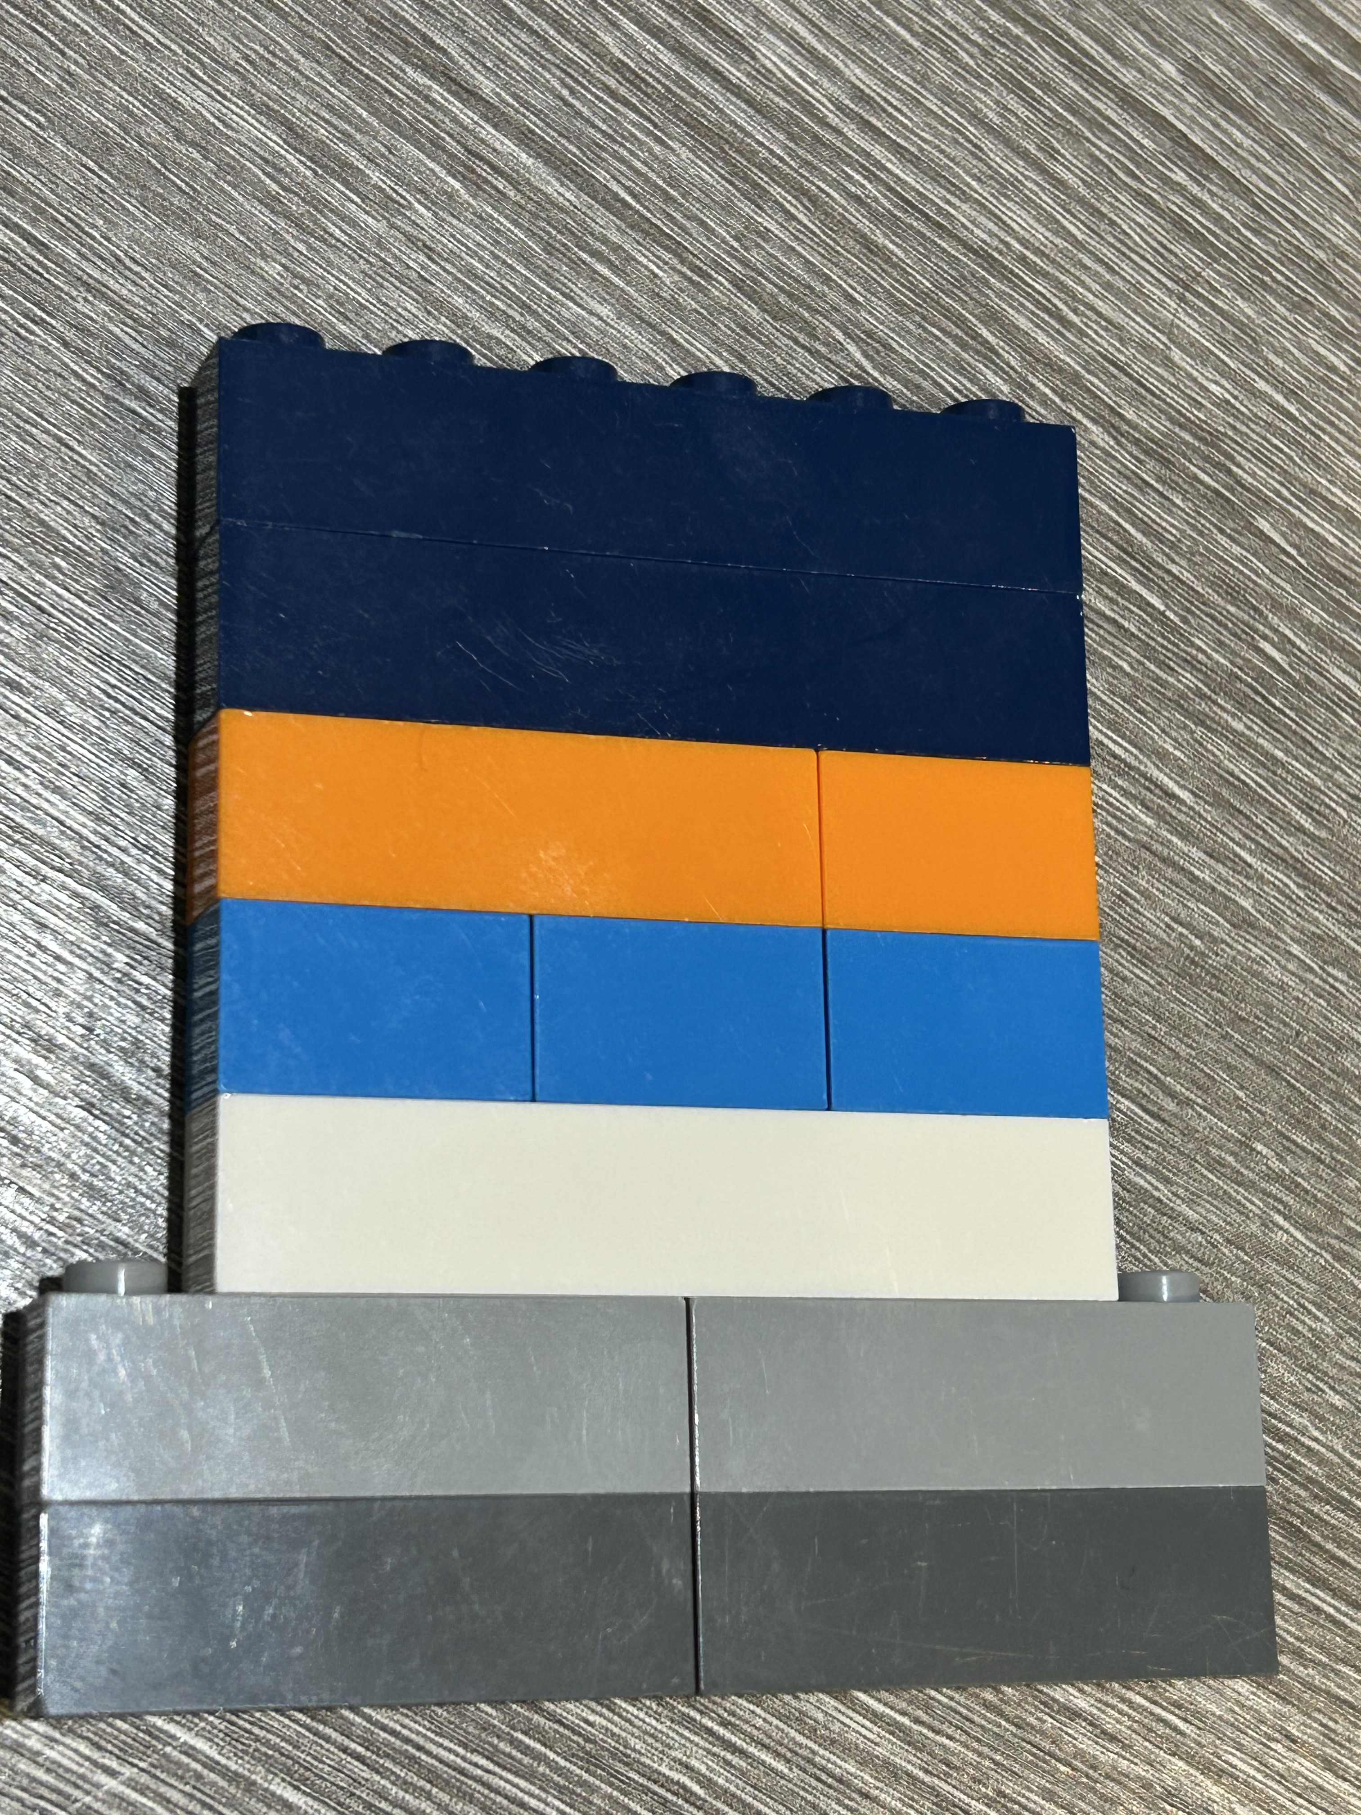
Inspired by Lego Arctic explorer range colour scheme.

