Slide 1




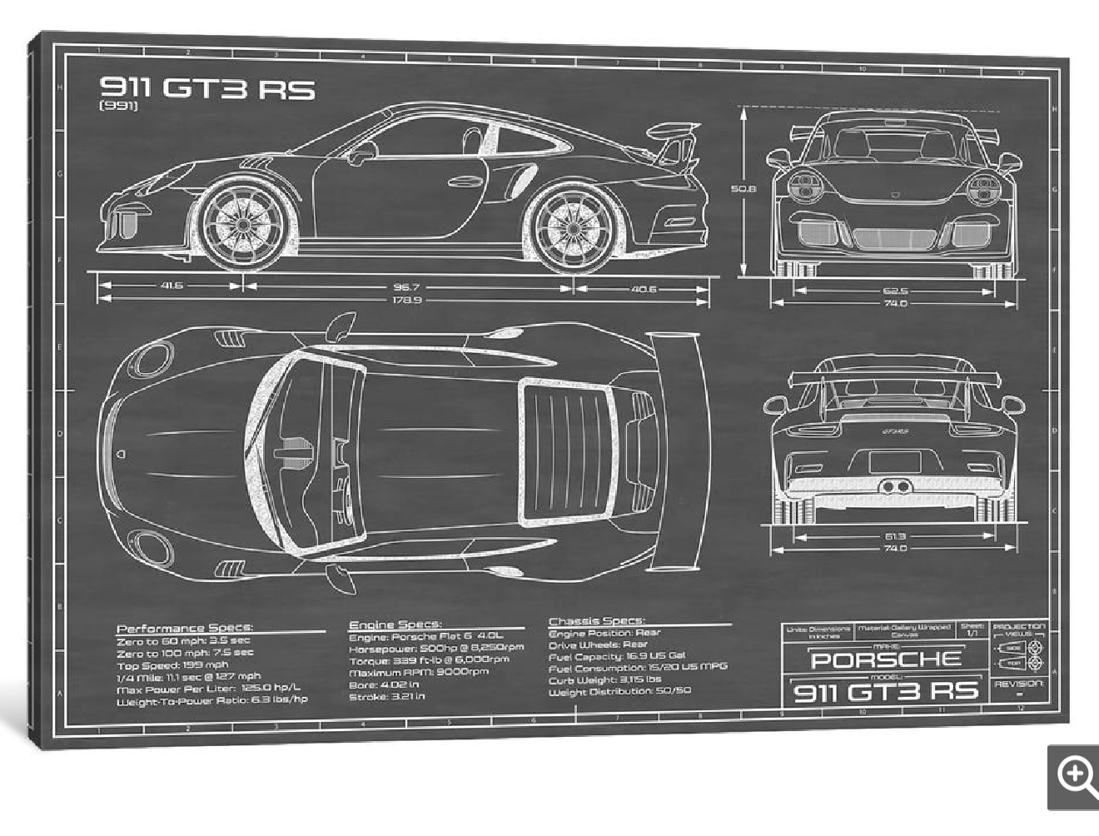


TMS Performance Mood Board
Tyler Thomas
Founder
203-297-5787
atylerthomas@icloud.com
Oahu, Hawaii
Wrapping and Detailing
By Appointment Only
TMS
PERFORMANCE

