Slide 1

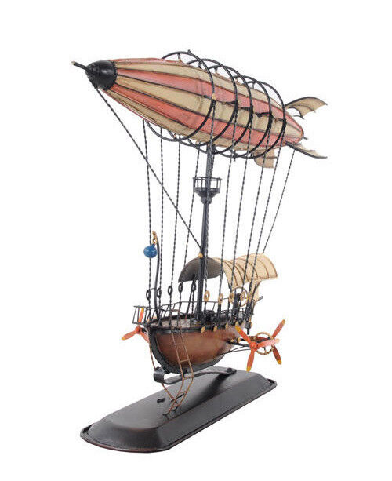
Benefit Airship
FFE1A1
603E2C
CD7E76

