Slide 1

Cafè Toma Toma
A lively social beverage spot

Slide 2

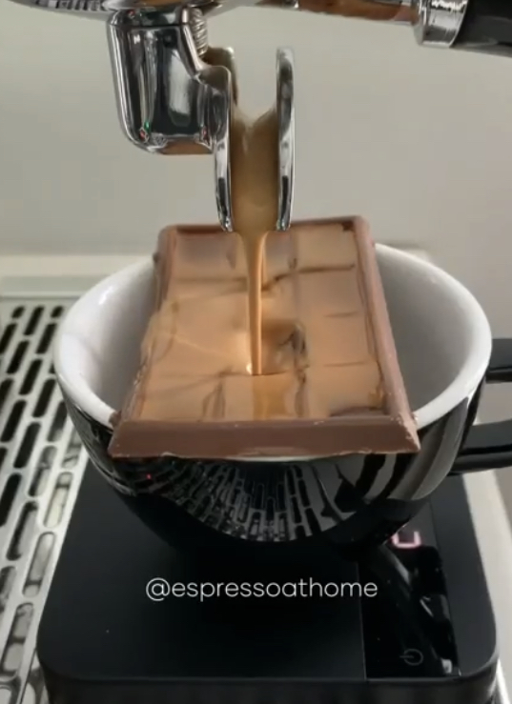
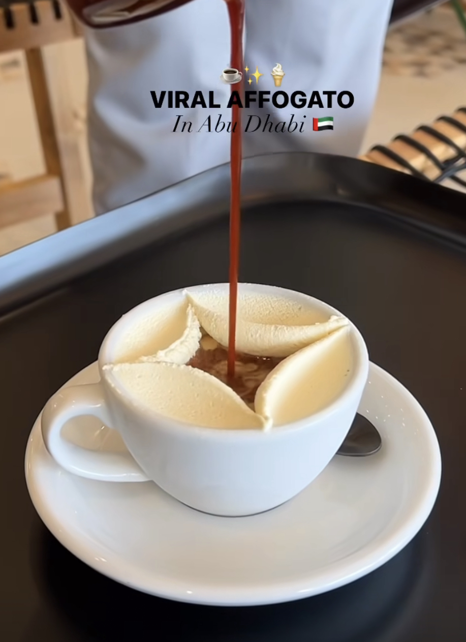
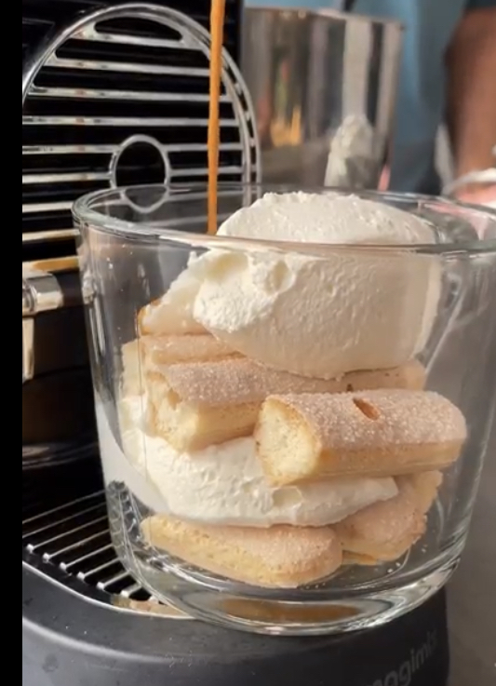
CREATIVE ESPRESSO DRINKS

Slide 3
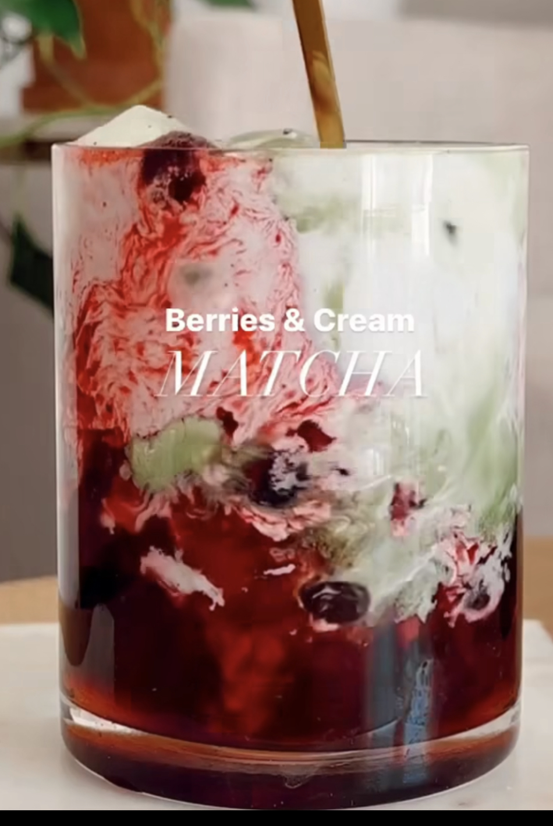
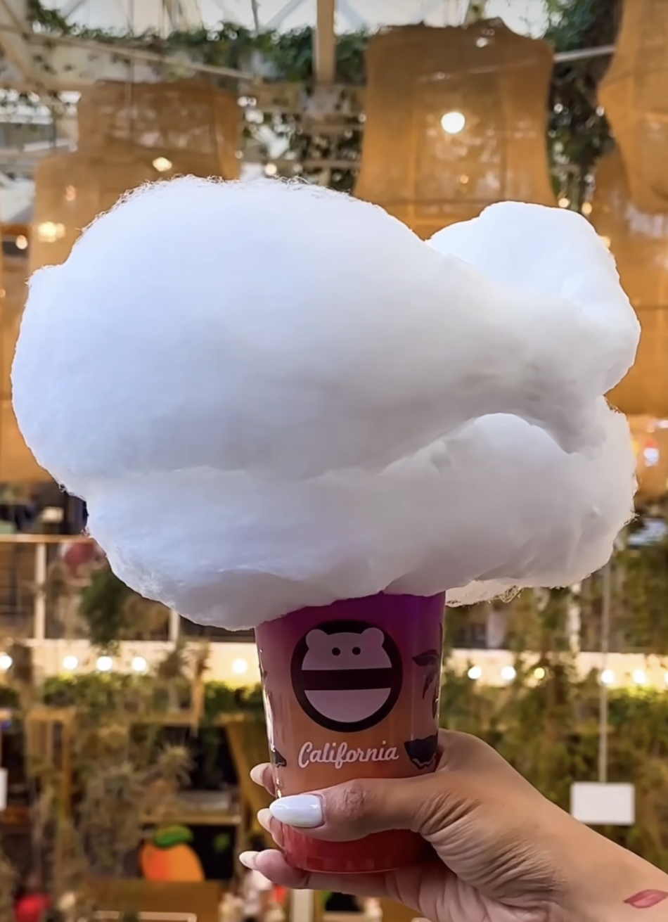
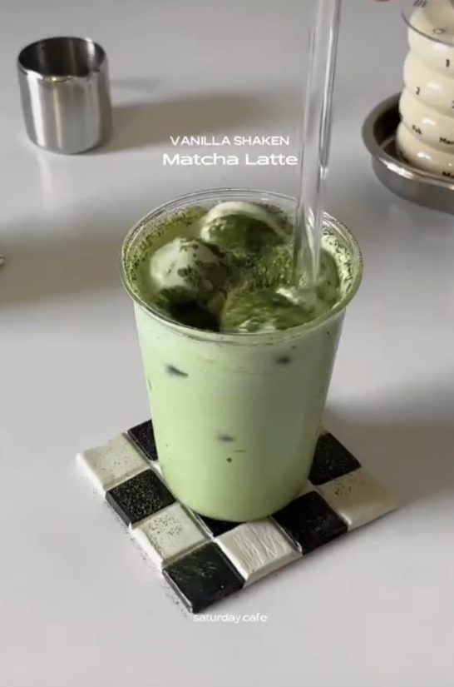

SIGNATURE ICED DRINKS

Slide 4

Healthy Food Option

Slide 5
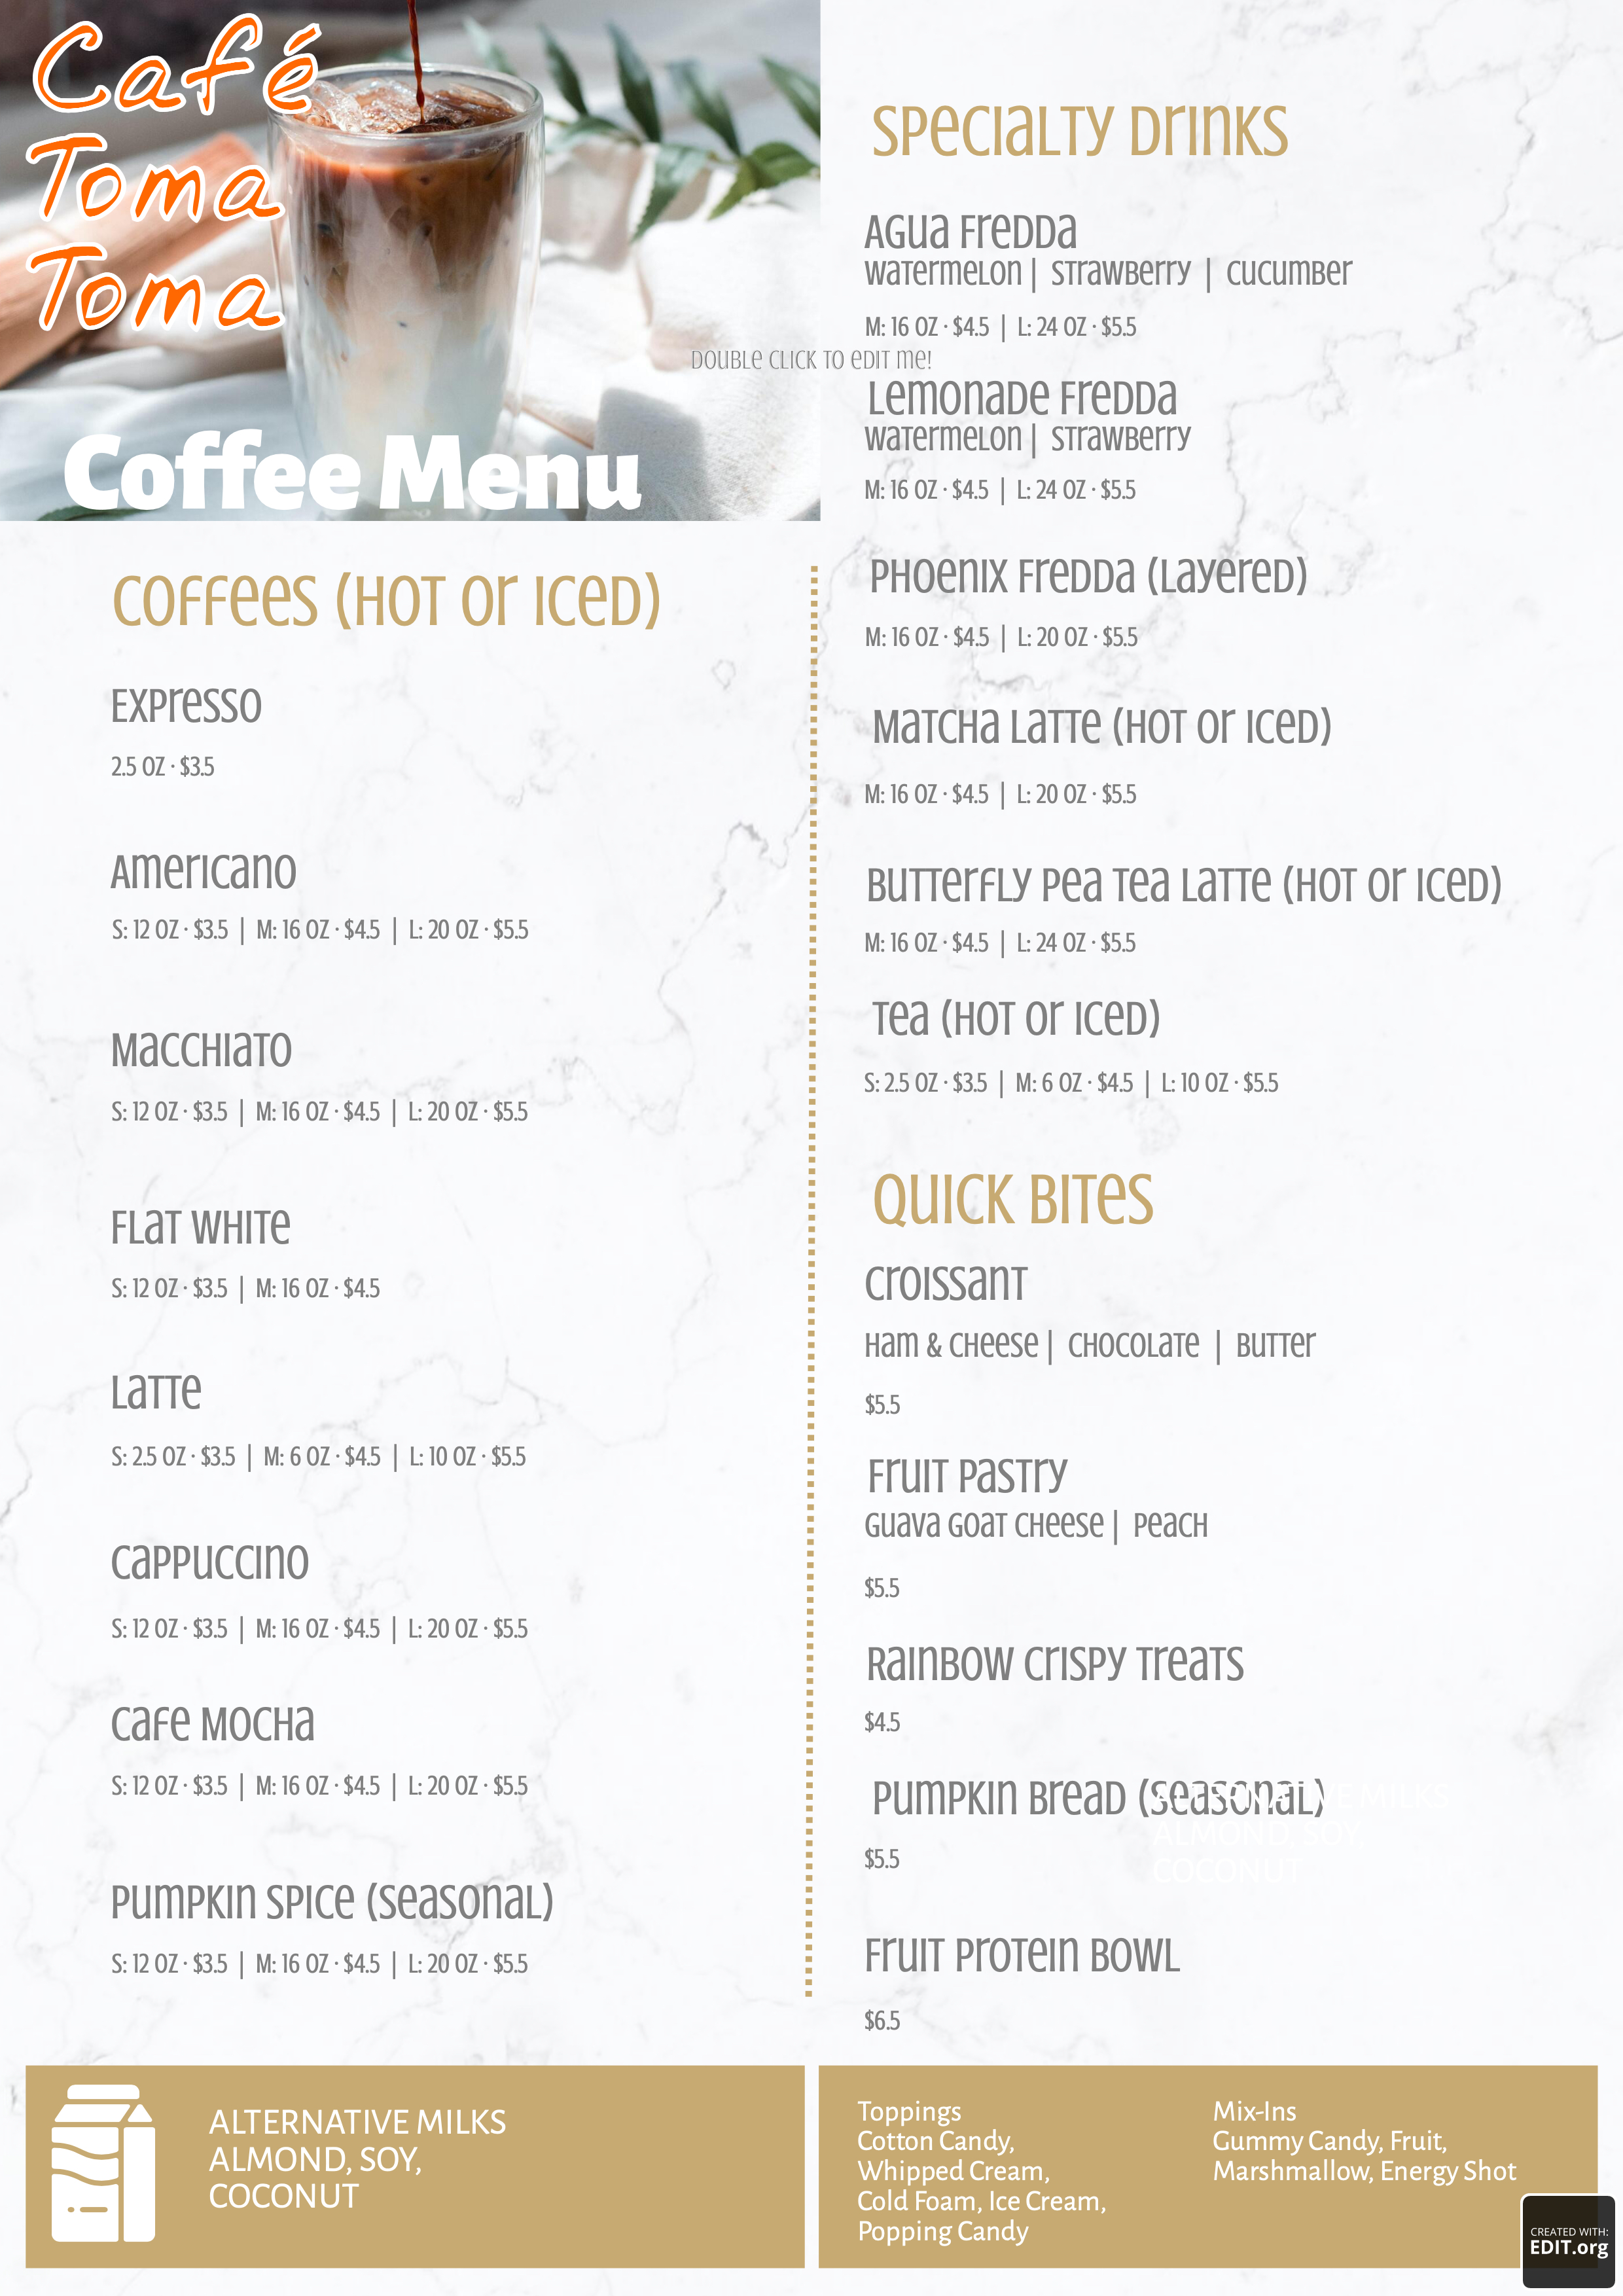
SAMPLE MENU

Slide 6
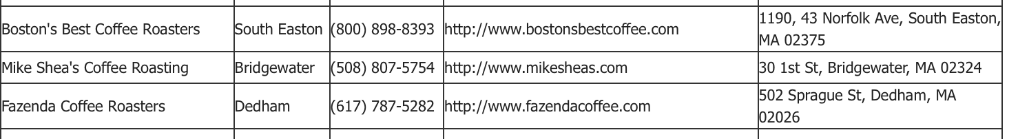
Procure Local Coffee Roaster & Barista Training

Slide 7
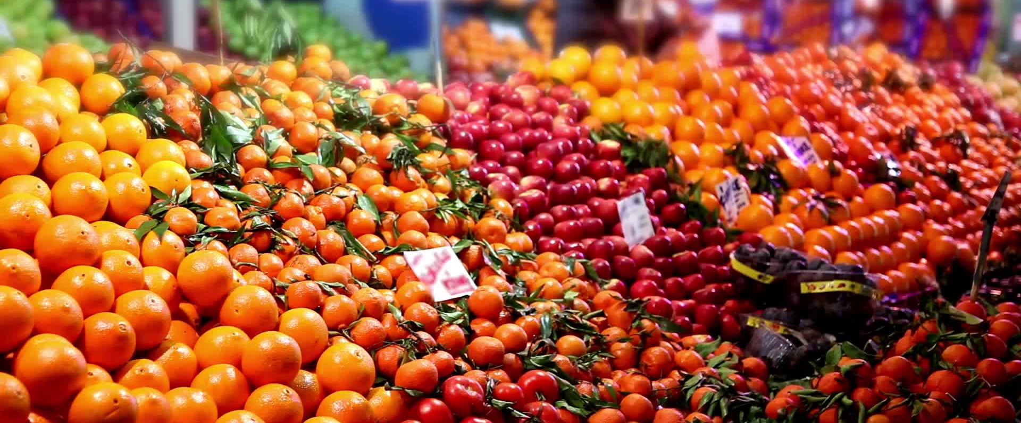
Procure Food Distributer and Paper Products Supplier:
WebstaurantStore, Barista Underground, Sysco

Slide 8

Eco Friendly Food and Beverage Packaging
Compostable and Biodegradable
  Plant based straws, cups, lids and sleeves
  Eco Safe compostable food service gloves
  Distributers: Good Start Packaging, the good cup, Sysco, and WebstaurantStore

