Slide 1

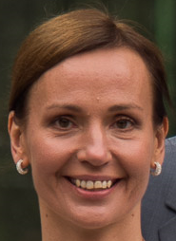
50
2 times 50 …. 2 parties and you are invited
Corona postponed Estonian song festival, so I postpone my 50th
07/07/2025
Tallinn

Slide 2
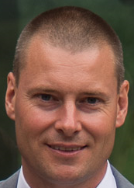
50
2 times 50 …. 2 parties and you are invited
Once in a lifetime, I would like to celebrate my birthday in summer
29/06/2024
Guchtveld 15, 1790 Affligem

