Slide 1

DATransformation
2026
ExCom Alignment
Transformation Strategy
03.26.2019

Slide 2
Agenda
Current State Evaluation
Strategy and Financial Plan
Other Initiatives

Slide 3
1. Current State Evaluation

Slide 4

DAT vs. Market Production and Forecast
Forecast
Key Highlights
2.2%
Historical
Overall mortgage production will continue to decline for the 4th year in a row to c. 100,000 units
DAT is projected to grow mortgage sales by +22% in 2023 (vs. a market decline of -35%)
Forecast
Market production is forecast to reach 150,000 units by 2026 led by growth in off plan and self construction
DAT is forecast to grow production by 83% over the next 3 years (vs. 50% for the overall market)
2.1%
2.2%
2.0%
1.7%
1.1%
0.9%
0.9%
DAT Market Share

Slide 5
Market Production Mix – REDF Share
Key Highlights
Non REDF share has increased the last four years and now represents 36% of the overall mortgage market due to decline in REDF sales

Slide 6
Market Production Mix – REDF Products
Key Highlights
Self Construction declined in 2022 due to changes in MOMRAH regulations
Off Plan and Self Construction make up more than 30% of REDF subsidy production
Off Plan will continue to grow in accordance with new MOMRA and NHC project plans

Slide 7
DAT vs. Market Production Mix
DAT (2023)
REDF Market (2023)
DAT Opportunity
(3 year plan)
Key Highlights
Product
Off Plan: 450M
Self Construction: 150M
Product: REDF Non Ready Unit production makes up 32% of the addressable mortgage market
Region: Riyadh is below market average by 10%. Non main regions make up just 9% of DAT production (vs. 35% for the overall market)
REDF: DAT has higher share of REDF production as we were able to grow our year-on-year bookings as compared to market
Region
Ready Unit
Riyadh: 450M
Non Main Regions: 200M
REDF

Slide 8
DAT Production Mix
DAT (2023)
Key Highlights
Income
Income and Property Type: Changes to the REDF subsidy table has driven production towards beneficiaries with income below 10K and apartment units with lower loan amounts
Loan Amount: DAT is concentrated below SAR 750K. We have a strategy to introduce new features and loan products to increase average loan size.
Property Type
Loan Amount

Slide 9
DAT and NBFI Market Share

Slide 10
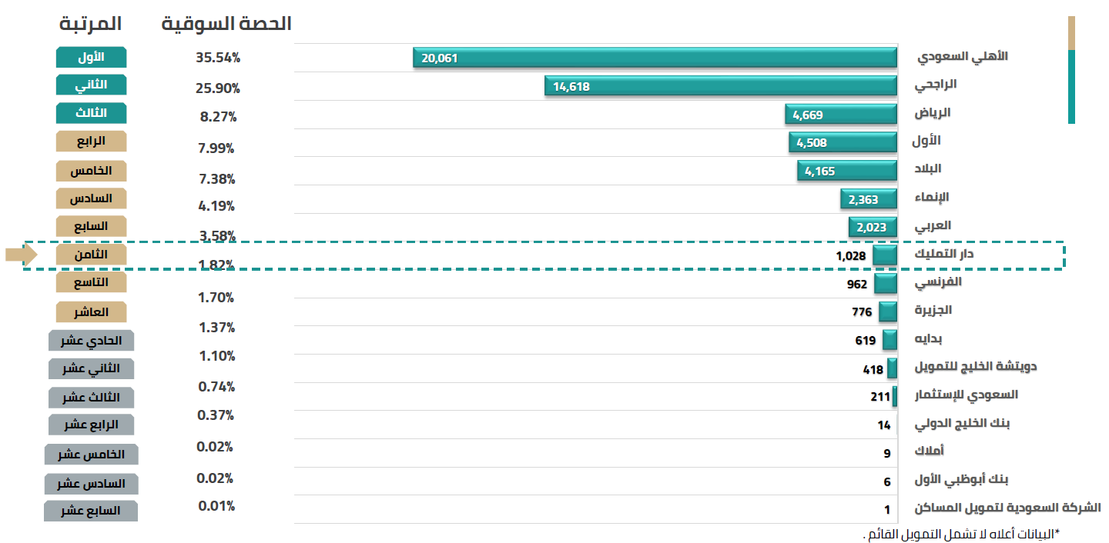
REDF Production (YTD October 2023)
Key Highlights
DAT is currently ranked #8 in REDF production up from #10 in December 2022
Market share has improved to 1.82% up from 1.02% in December 2022

Slide 11




DAT SWOT Analysis
STRENGTHS
WEAKNESSES
Mortgage only
Ready-unit only
Masakin Program concentration
Geographical reach
Revenue stream dependency
On-balance Sheet portfolio size
Mortgage specialization
Masakin program
NBFI market share
Program management expertise
Mortgage servicing capabilities
Off balance sheet loan book
01
02
SWOT
Grow market share of existing products
Explore new markets
Develop new mortgage products
Digital innovation
Develop new business lines
04
Masakin shift
REDF shift
MOH shift
Speed of digital transformation
Regulatory oversight
Competitive pressure from banks
Macro factors (interest rates / property values)
03
OPPORTUNITIES
THREATS

Slide 12








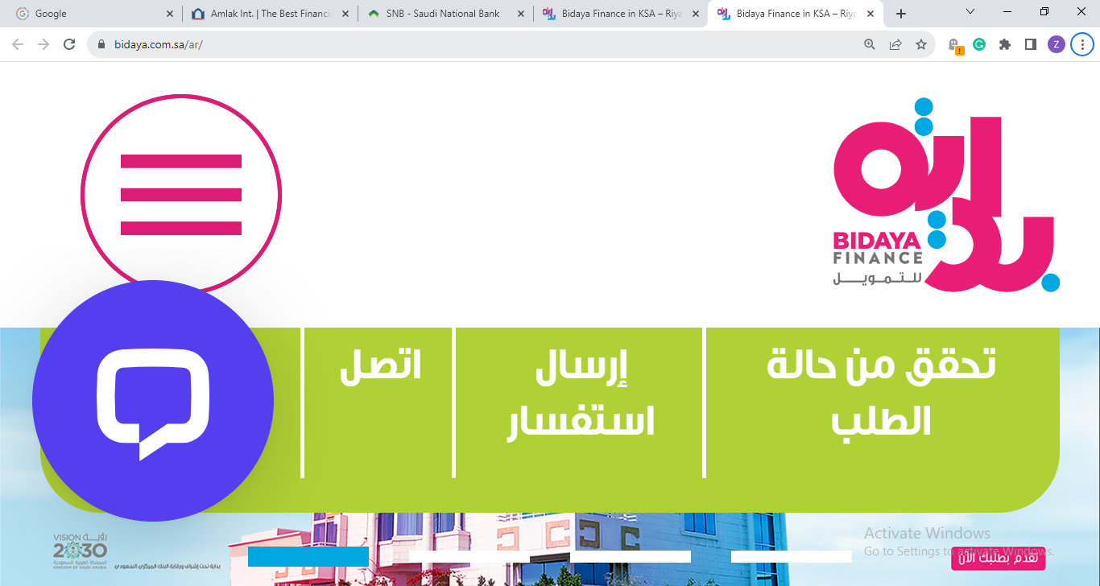


Real Estate Finance companies working on diversifying
57 Licensed Finance Companies by SAMA
Financial Leasing
49%
Consumer Financing
47%
SME Financing
46%
Production Assets Financing
28%
Real Estate Finance
11%
Debt-Based Crowdfunding
11%
Buy Now Pay Later
11%
Microfinance
7%
Consumer Microfinance Activity
Using Financial Technology
5%
4%
Credit Card Financing
Real Estate
Re-Finance
2%

Slide 13
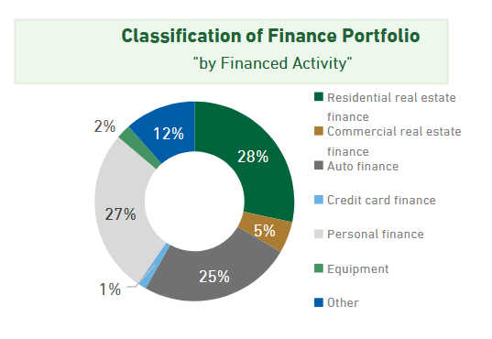
Finance Company Portfolio Composition
Key Highlights
Real estate finance: represents 28% of finance company portfolios (on and off balance sheet)
Personal finance: makes up 27% of total portfolios
SME: including commercial real estate, equipment, and other totals 19% of total portfolios

Slide 14
Competitor Financial Comparison
H1 2023
DAT
Bidaya
Deutsche
SHL
Amlak
Nayifat
MRNA
Quara
Key Highlights
Paid Capital (M)
359
900
575
1,000
906
1,000
714
300
RF competitor’s net income impacted in 2023 by high borrowing costs and interest rate mismatch
Companies who are in the Personal Finance and SME business have the highest ROE
Total Assets (M)
969
3,050
2,324
4,307
3,555
2,085
1,521
889
Shareholder Equity (M)
589
892
700
1,663
1,182
1,342
882
366
Borrowings (M)
36
1,705
1,500
2,544
2,031
669
595
405
Portfolio Size On/Off B/S (M)
10,080
2,855
2,130
4,076
3,246
1,895
1,019
725
Net Income (annualized) (M)
29.2
(48.8)
2.0
8.6
34.6
107.4
57.0
55.8
ROE
(annualized)
4.9%
(5.4%)
0.2%
0.6%
3.0%
8.0%
6.5%
15%
Mainly RF
RF & SME
PF & SME

Slide 15
2. Strategy and Financial Plan

Slide 16
Transformation Strategy Statement
As we transform into a comprehensive financial services company, we remain committed to continue extending our range and reach of mortgage solutions.
Our strategy involves expanding our offering beyond mortgages to deliver a broader range of financial solutions to consumers and small and medium enterprises while maintaining our commitment to bespoke experience and technological advancement.

Slide 17
Current and Future State Comparison
Current State
Future State
Mortgage originator &
service provider
Financial Services
Single Program Value Proposition
Diverse finance solutions
Expansive Geographic Reach
Limited Geographic Reach
Multiple Sources of Funding
Single Source of Funding

Slide 18
Financial Objectives and KPIs
Financial KPIs
Production and Customer KPIs
Market Share
1.7%
REDF Rank
# 8
Turnaround Time
21 days
2.1%
# 7
12 days
+ 24%
+ 43%
Portfolio Size
15.5B
Net Income
29.3M
ROE
4.9%
TBD
50.3M
20.5B
+ 32%
+ 72%
2023
2026
Change
2023
2026
Change
+ 1
* Work in progress. To be finalized prior to Board strategy session.

Slide 19
5 DAT Transformation Pillars
Market Penetration
Product Development
Market Development
Diversification
Technology
DAT Transformation Pillars

Slide 20
Pillar #1: Market Penetration
+200 million production impact
Grow market share of residential finance in existing market
Market Penetration
Improve Productivity
Increase Leads & conversion
Increase
Sales Head Count
Implement CRM Platform
Increase HSF productivity across regions
Clinical focus on volatile and low performers
Revise incentive scheme
Seasonal sales Campaigns
Revise leads assignment and utilization criteria
Continue to challenge and improve DAT marketing activities
Increase HC in existing branches i.e Riyadh, Dammam, Tabouk
New HC allocated for new branches
Benefits include:
Improved customer relationships
Enhanced data management
Increased efficiency in sales and marketing processes

Slide 21
Pillar #2: Product Development
+500 million production impact
Develop new residential finance products for existing market
Residential Finance Products
Off Plan
Self Construction
Rent
-to-
Own
Mortgage Savings Program
Partner Programs
Masakin
Enhancements
REDF
New programs
SRC
Enhancements
Banks
New Programs

Slide 22
Pillar #2: Product Development - Residential
Develop new residential finance products for existing market
Residential Finance Products
Off Plan
Self Construction
Rent-to-Own
Mortgage Savings Program
Pending SAMA approval
Build Key relationships with off-plan developers
Secure presence at Sakani Centers
Introduce new product features
Subject to required approvals
Develop and launch Self Construction
Tie out with modern Construction providers
Include Renovation
New concept subject to SAMA approval
Replace down payment requirement with Balloon payment
Comparable concept to “lease to own” Car finance programs with adjustments relevant to housing programs
New concept subject to SAMA approval
Promotes home ownership and savings
In line with the direction of the Saudi National Savings Initiative

Slide 23
Pillar #2: Product Development - Partner
Develop new residential finance products for existing market
Partner Programs
Masakin
Enhancements
REDF
New programs
SRC
Enhancements
Strategically add new product opportunities i.e Self construction
Enhance value proposition and criteria
Speed up loan processing via GOSI initiative for DAT to take over full management or program
Explore participation in the upfront subsidy program
Develop new program management arrangements funded by REDF
Enhance value proposition and criteria
Employ low cost credit facility
Leverage full LTFR product menu including MGS and step-up / step-down

Slide 24
Pillar #3: Market Development
+200 million production impact
Take current Residential finance products to new geographical markets
Branch Network
Riyadh Service Center
Asir Service Center
Najran Service Center
New Partnerships
Banks
Fintechs
Agents & Brokers
Aggregators
Out of KSA Residential Finance
Digital
Fully digitized
B2C
Integration Solution
B2B
White Label Solution

Slide 25
Pillar #3: Market Development – Branch Network
Take current Residential finance products to new geographical markets
Branch Network
Riyadh
Asir
Najran
Operate DAT Location within NHC SAKANI Center to integrate with off plan developers
Operate new Local Service Center (LSC) to serve new developing areas
Open LSC concept in Abha and Khamees Musheit instead of current branch in ABHA
Utilize future programs expansion such as self construction
Open LSC in Najran and Jazan
Utilize future programs expansion such as self construction

Slide 26
Pillar #3: Market Development – New Partnerships
Take current Residential finance products to new geographical markets
New Partnerships
Banks
Fintechs
Aggregators
Agents & Brokers
Out of KSA Residential Finance
Develop new agency programs
Develop new loan sale arrangements
Include warehousing arrangements to lower our cost-of-funding
Develop new agency programs
Technical Integration collaboration to cross sell RF and PF
Technical Integration collaboration to cross sell RF or pass mortgage leads into our platform
Generate hot leads through online platform
Leverage open banking integration
Technical Integration collaboration to cross sell RF or pass mortgage leads into our platform
Generate hot leads through online platform
Enable local affluent customers to finance residence out of KSA

Slide 27
Pillar #3: Market Development - Digital
Take current Residential finance products to new geographical markets
Digital
Fully digitized
B2C
Integration Solution
B2B
White Label Solution
Business to Customer
Target individual customers
Full end to end finance platform serving DAT customers directly
Serve customers anywhere any time
Improve customer experience
Omni channel solution
Business to Business
Target corporate entities
Fully integrated digital finance solution with corporate partners
Enables reach and servicing of partners’ customers
New Subscription Model
Sell DAT LOS as a front end finance solution operated by partners coupled with DAT After sales services
Additional servicing income stream

Slide 28
Forecast Assumptions - RF
Key Highlights
Item
2022
2023
2024
2025
2026
2.1 Billion in RF production by 2026 (+75% growth vs 2023)
Increased marketing cost from around SR1,200 in 2023 to SR1,400 per contract to support new initiatives
Portfolio sale is mainly the sale of LTFR (Long Term Fixed Rate) loans to SRC
Sales Unit Count
1,395
1,689
2,406
2,771
3,107
Sales Volume (M)
1.17
1.2
1.6
1.9
2.1
Average Loan Size
838,662
710,434
678,508
684,645
685,094
Marketing Cost per Loan
2,150
1,200
1,400
1,400
1,400
Bank Loans (M)
40
63
138
233
349
Portfolio Sale (M)
86
80
371
391
419
Staff Count
167
162
183
192
192
Sales Commission %
0.6%
0.5%
0.5%
0.5%
0.5%

Slide 29
12-Month SIBOR Tracking
Key Highlights
SIBOR Increase: The sudden jump in the 12-month SIBOR (5-point increase between Dec 2021 and Dec 2022) has diminished the servicing fees for ANB and SNB pools.
Lingering elevated SIBOR: Has caused borrowing cost to increase and margins to shrink.
* Forward curve to be updated prior to Board strategy session.

Slide 30
Income Statement Forecast - RF
Income Statement | 2023 | 2024 | 2025 | 2026
Total Operating Revenues | 185.5 | 212.0 | 235.2 | 260.4
Total Operating Expense | 77.5 | 92.1 | 100.1 | 104.1
Operating Income | 108.1 | 119.9 | 135.1 | 155.9
Other Expenses | 5.9 | 12.1 | 19.3 | 28.9
Other Revenues | 7.2 | 10.3 | 11.4 | 12.8
Earning Before Zakat | 33.1 | 39.0 | 45.2 | 55.8
Net Earnings | 29.3 | 35.1 | 40.7 | 50.3
Dividends | 35.0 | 24.0 | 28.0 | 32.5
Key Highlights
Operating Income: Increased by 44% in 2026 compared to 2023
Total Operating Expenses: Increased by 35% in 2026 compared to 2023
Other Expenses: Increased almost five fold, mainly due increased finance charges
Net Income: Increased by 72% in 2026 compared to 2023. 19.7% CAGR
Net Earnings as per prior Strategy Session | 27.0 | 30.0 | 35.5 | 40.0

Slide 31
Factors Affecting RF Income Statement
SAR Millions | 2023 | 2024 | 2025 | 2026
Diversification Cost | - | 13.8 | 14.6 | 15.9
Borrowing Cost | 2.77 | 7.2 | 13.3 | 23.0
Specialized Staffing | - | 2.5 | 2.5 | 2.5
Total | 2.77 | 23.5 | 30.4 | 41.4
Would be Net Income | 32.1 | 58.6 | 71.1 | 91.7
Key Highlights
Diversification Cost: Increased LTFR production with lower MSR
Borrowing Cost: Increased borrowing to support the increased on-balance-sheet production
Staffing: Five key senior-level staff to support the transformation efforts

Slide 32
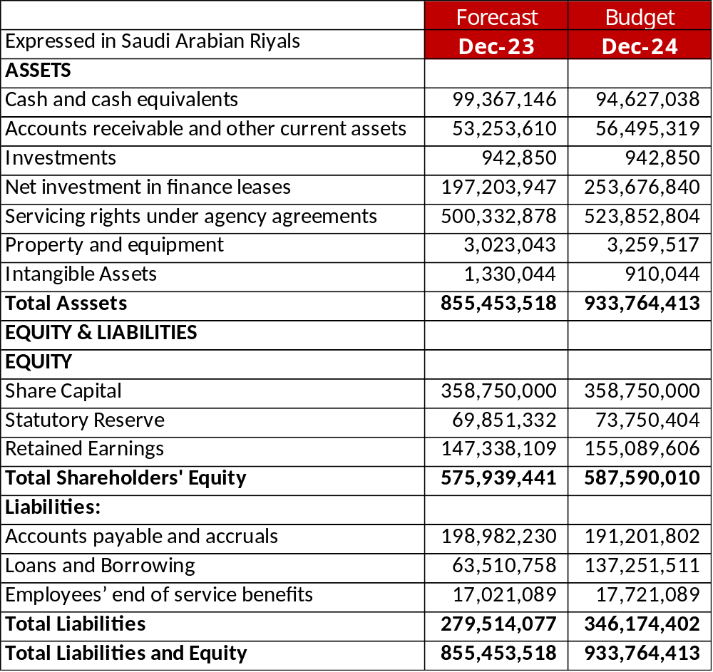
2023 and 2024 Balance Sheet
Key Highlights
Net investment in finance lease will see an increase of 28% due to increased on-balance-sheet production
Loans and Borrowings will increase two-fold caused by increased on-balance-sheet production
Note: Balance Sheet items for 2023 and 2024 are estimates only

Slide 33
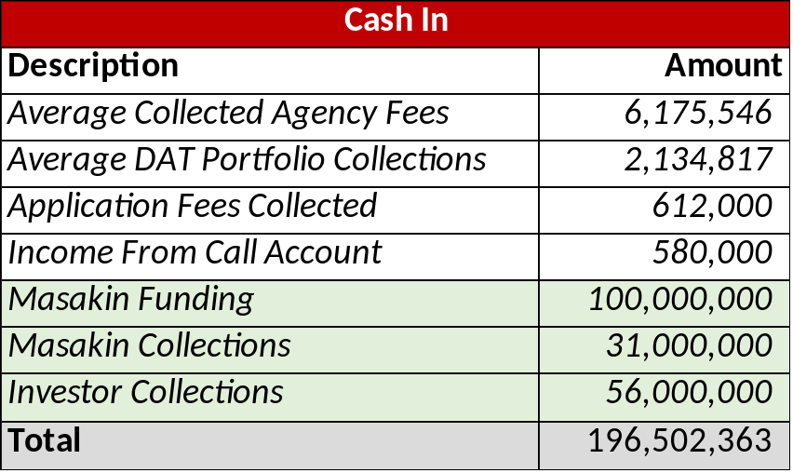
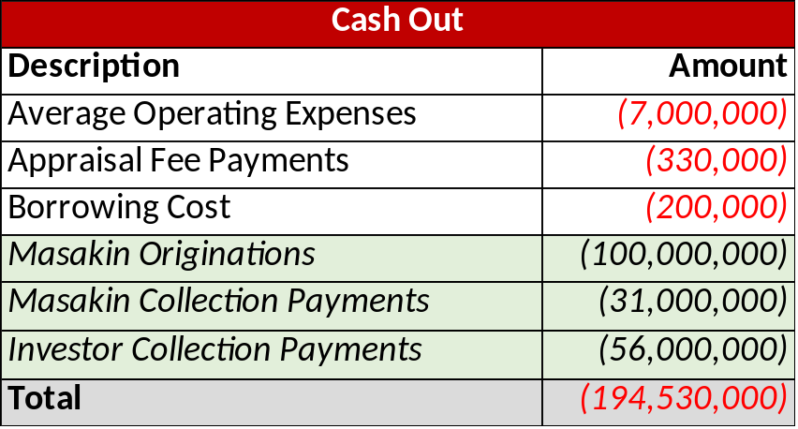
Monthly Cash Movement Analysis
Key Highlights
Cash and cash equivalents shown in the balance sheet is normally the cash that’s on hand at a point in time due to a lag between collection time from customers and remittal time to investors
True net cash inflow is around SAR 2 Million per month
Cash related to Masakin funding and collections and investor collections are netted out

Slide 34
Pillar #4: Diversification
+270 million production impact
Develop new Business lines – new products in new markets
Financial Services – New business lines
Personal Finance
Micro Finance
SME Finance
Develop and launch personal finance solution to serve the following:
DAT home buyers down payment needs
12% remaining DBR through NBFIs
Full personal finance exposure (I.e. Private sector customers, expats and affluent customers)
Develop and launch Micro personal finance solution to serve the following:
Low income segment
Non bankable segment
Short term loan
High profit margin
Develop and launch SME Finance
Design tailored financing solutions to small in medium enterprises
Create an online platform for SMEs
New and sovereign SMT team independent from existing mortgage setup

Slide 35
Personal Finance & SME Companies Review
Key Highlights
Portfolio Return: All three companies show a good return on their on-balance-sheet portfolio.
Personal Finance volumes are growing while the SME volumes are stressed
10.6%
1.3B
1.9B
13.4%
220M
725M
8.2%
360M
1.0B
Portfolio Return
2023 Prod. Est.
Portfolio Size
Portfolio Return
2023 Prod. Est.
Portfolio Size
Portfolio Return
2023 Prod. Est.
Portfolio Size

Slide 36
Personal Finance (PF) Market Overview
Market Sizing
Market Size (all) = 445B (2023)
Loan Terms
Average Loan Size = SAR 20-50K (up to 300K)
Return
Average Lending Rate = 20-25%
Market Size (NBFI) = 23B (2023)
Forecast 3 year CAGR = 8%
Term = 5 years
100M annual
DAT Target Production
Borrowing cost = SIBOR + 3-4%

Slide 37
Forecast Assumptions – RF & PF
Item
2024
2025
2026
Key Highlights
Sales Unit Count
2,406
2,771
3,107
Controlled PF expenses by utilizing and enhancing DAT existing LOS system + external plug-ins
Heavy reliance on digitalization for PF program
Additional staff count will consist of PF collections staff
RF
Sales Volume (SAR Billion)
1.6
1.9
2.1
Average Loan Size
678,508
684,645
685,094
Sales Unit Count
626
5,000
7,500
PF
Sales Volume (SAR Million)
12
100
150
Average Loan Size
20,000
20,000
20,000
Bank Loans (SAR Million)
12
100
150
Additional
Staff Count*
1
5
8
Expenses (Marketing, …)
-
200,000
500,000
* Estimated requirements. Subject to final feasibility study.

Slide 38
Income Statement Forecast RF + PF
Income Statement | 2023 | 2024 | 2025 | 2026
Net Earnings –– RF | 29.3 | 35.1 | 40.7 | 50.3
Additional Revenues (PF only) | - | 0.72 | 6.0 | 9.0
Additional Expenses (PF only) | - | (0.2) | (1.0) | (1.5)
Net Earnings –– RF + PF | 29.3 | 35.6 | 45.7 | 57.8
Key Highlights
Additional Revenues from PF only projected at 6% of the expected production
Additional Expenses include additional staffing cost, systems cost, and marketing

Slide 39
SME Market Overview
Market Sizing
Market Size (all) = 245B (2023)
Loan Terms
Average Loan Size = SAR 1M (up to 15M – Medium Enterprises)
Return
Average Lending Rate = 16%
TBD
DAT Target Production
Borrowing cost = SIBOR + 3-4%
Market Size (NBFI) = 17B (2023)
Forecast 3 year CAGR = 10%
Term = 3-5 years

Slide 40
Financial Forecast Summary
Year 2026 (SAR Millions) | RF | RF + PF | RF + PF + SME
Total Operating Revenues | 260 | 269 | TBD
Total Operating Expense | 104 | 105 | TBD
Borrowings (New) | 349 | 499 | TBD
Net Earnings | 50.3 | 57.8 | TBD

Slide 41
Pillar #5: Technology
Develop the technological infrastructure
New Partnerships
Digital Backend
Integration Hub
New LOS
Integration Hub
A digital back end solution that is supported with CRM and self-service / Chabot functionalities to enable an end to end digital platform, and leading to a white label services.
Digital Integration Hub, a middleware API platform that expands our integration capabilities with external partners for originations and cross-selling opportunities
Extending our system’s core origination modules to enable product diversification initiatives, faster development and delivery and simplify & streamline customer experience

Slide 42
Business Transformation Roadmap
Market Penetration
Product Development
Market Development
Diversification
Technology
Improved productivity from existing HFS
Additional sales staff in Riyadh
CRM solution
Masakin program enhancements
SRC program enhancements
Off Plan
New RF products: Affluent, Expat
Riyadh expansion
Asir service center
Integration Hub: Fintech
PF Origination (Phase 1)
Core+ Systems: New Backend Origination System
DAT Digital Platform (B2C)
2024
Self Construction
New RF products: Mortgage Savings, RTO
Najran service center
Integration Hub: RE Aggregators
PF Origination (Phase 2)
SME Origination (Phase 1)
DAT B2B Digital Platform App
2025
SME Origination (Phase 2)
Micro Finance
DAT Digital White-Label Platform
2026

Slide 43
3. Other Initiatives

Slide 44
Customer Experience Initiatives
Improved Customer Journey
Omni Channel
Empowered Customer Support
Lead to Deed
New Performance Metrics
Faster turnaround time
Streamlined process
Automating document collection
Digitization of after sales
Empowering the customer to choose when, where, and how they interact with DAT
Chatbots, AI, video calls, expanded call center hours
Turnaround time
Net Promoter Score (NPS)
Sent-to-Sales rate
Complaints ratio
Complaints resolution time

Slide 45
Corporate HR Initiatives
Corporate Initiatives
Integration Hub
New HR Strategies
Staff Engagement Survey
Staff Engagement Program
New and relevant organizational structure
Updated roles and responsibilities
Inspiring objectives
Shared KPIs
Talent retention programs
Assess employee satisfaction and address concerns
Evaluate areas of improvement
Understand communication gaps
Foster positive work environment
Enhance employee satisfaction
Improve communication and engagement
Increase employee productivity
Improve Retention

Slide 46
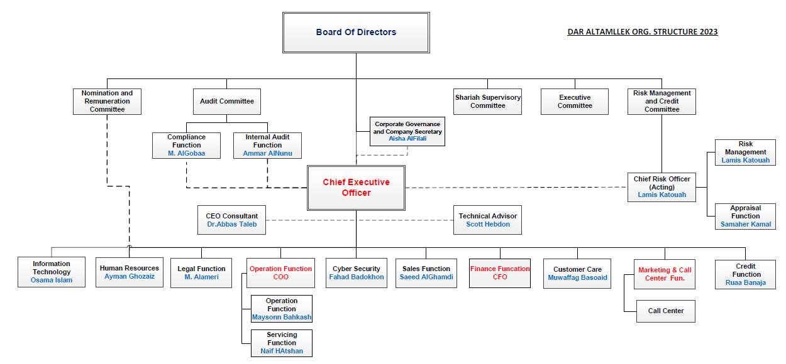
Corporate HR Initiatives – Org Structure (Current)
Current DAT Structure
Approved by NRC on 29 Mar 2023
15 direct reports to CEO

Slide 47
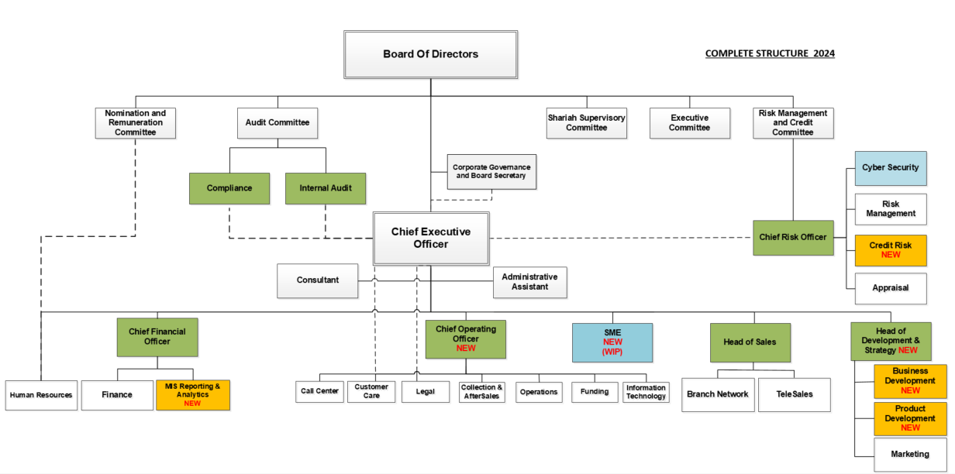
Corporate HR Initiatives – Org Structure (Proposed)

Slide 48
Branding Initiatives
Brand Identity
Company Name
Logo
Adaptations
Evolution of company name to reflect new direction and strategy
Development of new Logo for the new company name
Develop communication guidelines of relevant adaptations according to new company name and logo

Slide 49



Finance companies Logo Facelift Samples
Old
New
BIDAYA
Bidaya's Brand and logo has undergone a minimal modification to incorporate the word Finance to represent Bidaya’s evolution towards offering a range of finance services beyond home loans.
Old
New
Deutsche Gulf Finance
Deutsche Gulf Finance has received a new Brand and Logo becoming Masar Finance representing their evolution towards offering a range of finance services beyond home loans.

Slide 50







Leading Saudi companies Logo Facelift Samples

Slide 51

DAT Brand and Logo Evolution Options
Option 1
Option 2
  Same Brand name
  New Slogan
  Facelifted Logo
  New Brand name
  New Slogan
  New Logo

Slide 52
Thank you

