Slide 1
Inspiration and starting point ideas for TBP Logo

Slide 2
Family logo - my pet name is Betsy Bear (I'm a bear). My husband's pet name is Zach Potato (he's a potato). Together we call ourselves “Team Bear Potato (TBP)”. It’s mostly a private inside joke between us.
Our favorite kind of bear is polar bears (we have polar bears on our wedding rings ☺)
I’d like to make a logo and print it on exercise T-shirts, water bottles etc. for personal use.

Slide 3
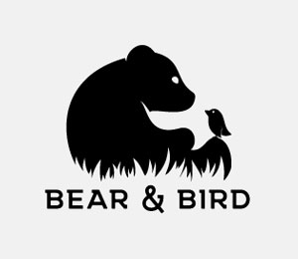
Maybe something like this but with a potato instead of a bird. I like the vibe of innocence and friendship.
Could say “Bear & Potato” instead of “TBP”. I don’t think I like “Team Bear Potato” as much in full words.
From brandcrowd.com

Slide 4

I like something like this but with a potato instead of a bird.
I like the vibe of togetherness / hugging in this image and the softness of the bear.
https://www.pinterest.com/pin/631841022711488421/s

Slide 5



Maybe “TBP” could be the main logo? I like that the Bear looks curious and cute and is part of the letter. The P would need to be personified and as cute as possible. Not sure what the T would look like.

Slide 6
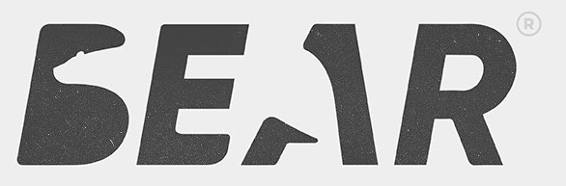
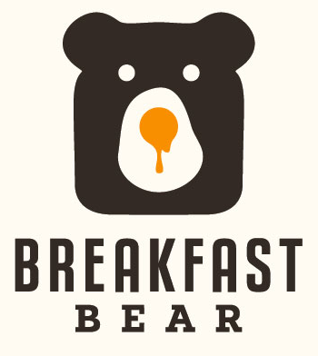
I think negative space designs are super cool.
Not sure I’m going for a breakfast vibe, but so clever and simple! ->

Slide 7
52 Cool Bear Logo Ideas For 2019 (designcrowd.com)

