Slide 1

WE HELP LATVIAN PRINTING INDUSTRY GROW
Your growth is our priority!

Slide 2
Presentation Guide
ABOUT POLAP
03
WHAT WE OFFER
08
POLAP LOGISTICS
04
OUR SUPPLIERS
13
POLAP AND IGEPA
05
OUR PRODUCTS
14
PERFORMANCE
06

Slide 3
About POLAP
1993
1700+
over 10000
ONE-STOP-SHOP
34 ⁽²⁰²³⁾
ANNO
Active Costumer
Assortment Positions
Everything for Printing in One Place
Employees

Slide 4

POLAP Logistics
6000+ m2
12000+
24H
up to 38
8
at least 20
Our own Logistic Center
Pallet spaces in our combined warehouses
Delivery in Latvia
Incoming cargo trucks per month
Our own delivery Trucks
Delivery trips per day

Slide 5




Proactive owner involvement guarantees swift response to market shifts
75%
&
of POLAP shares belong to Juris Lapa
(since 2003)
Membership with IGEPA ensures direct access to main paper producers at the best prices
25%
of POLAP shares belong to IGEPA

Slide 6
1700+
Regular customers in Latvia, Estonia and Lithuania.
70+
Deliveries daily; over 10,000 invoices each year.
95%
Of businesses in the Latvian Printing industry are our customers
15,000+
Tons of products delivered annually to our customers.
17 500 000
EUR turnover in 2022

Slide 7
Be Professional with Us
We are as a bridge between manufacturer and customer
Long-term partnership with both – customers
and suppliers
Credit options – contracts with deferred payment terms
Flexibility, understanding and efficiency
Transport solutions between various printing companies
FSC certified

Slide 8






POLAP Is Focused On Five Product Groups
Printing Supplies
Packaging and labels
Paper and Board
Visual Communication
Photo
Supplies

Slide 9
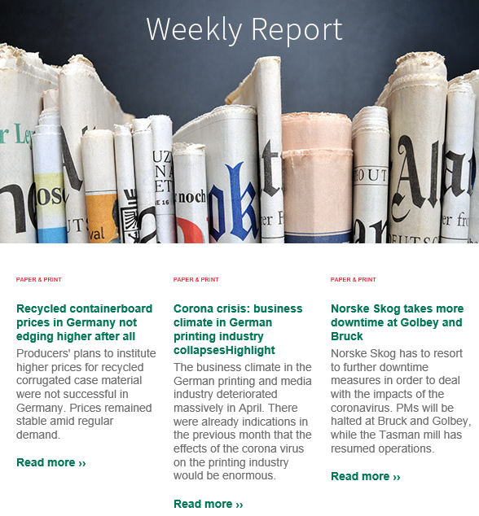
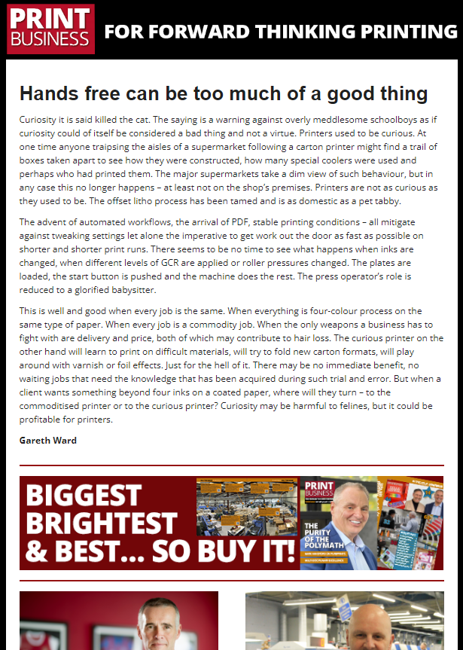

We keep up with the market news
Every week we
Receive IGEPA Group news summarizing the overall market view
Follow Print Business daily (UK), Printweek Europe
We are a member of LPUA, LIA and LTRK
We regularly attend exhibitions;
We attend INTERGRAF conferences;
We stay in touch with our suppliers and collaborators
Receive Supplier marketing materials;
Regularly participate in Supplier training;
Cooperate with Riga State Technical School.
Notes:
LPUA (LPCA) - Latvian Printing Companies Association
LIA (LPA) - Latvian Packaging Association
LTRK (LCCI) - Latvian Chamber of Commerce and Industry

Slide 10

POLAP E-commerce
15% of POLAP sales go via our e-commerce platform, with the tendency to grow.
Our e-platform is user-friendly with high customer satisfaction.
The most important benefits of the e-platform:
Customer individual pricing
24/7 ordering possibility and full history
Real-time inventory count

Slide 11




POLAP Services For Printing Industry
Rolls to sheets cutting (coming 1Q of 2024)
Blanket (Rubber) cutting
Pantone color mixing
Logistics between Printing Industry companies

Slide 12
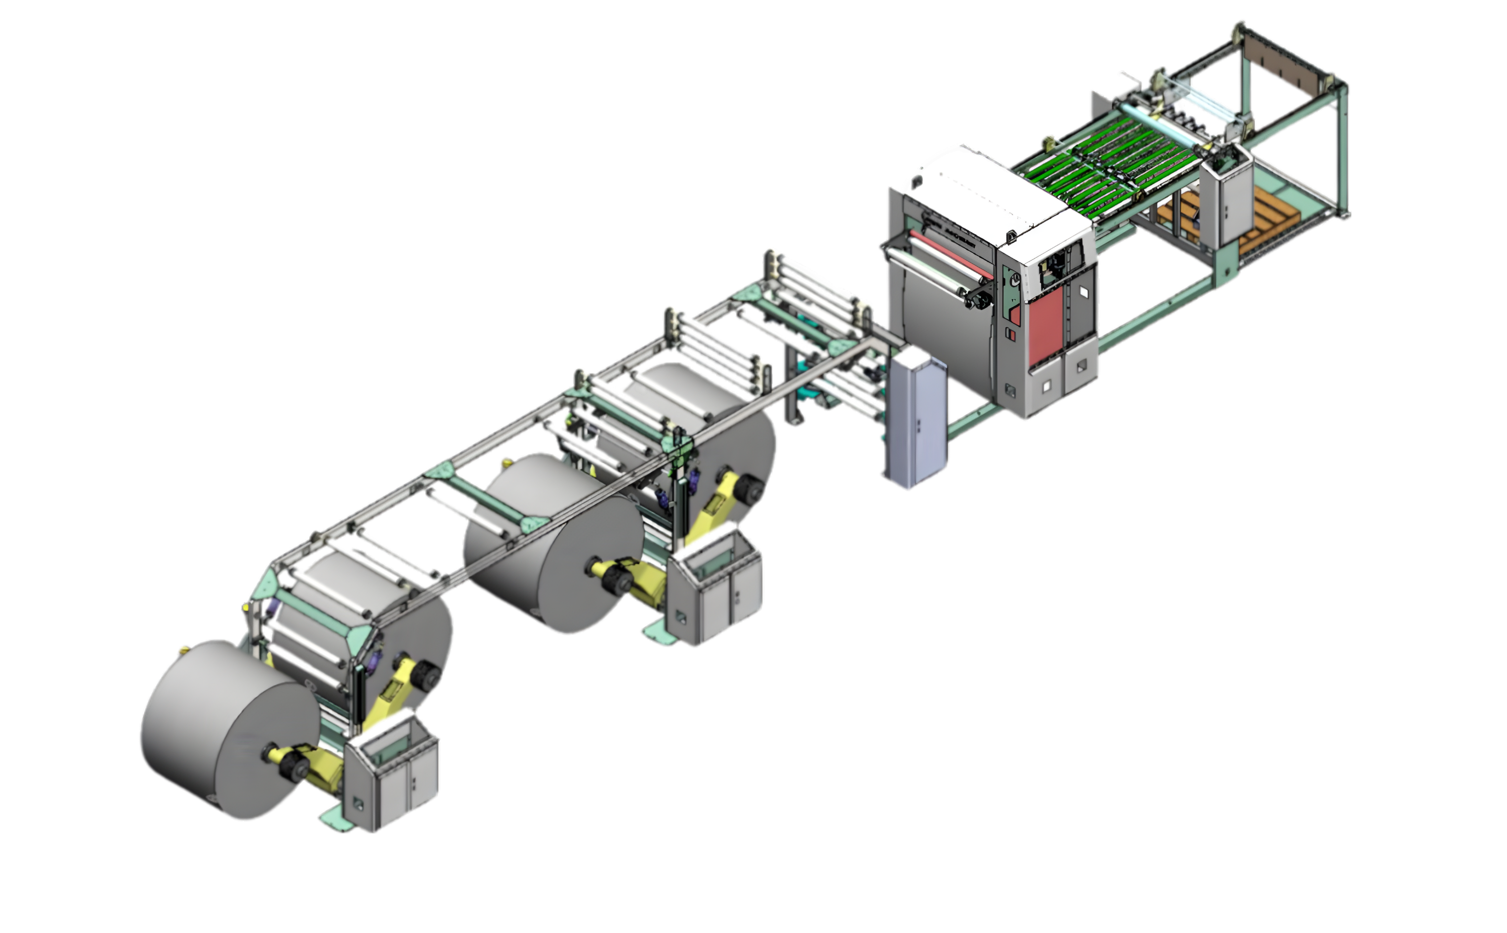
POLAP Paper cutting machine
4 rolls sheeting machine, coming 1st quarter of 2024
High-precision sheeting machine designed to process paper and cardboard rolls into sheets
With advanced technology and robust build, an efficient production is provided, while maintaining the quality and integrity of the processed material

Slide 13





























Paper
Print Materials
50+ Leading Paper and printing Material Brands Trust POLAP
Photo
With over 90% of our suppliers, we have a history of more than 15 years of long-term cooperation

Slide 14

Kurz foils
Staples
Kodak printing plates
Pantone catalogs
POLAP Printing Supplies
Offset rubber blankets
All types of laminating film
Offset inks
Adhesives
Chemicals
Calibrated paper
Astrolon

Slide 15
Two-layer corrugated cardboard
Corrugated cardboard boxes
POLAP Packaging and Labels
Corrugated cardboard pallets
Packaging film
Adhesive tape
Pallet corners
Corrugated cardboard sheet-spacer

Slide 16
Coated papers
Uncoated papers
POLAP Paper and Board
Cardboards
Binder boards
Self-adhesive papers
Colored papers
Binding materials
Digitals papers
Packaging materials

Slide 17
Digital print paper
Digital print cardboard
POLAP
Visual Communication
Self-adhesive paper
Self-adhesive foil

Slide 18
Albums
Minilab accessories
Photo Album Covers
Laboratory paper
POLAP Photo Materials
Memory Card
Frames
Batteries
Photo frame fixings
Gift bags
Stands
Photo films
Hi-Ti
Thermal sublimation paper
Inkjet
Charging devices
Chemistry
Disposable cameras

Slide 19




https://www.polap.lv/en
Contact Us
https://www.linkedin.com/company/poligrāfijas-apgāds-polap/
https://www.facebook.com/polap.lv
Andris dementjevs
Linda Lapa
Gundega Sproģe
Sales Director
BOARD MEMBER
Head of Paper Group
andris.dementjevs@polap.lv
linda.lapa@polap.lv
gundega.sproge@polap.lv
+371 26 434 821
+371 29 432 447
+371 26 303 990

Slide 20
https://www.polap.lv/en
Contact Us
https://www.linkedin.com/company/poligrāfijas-apgāds-polap/
https://www.facebook.com/polap.lv
Andris dementjevs
Linda Lapa
Baiba Burve
Sales Director
BOARD MEMBER
Photo department
representative
andris.dementjevs@polap.lv
linda.lapa@polap.lv
baiba.burve@polap.lv
+371 26 434 821
+371 29 432 447
+371 26 558 010

