Slide 1






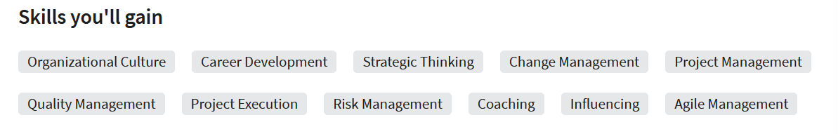

Overview
Courses
Enrolled Tracks
Project Management
4h 12 m of Content
14 items of learning content
Beginner level
Shareable Certificate
Owner: Learning Academy
Fundamentals of Project Management
Project managers have diverse skill sets that allow them to approach projects with strategy and efficiency. After completing this learning path, you'll have the skills and knowledge to manage various types of projects from beginning to end using proven project management techniques.
Experts/Instructors
Continue Track

Slide 2

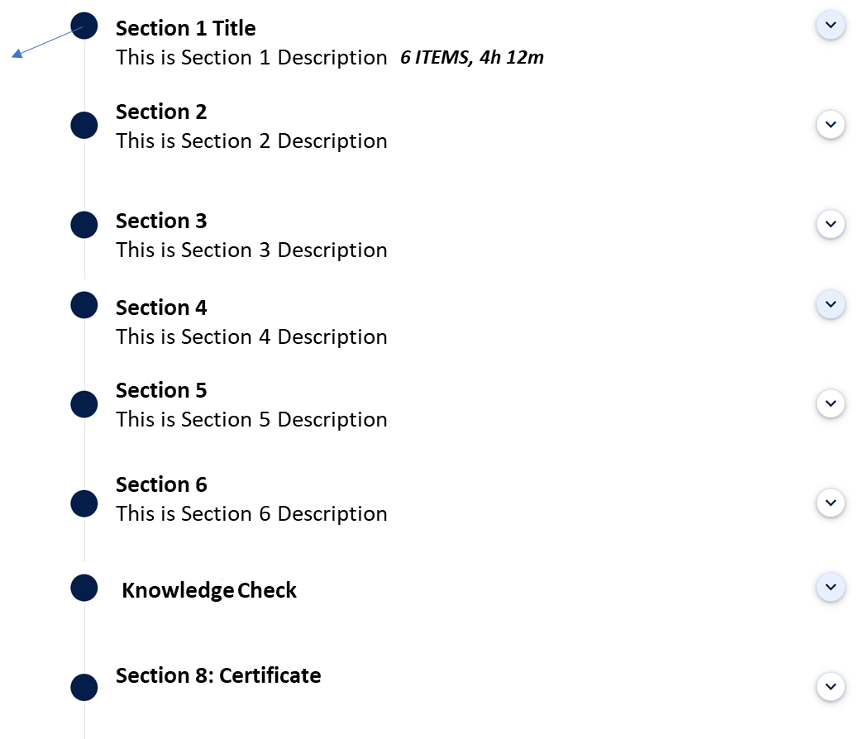
Overview
Courses
Can Also be icons

Slide 3
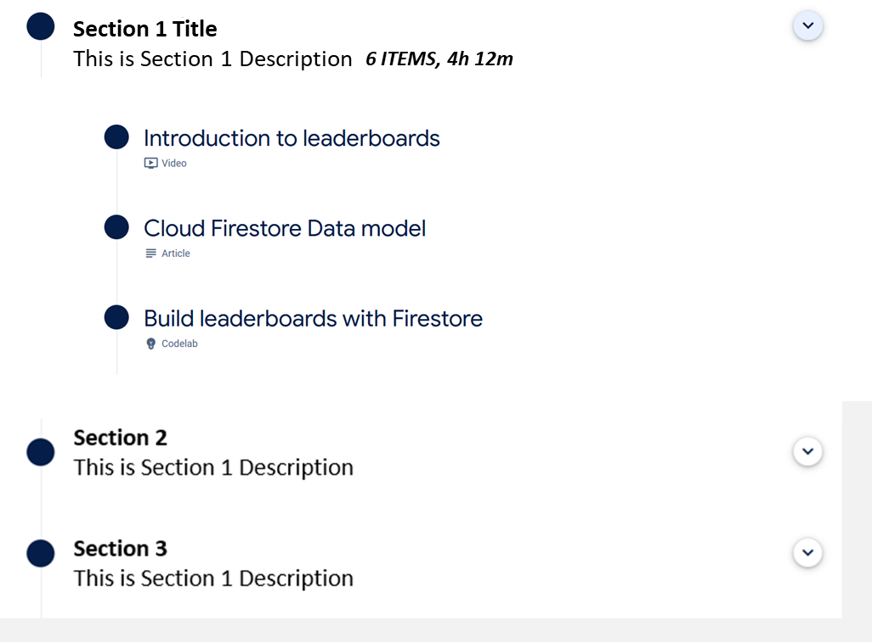




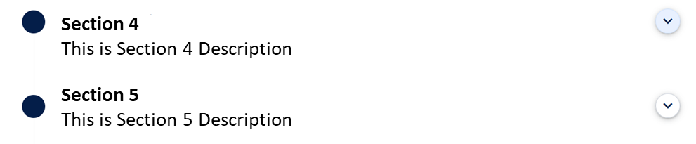
Option 1
Overview
Courses
Introduction to Leaderboards
In this course we will discover what Artificial intelligence is, and how AI is being implemented in both industry and research. Along with a conceptual look at Artificial Intelligence
Start

Slide 4


Option 2
Overview
Courses
What is generative AI?

Slide 5
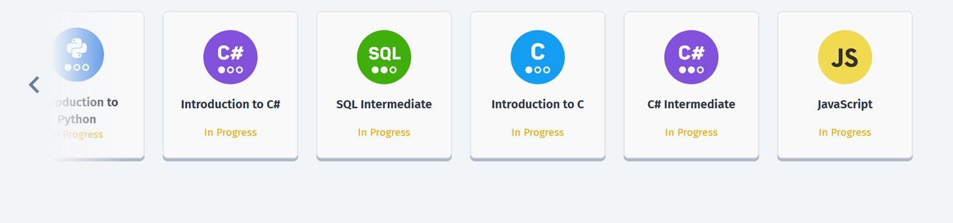

Overview
Courses
My Enrolled Tracks
Option 1
Option 2

