Slide 1


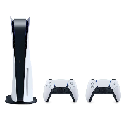
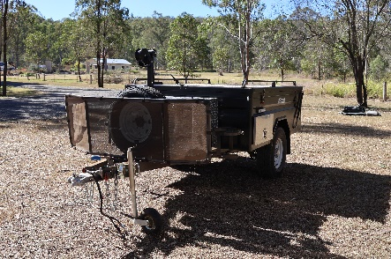



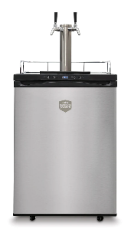
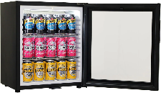

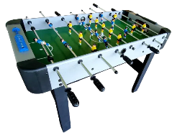
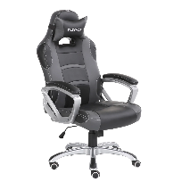

PICK YOUR PRIZE!
CHOOSE FROM:
50 X $500 Prezzee Vouchers To Be Won
A CAMPER TRAILER
Valued at $10,999
A TAG HEUER WATCH
Valued at $10,150
A GAMES ROOM
Valued at $10,033
OR
OR
PLUS
EVERYONE'S A WINNER!
Get a $75 Prezzee Voucher if you spend $3000 or more.
Receive a bonus entry for every $200 you spend over $3000
SIMPLY SPEND $2,000 ON ANY RYCO
PRODUCTS FOR YOUR CHANCE TO WIN.
Register to win at www.winwithryco.com
TERMS & CONDITIONS: Jlncjfkjrklfjeracjmf; erjkgl;ajradfkljgradjgjeragjeraijgeroaijg;e radjig;lradjgadfjgjdf;hg;radhg;kadfhvlkhdfalbkvjn zf.lknvdfkljglradkjg;idfhjblkvjhdfl/kbgj;dfjg;oiraegierahgioljaf;iofg;aerjflnadf. lvn;aerjg;rakjlkfajd gjljadfl;gjladkhajrfjarjga;rjg;arjegjadfkgjkladjg;oiajnc;njwe;pojfn;oviatuaretyblvruitgyranhglvarhvg.abh.rvgha;nlrjgv.ldznfj g.lzdfjkgjdzfj g.zdflgj.lkdfzjg ran;gjv;aerugusrthugurthylitau;oreiugvaenrug;aeur;gnuerougn;eranu g;earug;ajrlngj;ridlzj g;lndjrlkgnjd;lrjg;noivrsetujg;viaurntgvja;eronijg;eruiag;oeajg;noiaj g;oajfg;nraj;pgn ajenrpgjarpdfjg’roaj g;anojfgajndzdf;lksad;lf;ldsfkds kf;sdkf;ksgaklg;adj;gjadfkjgadrk jfg;jadflgj;adlfjgkjadflgjadf;jgakd fjg;lkj

Slide 2
LIST GAMES ROOM PRIZES ALONGSIDE GAMES ROOM IMAGE PRIZE:
Samsung 75” Neo QLED Mini LED 4K Smart TV
Sonos Soundbar. Sonos SubWoofer & 2 x Sonos One Portable Speaker
PS5 PlayStation 5 Console with Two DualSens Wireless Controllers
165 Litre Beer And Wine Dual Zone Bar Fridge
Evolve Zero Gravity Full Body Massage Chair
9ft Slate Pool Table with Accessories
Dual Tap Built-In Kegerator
10 Player 7ft LED Light Foldbale Poker Table With Poker Set
Pub Design Table and Chairs

