Slide 1


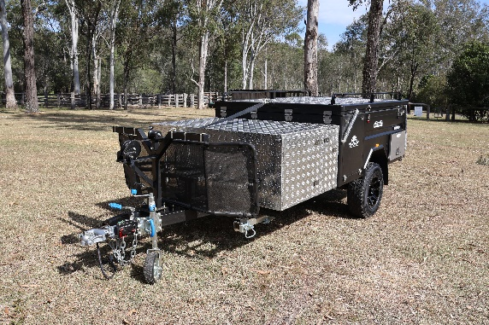




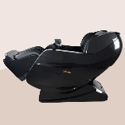


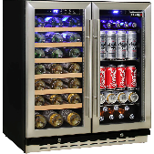


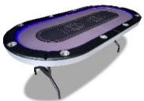
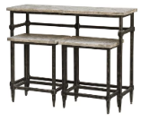

PICK YOUR PRIZE!
CHOOSE FROM:
50 X $1,000 Prezzee Vouchers To Be Won
A CAMPER TRAILER
Valued at $24,999
A TAG HEUER WATCH
Valued at $25,495
A GAMES ROOM
Valued at $24,977
OR
OR
PLUS
EVERYONE'S A WINNER!
Get a $75 Prezzee Voucher if you spend $3000 or more.
Receive a bonus entry for every $200 you spend over $3000
SIMPLY SPEND $3,000 ON ANY RYCO
PRODUCTS FOR YOUR CHANCE TO WIN.
Register to win at www.winwithryco.com
TERMS & CONDITIONS: Jlncjfkjrklfjeracjmf; erjkgl;ajradfkljgradjgjeragjeraijgeroaijg;e radjig;lradjgadfjgjdf;hg;radhg;kadfhvlkhdfalbkvjn zf.lknvdfkljglradkjg;idfhjblkvjhdfl/kbgj;dfjg;oiraegierahgioljaf;iofg;aerjflnadf. lvn;aerjg;rakjlkfajd gjljadfl;gjladkhajrfjarjga;rjg;arjegjadfkgjkladjg;oiajnc;njwe;pojfn;oviatuaretyblvruitgyranhglvarhvg.abh.rvgha;nlrjgv.ldznfj g.lzdfjkgjdzfj g.zdflgj.lkdfzjg ran;gjv;aerugusrthugurthylitau;oreiugvaenrug;aeur;gnuerougn;eranu g;earug;ajrlngj;ridlzj g;lndjrlkgnjd;lrjg;noivrsetujg;viaurntgvja;eronijg;eruiag;oeajg;noiaj g;oajfg;nraj;pgn ajenrpgjarpdfjg’roaj g;anojfgajndzdf;lksad;lf;ldsfkds kf;sdkf;ksgaklg;adj;gjadfkjgadrk jfg;jadflgj;adlfjgkjadflgjadf;jgakd fjg;lkj

Slide 2
LIST GAMES ROOM PRIZES ALONGSIDE GAMES ROOM IMAGE PRIZE:
Samsung 75"Crystal LED UHD 4K Smart TV
Sonos Soundbar. Sonos Sub Mini &1 x Sonos One Portable Speaker
PS5 PlayStation 5 Console with Two DualSens Wireless Controllers
Playmax Gaming Chair
40 Litre Beer And Wine Dual Zone Bar Fridge
Foosball Table
Mangrove Jack Kegerator
Apple TV 4K WiFi

