Slide 1
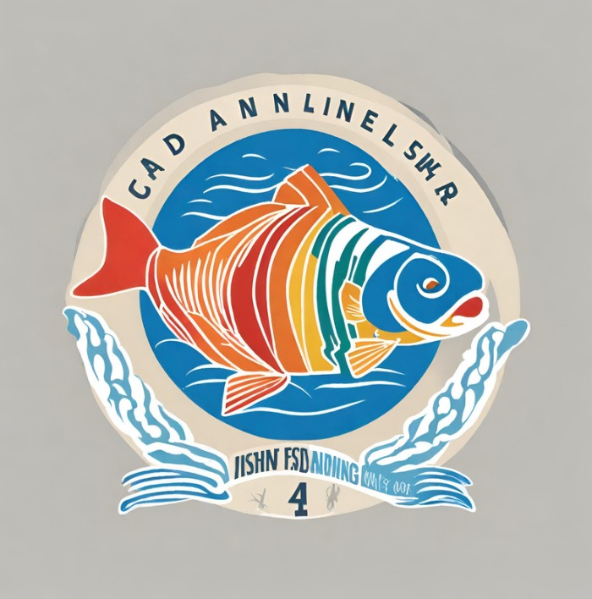
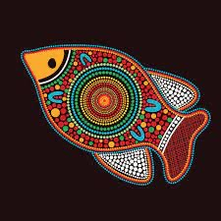
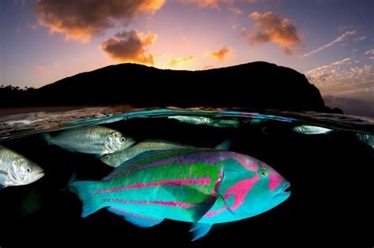
My friend and I are creating a not-for-profit for the angler community who also have an interest in protecting the ocean. Here is our mission statement:
We empower sustainable anglers, providing them with a voice to share their passion for fishing while championing responsible practices, caring for the planet, safeguarding our oceans' health and biodiversity, and preserving the critical habitats that ensure the future of our fish and marine ecosystems
Here is our idea for the logo: we want it to be appealing to both anglers and conservationist so the fish will be the colors of all SDGs. A fish that most looks like our vision is the Surge Wrasse
This is the Surge Wrasse:

