Slide 1
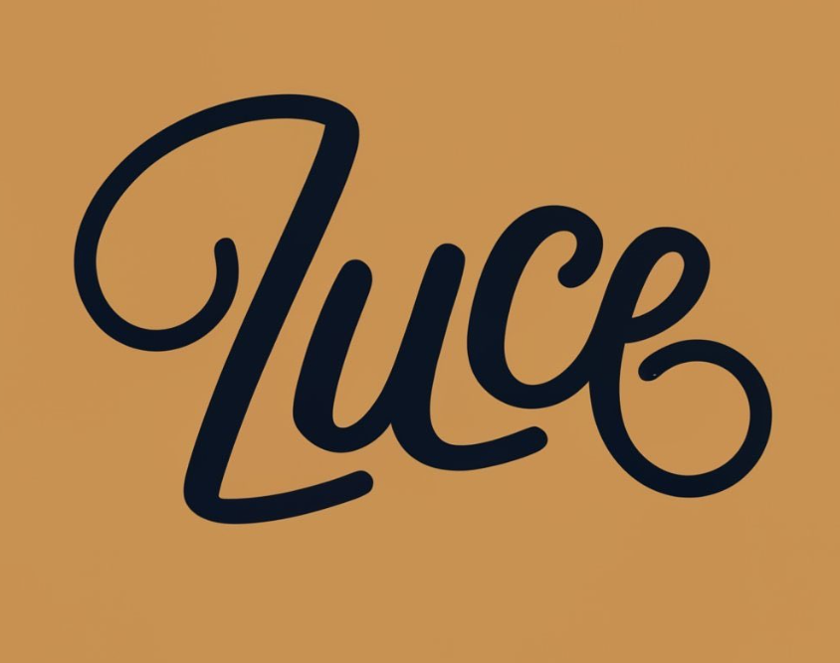
Color can change, it is a bit dead!
Also Pizzeria and Trattoria underneath can have contrasting background or complementing
Pizzeria & Trattoria

Slide 2
Pizzeria
&
Trattoria
The billboard could have the Luce name on the left and Pizzeria & Trattoria on the right. But should look cool, trendy OR Pizzeria and Trattoria could be right underneath and Luce name could be at the middle then would it look empty?

Slide 3
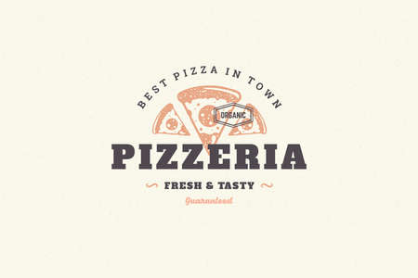
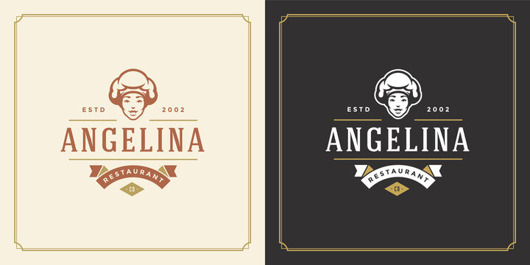

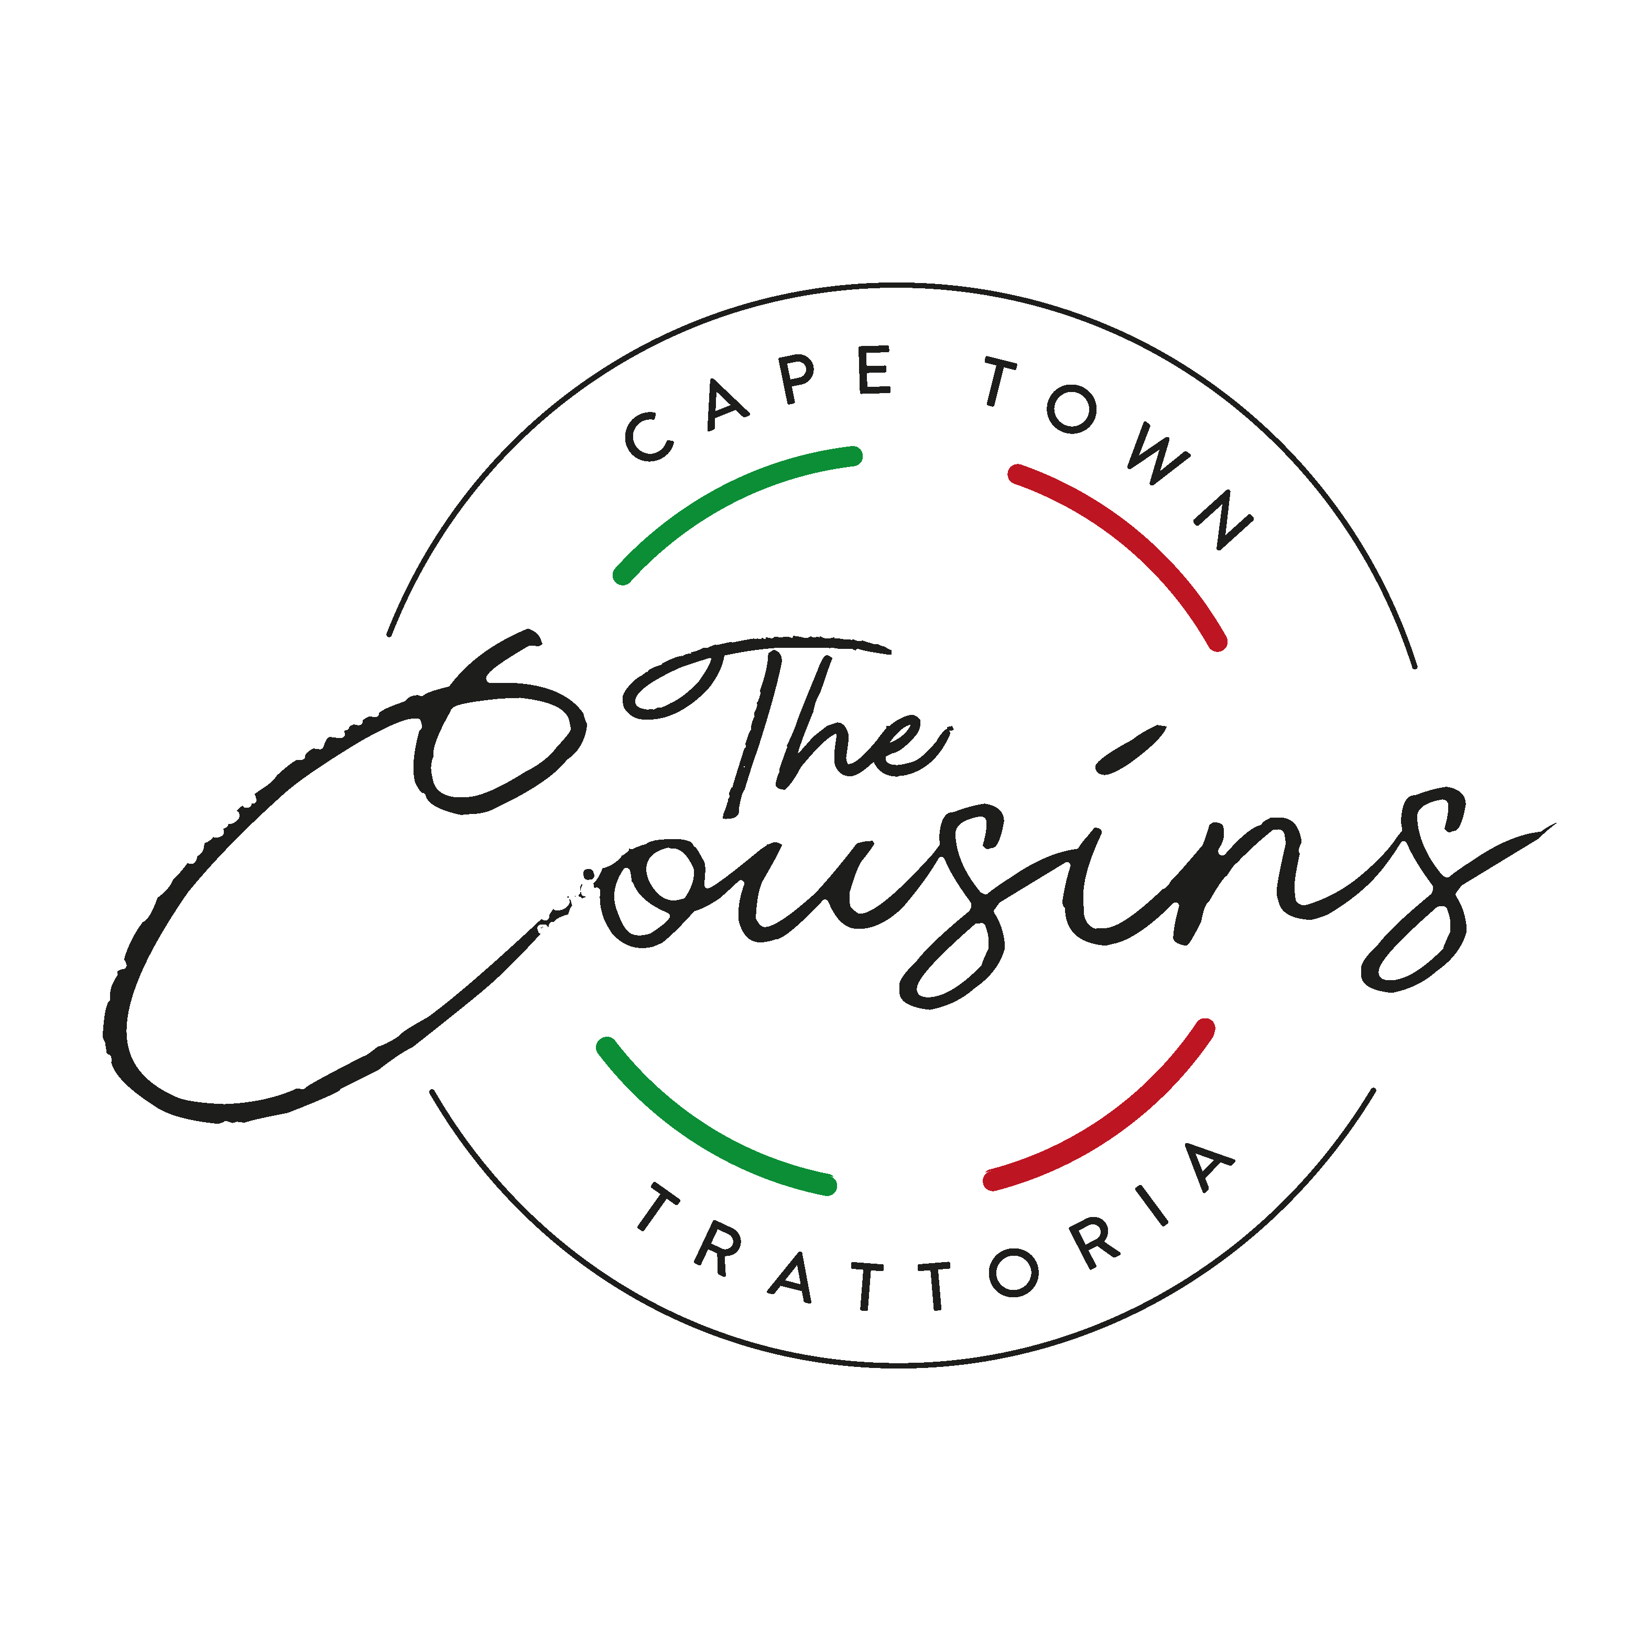
EXAMPLES WE LIKE!

