Slide 1

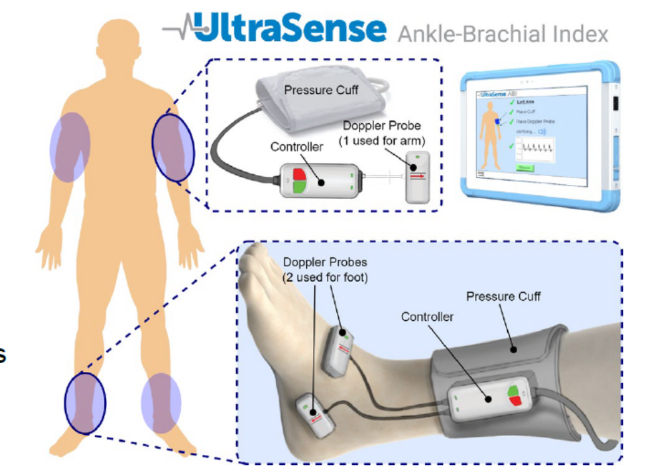
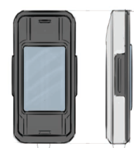
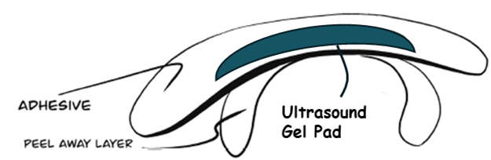
Full UltraSense System
We need a better drawing with our updated images
See attached detail

Slide 2
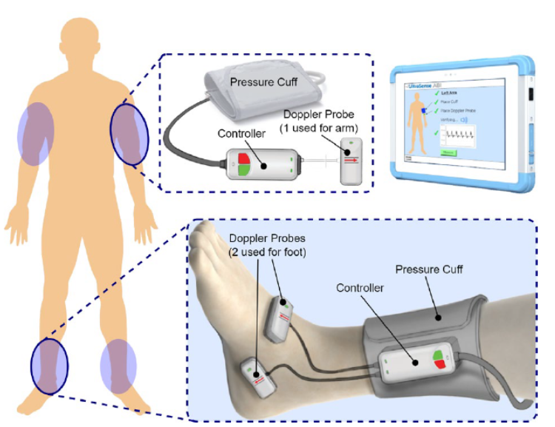
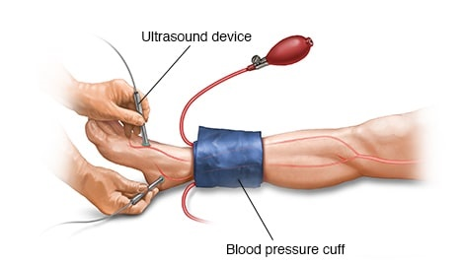
Detailed directions for foot product on slide 1
Please remove the cables that are used as connectors
Please remove the labels and indication lines
Move the Doppler probe a bit down the foot toward the toes in the spot marked
This drawing of the leg is better than the top image and I prefer the more detailed image.
The ultrasound devices in both hands are pointing at the areas where I want the Doppler probes to be from the top image
The Pressure cuff is a Velcro wrap but our produce will be like the picture above, no cables coming off but a controller attached

Slide 3

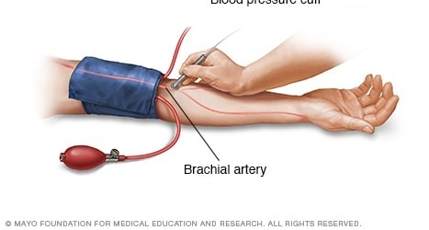
Detailed directions for arm product on slide 1
Please remove the cables that are used as connectors
Please remove the labels and indication lines
The controller is sewn into the pressure cuff, it is not a separate part
This drawing of the arm is better than the top image and I prefer the more detailed image.
The ultrasound device in this image is pointing at the spot where I want the Doppler probe to be
The Pressure cuff is a Velcro wrap but our produce will be like the picture above, no cables coming off but a controller attached

Slide 4
Detailed directions for the sticker on the skin on slide 1
These ridges are suppose to allow the multielement doppler probe to snap into an adhesive patch that is applied to the skin. I think we need to make these ridges a bit more pronounced
The adhesive patch will need a plastic frame that the multielement probe can snap into
In the middle of the patch under the doppler probes we will have Ultrasound gell as a part of the patch. The gel we will use is a solid form and its thicker than the adhesive part and fits tight to the bottom of multielement probes when it is snapped in

Slide 5
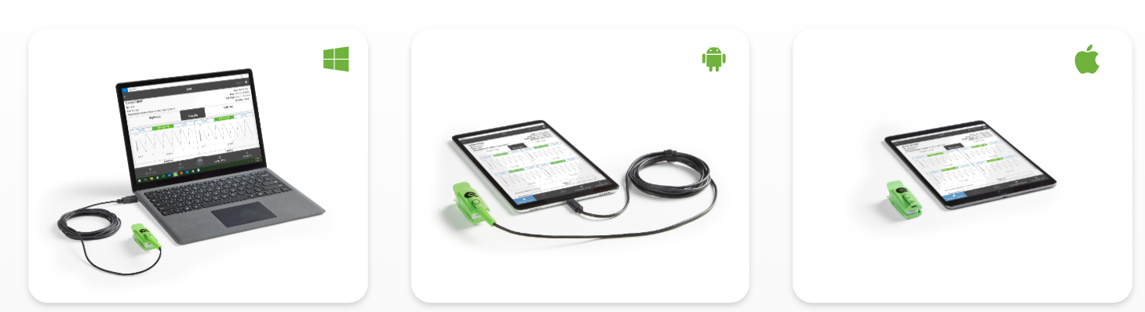
Detailed directions for tablet on slide 1
We need a better image of a Tablet we will sell for the ABI
I like the image here that shows all 3 styles but no cord of green attachment on ours

