Slide 1

Moving For The Next Generation
Prospective Alliance Presentation
Robert Peterson
July 2023
nexmuv.com

Slide 2

About Us
NexMuv is the next logical evolution in professional moving. Professional moving clients have battled soaring prices, acute capacity problems and deteriorating service levels.
NexMuv was founded by lifelong moving professionals who have developed the answer to better moving services. Poised as THE industry disruptor, we deliver faster, offer guaranteed prices and even offer no credit check financing options. We are a technology first organization using proprietary software to deliver moving's best service experience.

Slide 3
OUR VISION
The traditional moving industry is broken, outdated, inefficient, and unable to change.
Our Vision
Our Mission
Our Goal
Revolutionize an $86B industry by providing great value to everyone involved
Disrupt a sleepy giant of an inefficient industry
Becoming the moving platform of choice
NexMuv Customers - Consumers, Movers, Corporate Clients, and Relocation Management Companies all receive better value with NexMuv than anywhere else.
NexMuv’s deep understanding of the professional moving industry, supported by extensive market research has set NexMuv up for ultimate success in disrupting this industry by creating cost-saving efficiencies throughout.
As NexMuv’s market share grows, the customer acquisition cost and operational cost plummets. This creates even more market penetration, more efficiencies, and exponential growth.

Slide 4

Moving’s Problems
Cost
Capacity
Services
Transparency
Moving cost has skyrocketed over the last three years. Charges have increased 38% since 2018.
Long-haul driver shortages and limited equipment coupled with growing demand has pushed capacity to a crisis state
Quality labor has been difficult to source and afford. Virtually all RMC’s report a decline in service quality
Too many margin layers...van line, agent, driver and help. In addition, charges are convoluted and
confusing

Slide 5
What NexMuv Has Accomplished
Reduce Costs
Simplify the Moving Process
One
Two
Three
Four
Five
Eliminate Capacity Constraints
Improve Service Levels
Break the Typical
Moving Mold

Slide 6



Solution
Uberized Process
NexMuv automatically audits: Compliance, Insurance, Regulatory, Bonding, Background checks, and Quality.
One Point of Contact
Today moves are sold from broker to broker until it’s finally sold to a mover. Many entities involved means a confusing line of correspondence for the customer.
Book Now Pay Later
Moving has a high price tag, but no one has ever offered a pay later solution. Much less a no credit check offer.
GPS Tracking
Amazon has conditioned consumers to expect real-time tracking of goods. Only NexMuv enables you to track all of your belongings door to door.
Simple Honest Pricing
NexMuv’s proprietary algorithms and data are backed up by a checks and balances process giving the first instant pricing solution that won’t change.

Slide 7

NexMuv Low-Cost Competitive Strategy
PROFESSIONAL MOVING’S BLOATED MARGIN MODEL
Customer
Broker
Van Line
Van Line Agent
Contractor
Labor
Unaware
Corporate Maintains Significant Margin
Recruits Contractors For Profit.
Move Production Labor Coordination
Hired By Driver At A Profit
Adds Cost Not Value
NEXMUV’ MODEL
Van Lines
Customer
The traditional van line model is no
longer viable.
Van lines have added too much additional cost with diminishing value.
Movers have morphed into brokers adding a significant markup
All on the back of trucks and labor
Contractor(s)
Informed
Direct Contract Network
On-site Move Manager
Labor
Linehaul
Professional Movers
Common Carrier Pup(s)

Slide 8
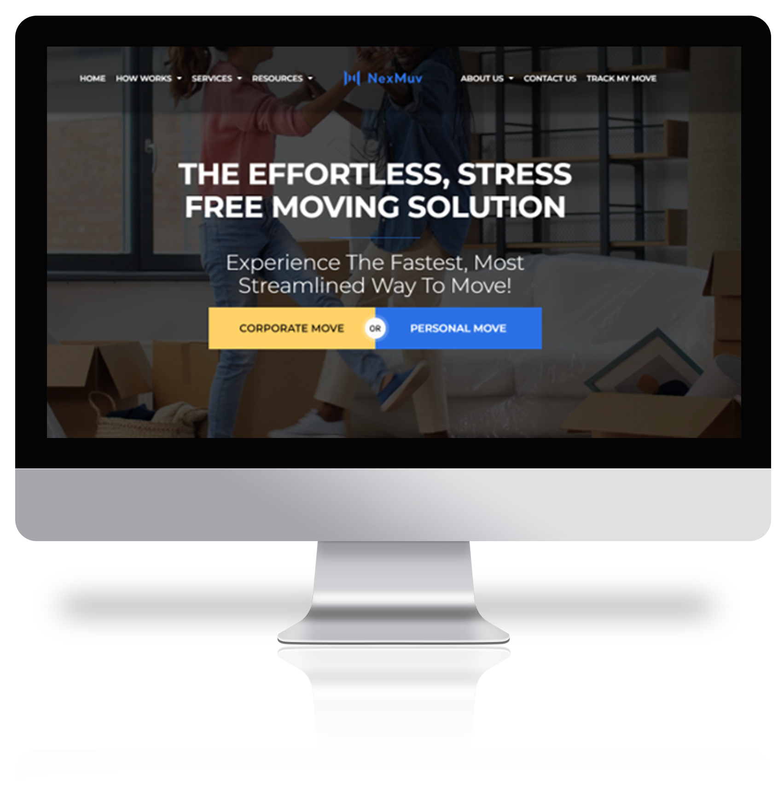
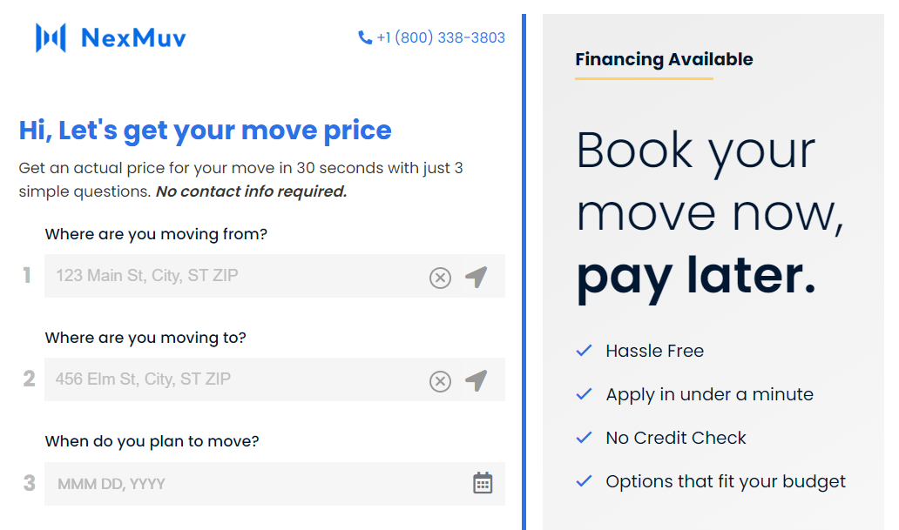
Another NexMuv Advantage
Partner with NexMuv and take advantage of our cutting-edge technology to gain a competitive edge in the industry.
NexMuv offers a white labeling solution for companies looking to capture lump sum and consumer direct moves. Our technology platform can be customized with your branding to provide a seamless integration with your existing systems and processes. This allows you to offer a top-notch moving experience to your customers, while leveraging the power of NexMuv's proven technology. With this solution, you can streamline your operations, increase customer satisfaction, and capture more business in the growing market of long-distance moves.

Slide 9
NexMuv Built-in Checks and Balances
1
2
Independent Survey Company
Multiple Network Service Providers
NexMuv automatically audits: Compliance, Insurance, Regulatory, Bonding, Background checks, and Quality.
With several professional teams engaged there are a series of checks and cross checks.
3
4
Independent groups working together to mitigate risk and error
Concierge Service
Immediate Capacity Secured
Proven, proactive process operated by our award-winning team of experienced customer service professionals.
Virtually limitless capacity even during peak moving days.

Slide 10





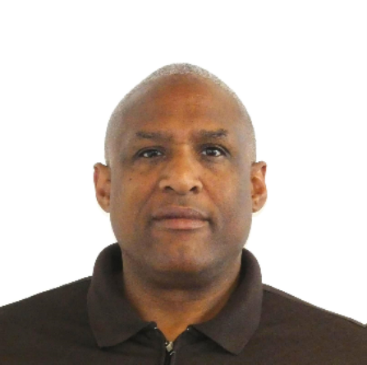

Leadership Team
Wes Struebing
Chief Executive Officer
Steve Kuhn
Chief Operations Officer
Steve Delane
Chief Marketing Officer
Dave Delane
SVP B2B
Jerad Lovett
SVP Operations
Mario Reyes
SVP B2C
Georgia Angell
VP B2C

Slide 11
NexMuv Customer Service Process (Truncated)
NexMuv is a tech-driven moving company that automates the move management process.
1
2
3
4
Info Gather
Move Manager
Quote Prep
Detail Review
The system gathers all relevant information about the move, including the customer's name, contact information, the date of the move, the origin and destination addresses, and a detailed list of items to be moved coming from the video survey.
The system assigns a move manager to act as the point of contact for the customer. Our talented team has mastered the moving process and have exceptional customer service skills.
Based on the information gathered, the customer service team uses the system to prepare a quote for the customer, the system automatically considers the distance of the move, the size of the shipment, and any special services required.
The move manager confirms all details of the move with the customer, including the date of the move, the origin and destination addresses, and any special requests.
5
Scheduling
Based on the confirmed details, the system automatically schedules the move with the movers and ensure that all necessary resources, such as trucks and equipment, are available on the scheduled date. The Move Manager confirms receipt of order and reviews plan with crew teams.
9
8
7
6
Follow Up
Issue Mgmt.
Oversight
Move Prep
After the move is completed, the move manager follows up with the customer to ensure that they are satisfied with the service provided. They will also handle any post-move issues or complaints that may arise.
If any issues arise during the move, the customer service team should be available to help the customer resolve them and provide any necessary support.
The customer service team should monitor the move, ensuring that the movers are communicating with the customer and updating them on the status of the shipment.
The move manager provides the customer with any necessary forms and documentation, including a list of items to be moved and a detailed inventory of the shipment automatically.
Our proprietary technology streamlines the process, offering customers a seamless experience and peace of mind. We have simplified the complex and often stressful task of moving.

Slide 12
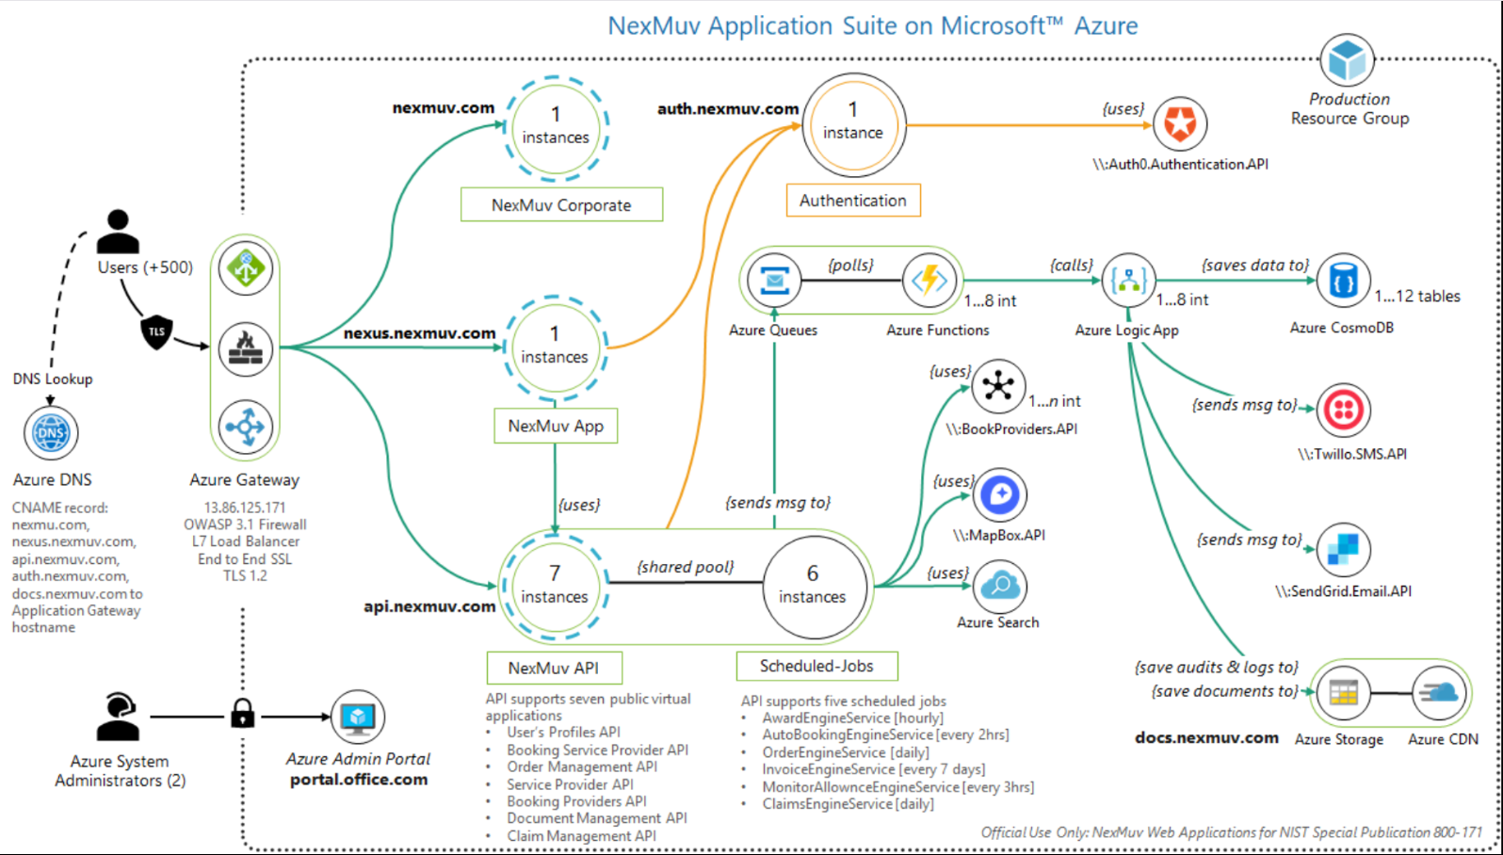

NexMuv Tech Stack
Azure

Slide 13
NexMuv White Label
Partner with NexMuv and take advantage of our cutting-edge technology to gain a competitive edge in the industry.
NexMuv offers a white labeling solution for companies looking to capture lump sum and consumer direct moves. Our technology platform can be customized with your branding to provide a seamless integration with your existing systems and processes. This allows you to offer a top-notch moving experience to your customers, while leveraging the power of NexMuv's proven technology. With this solution, you can streamline your operations, increase customer satisfaction, and capture more business in the growing market of long-distance moves.

Slide 14
619 W. Main Street
Oklahoma City, OK 73102
(800) 338-3803
Thank You
nexmuv.com
support@nexmuv.com

