Slide 1



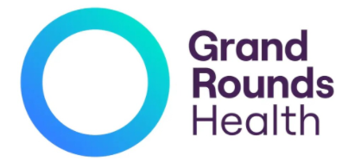


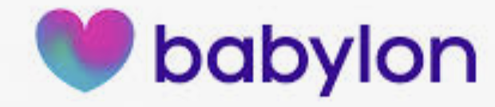
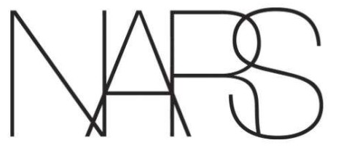

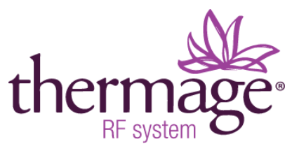

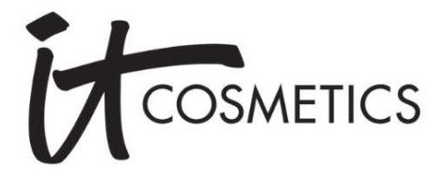



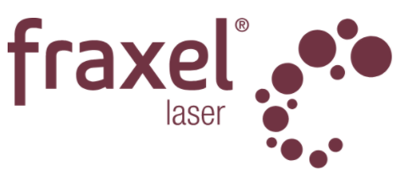

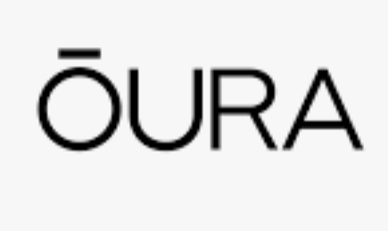



Examples of Wordmark Fonts and/or Emblem/Icons Supporting their wordmark – we like
Emblems /Icons - Simplicity in Execution Examples we like
Poor or Dated Execution Examples - we do NOT LIKE
RF skin tightening
Good execution (modern, upscale positioning)
Good example of Emblem/Icon balanced with wordmark
Remote monitoring software
Simple emblem w all Caps thin lettering communicates modern, & simplicity
Emblem too large
Telehealth
Hearts may be overused in healthcare, but execution is different
Potential one directional emblem option
Logo & font looks dated
Emblem too busy
Upscale cosmetics & skincare
Unique execution of wordmark does not need emblem
Overlapping letters slightly confusing to some
Primary Care & Health Mgt Solutions
Newer, warmer colors being used for healthcare, vs traditional blue, grey tones; trusting, approachable
Font is NOT upscale
Emblem too complex
Font not modern
Example of wordmark supported by emblem/icon (potentially slightly large?)
Approachable, trusting
Preowned Luxury Watches
Simplicity
Emblem too complex
Overpowers logo
Font slightly too heavy
Oura ring (sleep, wellness ring & app)
Modern, thin upscale font
Australian healthcare services company connecting care/support workers for at home aging and disabled
Interesting simple use of people icons
Font is not upscale
Upscale skincare, but TOO UPSCALE
Unique initials in middle of Wordmark
Emblem too large

