Slide 1


Partnership is when both parties grow and flourish Together!
We help our clients grow and achieve their business goals.
Your growth is our priority!

Slide 2







To help the Latvian printing industry grow!
ANNO
1993
Active Customer Count
1700+
Assortment Positions 10 000+
Our Logistics Center
6000+ m²
Delivery in Latvia within 24H
Everything for Printing in One Place ONE-STOP-SHOP

Slide 3




To help the Latvian printing industry grow!
> 10,000 pallet spaces in the warehouse
35-38 incoming cargo trucks per month
> 20 delivery trips per day
8 delivery trucks

Slide 4







34 Employees
20 years as part of the IGEPA GROUP
25%
75%
Juris Lapa
Owners actively involved in the company
Notes:
Because employees are the most important asset of the company
Founded in 1993... Who and how...
Polap has grown, and since 2003, we have been part of the international paper traders IGEPA GROUP. The group currently operates in 24 countries. Our main principle of cooperation is to consolidate demand from all these countries and enter into direct supply agreements with paper manufacturers.
POLAP is a family-owned company, with 75% of the share capital belonging to the company's founder, Juris Lapa, and 25% belonging to IGEPA group.
The owners of the company are directly involved in its operation, allowing us to make various decisions - financial, product-related, and solution-oriented - quickly, thus minimizing any bureaucratic processes.

Slide 5
To help the Latvian printing industry grow!
A bridge between manufacturer and customer;
Flexibility, understanding, and efficiency;
Long-term partnerships – with both customers and suppliers;
FSC certified;
Credit options - contracts with deferred payment terms;
Transport solutions between various printing companies.
Notes:
Belonging to the IGEPA group allows us to purchase large volumes at favorable prices, enabling us to provide a wide range of products to meet your needs. Our product range includes items not available in our local warehouse but accessible through the central IGEPA group's inventory system in member countries.
Flexibility is our strength – we can quickly adapt to market conditions with pricing policies and financial solutions to offer you the best deals according to the market situation.
We prioritize long-term partnerships, both with our customers and suppliers. We only work with trusted suppliers and avoid experimenting with products from one-day manufacturers to ensure you have a range of tested and certified products. We are FSC certified.
We serve as a connecting bridge between manufacturers and customers. We will stay committed and find solutions even if challenges arise in your production processes.
We offer credit options and can arrange contracts with post-payment terms.
We provide transportation solutions between various printing companies to facilitate freight transportation for you, our clients, in the printing industry.

Slide 6
95
95
1700+
%
Regular customers in Latvia, Estonia and Lithuania
70+
Deliveries daily; over 10,000 invoices each year
15,000+
Tons of products delivered annually to our customers
Of businesses in the Latvian Printing industry are our customers
17 500 000
EUR turnover in 2022

Slide 7





POLAP IS FOCUSED ON FIVE PRODUCT GROUPS
Printing
Supplies
Packaging and labels
Paper and Board
Materials for Visual Communications
Photo Supplies

Slide 8




Services for the printing industry
Rolls to sheets cutting
Blanket (Rubber)
cutting
Pantone color mixing
Logistics between Printing Industry companies

Slide 9
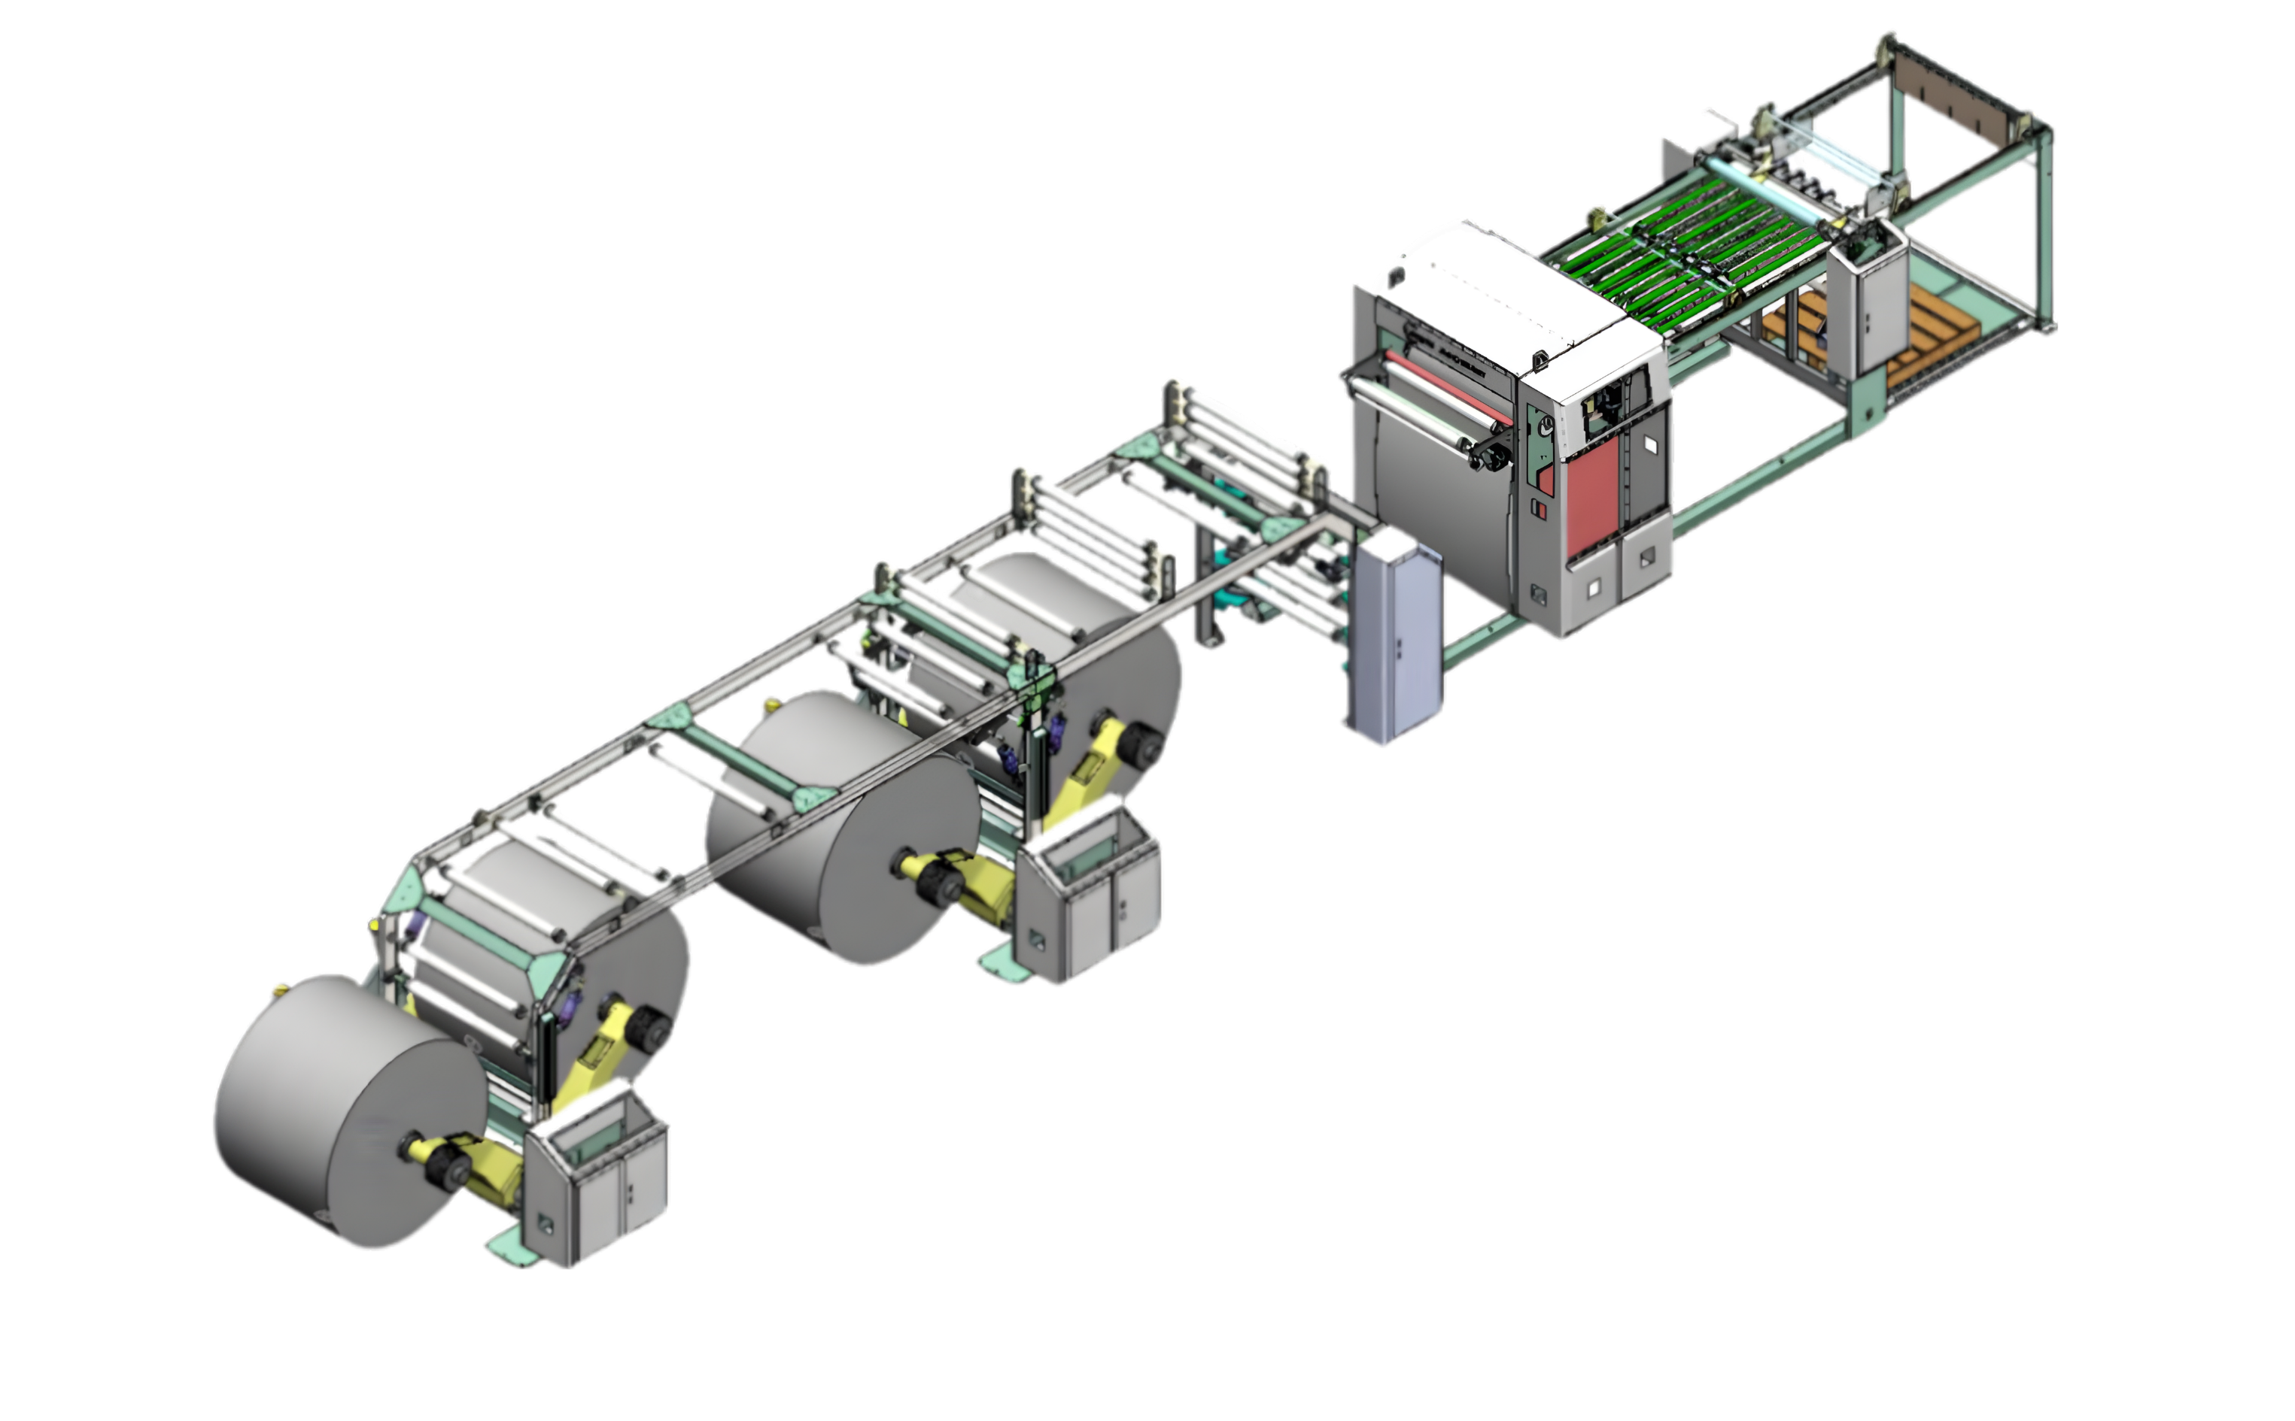
Paper cutting machine
4 rolls sheeting machine
High-precision sheeting machine designed to process paper and cardboard rolls into sheets.
With advanced technology and robust build, an efficient production is provided, while maintaining the quality and integrity of the processed material.

Slide 10































with over 90% of our suppliers, we have a history of more than 15 years of LONG-TERM cooperation.
50+ Leading Paper and PRINTING
material brands trust Polap
Papīrs
fij
materiāli
foto

Slide 11
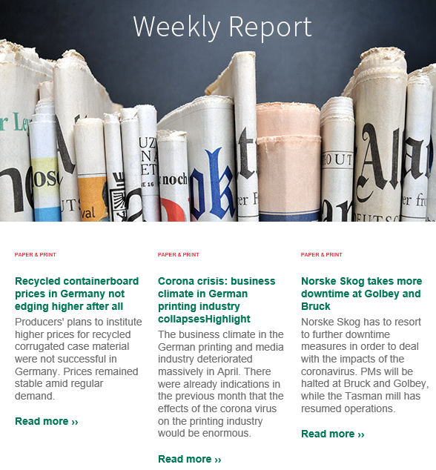
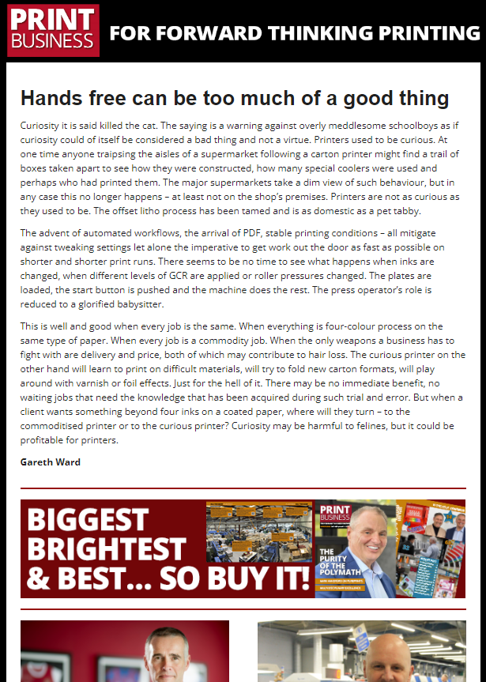
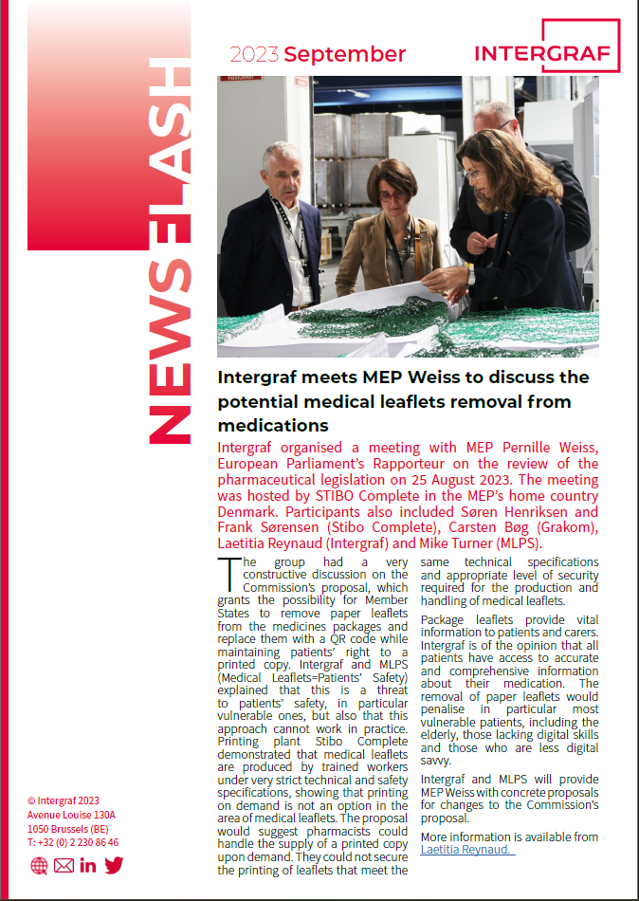
We keep up with market news
Every week we receive IGEPA Group news summarizing the overall market view;
We follow Print Business daily (UK), Printweek Europe;
We are members of LPUA, LIA, and LTRK;
We regularly attend exhibitions;
We attend INTERGRAF conferences;
We receive Supplier marketing materials;
We regularly participate in Supplier training;
We cooperate with Riga State Technical School.
Notes:
LPUA (LPCA) - Latvian Printing Companies Association
LIA (LPA) - Latvian Packaging Association
LTRK (LCCI) - Latvian Chamber of Commerce and Industry

Slide 12
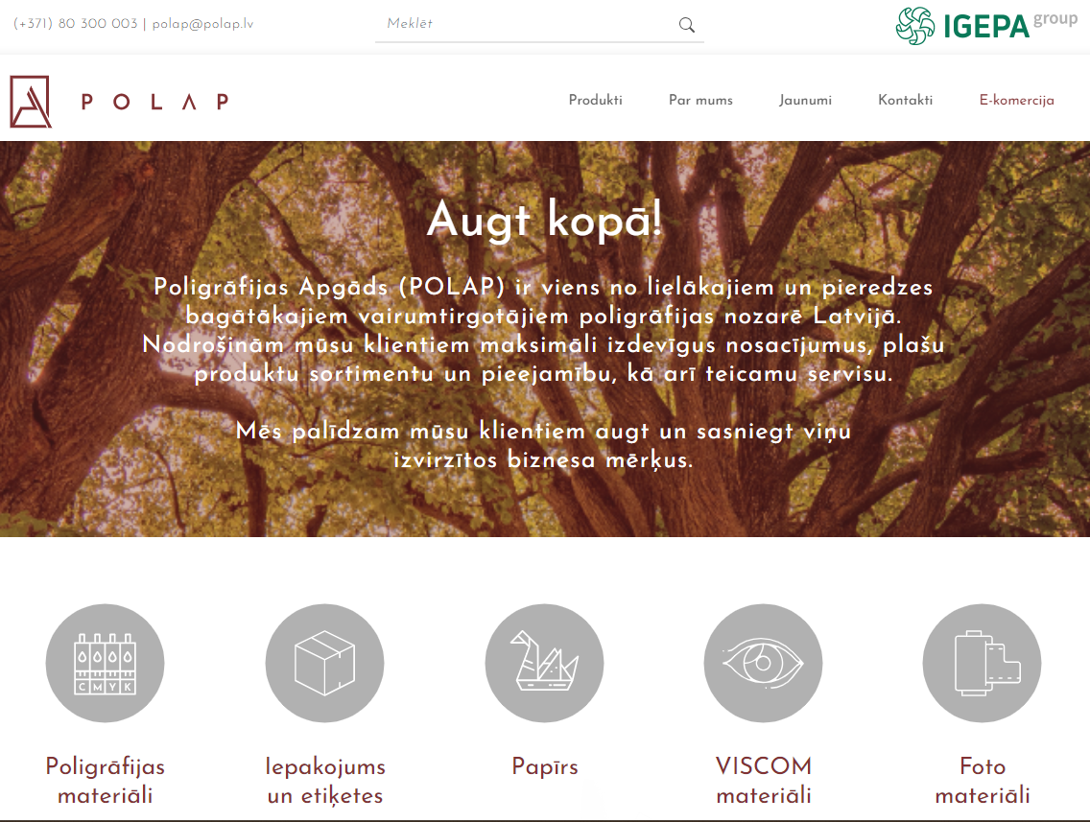

POLAP E-COMMERCE
15% of POLAP sales go via our e-commerce platform, with the tendency to grow.
Our e-platform is user-friendly with high customer satisfaction.
The most important benefits of the e-platform:
Customer individual pricing;
24/7 ordering possibility and full history;
Real-time inventory count.

Slide 13
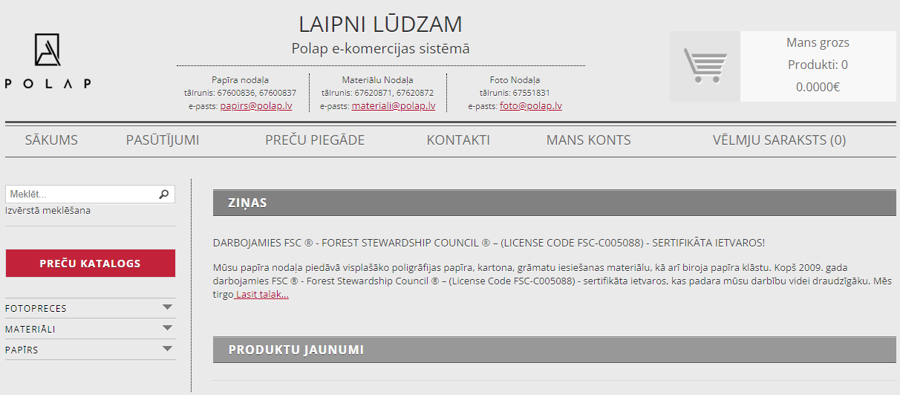
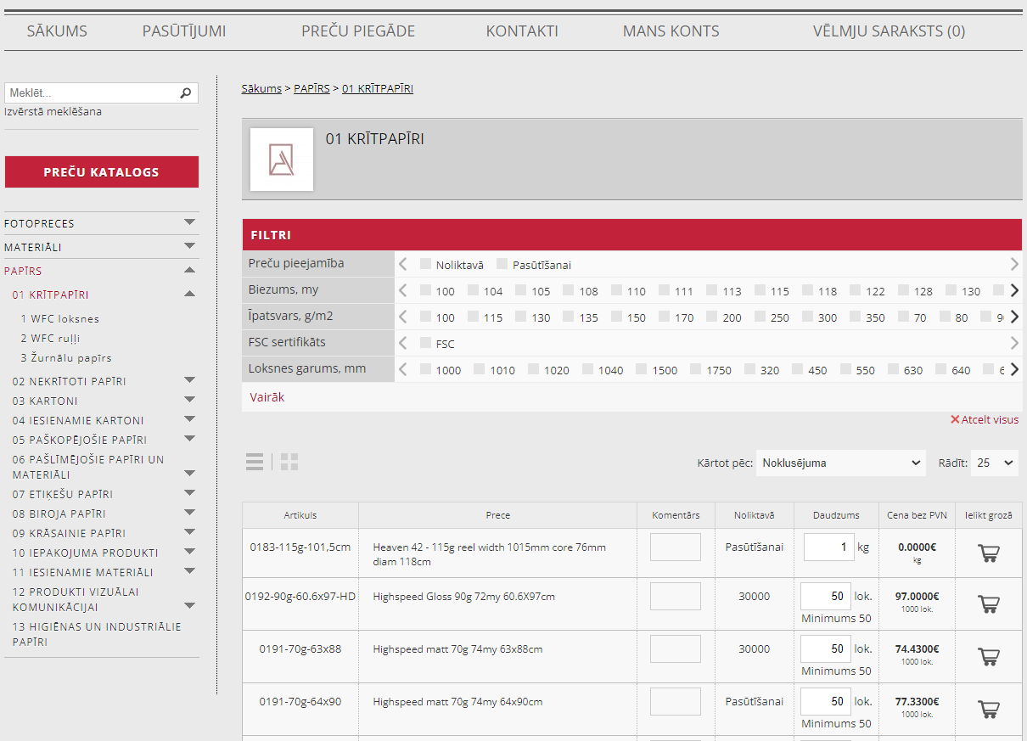
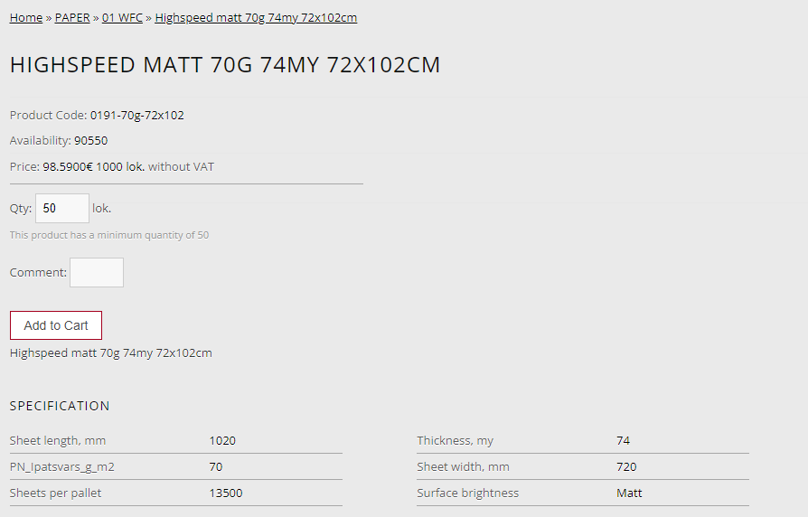
POLAP E-COMMERCE

Slide 14




POLAP
Printing Materials
Kurz foils;
Kodak printing plates;
Offset rubber blankets;
All types of laminating film;
Offset inks;
Adhesives;
Chemicals;
Calibrated paper;
Astrolon;
Staples;
Pantone catalogs.

Slide 15





POLAP Paper
Coated papers;
Uncoated papers;
Cardboards;
Binder boards;
Self-adhesive papers;
Colored papers;
Binding materials;
Digital papers;
Packaging materials.

Slide 16


POLAP
Packaging
Two-layer corrugated cardboard
Corrugated cardboard boxes
Corrugated cardboard pallets
Packaging film
Adhesive tape
Pallet corners
Corrugated cardboard sheet-spacer

Slide 17


POLAP
Visual communication
Digital print paper
Digital print cardboard
Self-adhesive paper
Self-adhesive foil

Slide 18



POLAP
Photo materials
Albums
Photo album covers
Memory cards
Batteries
Gift bags
Photo films
Hi-Ti
Inkjet
Chemistry
Minilab Accessories
Laboratory paper
Frames
Photo frame fixings
Stands
Thermal sublimation paper
Charging devices
Disposable cameras

Slide 19


CHOOSE POLAP AS YOUR PRINTING MATERIAL Supplier!
Andris dementjevs
Linda Lapa
Gundega Sproģe
Sales Manager
BOARD MEMBER
Head of Paper Group
andris.dementjevs@polap.lv
linda.lapa@polap.lv
gundega.sproge@polap.lv
+371 26 434 821
+371 29 432 447
+371 26 303 990

