Slide 1




Annual Investor Meeting
October 24ᵗʰ

Slide 2
Agenda
  The Opportunity
  Building a Strong Leadership Team
  Upgrading the Technology Stack
  Outstanding Business Performance
  Exciting Areas for Continued Growth
10/2/2023
‹#›

Slide 3
The Opportunity
  The #1 Leading Compliance Poster Company Online
    #1 in Organic Search on Google, Bing & Amazon for past 20 years
  Significant Growth Post COVID- Increased Workplace Legislation (State and Federal)
    >17%* 3-Year CAGR (2022 to *2023 est.)
  Large & Highly Fragmented Poster Compliance Industry Ripe for Aquisition
    Addressable market > $1Billion
    4. Potential to Grab Significant Market Share- Current Share Est.15% to 20%
    5. Extremely profitable business with simple manufacturing footprint easily scaled
10/2/2023
‹#›

Slide 4
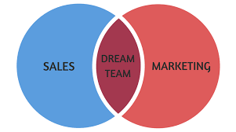
The Leadership Team
VP of Digital & VP of Sales Working together to Drive Inbound & Outbound Sales with KPI Analysis
Bhavna Patel- VP of Digital
Al Contrera- VP of Sales
Kyle Winkler- CFO
Sales:
Maximizing Quote Opportunities and Prospecting “look-a-like” customers
Marketing:
Driving Inbound Orders from Maximizing Digital Search & Conversion
Finance (Foundation):
KPI Analysis: Customer, Pricing & Product Analysis for Better Decision Making
10/2/2023
‹#›

Slide 5



Upgrading The Tech Stack
  Upgrading to Latest Version of Magento
    Increase Site Speed
    Increase Conversion
    Improve Customer Experience
  New Web Hosting Environment in Webscale
    Level loading site demand across servers during busy seasons
    Increased Security & Site Performance Reporting
  Implemented NetSuite ERP to replace QuickBooks and Spreadsheets
    Automate manual entries
    Greater depth and breadth of reporting
10/2/2023
‹#›

Slide 6
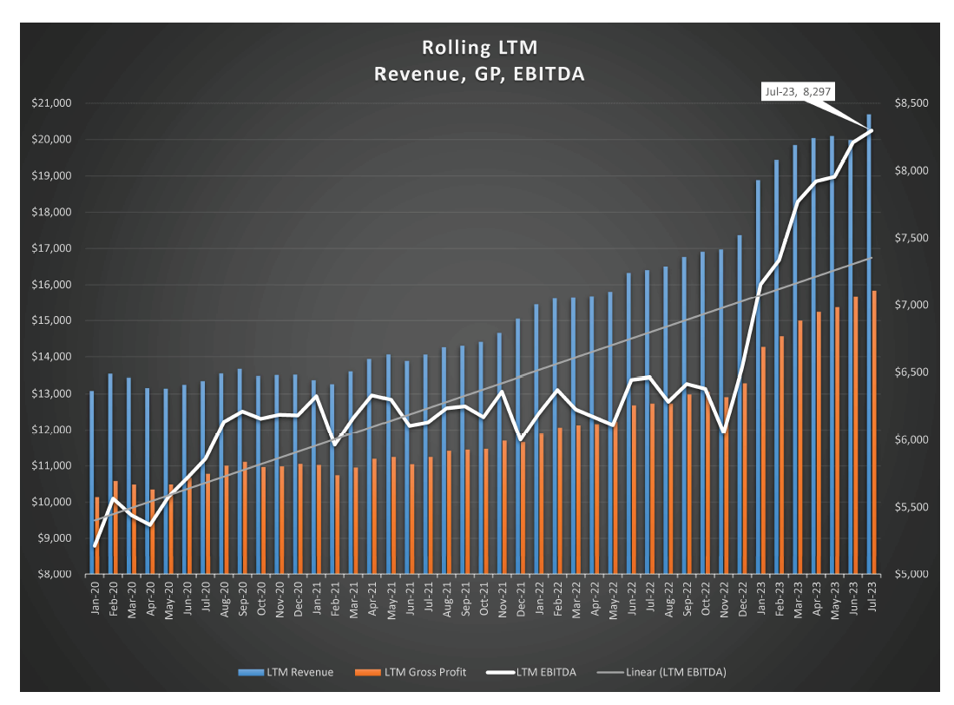
The So What?? Unprecedented Organic Growth
Add markers for
- Acquired by Kian Capital (10/21)
- CEO & CFO Join (3/22)
- VP of Digital join (8/22)
- VP of Sales join (6/23)
10/2/2023
‹#›

Slide 7
Areas for Continued Growth
  Trade-Up Existing Customers from 1x to multi-year Subscription
  Continue to Scale Outbound Sales Team- Drive New Business/Prospects
  Improve Features & Benefits of B2B Customer Portal
    Greater poster tracking capabilities
  Industry Specific Products and Solutions
  Expand Operations into Canda
  Acquire value add acquisitions with East Coast Manufacturing/Distribution
10/2/2023
‹#›

