Slide 1
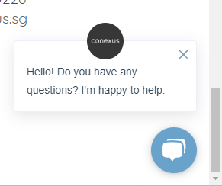
CONTENT
Video design-By Greeen
Logo image – front page to be creative-Web Page design
Natural- Natural like having plant or forest image
Awards- Must incorporate in the last page - Contact
All the customer logo
Our main advantage/Slogan is – Bring goods straight from factory and cut away the middleman costing so client can have a better quality with affordable price.
Our portfolio must be in the top front page – So client can just click on it
Calculator, timing and costing must have. – We can email them the info after they have key in all the particular
Contact person-
Pictures showing them our warehouse are
able to keep the goods for renovation(4000sqft)

Slide 2
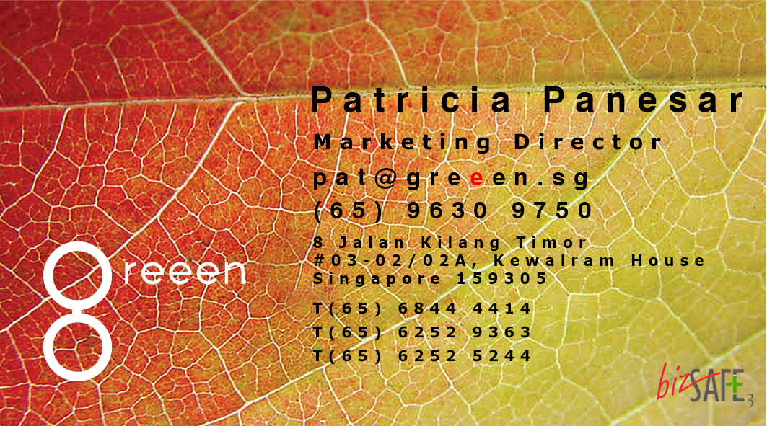
My current link for the web page is – greeen.sg

