Slide 1



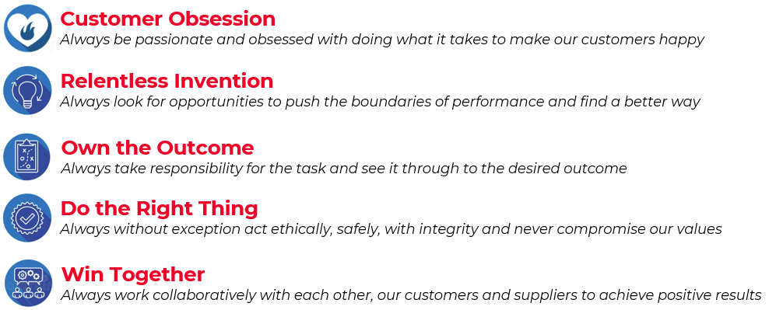

TBS on a page
Our Purpose:
We’re passionate about pushing the boundaries of our machine performance, technology and service to add value for our customers in the battery industry
Our Values:
Customer
Obsession
Invention
Technology
Leadership
Operational
Excellence
Health
Safety
Environment
People
Development
Strategic
Pillars:
Business
Priorities:
Integrated End-to-End Solutions
Global Aftermarket Footprint
Industry 4.0 Adoption

