Slide 1
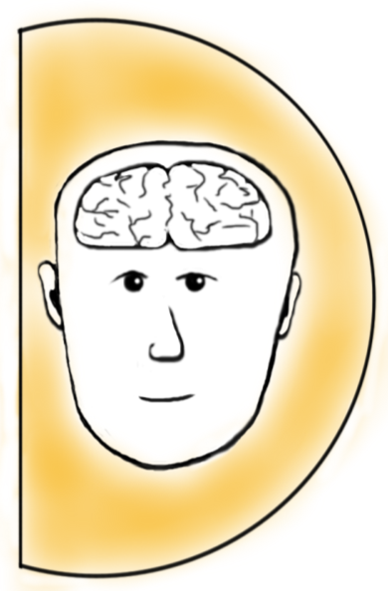
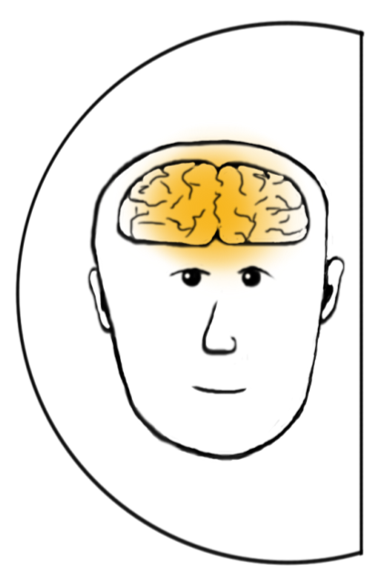
Why is it someone is not doing what you expect? (T-SAW)
WILL
AWARENESS
Our default is to often assume it is about Will. Check the others!
SKILL
TIME

Slide 2
Levels of Perspective (Daniel Kim)
Vision
Mental models
Systemic structure
L
E V E R A G E
Patterns of behaviour
Events

Slide 3






MISSION | PURPOSE
What is your WHY?
VISION
What do you really want to SEE?
MENTAL MODELS
Values and beliefs?
SYSTEMIC STRUCTURES
Systems and processes
PATTERNS OF BEHAVIOUR
Habits and routines
EVENTS
Outcomes and outputs

Slide 4






PERSONAL AND STRATEGIC
IMPERATIVES
Health
Career
ME
Intrapersonal
Relationships
Physical Environment
Finance

Slide 5












TEAM EQUATION
+
+
+
= 40
+
-
-
= 0
x
x
x
= 10,000
x
x
x
= 2,401
= 4,096

Slide 6
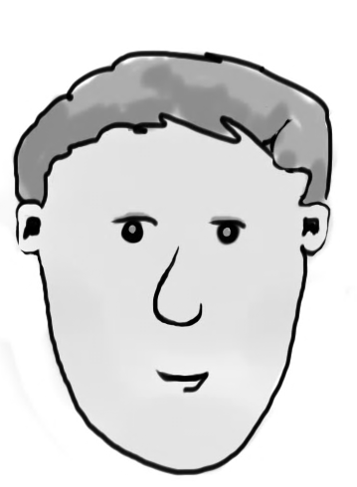
Ladder of Inference (Chris Argyris)
REFLEXIVE LOOP
Delicious loop of self delusion
ACTION
MENTAL MODEL
CONCLUSION
ASSUMPTIONS
MEANING
DATA
SITUATION

Slide 7
How do we make decisions?
OUTSIDE SELF
INSIDE SELF
Published research
& data
Personal practical knowledge
Reflection Generation Action
Current practice
Mental models

Slide 8

Transformational
L +
clear understood flows
time
THE PIT
confusion frustration angst
L ++

Slide 9

Our Purpose (Our Why)
Our Vision (what will we see)
Our Motto (Rallying Guiding light)
Our Values (How we live our lives)
Strategic Pillars
Key Result Areas (+SMARTO KPIs)
Dashboard

Slide 10

DEAR DIARY…
What should I start/stop/continue/develop
by December 2023?
From the Masterclass what action will you take from your learning?

