Slide 1

Balanced nutrient composition:
Good quality of proteins (47%) and lipids ~19%)
Source of essential amino acids (~1/3 of total amount)
Adequate fatty acid profile (~49% PUFAs)
EPA represents ~43% of total fatty acids, and ~5% dry weight
Ratio ω6/ω3<1
Bioactive micronutrients:
Carotenoids: β-carotene (0.10 mg/g), zeazanthin (0.16 mg/g), astaxanthin (up to 7% dw); antioxidant and antiinflammatory properties
Chlorophyll a (~2 mg/g); antioxidant properties
Polyphenolic compounds (~38 ppm): quercetin, caffeoyl glucoside, protocatechuic acid, caffeic acid, feruloyl glucaricacid acid; antioxidant properties
Vitamin C (2.4 mg/g) and E (0.4 mg/g); antioxidant properties
Oxylipins: 15-HEPE; anti-tumor, antiproliferative/cytotoxic properties
COMPOSITION
Bioactive compounds with antiproliferative/cytotoxic properties:
Trihydroxyanthraquinone
Heteronemin
lasonolide G
Sitoindoside IX
Withalongolide J
Physapubenolide
Bioactive compounds with antiinflammatory properties:
Asperulosidic acid
Klymollin E
Bioactive compounds with antibiotic properties:
Petrosynone
Monensin B

Slide 2
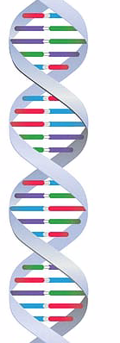
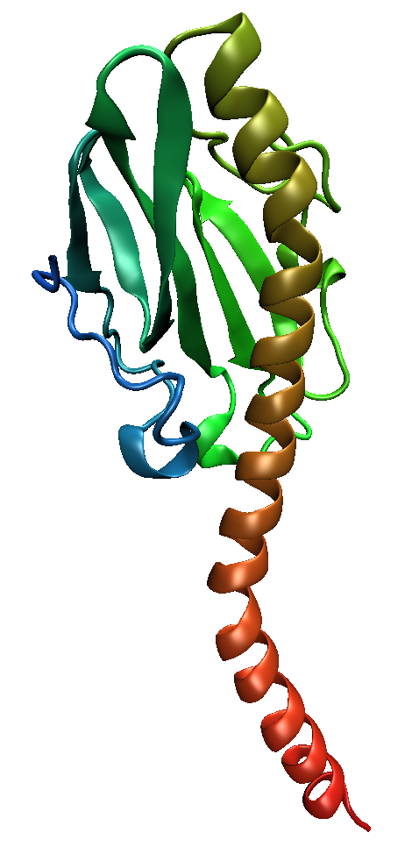
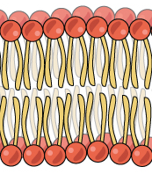
ROS
overproduction
Non-enzymatic
scavengers
Vitamins (C, E)
Carotenoids
Polyphenols
Enzymatic defenses
SOD, CAT, GPx
TXN
PRX
GSH pathway
Metabolic byproducts
Xantina oxidases
NO synthetase
Mitochondria
Enzymatic synthesis
NADPH oxidases
Physichal/chemical
Radiation
Pollution
Heat
Antioxidant defences
Cellular respiration
Mitochondrial
semi-ubiquinone
OXIDATIVE STRESS
OXIDATIVE STRESS AND Gaditae™
DAMAGE
DAMAGE
CELL
INJURIES
TISSUE
DAMAGES
DISEASES
DNA
PROTEINS
LIPIDS
Notes:
Living organisms on Earth are exposed during lifetime to oxygen, sunlight, and a range of different chemicals present in atmosphere, soil, and water. Moreover, apart from these exogenous environmental factors, endogenously produced chemical and metabolites often perturb cellular and organismal functions. To cope with such perturbations, we all display defence mechanisms specialized in an individual stress to respond to the stress for adaptation and maintenance of homeostasis. All cells produce reactive oxygen species (ROS) as a consequence of the own metabolic processes, the superoxide anion being the precursor of all other ROS. The three main in vivo sources for superoxide anion are the mitochondrial respiratory chain complexes, the nicotinamide adenine dinucleotide phosphate-oxidase, and xanthine oxidases. Ultimately, ROS can provoke damages in proteins, lipids, and DNA when antioxidant capabilities are overwhelmed by the burden of ROS, and this state is known as oxidative stress.

Slide 3
In vitro testing: Demonstrated free-radical scavenging activity to combat oxidative damage
Gaditae™ is a DIRECT antioxidant
DPPH
FRAP
Antioxidant
activity
ABTS
ORAC
Fe²⁺ chelating activity
β-carotene bleaching
Notes:
DPPH: 2,2-Diphenyl-1-picrylhydrazyl
FRAP: Ferric Reducing Antioxidant Power
ORAC: Oxygen Radical Absorbance Capacity
ABTS: 2,2'-azino-bis(3-ethylbenzothiazoline-6-sulfonic acid

Slide 4
Direct antioxidant: Demonstrated free-radical scavenging activity to combat oxidative stress by in vitro testing
DPPH assay
FRAP assay
Units OD (5 mg/ml extract): 0.414 (Kherraf et al., 2017)
IC₅₀ (µg/ml extract): 365 (Maadane et al., 2015)
µg TE/g: 254.6 (Martinez et al., 2022)
µM AAE/mg: 2.76 (Letsiou et al., 2017)
mmol TE/Kg oil: 1.8 (Millao and Uquiche, 2016)
IC₅₀ (mg/ml extract): 15.5 (Mekdade et al., 2016)
IC₅₀ (mg/ml extract): 2.02 (Kherraf et al., 2017)
AAE/ml extract: 32.71 (Haoujar et al., 2019)
IC₅₀ (mg/ml extract): 44.37 (Mekdade et al., 2016)
mmol Fe(II)/Kg oil: 85.52 (Millao and Uquiche, 2016)
IC₅₀ (µg/ml extract): 400 (Haoujar et al., 2019)
ABTS
ORAC
µg GAE/g: 193.68 (Martinez et al., 2022)
IC₅₀ (mg TE/ml extract): 0.026 (Medina et al., 2015)
IC₅₀ (mg/ml extract): 0.336 (Letsiou et al., 2017)
Lipid peroxidation inhibition
β-carotene bleaching
UAA/g: 45 (Martinez et al., 2022)
Percentage: 96.55 (Millao and Uquiche, 2016)
Fe²⁺ chelating activity
IC₅₀ (mg/ml extract): 3.52 (Haoujar et al., 2019)
Notes:
DPPH: 2,2-Diphenyl-1-picrylhydrazyl
FRAP: Ferric Reducing Antioxidant Power
ORAC: Oxygen Radical Absorbance Capacity
ABTS: 2,2'-azino-bis(3-ethylbenzothiazoline-6-sulfonic acid

Slide 5
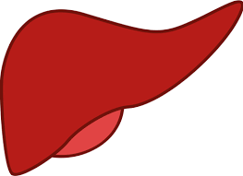
In vivo testing: Demonstrated activation of cellular antioxidant mechanisms in animal models
Gaditae™ is an INDIRECT antioxidant
Increase antioxidant enzyme activities
Decrease MDA and carbonyl proteins
GPx
Nacer et al., 2020
MnSOD
GST
CAT
Cu,ZnSOD
Increase GSH content
Nacer et al., 2020
Martínez et al., 2022
Liver
Nacer et al., 2020
Notes:
MDA: Malondialdehyde, biomarker of lipid peroxidation
Carbonyl proteins: Biomarker of protein oxidation
GSH: Reduced Glutathione

Slide 6
In vivo testing: Demonstrated activation of cellular antioxidant mechanisms in animal models
Gaditae™ is an INDIRECT antioxidant
Increase antioxidant enzyme activities
(P & E)
Decrease MDA and carbonyl proteins
(P & E)
CAT
SOD
Nacer et al., 2019
Nacer et al., 2019
Increase GSH content (E)
Increase vitamin C content (P)
Plasma (P) Erythrocytes (E)
Nacer et al., 2019
Nacer et al., 2019
Notes:
MDA: Malondialdehyde, biomarker of lipid peroxidation
Carbonyl proteins: Biomarker of protein oxidation
GSH: Reduced Glutathione

Slide 7

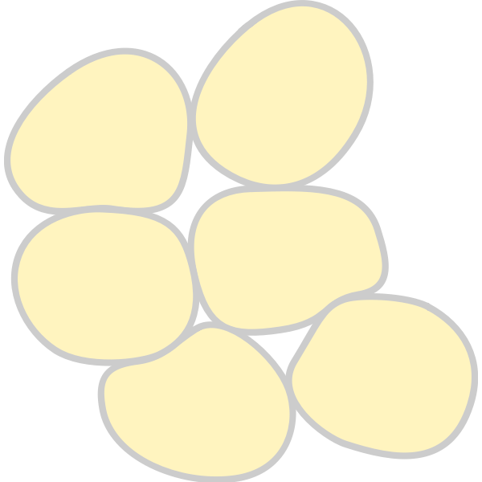
In vivo testing: Demonstrated hypolipidemic effects in animal models
Decrease in total
cholesterol
Increase in LPL activity
Liver
Pancreas
Nacer et al., 2019
Nacer et al., 2019
Adipose tissue
Decrease in
triglycerides
Nacer et al., 2019
Liver
Bendimerad-Benmokhtar et al., 2019
Decrease in fat content
Decrease in VLDL-C and LDL-C
Martínez et al., 2022
Decrease in cholesterol
Nacer et al., 2019
Plasma
Nacer et al., 2020
Increase in HDL-C
Decrease in
triglycerides
Nacer et al., 2019
Martínez et al., 2022
Nacer et al., 2020
Notes:
VLDL-C: very low density lipoprotein-cholesterol
LDL-C: low density lipoprotein-cholesterol
HDL-C: high density lipoprotein-colesterol
LPL: Lipoprotein lipase is an enzyme that degrades circulating triglycerides in the bloodstream. These triglycerides are embedded in very low-density lipoproteins (VLDL) and chylomicrons traveling through the bloodstream. Fatty acids liberated from the triglycerides are then used for storage in adipose tissue or fuel in skeletal or cardiac muscle.

Slide 8
In vivo testing: Demonstrated hypoglycemic effects in animal models
Decrease in glucose levels
Decrease in glycated hemoglobin
Nacer et al., 2019
Nacer et al., 2019
Nacer et al., 2020
Nacer et al., 2020
Martínez et al., 2022
Bendimerad-Benmokhtar et al., 2019
Plasma
In vivo testing: Demonstrated hepatoprotective effect in an animal model
Decrease in serum levels of ALT, AST, ALP, and LDH
Nacer et al., 2020
Notes:
- Glycated hemoglobin has always been considered as an important indicator of long-term glycemic control. The excess glucose present in the blood reacts with hemoglobin to form glycated hemoglobin.
- Serum alanine aminotransferase (ALT), aspartate amino-transferase (AST), alkaline phosphatase ALP, lactate dehydrogenase LDH. High levels of these enzymes is attributed to the leakage of the enzymes from the liver cytosol into the bloodstream, which may be due to liver dysfunction or damage of liver cells.

Slide 9
Demonstrated anti-inflammatory effect
In vivo (animal model)
In vitro
Decrease in serum levels of IL-6 and TNFα
Inhibited production of TNFα induced by LPS in differentiated macrophagues
Martínez et al., 2022
de los Reyes et al., 2014
Notes:
- IL-6 (Interleukin 6) and TNFa (Tumor Necrosis Factor alpha) are two of the major pro-inflammatory cytokines

Slide 10
In vitro: Demonstrated anti-proliferative effect in tumor cells
Caco-2
(human colorectal adenocarcinoma)
Carrasco-Reinado et al., 2021
A549
(adenocarcinomic human alveolar
basal epithelial cells)
Martínez et al., 2022
HT-29
(human colon cancer)
Ávila-Román et al., 2016
UACC-62
(human skin melanoma)
Ávila-Román et al., 2016
HepG2
(human liver cancer)
Carrasco-Reinado et al., 2021
T84
(human colorectal carcinoma)
Martínez et al., 2022
HCT-116
(human colon cancer)
Castejón and Marko, 2016

Slide 11
Other potential bioactivies exhibited by in vitro testing
Anti-steatotic effect
Prevented the accumulation of triglycerides induced by palmitic acid in cultured hepatocytes (AML-12 cells)
(González-Arceo et al., 2023)
Anti-hypertensive effect
Inhibition of ACE-1
(de los Reyes et al., 2014)
Skin protection against oxidative damage
Increased cell viability under oxidative stress in NHDF cells
(Letsiou et al., 2017)
Notes:
ACE-1 is a key enzyme that helps to regulate the salt–water balance and blood pressure within the renin-angiotensin-aldosterone system. It converts Ang-I in Ang-II, which is considered the main active peptide, which acts on target tissues and regulates blood pressure through renal reabsorption of sodium and water and systemic vasoconstriction.
NHDF: Nornal Hurman Dermal Fibroblasts

Slide 12
Other potential bioactivies exhibited by in vitro testing
Antioxidant effect
Up-regulation of GPX1 and FOXO3 genes in NHDF cells
(Letsiou et al., 2017)
Immunomodulatory effect
Up-regulation of FOXO3 and KLF2 genes in NHDF cells
(Letsiou et al., 2017)
Anti-inflammatory effect
Up-regulation of FOXO3, KLF2, and IL-1R genes in NHDF cells
(Letsiou et al., 2017)
Anti-adipogenic effect
Up-regulation of KLF2 gene in NHDF cells
(Letsiou et al., 2017)
Notes:
NHDF: Nornal Hurman Dermal Fibroblasts
Glutathione peroxidases are a family of enzymes that uses glutathione as a co-substrate in the reduction of H2O2 to water, with glutathione peroxidase-1 (GPX1) being the most abundant member of the family. Actually, GPX1 is considered a crucial antioxidant enzyme involved in preventing the harmful accumulation of intracellular H2O2.
Forkhead box (FOX) proteins are transcriptional regulators that play a key role in the modulation of a range of cellular biological processes including substrate metabolism, protein turnover, cell survival and proliferation, cell death, autophagy, inflammation, cytokine expression, and immunity. In particular, a role of FOXO subfamily in the cellular strategies of antioxidant defense is well stablished. FOXO3 is a representative member of the FOXO subfamily, which is expressed in a range of different tissues, and can be regulated at different levels: transcription, translation, and post-translational modifications. FOXO3 is known to protect cells from oxidative stress by directly increasing the manganese superoxide dismutase isoform (MnSOD, or SOD2) both at transcriptional and protein levels. Additional studies have shown that FOXO3 is also required for the expression of not only SOD2 but also other key antioxidant genes such as SOD1, catalase (CAT), and GPX1. On the other hand, it is known that perturbations in the expression or activity of FOXO3 are increasingly linked to chronic inflammatory processes. Anti-inflammatory and immunomodulatory actions of FOXO3 are well characterized, and include: i) inhibition of production of inflammatory cytokines such as IL-2 and IL-6, ii) a critical role for T-cell proliferation and activation, monocyte cytokine secretion, or neutrophil survival, and it can also direct inflammatory response in non-immune cells, and iii) limitation of memory T cells expansion.
The Krüppel-like family of DNA-binding transcription factors (a total of 17 different members, referred to as KLF1 to KLF17, have been characterized so far) have been found in all multicellular organisms, where they control a broad range of intracellular processes including quiescence, proliferation, differentiation, development, growth and inflammation. Among them, KLF2 has been detected in a range of different tissues, including spleen, thymus, adipose tissue, skeletal muscle, heart, as well as in myeloid and lymphoid immune cells. According to literature, it is known that KLF2 plays key roles in: i) immune function, regulating survival, migration and trafficking of T-cells and B-cells, controlling proliferation of induced regulatory T-cells, and regulating activation, differentiation, and cytokine secretion in monocytes, ii) inflammation, acting as an inhibitor of NF-κB, a well-known transcription factor that plays a central role in regulation of inflammation mediating pro-inflammatory signals (Turpaev, 2020), and iii) adipogenesis, being a negative regulator of adipogenesis through inhibition of peroxisome proliferator-activated receptor-γ (PPAR-γ) expression.
The interleukin-1 (IL-1) family of cytokines includes 11 different members, the family being closely linked to damaging inflammation mediated by induction of inflammatory factors such as cyclooxygenase 2 (COX2), synthesis of nitric oxide, or production of multiple cytokines and chemokines. To trigger cellular responses, IL-1 members bind to specific receptors on the surface of target cells, known as IL-1 receptors (IL-1R). Particularly, IL-1R1 mediates biological functions of both IL-1α and IL-1β, which are mainly inflammatory, and includes induction of pro-inflammatory cytokines, toxic reactive oxygen species and nitrogen species, prostaglandins, proteolytic enzymes and a variety of additional factors, or up-regulation of IL-2 receptors.

