Slide 1
[Banner Image]
Elevate and Ignite Your Leadership
Transformative conversations for senior healthcare leaders.
Unlock purpose, engage authentically and amplify your leadership impact.
Analytic Coaching Group for Senior Leaders
As a senior leader in healthcare, you’re constantly navigating challenges.
But where do you turn for authentic connections, reflection and personal growth?
Rethink your leadership assumptions and approach challenges with fresh creativity.
Secure your spot in our exclusive Analytic Coaching Group and ignite your leadership potential.
Benefits to you
Transformative conversations: Engage in discussions that spark innovative leadership
Peer insights: Harness fresh insights from peers, enhancing your decision-making and effectiveness
Reimagined leadership: Channel your creativity and redefine your leadership, personally and professionally
Instant 360° insights: Gain real-time feedback from trusted peers to enrich your leadership
Lead authentically: Develop effective strategies using the latest insights from group and leadership psychology
“You bare your heart and share things you wouldn’t under normal circumstances. You get to know each other very quickly. There’s that sort of intense, shared experience that comes from speaking to each other’s lives.”
Sarah, Medical Director
Dates: 7 February 2024 – 11 December 2024
Time: 7:30am - 8:45am (UK time).
Commitment: Wednesdays, every 2 weeks
Location: Connect from anywhere by Zoom
Cost: Cost: £3350 [UK] €3900 [Europe] A$6530 [Australia]
Payment options available
Secure your spot now and
ignite your leadership potential..

Slide 2
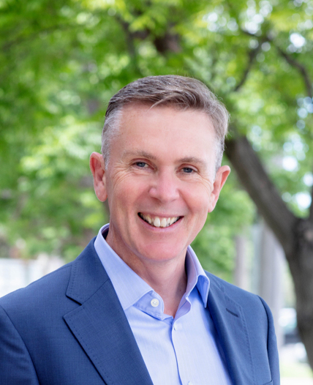


Expertly guided by insight, academic rigour and practical leadership strategies
Professor Michael Fischer has 30 years’ experience developing leaders. An award-winning business school professor, group analyst and psychoanalytic psychotherapist, he has taught senior leadership programmes at the University of Oxford, King’s College London and the University of Melbourne. His extensive leadership experience as an NHS clinical director and consultant psychotherapist inform his work as an ICF accredited executive coach. With a PhD from Imperial College, University of London, he is an expert in melding psychological insights with strategic organisational change.
Dr Rachel Gibbons is a renowned psychoanalyst, group analyst, consultant psychiatrist and organisational consultant in the health sector. She has 20 years of leadership within the NHS, and she was also the National Director of Therapies for the Priory Group, directing therapy services across 100 UK hospitals. She holds prominent positions as Chair of the Patient Safety Group, Chair of the Working Group on the Effect of Suicide and Homicide on Psychiatrists, and Vice Chair of the Psychotherapy Faculty at the Royal College of Psychiatrists.
Engage with global leaders, gain diverse insights and forge lasting bonds. Explore questions such as:
What kind of leader do I aspire to be in the next chapter of my life and career?
What unique qualities and actions do I offer that no one else can?
How can I galvanise my personal strengths to inspire and motivate others?
Limited spots available
Don’t miss this unique opportunity to transform your leadership journey.
Book your free discovery call
michael@fischerconsults.com
rachelgibbons@me.com
www.fischerconsults.com
“Through this exceptional coaching, our leadership team elevated its performance to lead the hospital with greater clarity, cohesion and thoughtfulness. Not only do we provide a superior work environment for staff, but better care for our patients.”
John, CEO

