Slide 1

The ‘Truth’ About Suicide
Dr Rachel Gibbons.
Chair of the Royal College of Psychiatrists Working Group on the effect of suicide and homicide on Clinicians, Vice-Chair Psychotherapy Faculty, Co-Chair of the Patient Safety Group
Consultant psychiatrist, psychoanalyst, group analyst

Slide 2
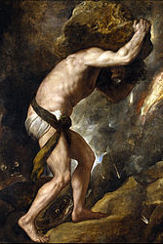
“There is only one philosophical question…and that is suicide”
Camus

Slide 3
The only way out is through

Slide 4

“To help a truly suicidal person you have to approach them with an open heart…
Chaplain of Beachy Head ”

Slide 5
My Experience
Suicide Lead: for Barnet Enfield & Haringey MHT
British Transport Police Suicide Prevention Team: Clinical Lead
Haringey Suicide Prevention Group: Founder member
Suicide Group for Consultants for 13 years
Coroners Office reviewing all suicides + audits, other data review
RCPsych: Chair Patient Safety Group & Working Group for the Effect of Patient Suicide and Homicide on Psychiatrists.
Suicide Strategy Nationally for Priory Group
Research with Oxford Centre for Suicide Research- Bulletin paper, Booklet for support.
Serious incident review group chair Haringey MHT
Writing national guidance for mental health organisations

Slide 6
‘Truths’ About suicide

Slide 7
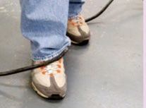
1: Suicide is not an accident
Suicide is not an accident
It is a result of complex universal unconscious mental mechanisms that we do not understand
It can be highly determined

Slide 8



2. You will never know why someone has died by suIcide

Slide 9
3: Impulsive
Vs premeditated

Slide 10
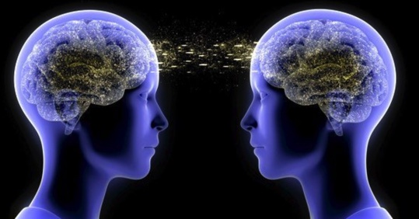
4: You do not know what is going on in someone else’s mind
We do not even know what is going on in our own mind!

Slide 11
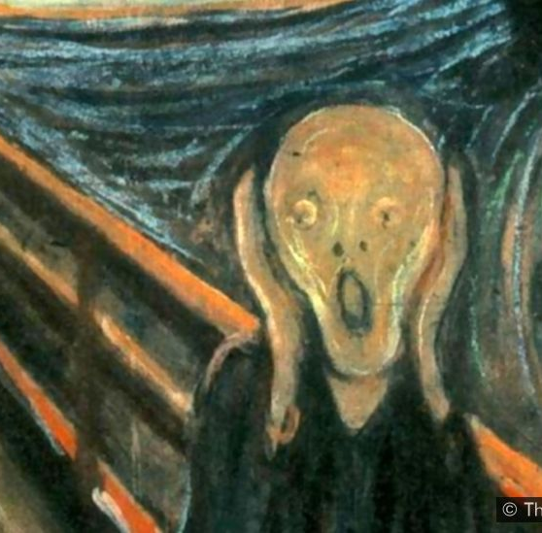
5. EVERYONE IS SHOCKED AND SURPRISED BY THE DEATH

Slide 12
6: Suicide result from an incapacity to mourn

Slide 13
Pathway to Suicide
1: Pre-suicidal vulnerability
3: Pre-suicidal state
4: Trigger event
5: Suicidal act
2: Trigger loss event
Notes:
No 1. is more controversial as we do not know this at all but hypothesis is that there is some developmental inadequacy with mourning and separation. So that there can be a psychically enmeshed relationship with primary object. To deal with ambivalence profound split in ego. Harsh superego and weak ego identified with hated part of object.
Loss event that cannot be mourned- perceived as abandonment and betrayal. Presuciidal state. In the presuicidal state split increased. Murderousness from loss projected into psychopathic superego that gains power, control and pleasure in sadism. Starts planning murder of ego. Secretly without knowledge of ego. Trying to set up a re-enactment of an early failure- trick others ino playing roles in this- then will allow for suicide. Acting out and projection of guilt into others. then a trigger event. Another loss event can be small again perceived betrayal.
Psychopathic part want to trick you into doing something. Wants to get you to walk into a trap. Perceived as failure of idealised care from past. Doesn’t want to let go of pleasure from Sadism. Rob Hale says ‘suicide freezes the relationship at the zenith of sadism’.
Wants walk into trap. Let of powerful option. Let go pleasure in sadism. Throws enormous sadomasochistic
Profound split = ambivalence. This means that total division not even conflict. One side then another without any connection between the two. And stuck

Slide 14

7: Suicide is a human condition not a MENTAL HEALTH CONDITION

Slide 15
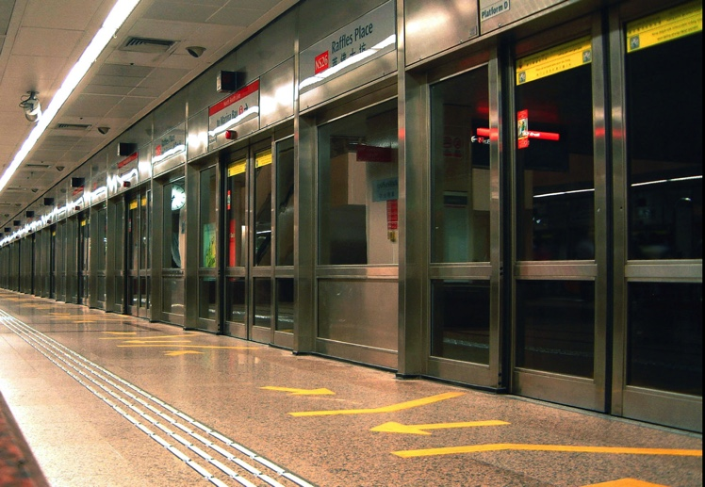
8: Suicide prevention challenging in any individual case but not on a population or conceptual level

Slide 16

9.Suicide is an acting out event
You act out when you cannot put your emotional experience into words

Slide 17
“An act like this is prepared within the silence of the heart, as is a great work of art. The man himself is ignorant of it. One evening he pulls the trigger or jumps”
Camus

Slide 18
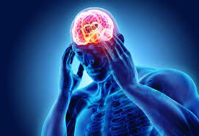
‘Facts’ or ‘Truths’ about suicide
Suicide is not an accident
You will never know why someone died by suicide
It is either impulsive or premeditated
You do not know what is going on in someon elses mind.
Everybody is shocked by the death
Suicide appears to result from an incapacity to mourn
Suicide is a human condition and not a mental health condition
Suicide prevention is a public health issue and talking about it reduces the risk
Suicide is an acting out event

Slide 19

Point 10: The most important point
No one is to blame for someone else’s death by suicide

Slide 20
10: NO ONE IS TO BLAME FOR
SOMEONES DEATH BY SUICIDE
Blame is a non-mentalizing word
It only allows for one - and the complexity and uncertainty of the situation are not considered.
RESPONSIBILITY is a mentalizing word

Slide 21
It’s is our belief that we can predict and prevent individual suicide that makes us the architect of our own downfall following the suicide of a patient
We then take suicide of a patient as our own failure
The truly suicidal then pose a risk to us
…and It makes us less likely to approach them with an open heart

Slide 22
Research
Citation: Tamworth, M.; Killaspy, H.; Billings, J.; Gibbons, R. Psychiatrists’ Experience of a Peer Support Group for Reflecting on Patient Suicide and Homicide: A Qualitative Study. Int. J. Environ. Res. Public Health 2022, 19, 14507. https://doi.org/10.3390/ijerph192114507
Croft A, Lascelles K, Brand F, Carbonnier A, Gibbons R, Wolfart G, Hawton K. Effects of patient deaths by suicide on clinicians working in mental health: a survey. International Journal of Mental Health Nursing. 2022.
Oates, A., & Gibbons, R. (2021). After a patient dies by suicide: An illustrative case for trainee psychiatrists and trainers. BJPsych Bulletin, 1-5. doi:10.1192/bjb.2021.106
Gibbons, R., Brand, F., Carbonnier, A., Croft, A., Lascelles, K., Wolfart, G., & Hawton, K. (2019). Effects of patient suicide on psychiatrists: Survey of experiences and support required. BJPsych Bulletin, 43(5), 236-241. doi:10.1192/bjb.2019.26

Slide 23


