Slide 1
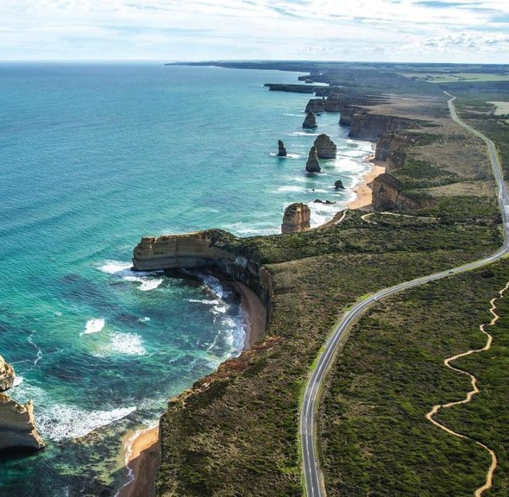


Crown land Utilisation Strategy
Request for Proposal – Q22-070
Attachment 1
Response by
November 2022
STRICTLY CONFIDENTIAL

Slide 2


We Pay our Respects to the Traditional Owners of the Great Ocean Road Region
ODIN360 acknowledges that the Eastern Maar and Wadawurrung Peoples are the custodians of the lands and waters encompassed by the Great Ocean Road region. As its First Peoples, these groups hold a unique position and we recognise there is much to learn from the Traditional Owners.
We acknowledge their ancestors who cared for the lands, rivers and sea, and all living creatures for thousands of generations. We pay our respects to their Elders past, present and future who continue this path.
Like GORCAPA, we will work respectfully with both groups to ensure we engage on the terms that they choose, realising their rights (including to self-determination) and respecting their cultures and knowledges.

Slide 3
  Table of Contents
Section
Page
Project Overview 4
Project Team 8
Our Philosophy & Initial Analysis 21
Our Project Methodology 28
Relevant Project Experience 55
Indicative Project Timeline 67
Project Fees 69
Referees and Insurance 71
Contact Details 73

Slide 4
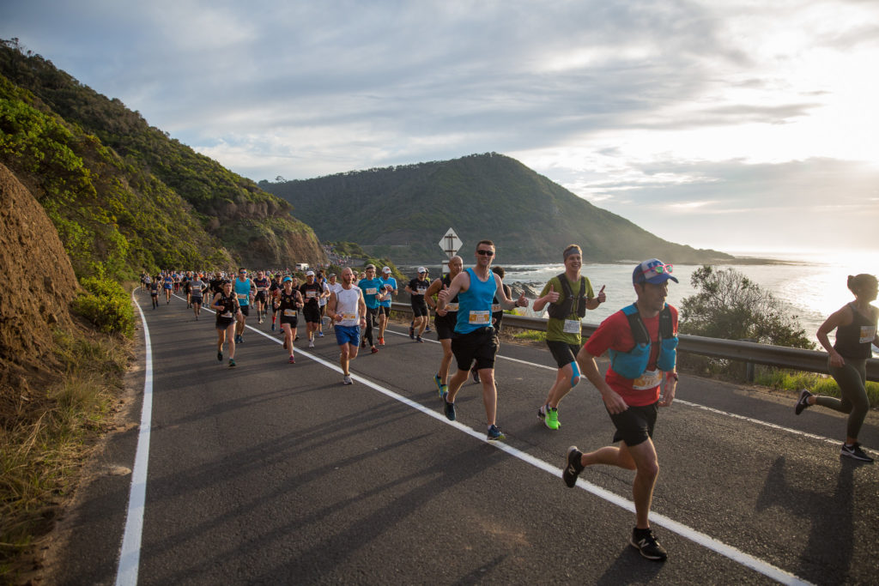
Development of Crown Land Utilisation Strategy
(to deliver GORCAPA outcomes including local economic stimulation)
1. Project Overview

Slide 5
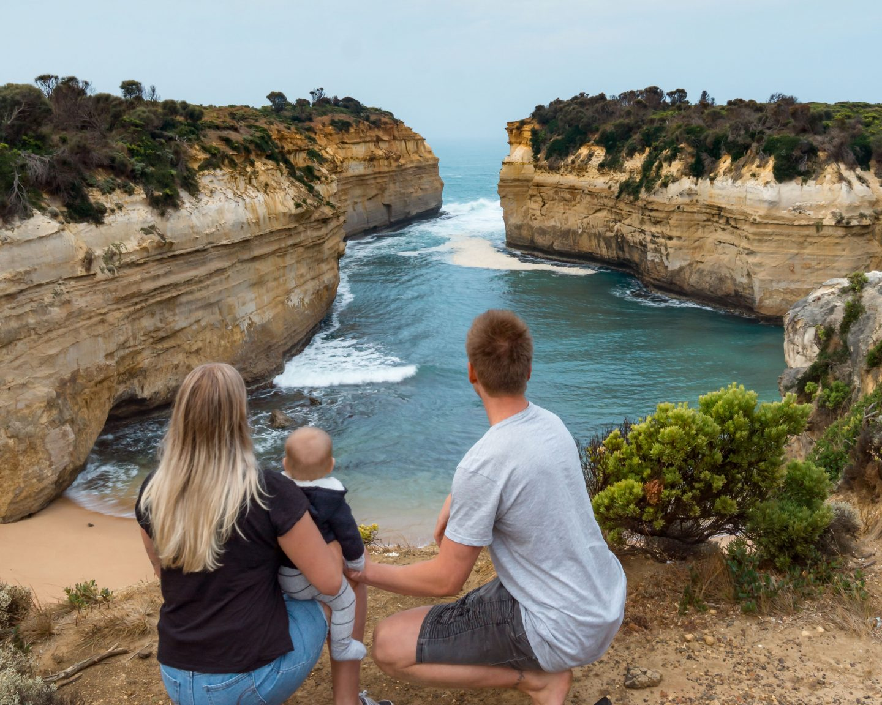
  Project Overview
Having been established in 2020, the Great Ocean Road Coast & Parks Authority (GORCAPA) has the principle purpose of protecting, conserving, enhancing and managing Crown land and coastal assets within the Great Ocean Road coast and parks area.
GORCAPA was also set up by the Victorian Government as a self sustaining entity – meaning that it must meet its operating and maintenance costs from its own revenue streams. This is not without challenges for GORCAPA. At present, the largest source of revenue for GORCAPA is the caravan parks and campgrounds that it currently operates. ODIN360 has the pleasure of currently working with GORCAPA on developing the strategic plan for those caravan parks and campgrounds. One of that Plan’s purpose is to ensure that they not only provide the required revenue to manage the parks, but also provide additional funds to enable the Authority to meet its other core conservation and sustainability obligations. That Plan is close to completion and there are a number of synergies to this project.
Another potential source of revenue for GORCAPA is the revenue optimisation of the vast amounts of Crown land that fall within its remit. This does not mean that GORCAPA can simply run commercial enterprises and activities across all its land. Any activation and optimisation strategy must be conducive with GORCAPA’s overarching ambit of protecting, conserving and enhancing the region. It must also do it in away that builds social licence and is supported by the Traditional Owners. Where possible, leadership of any activities should be undertaken with those Traditional Owners.
This project will involve researching, understanding, and identifying opportunities for the appropriate utilisation of Crown land reserves (under the remit of GORCAPA). There are a number of options and opportunities that will be considered through this strategy. The key requirement though is to ensure that the Traditional Owners as rightsholders, other key stakeholders and the local community all have the opportunity to input into the development of those concepts. This is extremely important to ensure that social licence is built for those activities and are consistent with the general views of the community across the region.

Slide 6

  Project Overview
ODIN360 will ensure that the final Strategy will achieve the following outcomes which are the defined Project Outcomes.
Deliver a strategic approach to utilising the Great Ocean Road region's Crown land reserve to improve year-round visitation, broaden use types, improve access to land for all people and to deliver positive economic impacts to our regional communities.
To ensure that Crown land reserve activities are complimentary and are not detrimental to our coastal environment.
Work with our traditional owners’ groups to understand their commercial aspirations and identify opportunities to activate and utilise the Crown land reserves.
That there is a clear strategy to attract and successfully support major events.
That an appropriate fee structure is applied consistently for all land use.
A plan of supportive infrastructure which is supported under the MACA (Marine and Coastal Act). Supportive infrastructure could include small scale items such as power and communications upgrades but also include large items such as seasonal worker accommodation.
ODIN360 has great pleasure in submitting this proposal to undertake the important work on this exciting project. As we indicated earlier, it closely aligns with our work on the Caravan and Camping Strategic Plan.
AS GORCAPA is aware, ODIN360 is one of Australia’s leading consulting agencies that has real expertise in nature based, sustainable tourism, events (large and small) as well as accommodation. The project team has significant experience in developing utilisation and economic optimisation models for commercial activities on Crown land.

Slide 7
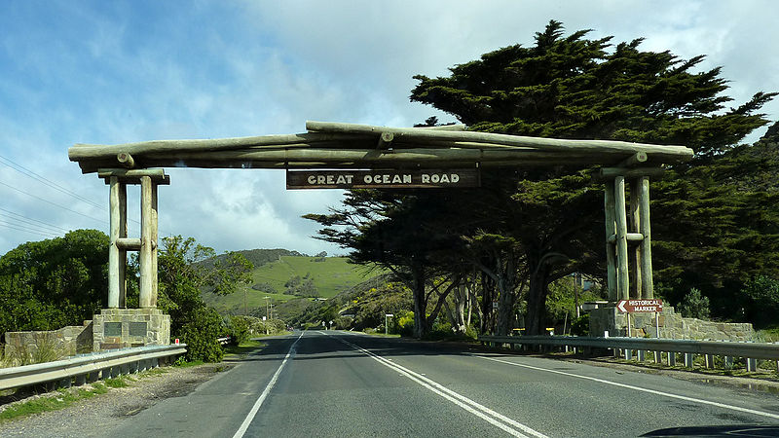

Slide 8
2. The Project Team

Slide 9
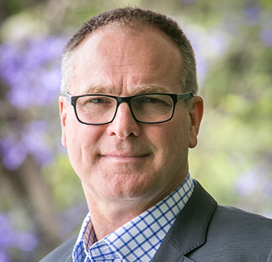
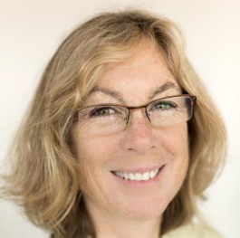
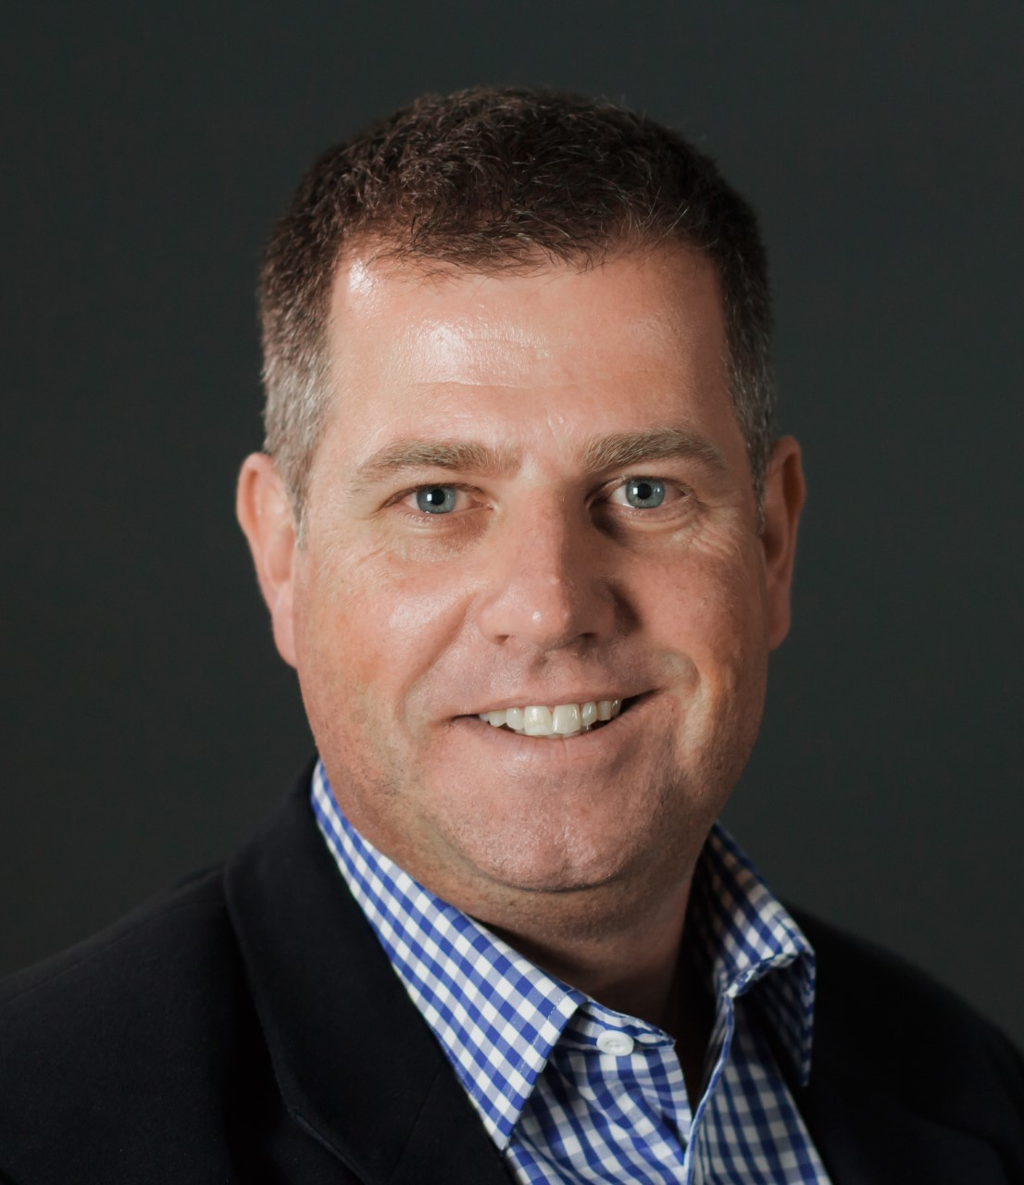
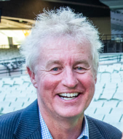

The Project Team
The project will be overseen by a team of four highly experienced tourism and event specialists, supported by a senior sustainable tourism statutory planner (if required)
Steven Wright
Project Leader
Tourism & Major Events Specialist
Dr Claire Ellis
Sustainability & Nature Based Tourism Specialist
James Paterson
Event Attraction
& Consumer Research
Specialist
Peter Jones AM
Event Planning & Facilities Management Specialist
Claire Baker
Strategic Planning & Sustainable Tourism Expert

Slide 10
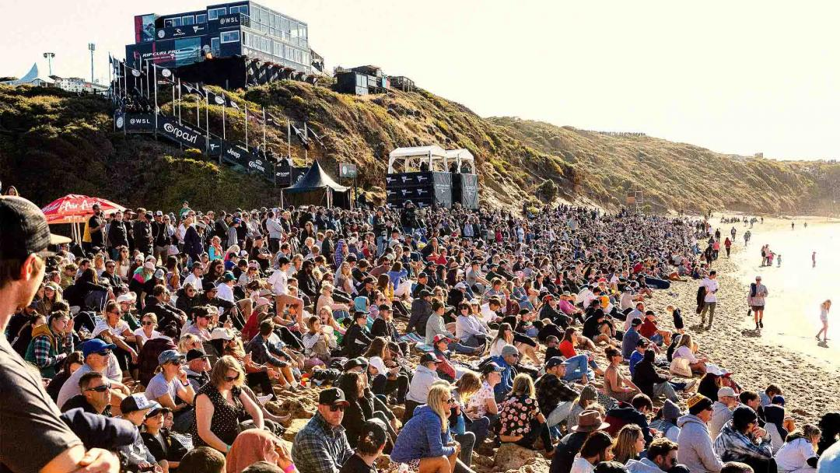

Slide 11
We bring to this extremely important project:
The most experienced project team in Australia in nature based tourism, events and the visitor economy. We understand the challenges and opportunities presented by utilising Crown land.
Each member of the project team and specialist team are experts in their field. They are not generalist consultants. All ODIN360 project work will be undertaken by these experts and NOT delegated to an inexperienced junior consultant.
The project team are all industry leaders of high standing that will bring insights and outcomes based on over 100 years of collective experience.
Our team have all sat on both the client and consultant side. We know exactly what is required to deliver a successful outcome for the client. For that reason, we operate under a co-design model.
We bring extensive local knowledge of the Great Ocean Road region, its visitor economy, its accommodation offerings and experience working with Aboriginal land custodians.
We have a laser like focus on stakeholder & community participation both through direct engagement and by survey. We understand and have great respect of the need for Social Licence and Sustainability of outcomes.
We bring passion and energy to our projects. We love our industry and our jobs. We have fun ensuring the best outcomes for our clients.
About ODIN360

Slide 12
The ODIN360 Project Ecosystem
Relevant Project Team Expertise
ODIN360 is one of Australia’s most experienced consulting and business advisory firms that focuses on tourism strategy, destination, event & product development, economic analysis, stakeholder engagement and consumer research – all of which are core aspects of this project.
Our innovative model allows ODIN360 to create specialist and bespoke “project eco-systems”. We create teams of senior specialists who are experts in their field who undertake the work themselves. They do not hand it off to juniors with limited knowledge, experience or understanding of the issues at hand. This guarantees that we provide the best possible advice and service to our clients.
In this project, we have identified 11 key areas that are critical to the project's success.
As ODIN360 only bring true experts to projects, collectively the team has extensive expertise in each of these 11 areas. We will also work closely with the relevant councils and stakeholders in respect of their own planning and local sustainability issues and policies.
Our project team are also not just “consultants”. They have all actually lived and breathed the key project issues and challenges as senior executives and directors of organisations such as Tourism & Events Qld, Visit Victoria, Destination NSW, Tourism Tasmania, BIG4 Holiday Parks, Nielsen, Repucom, Australian Grand Prix Corporation and several AFL Clubs to name a few.
As consultants, we have also worked with many regional tourism boards and local councils.
ODIN360 Project Ecosystem
Visitor Economy
Event Planning & Management
Tourism Product Development
Regenerative Tourism
Local Knowledge
Economic Analysis
Major & Community Events
Community & Traditional Owner Consultation
Statutory Planning
Major Event Attraction
Stakeholder Engagement

Slide 13
ODIN360 Project Team: Steven Wright - Project Manager (also member of Caravan Park Plan project)
Steven Wright is the founder and MD of ODIN360. He is an extremely experienced consultant and leader in strategy, tourism, major events and business planning. He has held Board, CEO and private consulting roles in well-known organisations in the public and private sector for over 25 years. He has the unique skill of being able to balance the often conflicting commercial / economic imperatives with community needs, social licence and public policy.
    Career Summary
    Current
      MD & Founder - ODIN360 management consulting
      Chairman - South East Leisure Pty Ltd / City of Greater Dandenong
      Director - Victoria Tourism Industry Council
      Advisory Board Member - Delaware North Australia
      Director - East Gippsland Water Corporation
      Director - Blackburn Community Bank – Bendigo Bank Franchisee
    Previous Executive
    BIG4 Holidays Parks of Aust – CEO
    Tourism & Events Qld – CEO : Qld Government Authority
    Brisbane Lions - CEO (interim) : AFL Club
    Richmond Football Club – CEO : AFL Club
    Aust Grand Prix Corp – CEO : Vic Govt Authority for F1
    Australian Grand Prix and MotoGP
    Herbert Smith Freehills, Commercial Solicitors - senior associate
Steven Wright
As a Director of the Victorian Tourism Industry Council (VTIC) and Delaware North Australia, former CEO of Tourism & Events Queensland, BIG4 Holiday Parks, Aust Grand Prix Corp and two AFL clubs, Steven has extensive knowledge of regional tourism and major events . He has particular understanding of the Great Ocean Road through those roles, as well as the work on the GORCAPA Caravan Park project. This has been further enhanced as a regular tourist “user” in the area. Across these varied roles, he has managed complex stakeholder and government relationships to achieve successful outcomes.
As a qualified lawyer, accountant and AICD Graduate, Steven has the academic, legal and practical governance, commercial, financial and operational experiences to ensure project success.
ACHIEVEMENTS:
Developed and successfully implemented corporate and tourism strategy across many large organisations and destinations.
Created sustainable model and framework for tourism activities in National Parks.
Introduced Tourism Management Planning across each Regional Tourism Board in Queensland.
Developed new products and commercialisation strategy for Bellarine Rail .
Developed masterplans for Indigo Shire caravan parks to maximise commercial opportunities
Developed commercial and community strategy for Blackburn South Community Bank
Created numerous masterplans for major tourism attractions and accommodation products
Developed numerous small and larger scale events connected with F1, MotoGP and AFL
Creator and Founder of Korin Gamadji Institute for indigenous leadership development.
Previous relevant board and advisory roles
    Member - Aust Govt Standing Committee on Tourism (ASCOT)
    Director - Surfers Paradise Alliance – a Gold Coast City Council Economic Development Authority
    Founder & Director - Australian & NZ Sports Law Assoc
    Director - Australian MotorSport Foundation
    Founder – Korin Gamadji Institute
      Awards & Qualifications
    Master of Laws – Monash University
    Bachelor of Economics – Monash University
    Harvard Business School Online – Disruptive Strategy
    Australian CEO of Year 2018 – Finalist
    Australian Tourism Executive of Year 2017 – Finalist

Slide 14
ODIN360 Project Team : Dr Claire Ellis- Product Development (also member of Caravan Park Plan project)
Dr Claire Ellis is Australia’s leading nature based and sustainability tourism consultant. She is Chair of Ecotourism Australia and works around the world in advising in strategic development, policy, sustainability and planning largely for destinations and across nature-based tourism products.
Claire has been consulting for over 10 years, having previously been working with remote expedition tours in Indonesia, undertaking research and working as a University lecturer, and then leading the supply-side of Tourism Tasmania for 7 years.
Career Summary
Current Roles
Managing Director - Claire Ellis Consulting
Consultant – ODIN360
Chair – Ecotourism Australia
Board member - Natural Resource Management Southern Tasmania
Director- Ingleton Scenery Company, Yorkshire, UK
Previous Roles
Director – Volunteering Tasmania
Director - Infrastructure and Industry Development, Tourism Tasmania
Lecturer – Tourism, University of Tasmania
Qualifications
Graduate – Australian Institute of Company Directors
PhD – University of Tasmania
Bachelor of Arts
Bachelor of Economics
Diploma of Education
Dr Claire Ellis
Sustainability & Nature Based Tourism Specialist
Her tourism consultancy work is varied with a strong regional and nature-based focus around strategic projects and immersive visitor experiences.
It varies from undertaking regional reviews, providing strategic advice on the design and development of major sustainable products in Crown lands such as multi-day walks to support regional development, through to designing and managing programs aimed at improving seasonality. Simply described, her work concentrates on examining an issue and designing practical and implementable sustainable solutions that work for clients and stakeholders.
Claire is currently drawing on contemporary post-COVID trends around sustainability, nature and health and wellbeing to create new appealing experiences such as the Kangaroo Island Guardian project for tourism operators that engages visitors in environmental care.
Claire’s role in this project will be to not only develop best practice commercial products for the Crown Lands Utilisation Project, but also ensure they will align with the overarching principles of sustainability in its true sense and be consistent with GORCAPA’s desire to received ECO destination certification.

Slide 15
ODIN360 Specialists – Event Attraction and Consumer Research specialist
When it comes to evidence based tourism insights and major event product development there is no one more experienced than James Paterson. He has more than 25 years experience leading insights and research teams across tourism and major events. He has headed up the tourism, and research divisions of both government and private organisations.
James also has extensive experience in undertaking consumer research to test the potential for new tourism and event products and to determine the core and target markets, and projecting the likely holistic impacts.
    Current Roles
    ODIN360 Market Research & Product Development Specialist
    Managing Director - JMP Consultants
    Previous Roles
    Principal, MI Associates specialising in Major Events, Strategy, Economic Impact Assessments, Consumer Research & New Product development
    Director, Government Tourism & Events – Nielsen Research
    Head of Government, Tourism & Events – Repucom
    Head of Strategy, Insights & Legal – Events NSW / Destination NSW
    Numerous other roles across: Major Events, Strategy, Feasibility, Planning, Consumer and Market Research, Evaluation, Valuation and Policy.
James Paterson
ODIN360
James’ other core specialty is major events. As the former Head of Strategy for Events NSW (now Destination NSW) he led a team that was focussed on maximising the holistic economic, brand and community benefits from its major event portfolio. He helped establish create Vivid Sydney along with NSW’s first Master Event Calendar and implemented world-class systems and processes to enable optimal event selection, investment, measurement and evaluation.
James has been involved in multiple event strategy projects for clients across Australia and New Zealand, including: Wellington (NZ); Parramatta; Upper Hutt (NZ); A.C.T; Northern Territory and Dubbo. This involved detailed analysis of event portfolio reviews, community insights, gap analyses, event attraction and developing best-in-class systems for assessing and measuring the holistic benefits of major events.
He also regularly works with clients in relation to building highly compelling business cases, evidence-based consumer research, along with major event strategy, feasibility, planning and evaluation.
In addition, James also has set up major online consumer research tracking studies to measure community and resident sentiment around tourism, brand, campaign effectiveness, events and tourism investment for State Tourism bodies.
      Qualifications
      Bachelor of Commerce (Majoring in Finance & Economics) – ANU
      Bachelor of Laws (Hons) - ANU
      Graduate Diploma of Legal Practice – ANU
      Master of Science – University of Massachusetts

Slide 16
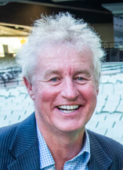
ODIN360 Specialist – Peter Jones AM : Event Strategy, Planning & Management Specialist
Peter Jones AM has been creating special events ever since he can remember and long before Peter Jones Special Events (PJSE) was established. Any special event in Victoria is not truly a special event unless Peter Jones and his team are managing it.
This year celebrates 30 years of Peter deciding to start his own “party” business – and what a journey that has been. There are a lot less parties now but many more amazing and spectacular events, although that’s only part of the story.
Peter has continually dedicated a great deal of time to representing and supporting the industry at many levels. His many years of outstanding voluntary service and contribution to events was recognised with his appointment as a Member of the Order of Australia.
Peter Jones AM
He is Trustee of the Melbourne Convention and Exhibition Centre, previously Chairman of the Victoria Events Industry Council (VEIC) and a member of the Victoria Tourism Industry Council. Peter was also a board member of Destination Melbourne and past President of the Melbourne chapter of the International Special Events Society (ISES). He regularly lectures at numerous event management courses, and only wishes there was a course around when he was studying.
But of course, Peter is much better known for the incredibly successful bespoke events company that PJSE has become. Whether it’s an intimate dinner for 20 or a public event for 100,000, PJSE experience with over 1,200 events makes them a trusted, well known company that continues to deliver. They specialise in public parades, public celebrations, outdoor events, opening ceremonies and unique one-off special event as well as gala dinners, awards nights, cocktail receptions, high-end fundraisers, incentive programs and product launches.
Generating creative and innovative concepts and exceptional execution is only the beginning of what the team at PJSE do. They understand that outcomes and objectives need to be met, and PSJE works with their clients to ensure that the event achieves the desired results. The team at PJSE never disappoints.
In an outdoor context, each year Peter organises the AFL Grand Final entertainment and supporting events program, including the Grand Final Parade. He also oversees the Melbourne Cup Parade as well as outdoor events for companies such as Qantas. He has also managed the major events of the Sports Australia Hall of Fame, AFL Brownlow Medal, Victorian Tourism Awards, Australian Grand Prix Ball, Victorian Racing Club and the Committee for Melbourne.
Whilst PJSE has a client list like the “Who’s Who of Australia” he also regularly gives back and supports numerous smaller and charitable organisations such as Second Bite and the Allannah & Madeleine Foundation.

Slide 17
ODIN360 Specialists – Recommended Option if Statutory Planning required
Claire is a nationally recognised strategic planning leader with razor-sharp insight and a desire to do things better. She has extensive experience as a strategic planning and policy advisor to government and industry. Her collaborative nature and measured approach ensure that stakeholders are involved in the right way, at the right time, to drive positive and lasting change.
Career Summary
Current Roles
Consultant – ODIN360
Founder, Director of Planning, Urbankind​ – A collaborative and creative Planning Studio delivering positive impacts for people, places and the planet.
Previous Roles
Coordinator Strategic Planning – Yarra City Council ​
Coordinator Strategic Planning – Maribyrnong City Council ​
Broadmeadows Central Activities District Development Facilitator – Hume City Council
Senior Policy Officer – London Borough of Waltham Forest​
Consultant Planner – RPS
Qualifications
Masters in Property RMIT​
Post Graduate Diploma Urban and Regional Planning QUT​
Bachelor of Sustainable Tourism USC​
Certified Engagement Practitioner IAP2​
Member Planning Institute of Australia
(Committee Member, WiPN + Olympic 2032 contributor)
Claire Baker
Strategic Planning
Her signature framework blends proven real-world expertise with international best practice, placing wellbeing, happiness and sustainability at the centre of every project. With diverse qualifications in Sustainable Tourism, Urban + Regional Planning and Property Economics she’ll is willing and able to advise on any planning issues that might apply to any of the proposals or concepts developed as part of the plan.
Claire brings valuable cross-disciplinary insights from two decades of delivering innovative region shaping policy solutions in Melbourne, London, Sunshine Coast, but most importantly also the Surf Coast and GOR region.. Based in Torquay, Claire brings significant local planning and community knowledge to this project. She is experienced at delivering creative region wide community engagement strategies that bring people along for the journey and help shape decisions that affect their daily lives.​
Claire also worked extensively in community legacy development for the 2012 London Olympic Games.
Her thoughtful approach to planning and grass roots community engagement saw her recognised with a nomination as an Outstanding Women in Planning in 2022 by the Planning Institute of Australia and a finalist in the Parks and Leisure Australia 2022 Regional Awards for Best Community Initiative.
She is the Founder of Urbankind, a collaborative and creative Planning Studio delivering positive impacts for people, places and the planet.

Slide 18
ODIN360 has been very fortunate to be appointed by GORCAPA to develop the new Caravan and Camping Plan Project (CCPP). This project is well advanced with the proposed Plan currently being written.
There are a number of significant synergies across these projects which will enable a much deeper analysis for the Crown Lands Utilisation Strategy for the same budget, than if it was undertaken in isolation. As the timings of these projects will overlap, we believe it makes considerable sense to run them collectively to maximise the efficiencies and knowledge gained across and for both projects. These efficiencies are outlined below.
Synergies with
Caravan and Camping Plan Project
Caravan & Camping Plan
Crown Land Utilisation Strategy

Slide 19
  Efficiencies of aligning CCPP and GORT projects
The key areas where efficiencies can be achieved by aligning the two projects are outlined in the attached diagram.
The first is in respect of consultation. There are several groups with whom consultation needs to occur for both projects. Added to this is a potential third round of consultation for the the proposed GORCAPA Trails project (for which ODIN360 has also submitted a proposal). There is a real risk that running three separate consultation phases at the same time with the same key Traditional Owners, stakeholders and community groups could generate significant pushback to the disadvantage of all projects. It therefore makes sense that where possible, the consultations be undertaken in a systematic way, especially given that all three projects will become interdependent when it comes to analysing accommodation opportunities in the CCPP for the GORT Trails project and GORCAPA Crown Land Utilisation Strategy.
Community Consultation
Stakeholder & EMAC Consultation
Use of Caravan Parks for work force short term accommodation
Sustainability Principles
Relevant Knowledge Sharing
Economic
Overview
Use of caravan parks to support events
By running the projects in connection, much larger numbers of the community and stakeholders will be able to have voice on all three projects, than if they are separated. We have allowed for additional or extended consultation sessions in the Crown Land Utilisation Strategy (although this could align under the Trails project) – particularly in respect of the First Nations Consultation.
A detailed analysis and understanding of the visitor economy is also required under all three projects so there are efficiencies in doing that once and not two or three times. The insights from the CCPP will feed into the Crown Land Utilisation Strategy as will the GORCAPA trails project .
One of the key issues for this project, as it is for the CCPP project, is the competitive positioning and balance of commercial v. environmental and social sustainability. It makes good sense to develop best practice sustainable and regenerative principles that will apply across to all GORCAPA tourism and events activities.
A key area across both the CCPP and Crown lands projects are the needs and location of potential sites for short term workers accommodation. This is in fact one of the recommendations of the CCPP.
Having the same consultants undertake the projects is also likely to allow and enable more efficient knowledge sharing across those projects to ensure that key insights relevant to those projects are factored across them all. Finally, project administration for both GORCAPA and the consultants will be simplified as well. It also reduces the time for GORCAPA in not having to explain their model, structure, purpose and systems on multiple occasions.

Slide 20


Slide 21
3. Our Philosophy and Initial Analysis

Slide 22
It must build social licence across the local community. Without it, it will likely fail;
It must focus on developing regenerative and sustainable outcomes across the GOR region supporting GORCAPA's remit;
It must be evidenced based and consider both supply and demand;
It must be innovative, visionary and achievable;
It must support the financial viability of operators/deliverers of the activities as well as the economic prosperity of the region;
It must be based on best practice criteria;
It must address key visitor economy opportunities;
It should align closely with the visions and needs of the Traditional Owners;
It must deliver quality visitor experiences that meet the needs and wants of the consumer; and
It must be measurable.
Our 10 Guiding Principles for a Successful
Crown Land
Utilisation Strategy

Slide 23


ODIN360 strongly supports the view that all stakeholders in the tourism value chain, including travellers, businesses, employees and communities have a shared responsibility in preserving the local assets and enabling the destination as a whole to develop.
In addition, the tourism industry and visitor economy should, and must, contribute to the United Nations Sustainable Development Goals (UNSDG).
The utilisation and commercialisation of Crown land must assist in the development of best practice tourism outcomes that are undertaken in a regenerative or sustainable way.
ODIN360 will bring this philosophy to the creation of this commercial opportunities project. We will use the guiding principles of the UNSDG and will also work GORCAPA and GORRT in developing the activities to ensure that they support their joint aim of the Great Ocean Road Region becoming a certified ECO Destination under the auspices of Ecotourism Australia.
Regenerative Tourism and Sustainability

Slide 24
Our Preliminary Analysis
of the “GOR”
Visitor Economy as it applies to cultural and sporting events
Understanding sporting and cultural event visitation by domestic adult overnight visitors to the Great Ocean Road (GOR) region
Tourism Research Australia (TRA) provides two ways of measuring the activities of these visitors.
The first, and preferred, method is to review answers to the “purpose of visit to stopover” question. When visitors answer “holiday” as the purpose of a domestic overnight trip they are prompted with further options allowing them to specify whether the purpose was to participate or spectate at a sporting event or attend an event, sport or cultural festival. Those who answer yes to these options presumably had this as a primary purpose of visit and would not have travelled to the GOR region otherwise.
The second method is to review answers to activities at the stopover question. This might for example pick up a wider range of positive responses by those who went for a cycle or played golf while away but this was not a primary reason for the trip to the GOR region.

Slide 25
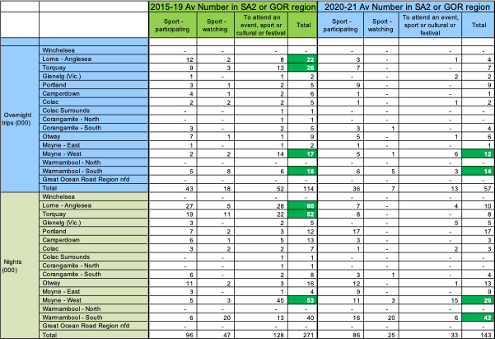
  GOR Visitor Economy as it applies to cultural and sporting events
Figure 1. Annual average number of total domestic overnight visitors and domestic visitor nights with purposes of visit related to particular events/activities in five years ending 2019 and in average of 2020 and 2021 (000s per annum)
This briefing focuses on the first of these methods.
On average across the five years pre-COVID, there were 114,000 domestic adult overnight visitors spending 271,000 visitor nights in the GOR region for the combined purposes of sport participating, sport watching or attending an event, sport or cultural festival.
As was expected these numbers halved in the COVID years of 2020 and 2021, with event purpose visitation falling by 75%.
The area of Moyne West includes Port Fairy which has a range of music festivals. Camperdown also performs well, but this is a less commonly visited area for other purposes.

Slide 26
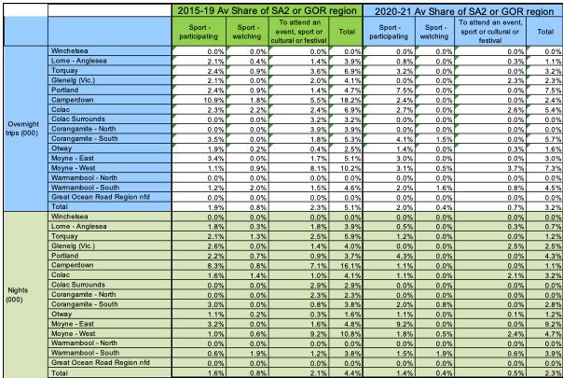
  GOR Visitor Economy as it applies to cultural and sporting events
Figure 2. Share of total domestic overnight visitors and domestic visitor nights with purposes of visit related to particular events/activities in five years ending 2019 and in average of 2020 and 2021
On average in the five years pre-COVID, there were 5.1% of the total domestic adult overnight visitors spending 4.4% of the total visitor nights in the GOR region for the combined purposes of sport participating, sport watching or attending an event, sport or cultural festival.
Looking only at event purpose visit, these visitors represented 2.3% of all domestic adult overnight visitors spending and 2.1% of domestic visitor nights in the GOR region.
Source: TRA, National Visitor Survey data

Slide 27
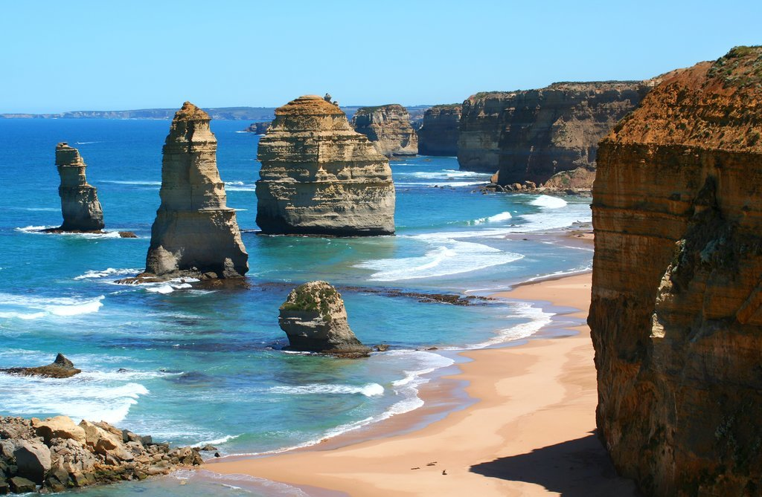

Slide 28
4. Our Project Methodology

Slide 29
Task 1 : Inception & Situation Analysis
Task 2 :
Traditional Owner and Stakeholder Consultation
Task 3:
Utilisation Strategy Development & Draft Plan
Task 4:
Reporting
Overall Project
Framework

Slide 30
  Four Tasks to the Project
To meet the project objectives of this project, being:
Deliver a strategic approach to utilising the Great Ocean Road region's Crown land reserve to improve year-round visitation, broaden use types, improve access to land for all people and to deliver positive economic impacts to our regional communities.
To ensure that Crown land reserve activities are complimentary and are not detrimental to our coastal environment.
Work with our traditional owners’ groups to understand their commercial aspirations and identify opportunities to activate and utilise the Crown land reserves.
That there is a clear strategy to attract and successfully support major events.
That an appropriate fee structure is applied consistently for all land use.
A plan of supportive infrastructure which is supported under the MACA (Marine and Coastal Act). Supportive infrastructure could include small scale items such as power and communications upgrades but also include large items such as seasonal worker accommodation.
We have created a 4 Task model being:
Task 1 – Inception & Situation Analysis
Task 2 – Traditional Owner & Stakeholder Engagement
Task 3 – Utilisation Strategy Development which then feeds into the Draft Report
Task 4 – Preparation of the Final Report
In that methodology we have also recommended a further two options in addition to the quoted project.
1. Market Research and product testing
2. Statutory planning advice on any new products
We have set out the pricing for those two options in the fee proposal.

Slide 31
The purpose of undertaking a Situation Analysis is to ensure that the project is built on solid evidence-based foundations and is undertaken in an efficient and timely manner. It will comprise of:
Our current situation analysis will focus on key strategy areas such as:
      Analysis of current Crown land utilisation under the control of GORCAPA
      Issues and opportunities including but not limited to events
        Impacts and delivery of breadth of desired GORCAPA outcomes
        Traditional Owner engagement
        Wider context including adjacent land uses and further GORCAPA Crown land acquisition, infrastructure issues and perspectives of rights holders and stakeholders etc
      Our detailed methodology in undertaking the Situation Analysis and Inception is outlined below.
Task1 : Inception & Situation Analysis
Task 2 :
Traditional Owner & Stakeholder Consultation
Task 3:
Utilisation Strategy Development & Draft Plan
Task 4:
Reporting
Situation Analysis
Preliminary Event Option Analysis
Desktop Analysis of Site Options
Environmental Audit
Competitor Product & Fee Analysis
Seasonal Worker Needs Analysis
Project Inception
Task 1:
Inception & Situation Analysis

Slide 32
Situation Analysis & Research
Item | Action
Project Inception | For the purposes of this submission and to aid discussion (and agreement or amendment) at the inception meeting, we have interpreted the Project Goals and Objectives to include a Crown land Utilisation Strategy that will deliver: An analysis of the current Crown land utilisation and highlighting issues and opportunities. A rapid scan product audit across the GOR and insights from stakeholders indicating wider supply and demand gaps and opportunities across GOR that may be appropriate for GORCAPA’s remit. Criteria to enhance transparency around ‘products’ GORCAPA will proactively seek to support and will contribute resources to assist delivery and ‘products’ GORCAPA will be an enabler, allowing operators to deliver but with no additional resource contribution from GORCAPA. A framework for analysis of economic (including detailed fee structures) and non economic outcomes, including events. Strategic direction for growth to deliver GORCAPA desired outcomes including but not limited to: Themed draft reports for Task 3 - fee structure, events, infrastructure needs, seasonal worker accommodation, and use of priority target land parcels. Additional insights (adding to the Caravan Park project findings) that are likely to cross several themes such as: Further development of the externally facing GORCAPA Brand, and points of difference Interconnections between CP use and Crown land use – events can drive off-season revenue in CP Insights to assist Investor prospectus development A summary of infrastructure needs to better facilitate existing or new activities Potential operator checklists on needs and capacity for use of GORCAPA sites Identified learnings for lease licensing agreements Following this meeting a detailed updated project plan and timeline will be provided to the Authority clearly stating the expectations, deliverables, project milestones and hold points for review. It will include a Stakeholder Engagement Plan that forms the base on Task 2.

Slide 33
Inception & Situation Analysis
Item | Action
Co-Design | Whilst GORCAPA has provided a detailed project brief, we believe that it is still important that the principles of co-design apply to this project. This is to ensure that our interpretation of the needs of the project actually reflects the needs of the stakeholders. Every project brief is read through the eye of the beholder and can be interpreted in many different ways. In our experience, to guarantee a successful project outcome, one of the first steps in a complex project such as this is to bring the Project Control Group together very early and conduct a comprehensive Project Inception meeting. The principles of co-design demand an inclusive participative and respectful discussion at the inception meeting to ensure that there is commonality across the group in respect of those key principles. This meeting would involve a detailed discussion across all key elements of the project including at its most basic - ensuring each member of the Project Working Group and ODIN360 all have the same project understanding around the Who, What, Where, When, Why and How.
Outcomes Focussed
Inclusive
Participative
Respectful
Adaptive
Principles of Co-Design

Slide 34
Situation Analysis & Research
Item | Action
Environmental Audit | Review all relevant Crown land policies, procedures and documents relevant to the project including those documents detailed in the project brief together with any other relevant materials. We will also seek access to the relevant event policies of each LGA. From these documents, we will identify the key items which will provide the opportunities or challenges for the project. We will undertake an analysis of Tourism Research Australia and relevant visitor economy data focussing not only on the general tourism market but also sports, festivals and events related travel to the Great Ocean Road. As part of the Caravan Park Revenue Management analysis we have already undertaken significant primary and secondary research around accommodation demand and supply. Our work to date has included detailed commercial accommodation supply analysis across the region across resorts, hotels, AirBnB and caravan parks. This will be undertaken as part of the CCPP project. We also have data from STR Global and the Caravan Industry Association of Australia to determine demand through both peak and off peak periods. We will utilise this work as part of the initial audit of available material as well as extend it further around the themes of infrastructure requirements, specific use of priority land parcels and short term worker accommodation.
Site Options | It will be critical to understand how each parcel of Crown land is currently being utilised – for what purposes, how often, when, by whom and how successful or otherwise the current usage is? We cannot hope to develop a strategy for Crown land if we do not fully understand its current usage and what facilities currently exist on or near each of those parcels of Crown land. This analysis will be undertaken in the context of whether the current usage improves year-round visitation and access as well as whether it delivers positive economic and social impacts to the region and the local community. Another key factor is whether the current Crown land reserve activities are complimentary, and not detrimental to the coastal environment. From this fully informed position of current Crown land activities, we will be able to determine which parcels of Crown land are being over or under utilised and also why that is the case. We can then determine which sites then have the potential to provide opportunities for strategic growth that will holistically benefit the region and its residents and businesses into the future.

Slide 35
Situation Analysis & Research
Item | Action
Preliminary Event Option Analysis | Along with understanding the current activities taking place on Crown land, it will be essential to analyse the current portfolio of events that occur on or nearby to Crown land. This needs to occur across all genres of events held in the region, right from community (e.g. markets or fun runs) through to major events like the Rip Curl Pro and the Cadel Evans Great Ocean Road Race. All available event evaluation data will need to be analysed including, but not limited to, the following for each event (where available): Duration Total unique and cumulative attendance Visitor numbers, place of origin, length of stay and expenditure Genre – community, mass participation, major event, etc. Community engagement and support Media coverage and profile Satisfaction levels Any other research or evaluation data Use of existing facilities Fees paid, waived or cost of hosting All of the above events will also then need to be examined from a broader context of overall seasonality peak and off-peak capacity, available accommodation and other tourism infrastructure and other capacity constraints: Facility audit – What infrastructure is currently in place? How old? Is it for purpose? What are the key future infrastructure requirements to facilitate growth or new product? Restrictions on future growth? Areas for potential growth? Seasonality and occupancy levels across each month Weather across each month Diversity of event product and genre Weekend v. weekdays Gap analysis – Where are the gaps in the calendar? What genres appeal? ? Competitor analysis – What utilisation activities are working in other regional locations? Brand fit with GORCAPA’s key attributes One-off v. annual v. regular

Slide 36
Situation Analysis & Research
Item | Action
Seasonal Worker Needs Analysis | Analysis will be undertaken in order to understand when and where seasonal workers are most required in the region and for what types of roles. Key questions to be answered are, how many are required, as well as how to best attract them? Also it will be key to analyse where any new seasonal worker accommodation is best suited. Additionally, it will be key to understand if GORCAPA’s existing assets (i.e. its caravan parks) play a major role in addressing this issue. Then it will also be key to examine how this accommodation can potentially be utilised when not being used for seasonal workers (i.e. school groups, etc.)?
Competitive Product & Fee Analysis | We will review other similar Council fee structures for land usage, and outline how they charge fees for use of Council owned or controlled Crown land, as well as how this is structured for both for profit and for not-for-profit events or other uses. These insights will assist in the development of new product and ensuring a fair and consistent fee structure for a range of events and other uses. As part of this analysis, we will also look to examine how regional competitors deal with the issue of a competitive market for events, and how the overall economic and social impact of a potential event is taken into account when attempting to attract events who may be able to choose from multiple destinations and demand event hosting fees.

Slide 37
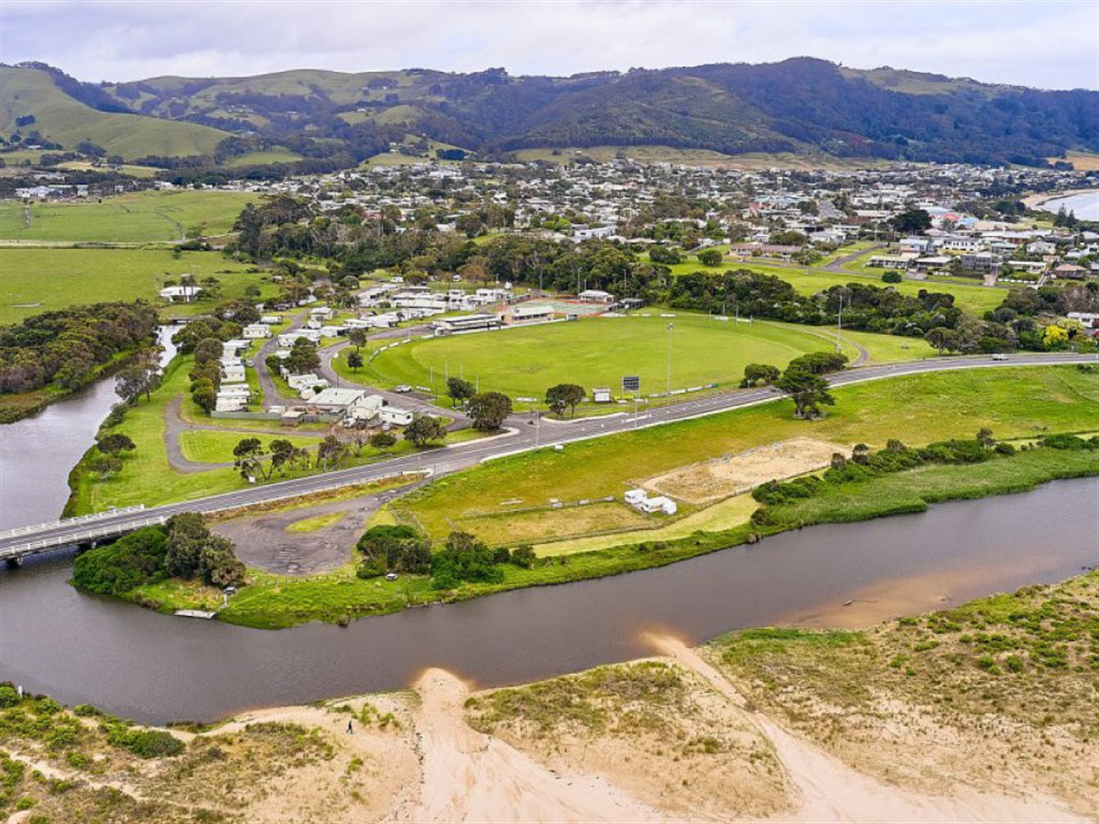

Slide 38
Task1 : Inception & Situation Analysis
Task 2 :
Traditional Owner & Stakeholder Consultation
Task 3:
Utilisation Strategy Development & Draft Plan
Task 4:
Reporting
We have 3 guiding principles for our engagement and consultation processes:
True engagement must allow the Rights Holder, Public and Stakeholders to be involved and influence the outcome.
First Nations communities are not just stakeholders – they are rights holders. As “First” implies – they traditional owners should be consulted first and on a continuing basis.
3. Building social license is imperative. It takes a whole community to welcome and take care of visitors.
We also follow the recommended processes for community and stakeholder engagement issued by the International Association of Public Participation (IAP2) model. This is generally regarded as best practice.
Partnering with GORCAPA to inform the Engagement Plan will support an inclusive outcome. Although stakeholders are grouped generally below, we understand there is nuance in each group and will work with GORCAPA to confirm key stakeholders for targeted participation including, but not limited to, the traditional owner rightsholders - Eastern Marr and Wadawurrung, and community and other stakeholders to the project who have key contributions to the conversation.
Much of the engagement will be face to face but some will be online as may be appropriate.
Task 2:
Traditional Owner and Stakeholder Engagement

Slide 39
  TO, Stakeholder and Community Engagement - Indicative Engagement List
In addition to GORCAPA, its member / supporter Local Councils and the Project Steering Committee, we will also undertake extensive engagement and consultation with the following groups
Stakeholder Group​ | Description​ | Names | Engagement tools​ | IAP2​
Group 1​ | Traditional Owner Rights Holders | EMAC, Wadawurrung | One on one interviews/meetings​ | Involve​
Group 2​ | Key Visitor Economy Stakeholders​ | Great Ocean Road Regional Tourism | One on one interview | Consult​/Collaborate
Group 3​ | Local Councils | Economic Development and Events Managers (or similar) from the local Council’s interfacing with the Authority | One on one interview | Consult​/Collaborate
Group 4 | Key Traders | Commerce Torquay Business and Tourism Anglesea Aireys Inlet Tourism and Traders Lorne Business and Tourism Apollo Bay Chamber of Commerce Port Campbell Business and Traders Association A selection of current licensed tour operators operating in the Great Ocean Road region | Workshops/ Meetings | Consult​/Collaborate
Group 4​ | Visitors to GOR region (option) | Undertaken across 3 major visitor markets: Melbourne, Regional Victoria and New South Wales. | Qualitative consumer research online survey (option) | Consult​
Group 5​ | Local Community​ | The GORCAPA Community Representative Committee | Workshops/ Meetings | Consult​

Slide 40
Our Proposed Consultation and Engagement Processes
Respectful
Culturally Aware & Informed
Continuing, Open & Transparent
Understand what Success looks like for all
Legacy Outcomes that meet Goals
Agree
Engagement Framework
Listen, Listen, Listen
Build Mutual Trust

Slide 41
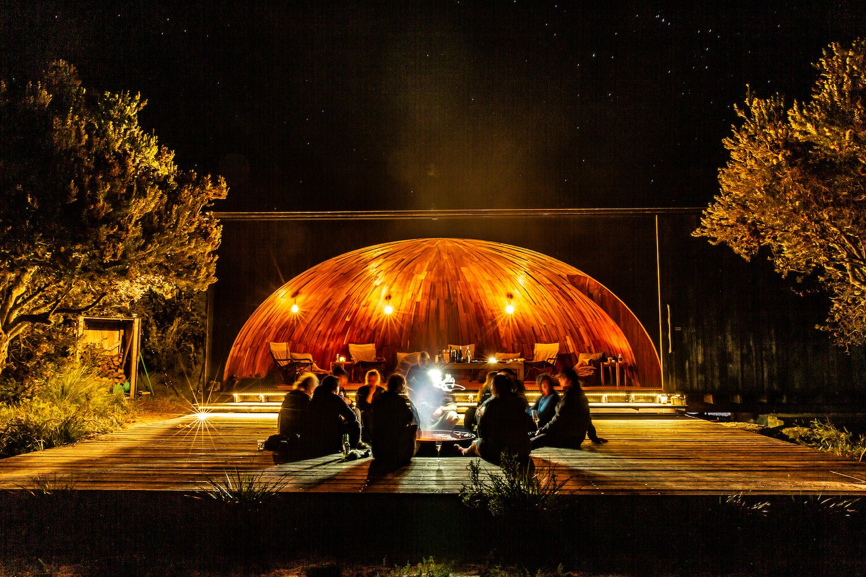

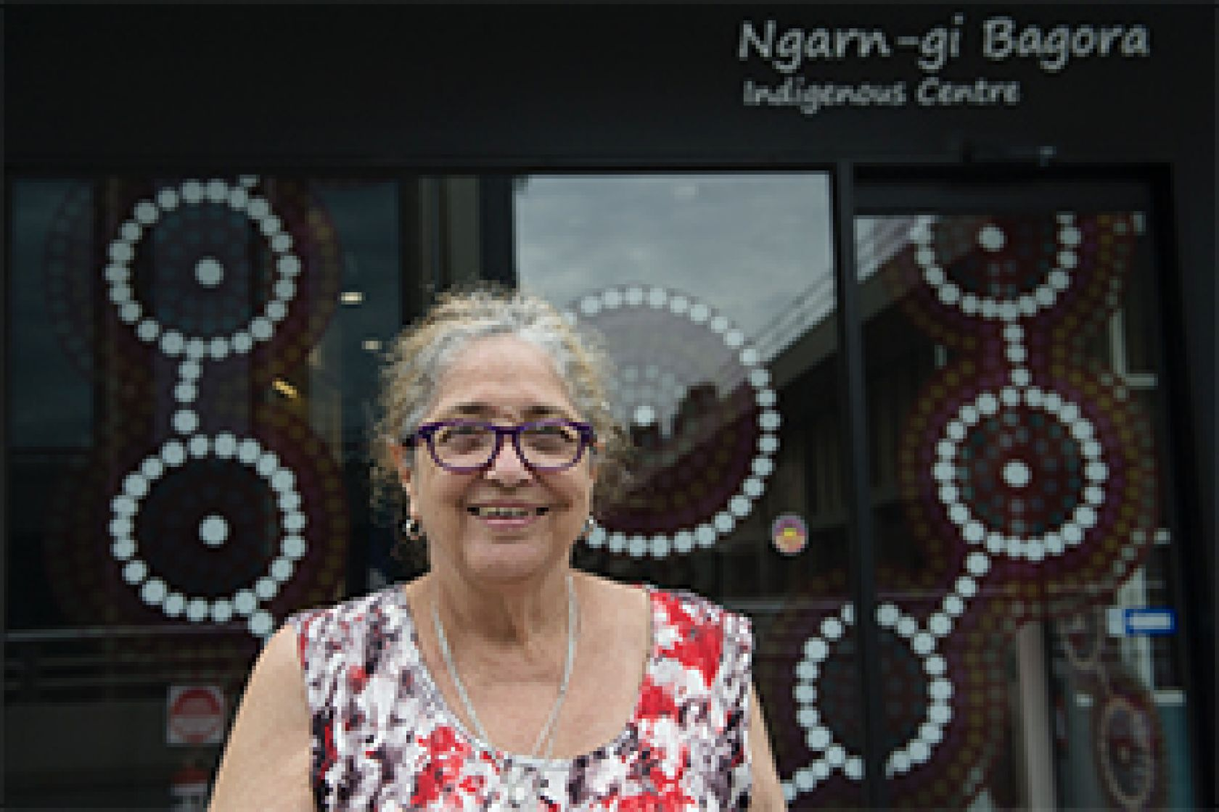

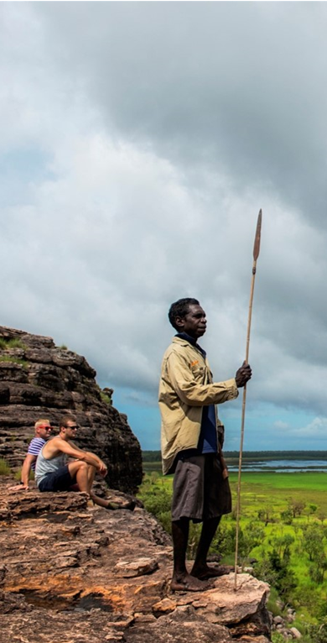
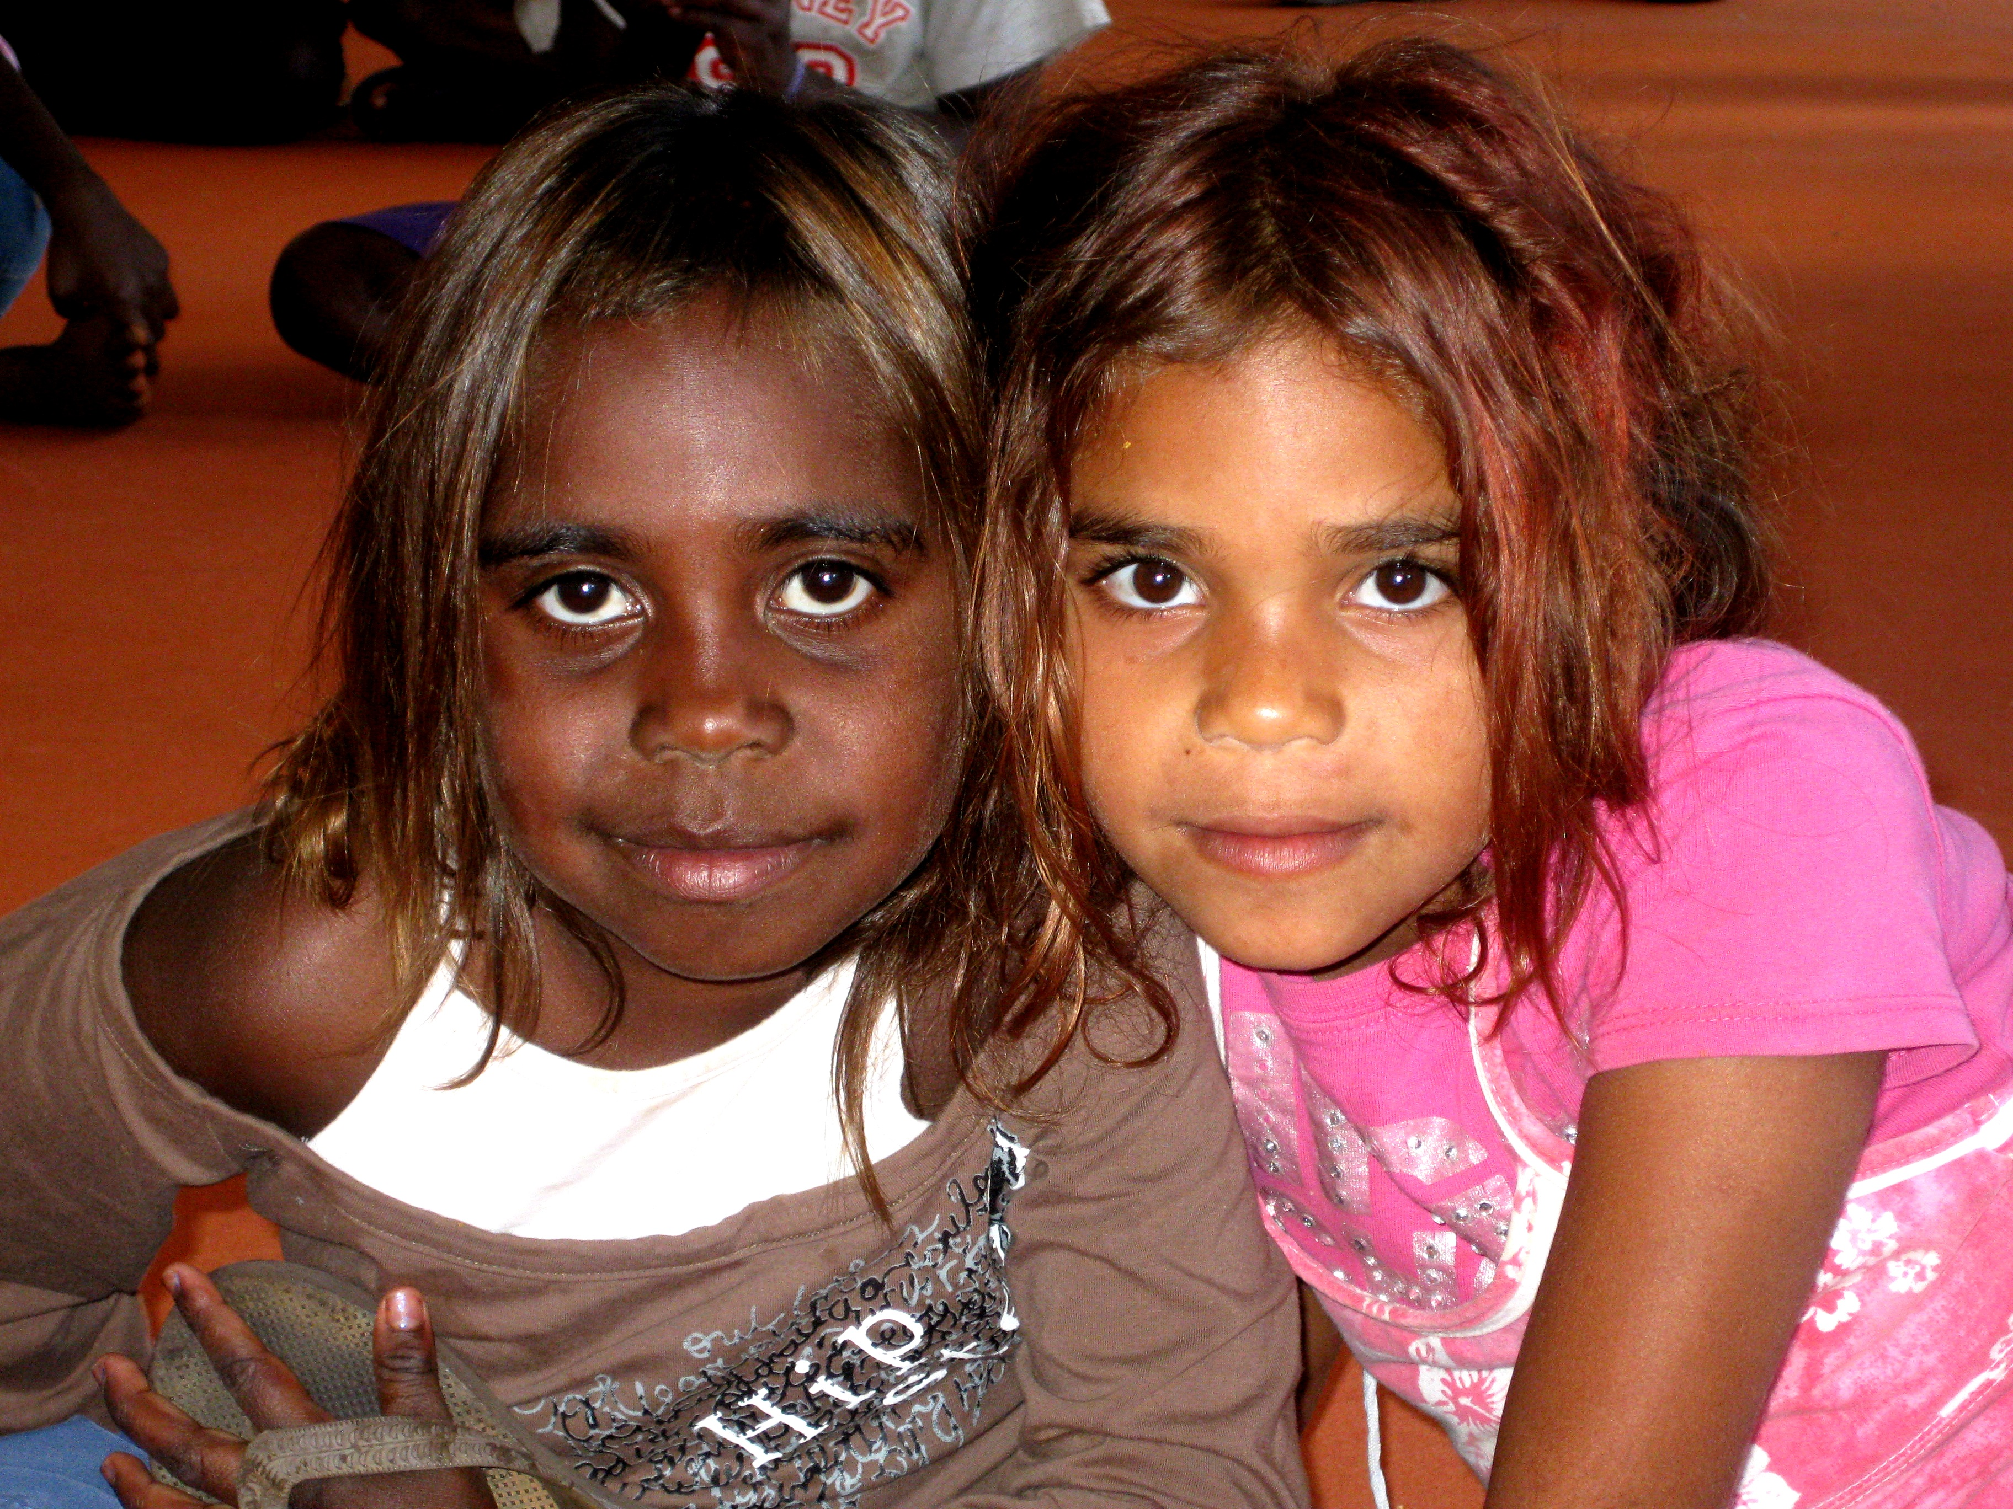



Our Experience in Consultation with First Nations Programs
Korin Gamadji Institute Advisory Committee
Aunty Joy Wandin Murphy
Prof Marcia Langton
Prof Lois Peeler
Andrew Jackamos
Philip Egan
Leon Egan
Rob Hyatt
Jason Mifsud
Luke Murray
Steven Wright (committee organiser & facilitator)
Engagement with Palawa
and Development of
Wukalina Walk
Larapuna (Bay of Fires)
Program Concept, Feasibility
& Development – creation of, and engaging with, senior Indigenous Advisory Group
Aunty Joy Wandin Murphy
Wurundjeri Elder
Program Concept & Development – Engagement by Essendon through Long Walk
Aboriginal Tourism Strategy 2030
Tigers In the Territory
Annual Program
Destination Management Plan
Commencing Engagement with Wurundjeri
Woi-wurrung

Slide 42
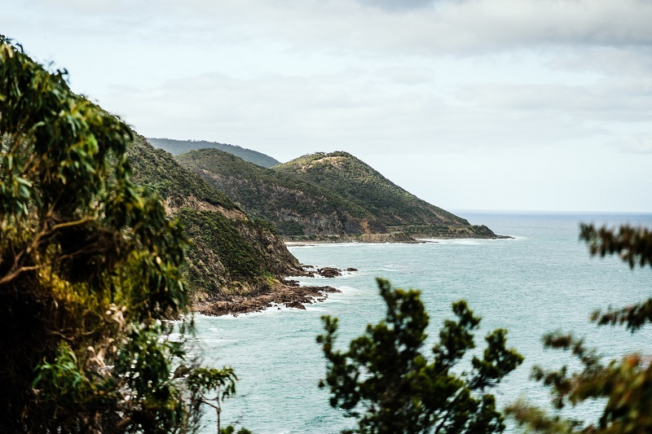
Notes:
The Gordon Culinary School will undergo a complete transformation, upgrading their existing training facilities and campus environs to provide a more connected, activated and immersive hospitality training precinct.

Slide 43
Task1 : Inception & Situation Analysis
Task 2 :
Traditional Owner & Stakeholder Consultation
Task 3:
Utilisation Strategy Development & Draft Plan
Task 4:
Reporting
Task 3 of the proposed methodology involves a comprehensive development of the Utilisation Strategy through a series of key assessments. This brings together the situation analysis and stakeholder engagement process outcomes and includes them in a significant amount of ideation, site analysis, fee planning, cost planning, outcome analysis and economic analysis.
The process through which this work will be undertaken is detailed on the following pages. This process will lead to the development of a Draft Report with the following elements:
Fee Framework
Prioritised Options
Prioritised
Sites
Prioritised infrastructure costs
High Level Cost Benefit
Detailed Assessment Criteria
Event
Attraction
Plan
Task 3:
Utilisation Strategy Development
Optional Planning Analysis
Optional Market Research & Event Product Testing
Draft Report

Slide 44
  Utilisation Strategy Development
Item | Action
Ideation - Events, Accommodation, Experiences, & Other including synthesis of Situation Analysis & Rights holders and Stakeholder outcomes | Based upon the key findings and learnings from the Situation Analysis and the key stakeholder consultation, we will commence a detailed ideation process whereby we will put forward a number of Crown land utilisation activities / activations which are most likely to drive and maximise the economic, social/ cultural and environmental benefits for the region. The key to this ideation process is ensuring that the key parameters identified by GORCAPA are met for each proposed activity, namely that each activity or activation will deliver on one or more of the following impacts: Increase year-round visitation to the region Increase Crown land access for all people Deliver a positive economic or wider contribution to local communities Is in line with Traditional Owner and/or community expectations
Physical Site Inspection of Prioritised Locations | In order to ensure that the proposed Crown land activities enunciated through the ideation process have the best possible chance of success, it will be necessary to identify the optimal sites that can meet the needs of attendees at those activities. This will require first-hand physical site inspections to understand the pros, cons and opportunities for each of the priority locations identified through the ideation process. This is critical to ensure that each priority Crown land site has been reviewed thoroughly and any potential immediate infrastructure requirements (i.e. power, water, amenities, fencing, parking etc.) are outlined and considered before allocating as a priority for future utilisation.
Development of Prioritisation Matrix | In order to facilitate an objective decision making process for future Crown land activities, it will be necessary to develop a Prioritisation Matrix. This Matrix will enable GORCAPA to compare and contrast activities across a range of genres and balance competing interests. Based on our knowledge of GORCAPA’s key objectives, a repeatable scoring and priority system will be developed which will grade and rank competing Crown land activities. Ultimately, the scoring, criteria and weighting system will need to be agreed with GORCAPA, and also which factors should be weighted higher than others i.e. Do visitor numbers and expenditure outweigh community engagement? Do activities that align with GORCAPA’s key brand attributes outweigh an activity that may generate a higher economic outcome?

Slide 45
  Utilisation Strategy Development
Item | Action
Initial Update to GORCAPA | A detailed update on the project’s progress will be undertaken with GORCAPA in order to showcase the outcomes from: The ideation process The prioritisation of parcels of Crown land The Prioritisation Matrix including the proposed criteria, scoring and weightings given to individual factors to enable an objective process for decision making and Crown land utilisation prioritisation. GORCAPA feedback at this stage will be fed into the process to ensure it aligns with key deliverable objectives.
Initial Indicative Costings | Indicative costings will be provided which will outline potential: Minor infrastructure investment required to upgrade and/or ensure a parcel of Crown land is able to host an activity or activation Activity hosting fees e.g. for additional major event content Operational costs if GORCAPA were to manage and host the activity as opposed to outsourcing management Please note that any major infrastructure requirements will be outlined, but no detailed costings provided.
Sustainability Assessment | A sustainability framework will be used to highlight specific aspects that require consideration to ensure activities and/or Crown land enhancements are appropriate under GORCAPA's remit. This includes economic, social/ cultural and environmental sustainability.
High-level Direct Economic Benefit | In order to enable GORCAPA to assess the merits of any of the proposed Crown land activities and/or Crown land enhancements and activations, a high level direct expenditure analysis will be undertaken. This will involve undertaking (where possible) a projection of the likely economic impacts of an activity or activation such as: Projected cumulative attendances Projected number of unique attendees Projected number of visitors Visitor type – day trip v. overnight Visitor origin – intrastate, interstate and overseas where applicable Visitor length of stay Visitor expenditure Organisational expenditure spent as a result of the activity

Slide 46
  Utilisation Strategy Development
Item | Action
Option Prioritisation | GORCAPA will be provided with a prioritised list of parcels of Crown land appropriate for improved activation as well as identifying the type of activities that could potentially occur on these parcels of Crown land. These will be broken down into various categories such as: Traditional Owner Opportunities, GORCAPA Opportunities, etc. A captured list of opportunities that were considered, but not recommended, will also be provided.
Presentation of Options and Opportunities Paper | We will conduct a Workshop with key GORCAPA executives, which will outline the Priorities Options & Opportunities for activities and activation of Crown land to increase utilisation, and also maximise the potential economic, social/cultural and environmental outcomes. Critically, we will take GORCAPA through our process and the reasoning behind our recommendations, along with why some potential opportunities were not prioritised or were excluded.
Incorporation of Feedback into Draft reports | Once GORCAPA’s feedback has been integrated, it will be provided with a Draft Report including each of the following: A Draft Fee Framework including a proposed pricing structure based on type of activity A Draft Event Attraction Plan A prioritised and costed (indicative) schedule of infrastructure needed to: - better support activation of Crown land; and/or - activate Crown land to better support local businesses (e.g. seasonal worker accommodation) A prioritised list of parcels of land appropriate for improved activation as well as identifying the type of activities that could occur on these parcels. This will specifically highlight any opportunities for traditional owner groups. A high-level economic benefit for each recommended activity / land activation to enable GORCAPA to quantify the potential benefit for each recommendation. Clear advice as to the criteria that was used in the prioritisation of the above recommendations.

Slide 47
  Draft Plan Framework
Fee Framework
Development of a fair and consistent fee structure for a range of events and other uses of Crown land for both not-for-profit and for profit activities.
Prioritised List of Options
A detailed list of evidence-based, prioritised Options & Opportunities for Crown land activities and activations for GORCAPA to consider.
Prioritised List of Land Parcels
Prioritised Infrastructure Costs
Detailed Assessment Criteria
Event Attraction Plan
Identification of key parcels of Crown land to be utilised for activities and/or activations to deliver GORCAPA’s key economic and social outcomes.
A summary of proposed Crown land infrastructure costs prioritised by key parcels of land.
High Level Economic Analysis
A summary of direct economic impacts as a result of each proposed activity or activation recommendation.
A comprehensive and objective assessment criteria whereby competing activities/activations can be scored, weighted and ranked for decision making.
A detailed Plan outlining the process by which GORCAPA can attract the key identified events outlined through this process, and how each can positively impact the region from an economic, social/ cultural and/or environmental perspective.
The Event Attraction Plan will assist current event holders, but also future event owners understand the type of event that will be eligible for licensing on GORCAPA land and the range of operating requirements. For instance, there may be continuous improvement requirements around waste management and minimal impact, plus reporting templates to gain next year approvals etc. Simple but meaningful online application forms can be used to show event managers the range of factors they must meet (such as council approvals, vehicle management plans, environmental plans etc).

Slide 48
Optional Planning Analysis
Item | Action
Planning Analysis (Optional) | Our expert planner, Claire Baker will provide comprehensive and strategic advice on the planning issues across the project and would undertake the following proposed planning analysis: Council Liaison - 60 minute online session with each of the relevant Councils to understand the strategic planning context, zoning and overlays and what is happening in practice that will influence the project and approvals. Understand which communities are most active and mobilised in opposing change in their neighbourhoods. Get a sense for any state priorities in this region that may influence the project Strategic Land Use Analysis Matrix - develop a bespoke matrix for the zoning and tourism activities [up to 20 uses] to create a broad assessment of what uses don't need a permit [i.e. BnB in a Rural Conservation Zone doesn't need a permit so could be encouraged in these areas], what needs a permit and what is prohibited. We can colour code with a traffic light system for easy analysis Detailed Land Use Zoning and Overlay Analysis - detailed investigation of areas to assess identified Tourism priority activities. This would be delivered in a highly visual output with the area mapping, zoning and overlay analysis with recommendations of what activities are likely to be supported by Council in each area and identification of further strategic investigations that may be required to answer that question (i.e. environmental considerations including Bushfire Management, Cultural Heritage, Flooding, Vegetation protection).

Slide 49
  Optional Event Product Testing Research
Item | Action
Market Research Process to Test the Appeal and Demand for New Event Products & other Activities (Optional) | To build an even stronger evidence-base, we have also included our Product Appeal and Intention Testing as a value-add. This model has been successfully utilised for other clients such as Barossa Australia, South Australian Tourism Commission, Tourism Western Australia, Regional Development Victoria and Tourism Greater Geelong and the Bellarine. We have designed this research element to test new event products and other activities. We can utilise that model to test any event ideas or products as a value add. This will assist in ensuring any new event products and experiences are based on sound evidence of expected market demand. Our proposed methodology would go to the same respondents as outlined in ODIN360’s other GORCAPA submissions, and would test a range of product options, using visual stimuli and a short narrative to explain it. From the analysis of the data, we would then be able to detail the most appealing new products and experiences, and the market appetite at various price points, as well as comparisons of appetite across different Australian regions, thereby allowing GORCAPA to prioritise its future investment direction. This will be particularly important in refining a future plan to develop the best products and experiences, based on consumer appeal and highest yield. Our Unique Product Appeal and Intention Testing Methodology Working with GORCAPA, we will develop proposed products for testing, after undertaking the survey questions required for the target visitor profiling and preferences. For each product, respondents will be randomly shown a splash screen with imagery and a short textual description of each product. Respondents will be given a scale of 0-10, with 0 being “not at all appealing” and 10 being “extremely appealing” and asked to rate their opinion of the event product’s appeal. Individual event products and experiences will be first tested for their appeal, and then respondents will be asked to rank products in relation to each other. By allowing for overlap in appeal ratings, we will be able to critically examine how events rate in relation to each other.

Slide 50
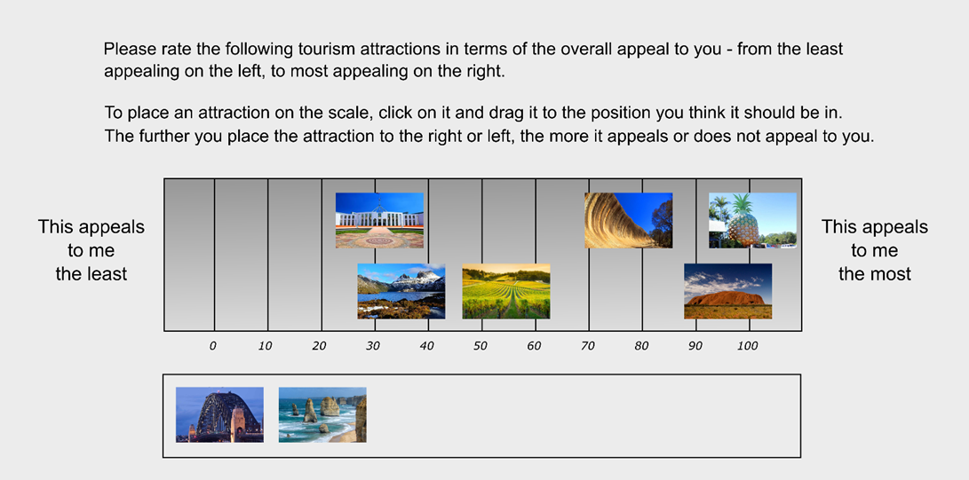
  Optional Event Product Testing Research
Item | Action
 | An example of this question structure is provided below: We prefer the drag and drop function for research, rather than a multiple-choice questionnaire structure where possible (can be done on PCs and laptops but far harder on mobile phones), as it allows for a wider number scale (7.1, 7.2, etc.), as opposed to whole numbers only. When analysed across the entire data set, this feature will allow for a greater differentiation in the overall appeal score eventually assigned to each product.

Slide 51

  Optional Event Product Testing Research
Item | Action
Market Research Process to Test the Appeal and Demand for New Tourism Products & other Activities (Optional) | We believe the best and most accurate visitor profiling requires a comprehensive quantitative research methodology solution. We will use an online permission-based panel sample to source a representative sample of research participants across GORCAPA’s key visitor source markets of Melbourne, Regional Victoria and New South Wales. A representative sample will be from GORCAPA key domestic visitor source markets of both Melbourne and Regional Victoria. NSW residents have also been targeted as they are largest interstate market for visitors and present a significant growth opportunity for GORCAPA. However, we could also potentially focus on GORCAPA’s nearby visitor markets of South Australia and Tasmania if required. The proposed total representative sample size will again be n=1,155-with: n=385 Melbourne residents n=385 Regional Victorian residents who live outside of the GORCAPA region n=385 NSW Residents who would consider a trip to the region This proposed sample size provides a margin of error of ± 2.9% at the 95% confidence interval or +4.9% for each of the three main sub-markets. Critically, this sample size allows for a detailed and robust analysis of key sub-groups to enable key visitor profiling analysis to occur in the questionnaire, our sampling will be set for both age and gender based on Australian Bureau of Statistics data residents. These will be sampling targets rather than hard quotas as the target audience may not be exactly in alignment with the demographics of the Victorian and NSW population. For example, we may find that NSW families are most likely to travel to the region, and if so there may be more aged 25 to 45 in that sample. We will work with our digital marketing research partner Dynata, to access the targeted panel of Victorian consumers. Dynata is a global leader in online data sampling and a trusted provider of comprehensive consumer data collection solutions. With 11 million panelists worldwide, Dynata has the capability to capture data from highly targeted audiences. Dynata is a proud member of the ESOMAR community and only uses its panels for market research, preventing potentially biased responses and ensuring the validity of the samples delivered.

Slide 52
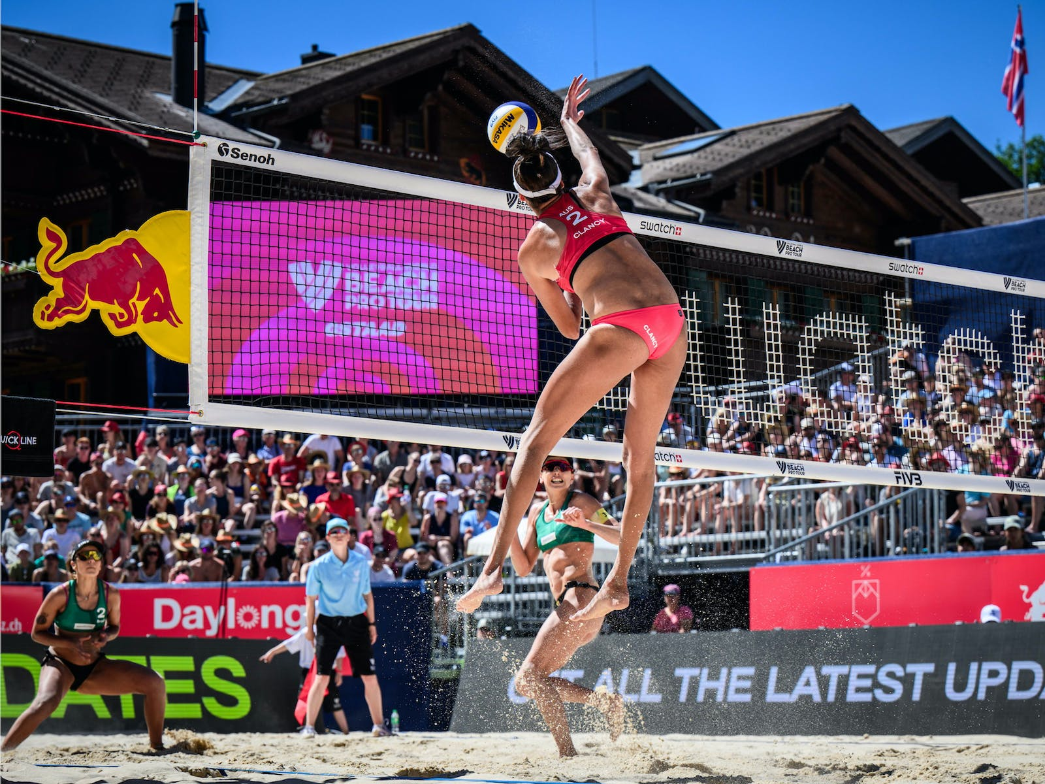

Slide 53
Task1 : Inception & Situation Analysis
Task 2 :
Traditional Owner & Stakeholder Consultation
Task 3:
Utilisation Strategy Development & Draft Plan
Task 4:
Reporting
The output of the project will be a detailed Final Report that covers each of the previous three phases detailed above, including:
Inception and Situation Analysis
Traditional Owner and Stakeholder Engagement
Utilisation Strategy Development & Draft Plan
as well as updating the Draft Report for feedback from the GORCAPA Board or other key stakeholders that has input into the Draft Report.
Task 4:
Reporting

Slide 54
  Reporting
Item | Action
Update Draft Report based on feedback | A process of formalised feedback from GORCAPA will be undertaken to ensure that we are fully aware of any issues, concerns or gaps in our process or methodology and the resulting outcomes. We will work with GORCAPA to amend the Draft Report based upon this essential feedback loop and ensure that the Draft Report addresses and meets GORCAPA’s project objectives.
Create “summary” plan for consultation and advocacy | We understand fully that GORCAPA will need to undertake a series of community consultation around the proposed Strategy. As such, we will prepare succinct and appropriate presentation materials for GORCAPA, which can then be used for this key community consultation process.
Deliver and present to the Authority Board the Draft Final Strategy | We fully understand that engaging and informing the GORCAPA Board around the process and formulation of the Crown land Utilisation Strategy is key to secure buy-in. As such, we are committed to presenting the Strategy to the GORCAPA Board as well as taking them through the thorough process, methodology and key findings used to arrive at the final outcome. This will again be a process to receive feedback and ensure that any required changes are made to the Final Report to reflect the GORCAPA Board’s feedback.
Delivery of the Final Strategy, incorporating final Authority Board Feedback | Once all feedback from the GORCAPA Board has been incorporated into the Final Report, we will provide GORCAPA with the final Crown land Utilisation Strategy Report.

Slide 55

5. Relevant Project Experience

Slide 56











  Our team has led senior management & CEO roles in these Tourism & Event companies

Slide 57













  Our Teams’ current clients include, amongst many others:

Slide 58
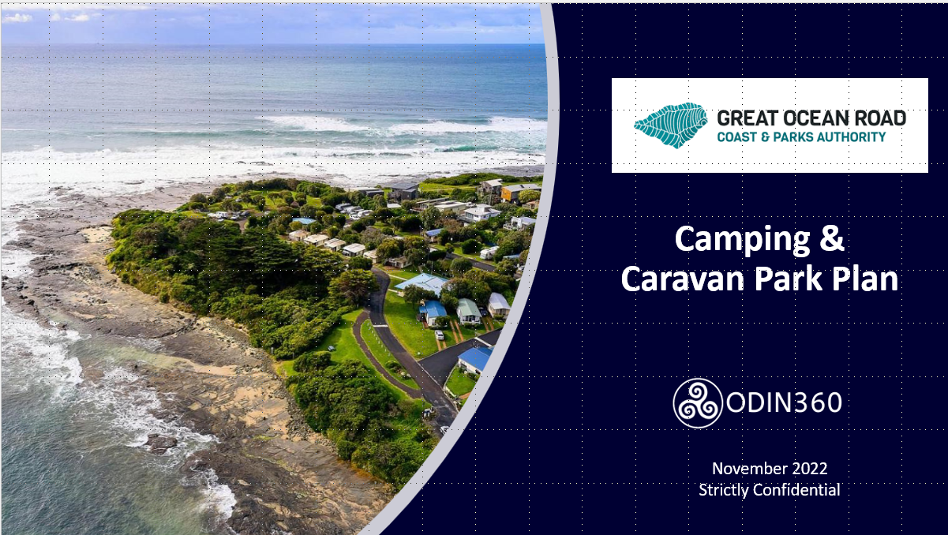
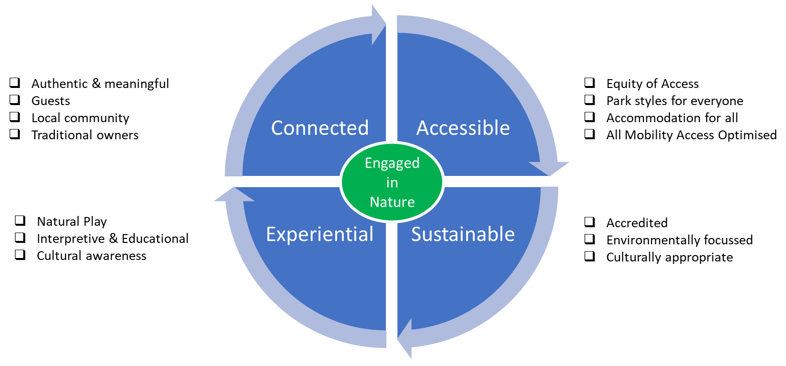
  Snapshot of relevant recent projects undertaken by the Project & Specialist team
Case Study – Great Ocean Road Coast and Parks Authority
Caravan Park and Campground Plan
Steven Wright and Claire Ellis are currently finalising the Caravan & Camping Park Plan for GORCAPA. The purposes and outcomes of that plan are directly relevant to this project. That plan proposes a new structured park framework as well as an overarching brand essence and architecture. Ideally, these will also apply to the Trails and Land Utilisation projects as that is part of its proposed purpose. It would provide a brand framework to sit across relevant GORCAPA commercial activities that engage with the consumer.
The parks themselves are likely to host several of the proposed events or activities or otherwise will be the prime accommodation provider for those events.
They are also the most likely locations for new seasonal worker accommodation
GORCAPA PARKS
Premium Holiday
Traditional Caravan
Beachside Foreshore
Recreation Reserve
Bush Camps
Boutique
Proposed Brand Essence and Attributes
Proposed Park Style Framework

Slide 59
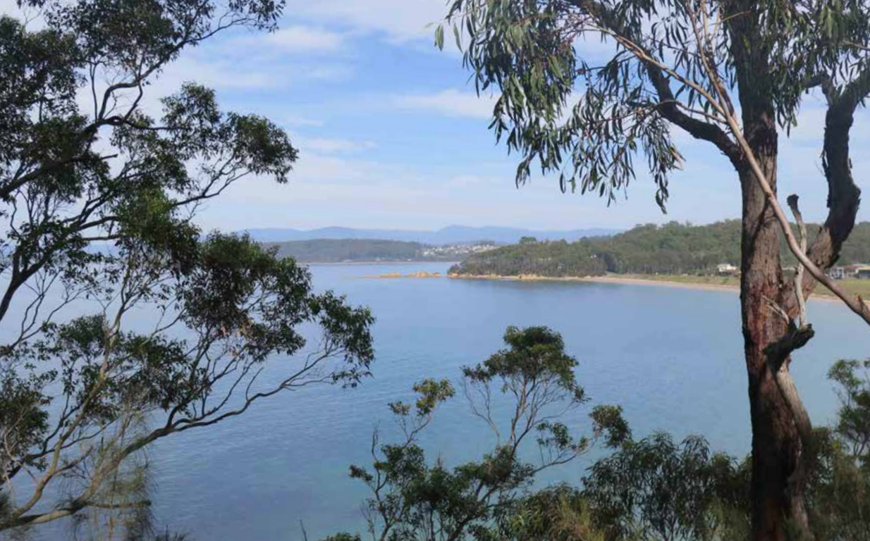
  Snapshot of relevant recent projects undertaken by the Project & Specialist team
Case Study : NSW National Parks & Wildlife Service
Murramarang – NSW South Coast Walk
Claire Ellis was contracted across 2019 to undertake an analysis of the proposed Murramarang South Coast Walk for NSW National Parks & Wildlife Service.
While providing insights into demand, the specific output was to focus on the capacity to deliver various visitor experiences that aligned with potential walker segments and identify the current capacity and level of interest of the existing tourism (and allied) industry in creating products and experiences around the Murramarang South Coast Walk.
The Murramarang South Coast Walk, proposed four-day, 39km walk alongside stunning beach and lake vistas, with access to accommodation in five local villages and on-park is quite different from many National park wilderness walks where road access is non existent or limited. This walk combines the pristine beauty of Murramarang National Park with Batemans Bay, Durras, Pebbly Beach and Kioloa villages to finish at Bawley Point. The walker can choose from luxe accommodation in resort villas, affordable beach shacks or cabins, or go with self-reliant camping. The proposed walk will provide an excellent walking hub with further opportunity for the Shoalhaven and Eurobodalla Councils to extend the walking trail network. The walk is also perfectly suited to being undertaken as individual day walks.
Unfortunately this area was subsequently seriously impacted by the 2019/20 bushfires, altering the progress of this project.

Slide 60
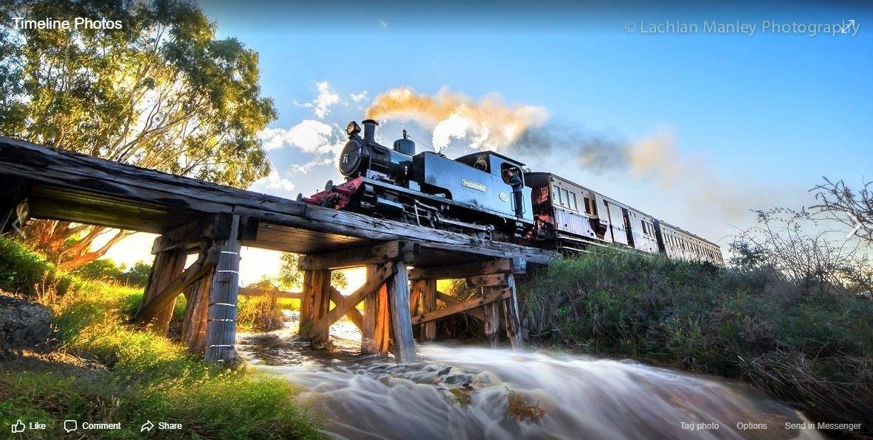
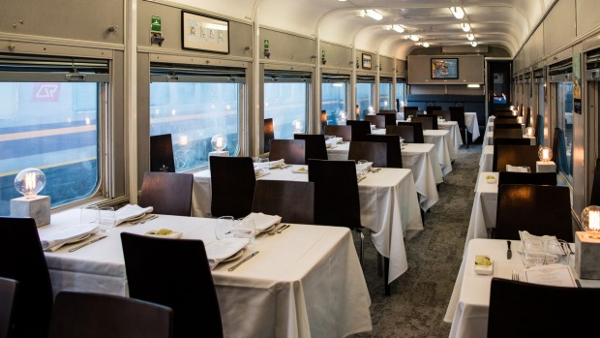
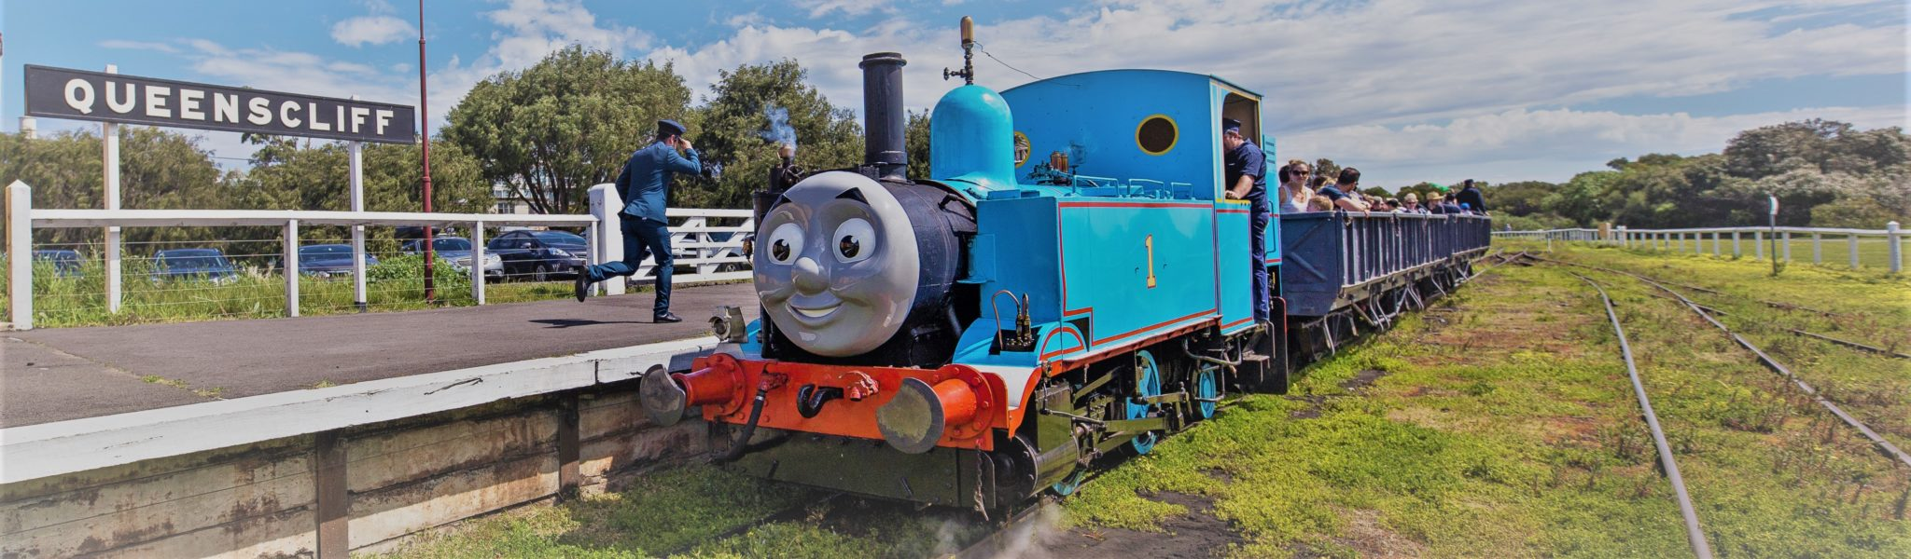
  Snapshot of relevant recent projects undertaken by the Project & Specialist team
Case Study: Tourism Greater Geelong & The Bellarine (TGGB) and Regional Development Victoria (RDV) for Bellarine Rail, Q Train and Blues Train
Commercial Optimisation, Market Research, Product Testing and Product Development
Bellarine Rail (BR) is a heritage rail service that runs between Queenscliff and Drysdale. BR operates a range of services from premium to family to basic. It partners with the QTrain to provide a premium food and beverage dining experience and supports Hugo Armstrong with the Blues Train, a night time “party” style music event . It also runs Thomas the Tank Engine rides for children as well as a heritage rail services.
It recently secured $5.3 m in funding from the State Government to upgrade its infrastructure and facilities. Similarly to GORCAPA, it will now have significant on-going maintenance costs but also the opportunity to develop new products to maximise the commercial opportunities the new infrastructure brings.
Given the complex stakeholder mix and that product development was beyond the capability of the volunteer BR committee, ODIN360 was appointed by TGGB and RDV to undertake this project The scope included:
Significant consultation and engagement across a divers and “challenging” group of stakeholders
Detailed market testing on the commercial potential of the new rail infrastructure and preliminary product scoping
Product development
Product testing vis market research
Cost benefit analysis of the recommended products.
This work has just been completed and six new products have been developed. BR is currently in the process of planning for the implementation of the new products, once the infrastructure upgrade is complete.

Slide 61


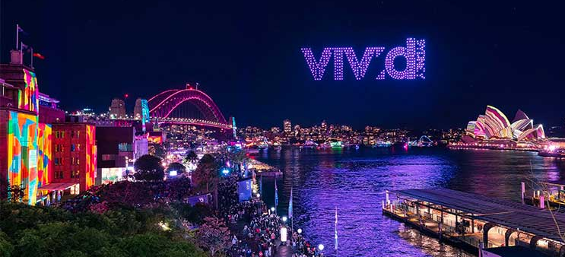
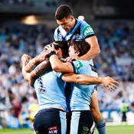
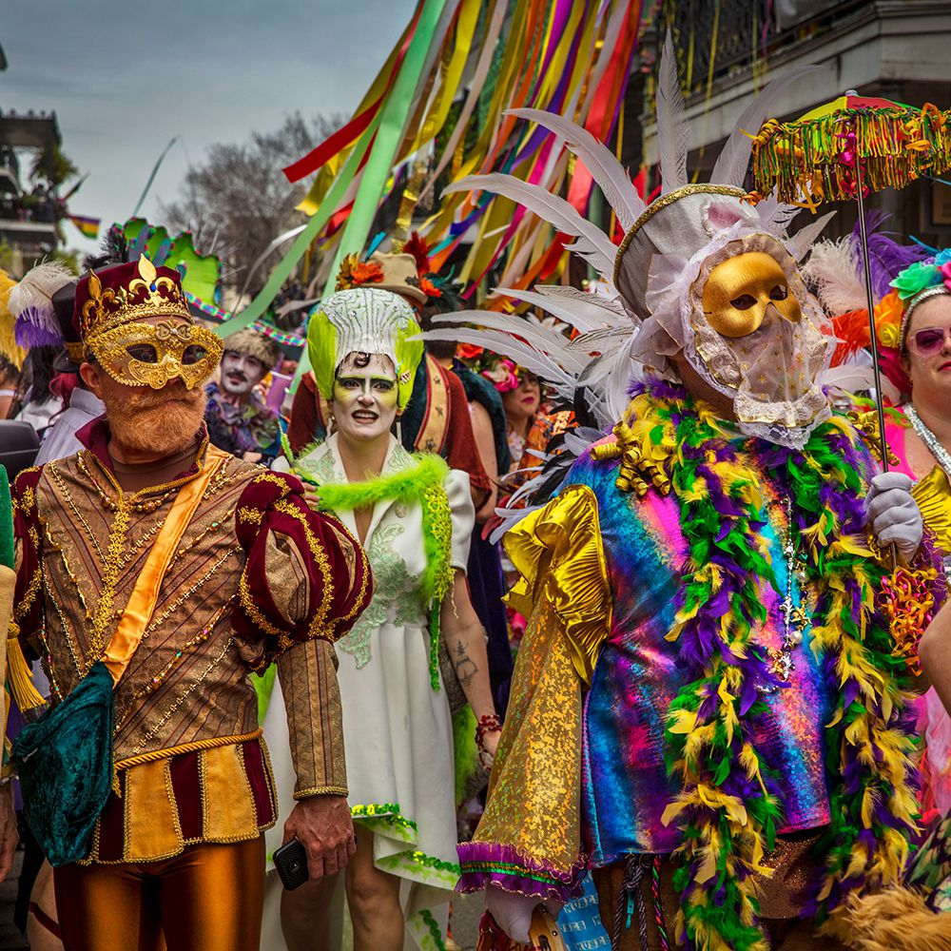
  Relevant Case Studies
Case Study – Events NSW / Destination NSW
Development of a Best-Practice Major Event Strategy & Evaluation Platform
CLIENT NEED
James Paterson was one the foundation employees of Events NSW (now Destination NSW) in 2008. Soon after it was formed, Events NSW needed to build and develop a globally recognised major event strategy for NSW. As part of this process, James developed the KPIs and research and evaluation systems processes and templates used to assess potential event investment and performance. He also created best in class pre and post major event research and evaluation systems which were then used this as an area of unique competitive advantage.
APPROACH
James undertook a comprehensive Review of the existing NSW major event portfolio to determine which events had development and growth potential and which were unlikely to be successful in the longer term. He then established a strategic and systematic approach to event investment to maximise ROI and ensure key stakeholder support. He developed key event criteria which meant major event investment was only given to those events that could deliver the key outcomes sought, ensure maximum ROI and align with the brand values of Sydney and NSW. He then developed and framed a superior and comprehensive holistic event evaluation framework to measure the economic, brand and community impact of all genres of events.
KEY OUTCOMES
A world-renowned major event strategy and research evaluation system was implemented which continues to deliver key strategic economic, brand and community outcomes for NSW and its residents.
The first ever NSW master event calendar was created and made a KEY focal point for driving intrastate, interstate and international visitation.
The NSW major event strategy was used as a key driver to successfully achieve the NSW Government’s target of doubling visitor expenditure by 2020.

Slide 62

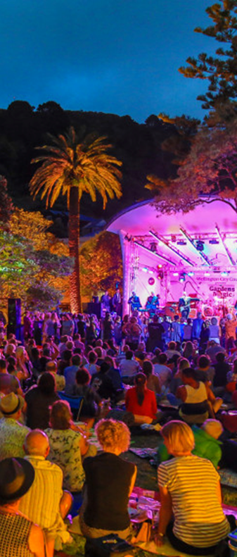
  Relevant Case Studies
Case Study – “WellingtonNZ” – WCC’s economic development agency
Major Event Review & Strategy Development
CLIENT NEED
WellingtonNZ – the economic development arm of Wellington City Council in New Zealand, required assistance in developing the foundation elements of Wellington’s Major Events Strategy. This process was designed to provide a strategic platform for future major event success, with the aim of providing a refreshed calendar of unique events to ensure Wellington remained a vibrant, exciting city that has the capacity to not only attract domestic and international visitors but also offer its residents a wonderful place in which to live, work, study and play.
SOLUTION
In consultation with WellingtonNZ, James Paterson developed the key elements of the strategy development process via three distinct phases. Initially, he undertook a comprehensive information discovery phase encompassing: extensive document review of current event and tourism landscape; regional major event trends; competitor analysis; key supply and demand side constraints; gap analysis; funding comparisons; and a thorough review of its current event portfolio and ROI modelling.
The next phase involved extensive internal and external stakeholder engagement. This included community and key stakeholder surveys plus a series of depth interviews to ensure comprehensive engagement. An internal workshop was conducted to examine the divergent views and issues and identify the potential opportunities and risks.
Task three was a key opportunities workshop with senior WellingtonNZ management to convey the key insights and identify Wellington’s unique selling points and its strengths and weaknesses. This then developed into a key set of recommendations developed in consultation with WellingtonNZ, producing a comprehensive overall strategy report.
CLIENT OUTCOME
WellingtonNZ embraced the key recommendations of the strategy and is now developing a public-facing document which clearly articulates Wellington’s, and the region’s, major event priorities, criteria and formula for success.

Slide 63

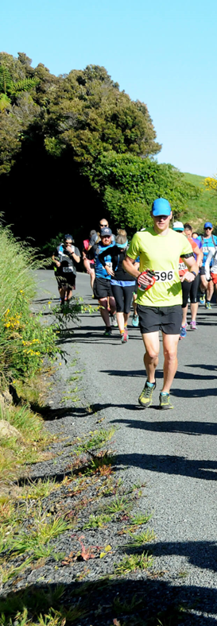
  Relevant Case Studies
Case Study – Upper Hutt City Council (NZ)
Regional Event Strategy & Planning
CLIENT NEED
The Upper Hutt City Council (UHCC) is responsible for the event economic development of its local government area near Wellington, New Zealand. Given the natural landscape advantages of the region and increasing costs to operate events, UHCC sought to understand how their current event strategy and operating model could be optimised to increase economic return. A new strategic approach to events needed to better consider the interaction between; the values of the local community, its landscape and infrastructure, which events would drive substantial economic returns, along with the strategic brand fit for the region to ensure a sustainable plan moving forward.
As COVID-19 had a catastrophic impact on events across New Zealand, UHCC also saw this project as an opportunity to shift the focus as to how events could assist in the local economy recovery while simultaneously assessing the future beyond COVID-19.
SOLUTION
James Paterson conducted an extensive review of available internal and external documentation provided by the UHCC and how this integrates with COVID-19 measures. In essence, he approached the UHCC event review across three critical phases:
a detailed community sentiment review to understand local resident appetite for events, preferred genres and values;
an environmental scan to understand social distancing measures in relation to existing event infrastructure and landscape; and
synthesising this information to form evidence-based recommendations which would optimise UHCC’s future event strategy.
CLIENT OUTCOME
UHCC was presented with a clear and concise review of their entire event portfolio (with particular consideration to COVID-19 restrictions) where James provided succinct and actionable recommendations to optimise UHCC’s future event strategy. This included a pathway to develop an event framework that benchmarks potential event economic returns to enable fully informed, evidence-based investment decisions. The UHCC formally adopted these recommendations, facilitating significant positive change in both their event strategy and operating model, consequently increasing their capacity to attract and retain events that drive higher economic return for the region whilst also ensuring close alignment to community values and local resident event genre preferences.

Slide 64

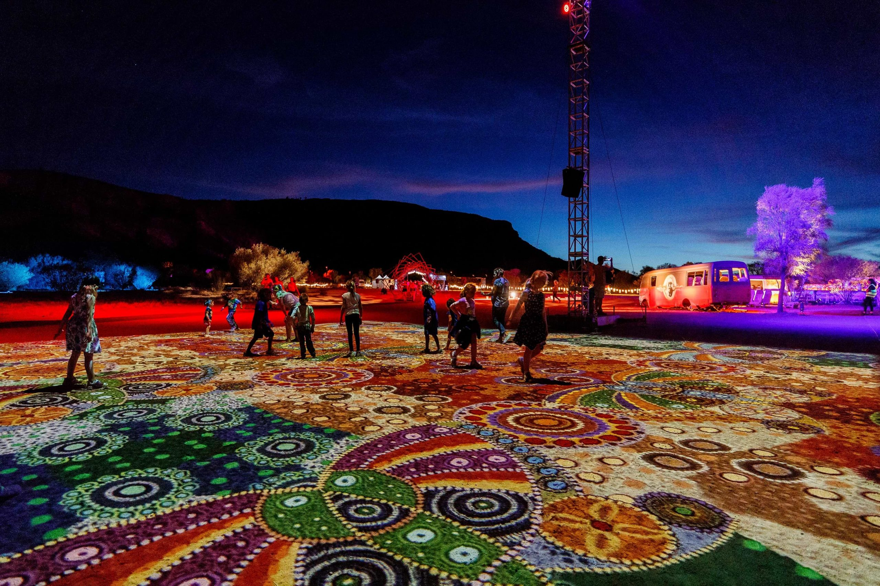
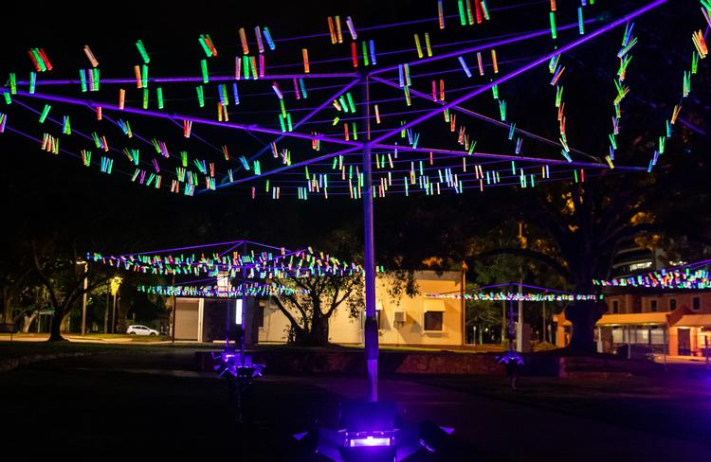
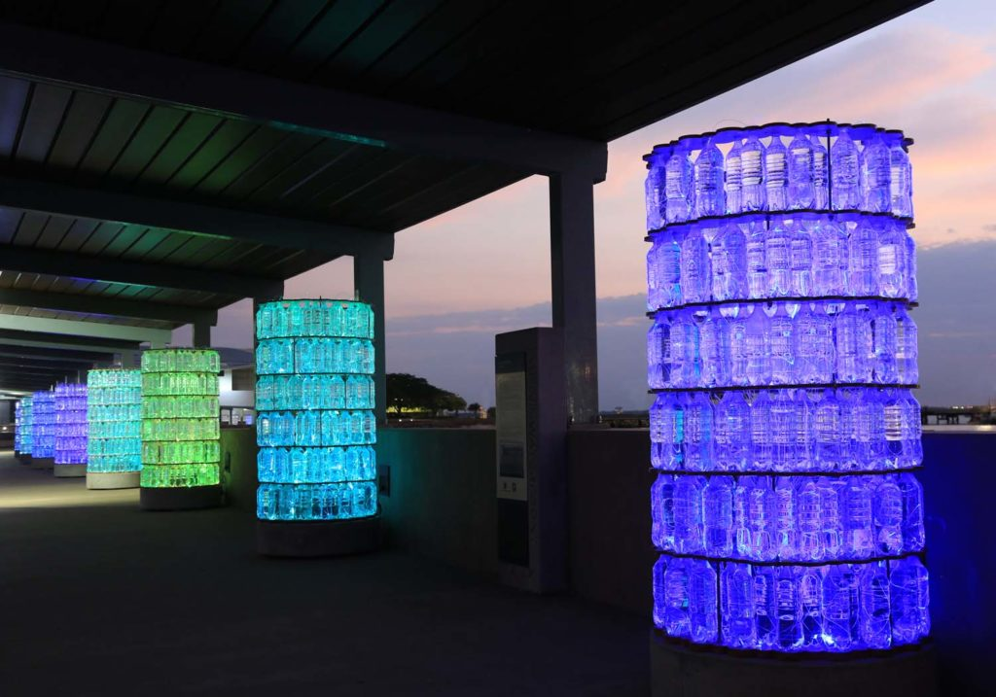
  Relevant Case Studies
Case Study – NT Major Events Company
Major Lighting Event Evaluations – Parrtjima & Bruce Munro’s Tropical Light
CLIENT NEED
Northern Territory Major Events Company (NTMEC) sought to understand the economic value provided to the Northern Territory through the direct investment and support of multiple events including Parrtjima in Alice Springs and Bruce Munro’s Tropical Lights in Darwin.
SOLUTION
As both events were free (although Parrtjima required pre-attendance registration) James designed a face-to-face survey research program, which involved deploying a research filed team who used tablets to undertake surveys with attendees to gain a comprehensive understanding of the attendee demographics, who they were with, where they were from and how long they were there, in addition to their reasons for attendance. They were also asked for their email addresses so that they could be sent a post event survey to capture their visitor expenditure.
James developed a custom online research program which was distributed to both event attendee databases to gather the data required to conduct a Direct Visitor Expenditure Analysis. The survey also collected other key event metrics including attendee behaviour, event satisfaction, sponsor engagement and awareness, and attitudes towards Government investment in major events.
OUTCOME
Economic Impact and Event Analysis reports were provided to NTMEC which gave them a thorough understanding of a variety of aspects relating to both events. By providing a Direct Visitor Expenditure Analysis, the economic benefit could be compared with other major events receiving investment from NTMEC. Additionally, the research provided detailed insights to attendee demographics, reasons for attendance, overall satisfaction and potential areas for improvement that could be incorporated into future events. The report has provided valuable evidence to support the decision-making around further investment and support provided by NTMEC.

Slide 65


  Relevant Case Studies
Case Study – Barossa Australia
Market & Consumer Research - Visitor Profile, Appeal, Key Drivers & Testing
CLIENT NEED
Barossa Australia (BA) was seeking evidence-based consumer research to support the development of a tourism visitor strategy specifically for its Destination Marketing Plan (DMP). This strategy would then be used to deliver a creative strategy that would target core audiences, with messages that address issues identified in the research, build on the Barossa’s strengths and bolster BA’s position to increase the value of the tourism economy. The focus of the research was to understand exactly who BA’s existing and potential visitors are, where they are coming from, the key drivers and barriers to visitation and identify key gaps and opportunities. In addition, BA wished to understand the potential appeal and demand for a range of new tourism experiences and events among domestic visitors to gain an insight as to whether the proposed experiences would drive visitation or supplement itinerary of existing visits.
SOLUTION
James Paterson designed and undertook a bespoke online consumer research study which targeted a specific set of almost 1,200 respondents to mirror BA’s key visitor source markets, namely Adelaide, Regional South Australia, Sydney and Melbourne. The research established key visitor profiles from each location, perceptions, key travel behaviours, drivers and barriers to visit the Barossa. It also benchmarked where the Barossa ranked against not only its regional SA competitors but also other key regional wine destinations around Australia. The study also used a unique methodology of choice-modelling to test a number of factors, such as appeal of the experience, and ability to drive visitation. The study offered insights as to the most popular products and where this appeal came from.
CLIENT OUTCOME
This comprehensive consumer research study provided the client with an evidence-base upon which to make critical marketing decisions, as well as a detailed understanding of the appeal of the Barossa from its key visitor source markets. It clearly identified the key drivers and barriers to future visitation to the Barossa, as well as outlining key opportunities to maximise visitation as a result of the impacts of COVID-19 and other key tourism trends. It also measured the appeal of proposed experiences across its key target markets, and the potential for each of these unique experiences to drive visitation to the Barossa.

Slide 66
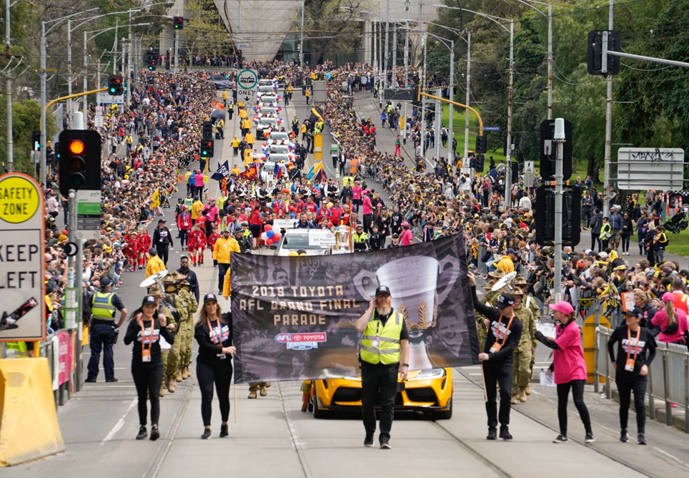
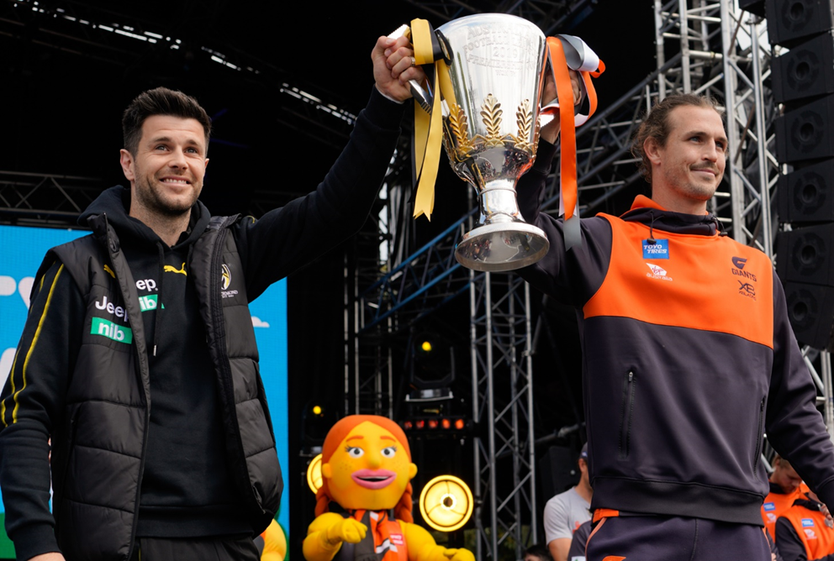
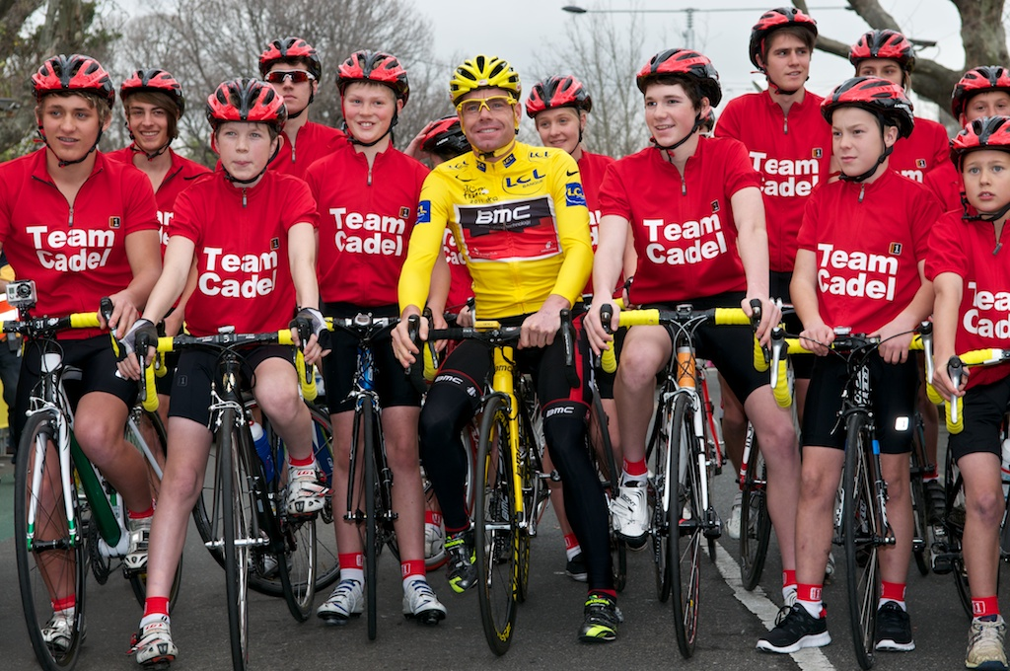
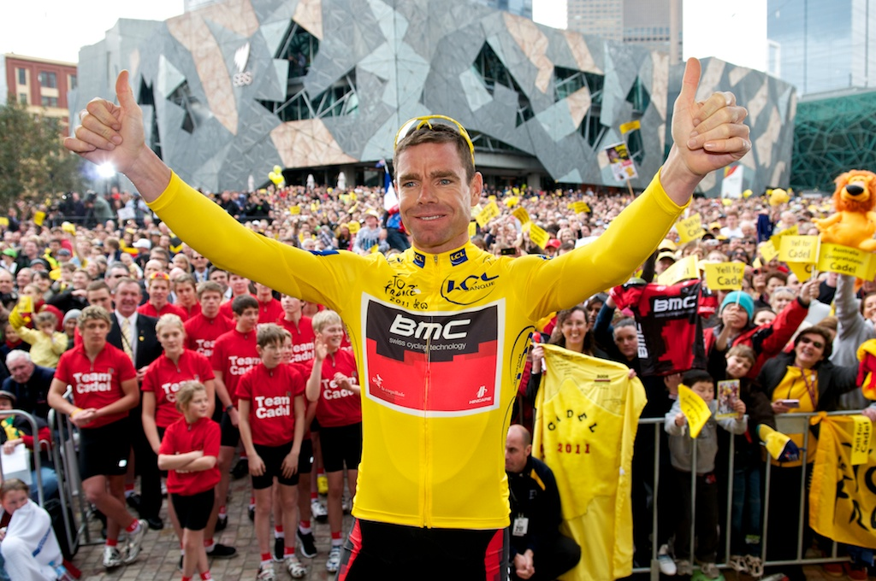
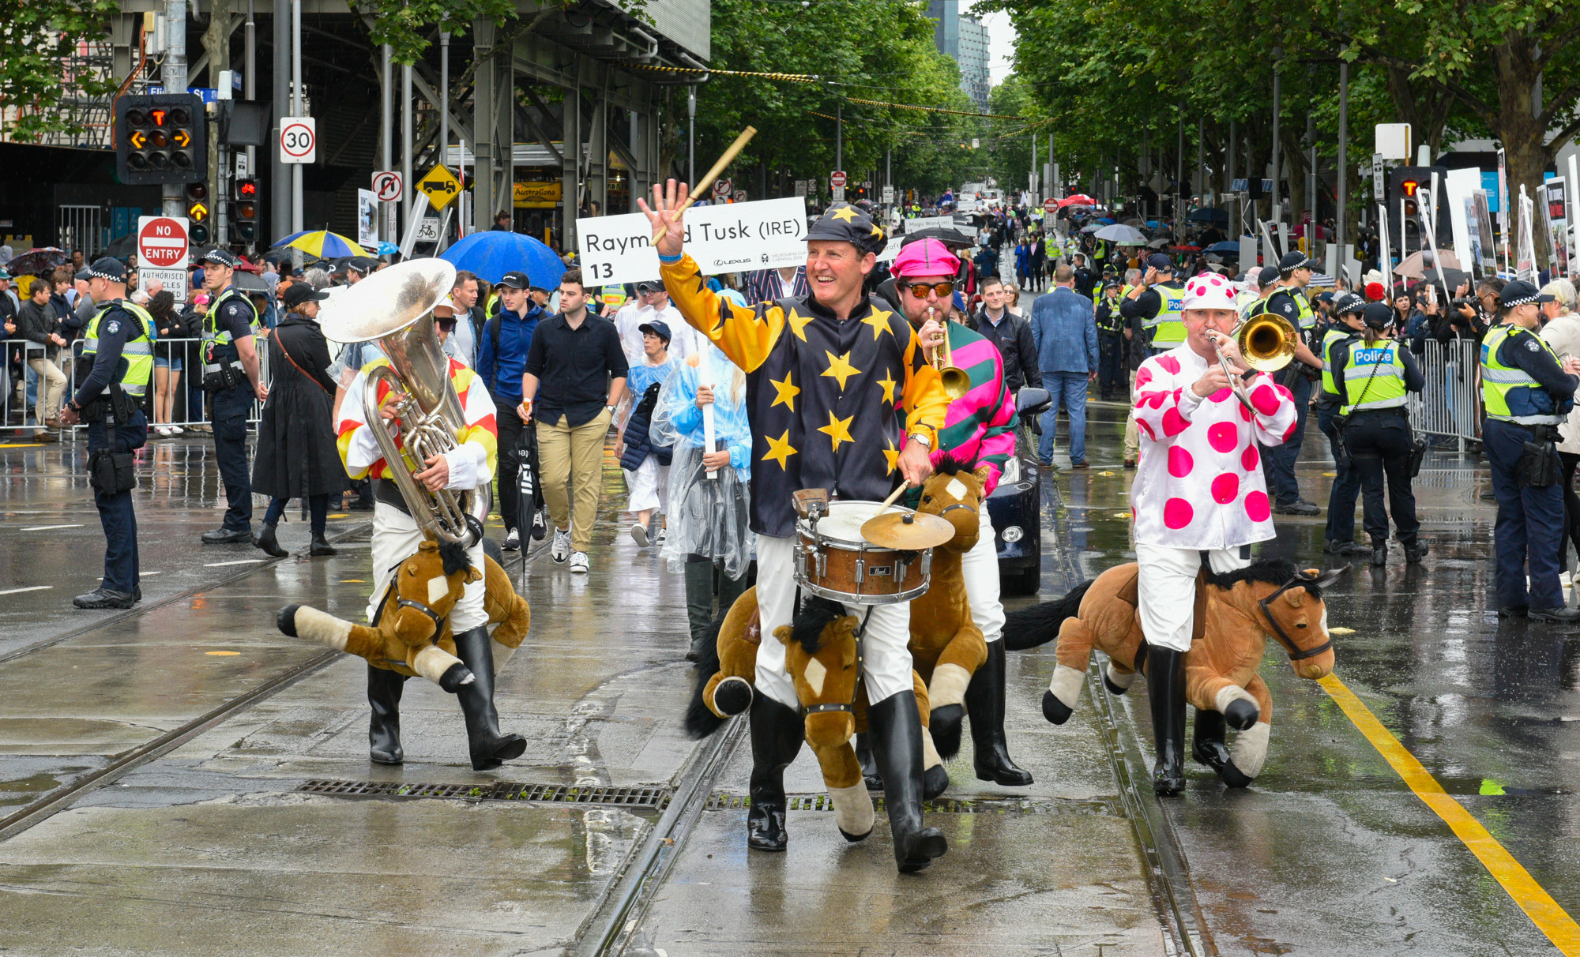
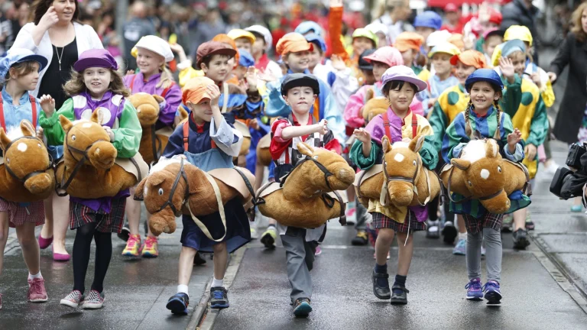
  Sample of outdoor major event sporting and cultural events overseen by Peter Jones
AFL Grand Final Parade
Peter Jones Special Events is the Event Manager for the annual parade and is responsible for all aspects of its planning & operations including infrastructure, traffic, risk, content etc.
Cadel Evans Welcome Home
After Victory in Tour de France
Annual Melbourne Cup Parade

Slide 67





Timeline
6. Indicative Project Timeline
Project Commences
Dec 22
Inception & Situation Analysis:
Dec 2022 -
Jan 2023
Stakeholder Engagement
Jan 2023-
Feb 2023
Development of Draft Plan
Feb-Mar 2022
Final Report
Mar -Apr 2023

Slide 68
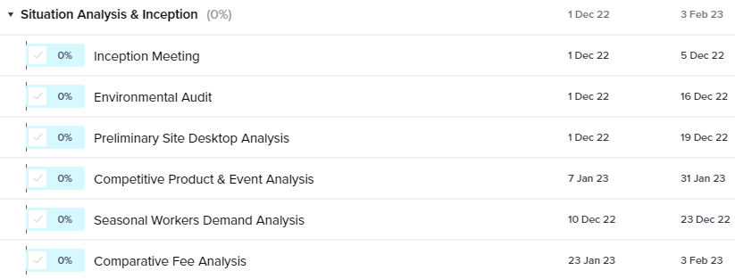
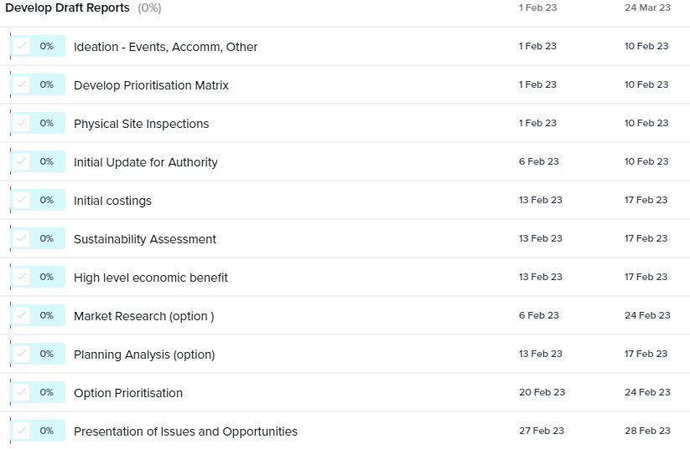
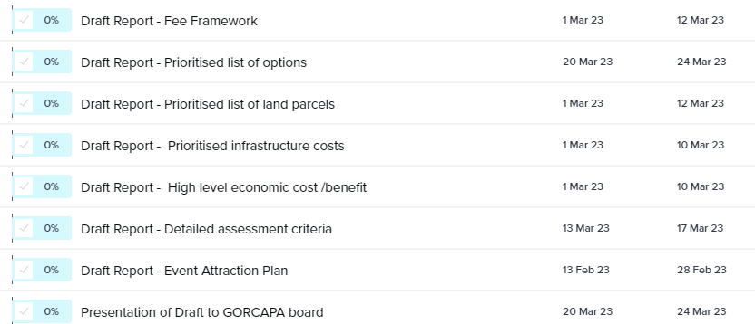
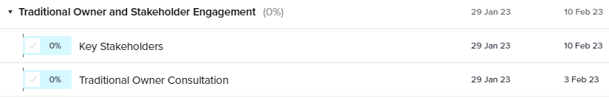
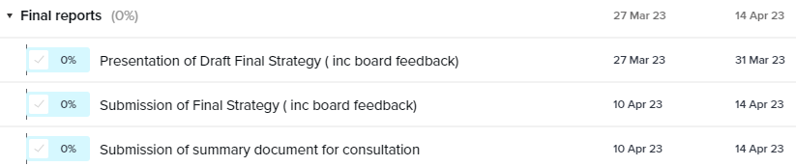
  Indicative Project Timeline
We have prepared an indicative timeline for the project. It assumes the project commences on 1 December 2022. The reports are completed and presented to board by 31 March. Any board requested final amendments to the plan will completed immediately afterward. This is a very tight timeline given Christmas and Easter holidays. In our experience, it is very hard to undertake any meaningful consultation and engagement through the period from mid December to Australia Day.
Develop Draft Reports cont’d

Slide 69
Utilising the above methodology, we have allocated the Project Fee into the Key Tasks tender brief
`
Key Tasks | Pricing $
Inception & Situation Analysis | 13,800
Consultation & Engagement | 13,400
Development & Preparation of Draft Reports | 51,400
Final report | 8,800
Total | 87,400
Travel Allowance | 3,000
Total costs ex GST | 90,400
GST | 9,040
Total Professional Fees Inc GST | 99,440
7. Total Project Fees
As detailed in the submission, we strongly recommend that the options of Market Research and Statutory Planning form a key part of this project. As options, those costs are not included in the above but are detailed on the next page.

Slide 70
  Project Days & Rates
Project Team | Daily / Hourly Rate $ | No of Days | Total $ Ex GST
Steven Wright | 2200 / 320 | 10 | 22,000
James Paterson | 2200 / 320 | 15 | 33,000
Claire Ellis | 1800 / 250 | 10 | 18,000
Peter Jones AM | 1800 / 250 | 8 | 14,400
Total Professional Fees |  |  | 87,400
Travel Allowance |  |  | 3,000
Total costs ex GST |  |  | 90,400
GST |  |  | 9,040
Total Professional Fees Inc GST |  |  | 99,440
Recommended Options | Rate (inc GST)
Statutory Planning by Claire Baker | $2,200 per day * (if required)
Product Testing via Market Research led by James Paterson. This research would be relevant across the Caravan Plan, GORT Trail and Crown land Utilisation Projects. | $33,000 (includes all third party panel and research costs)
All Daily and Hourly Rates are GST exclusive unless otherwise specified
The recommended option will only be implemented with the prior approval of GORCAPA.
Fees will be paid as follows: 10% at commencement and then pro-rata at the conclusion of each stage.
A provision for $3000 travel will be charged. This includes one economy return Hobart – Melbourne airfare will be required for Claire Ellis. Two economy return Sydney – Melbourne airfare will be required for James Paterson. All own vehicle travel will be charged at 75c/km. Any required accommodation will be provided by GORCAPA (foc) in a cabin at GORCAPA caravan parks.

Slide 71
Referee for Steven Wright
Matt Jackson, Chief Executive Officer
Parks Victoria
T: (03) 8427 2456 E CEO@parks.vic.gov.au
Referee for James Paterson
Graeme Moses, Director – Corporate Affairs and Membership
Tourism & Transport Forum
www.ttf.org.au
T: (02) 9240 2037 M: 0434 569 470 E: GMoses@ttf.org.au
Referee for Steven Wright & Peter Jones AM
Mark Stone AM
Current Chair – Goulburn Valley Water, SCT Logistics, Davidson Advisory Board, Youth Activating Youth
Former CEO - Parks Victoria, CEO – Tourism Victoria and CEO of Vic Chamber
M: 0418 517 232; E: mwstone@bigpond.com
Referee for Claire Ellis
Andrew Wagg, Project Manager – Next Great Bushwalk
Tasmania Parks & Wildlife Service
M: 0418 377 800 E andrew.wagg@parks.tas.gov.au
8. Referees & Insurance

Slide 72
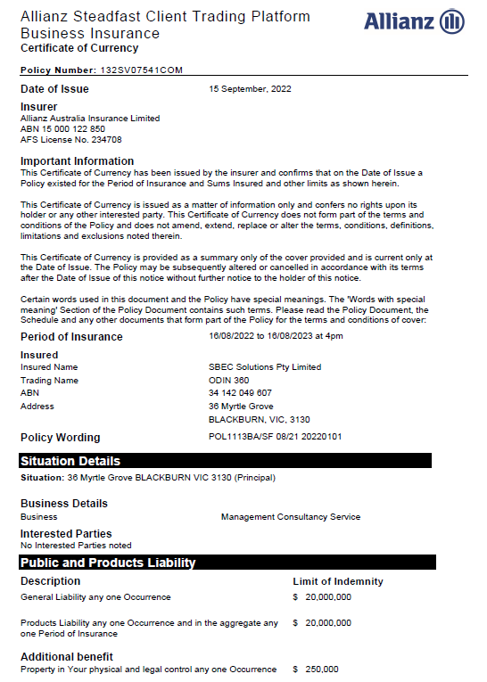
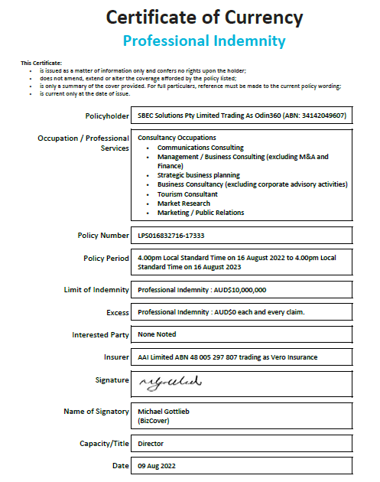
  Summary of Insurance & Certificates of Currency
Insurance Summary
Public Liability:
Cover: $20m
Underwriter - Allianz Australia Insurance Limited
Professional Indemnity:
Cover $10m
Underwriter: AAI Limited trading as Vero.
WorkSafe
Cover: Statutory
Employer No: 16205268
Manager: DXC Claims Management Service

Slide 73
9. Contact Details
If you have any questions in relation to this submission,
please do not hesitate to contact:
Steven Wright
Managing Director
ODIN360
E: steven.wright@odin360.com.au
M: +61 407 800 518
W: www.odin360.com.au
ODIN360 Locations:
Melbourne, Sydney, Brisbane, Gold Coast, Sunshine Coast, Hobart, Perth
Additional Information:
ODIN360 is a business owned by SBEC Solutions Pty Limited (ABN 34 142 049 607) and founded by Steven Wright. ODIN360 is a cooperative consulting organisation. Whilst each member of the ODIN360 team are independent contractors, they all have signed an agreement to work collectively under the ODIN360 model as and when required. This model allows the team to work both as individuals contractors on their own projects or as part of a project team under the ODIN360 Master Brand. This innovative model allows ODIN360 clients to have access to the best independent contractors in Australia through one vehicle. A one stop shop for the best qualified and experienced consultants in Australia for Government involvement and investment in Tourism, Sport and Major Events. All project and contract management is undertaken by ODIN360 including on behalf of all subcontractors Full details of the ODIN360 team of consultants and specialist advisers are detailed at www.odin360.com.au

