Slide 1
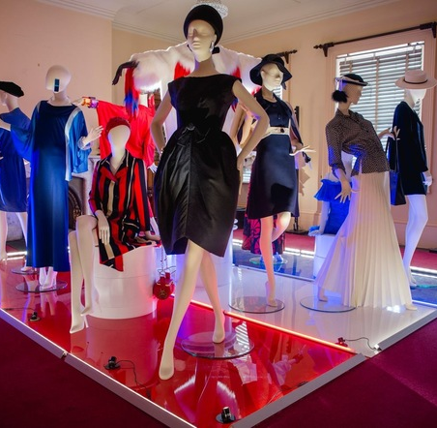


VIC
Fashion & Dress Resource
Feasibility Assessment
Request for Quotation
Response by
August 2023

Slide 2
  Table of Contents
Section | Title | Page No
1 | Project Overview | 4
2 | ODIN360 & Project Team | 8
3 | Methodology & Output | 16
4 | Sustainability | 28
5 | Relevant Experience | 28
6 | Project Timeline | 31
7 | Project Fee | 32
8 | Insurance | 33
9 | Contact Details | 34

Slide 3
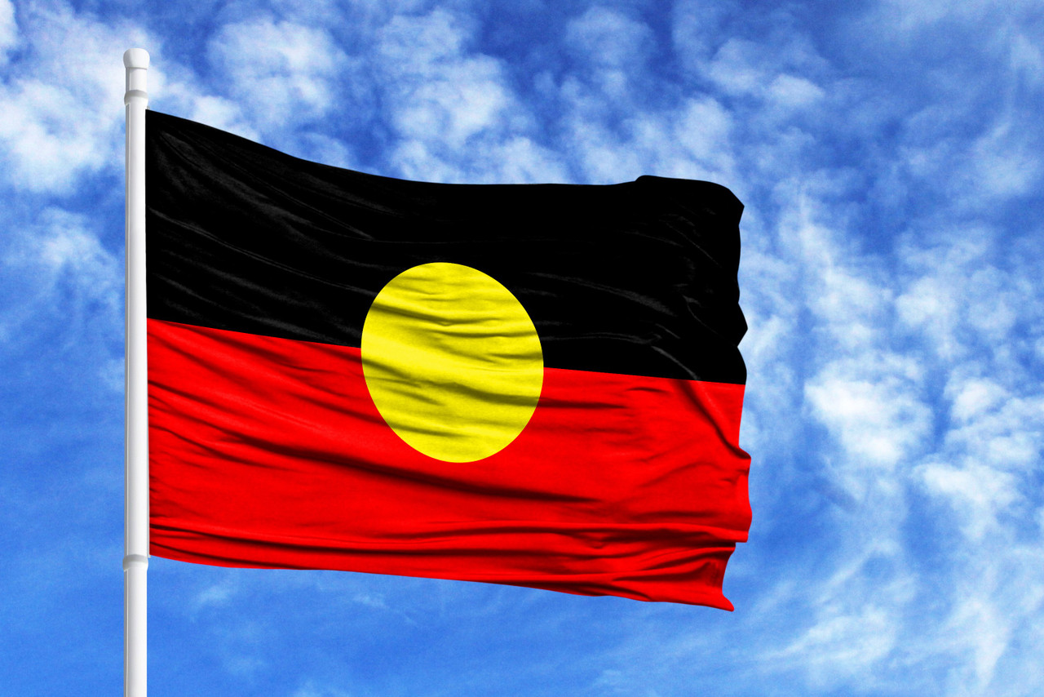
We acknowledge the Wurundjeri WoiWurrung, of the Kulin nation being the Traditional Custodians of the land and waterways of the Melbourne region.
We pay our respects to all Elders, past,
present, and emerging, who have been, and always will be, integral to the story of the Melbourne region.

Slide 4
ODIN360 has been requested to provide a quotation and submission to assist National Trust Victoria (NTV) in undertaking a feasibility assessment of the development of a Fashion and Dress Resource centre.
NTV has a significant Costume Collection and is looking at how best to realise this asset for NTV and the wider community. The Costume Collection is a nationally significant collection of fashion and dress and has been collecting items since 1961.
The collection now includes over 7,000 items. The breadth of the collection is considerable. Its strength spans the gold-rush era through the land-boom of the 1880s. A growing and developing collecting area is mid-twentieth century costume to the present day.
Public awareness of the collection is increasing and the outgoing loans to major public institutions such as the National Gallery of Victoria and Bendigo Art Gallery bring further attention to the Trust’s collection in the wider fashion research community.
Currently the Costume Collection is housed in multiple unsatisfactory storage facilities and the future preservation of the collection is at risk if this continues.
A different solution is required to ensure the preservation and presentation of the Costume Collection for the future. The proposed Fashion and Dress Resource centre is one suggested option. Better exploitation and preservation of the Collection resources is a key driver in the NTVV new Strategic Plan.
1. Project Overview

Slide 5
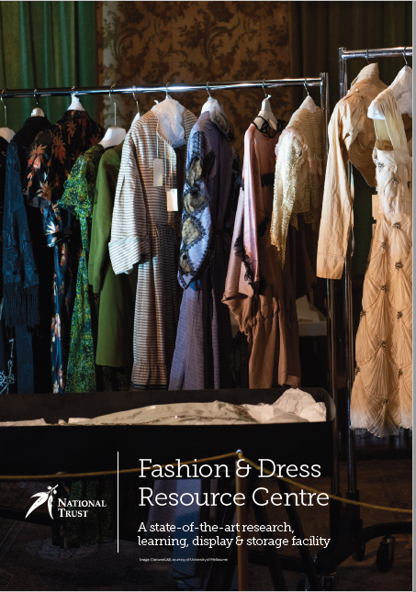
Project Overview
NTV has developed a draft Vision document, which is to be used as guidance in the development of this project which outlines the aspirations and possible solutions for realising value from this important asset.
This vision is outlined in the "Fashion & Dress Resource Centre - A state-of-the-art research, learning, display & storage facility" document.
Prior to this draft Vision, much historic work had been done over the years to reposition and capitalise on the costume collection as a resource. These activities have developed in an opportunistic fashion and the NTV now believes it is timely to take a more strategic approach to managing the collection.
NTV has had a Significance Assessment of the Costume Collection undertaken and also a Preservation Needs Assessment which will be reviewed as part of the project activities.
It is our understanding of the Project that it will be specifically tasked with developing a feasibility assessment for the Costume Collection based on an interim issues and options paper.
This issue and options paper will identify a range of activities that could be undertaken by NTVV in line with their current vision.
This may include other options or elements recommended by ODIN360 based on the analysis undertaken.
ODIN360 will rely on NTV staff to provide regular feedback throughout the project on areas such as costume/fashion expertise, NTV finances and investment appetite, internal procedures, marketing, costs, operational aspects and opportunities for linking the fashion collection with other NTVV building and other assets.
The methodology that ODIN360 will use in undertaking this project for NTV is detailed below.

Slide 6
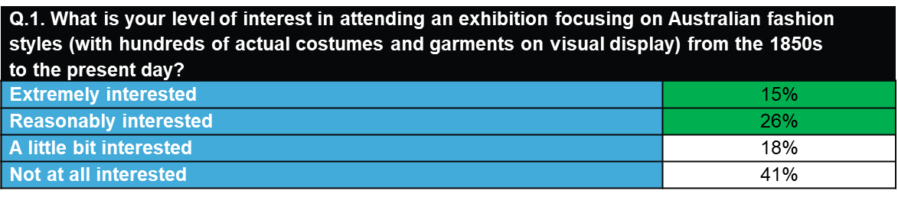
Project Overview
During the preparation of this submission, our market research partner JMP Consultants was able to undertake a preliminary online survey snapshot of 208 Australians (via our online Research Panel provider Dynata) with respect to the level of interest in a history of Australian fashion exhibition.
This high level research was undertaken on 14 August, 2023
and showed that:
41% of Australians are either extremely interested or reasonably interested in attending an Australian history of fashion exhibition so it appears that there is enough initial consumer appeal for this type of new event product with a select part of the community.
In Victoria for example, those who are extremely interested in attending such an exhibition would amount to almost 1 million people.
This will of course need further consumer concept testing but this was a positive finding for the potential levels of appeal.
Market research is a key part of the project and we have detailed below the proposed methodology, but these preliminary findings are very encouraging and show there is likely to be a solid base of support from which to build the project. This is further supported by the strong attendances and visitation to the fashion events and activities held at the Bendigo Art Gallery (as detailed on page 19 below). That visitation data, through sources such as Tourism Research Australia, will also enable us to extrapolate potential interest and visitation in the NTV project.
ODIN360 has great pleasure in submitting this proposal to undertake the Fashion and Dess Resource Feasibility Assessment for NTVV. We look forward to discussing it with you.

Slide 7
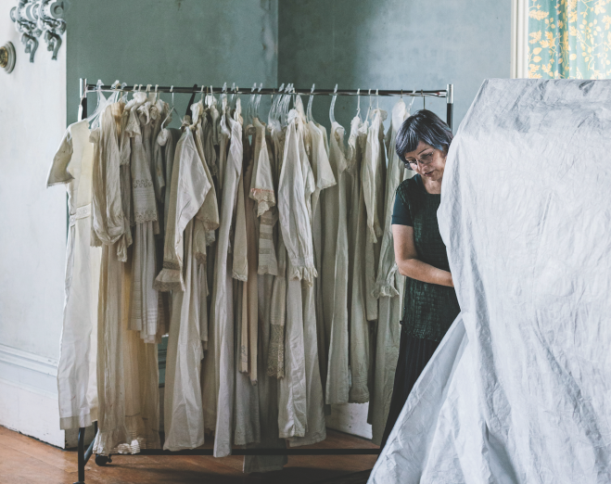

Slide 8
ODIN360 is one of Australia’s most experienced consulting and business advisory firms that focuses on strategy, destination planning & development, economic & feasibility analysis, investment attraction, tourism & product development and stakeholder engagement – all of which are core aspects of this project.
Our innovative model allows ODIN360 to create specialist and bespoke “project eco-systems”. We create teams of senior specialists who are experts in their field who undertake the work themselves.
We do not hand work off to juniors with limited knowledge, experience or understanding of the issues at hand. This guarantees that we provide the best possible advice and service to our clients.
ODIN360 has also recently been appointed to the Victorian State Government Contract Purchasing Panel across numerous categories of services including feasibility analysis.
The key items that make ODIN360 different (and in our view preferred) to other consultants is set out below.
2. ODIN360 & the project team

Slide 9
  ODIN360 & Project Team Overview
One of the most experienced project teams in Australia in feasibility, research and tourism product
We know what works and what is achievable and just as importantly “what doesn’t”.
We don’t use a cookie cutter plan. Each plan is bespoke & “right sized”
Understand relevant Federal, State Govt and local government strategies
We understand the needs of the ‘client’ as we have been the client
Most importantly, taking ALL the stakeholders on the journey is a cornerstone of success
We will bring extensive peer review to this project
The project team does the work. We don’t delegate to juniors
Extensive relevant knowledge in tourism, attractions, infrastructure and design
We have a laser like focus on stakeholder & community participation. We believe in co-design.
We focus on Social Licence and Sustainability of outcomes.
Our key insights are all evidence based. Not just an opinion

Slide 10
The ODIN360 Project Ecosystem
Relevant Project Team Expertise
In this project, we have identified nine key areas that are critical to the project's success.
As ODIN360 only brings true experts to projects, collectively the team has extensive expertise in each of these areas. The project team ticks all the boxes and have worked on numerous feasibility analysis similar to this one ( which are summarised in section five below).
One of the significant benefits of using ODIN360 is that our clients get much more than just another firm of consultants.
All the project team have lived and breathed the key project issues and challenges as senior executives and directors of organisations such as VTIC, Delaware North, BIG4 Holiday Parks, Tourism & Events Qld, Commonwealth Department of Tourism, Tourism Australia, Federation Square, numerous local councils, East Gippsland Water, Commonwealth Games and Australian Grand Prix Corporation and several AFL/NRL Clubs to name a few.
The team understand the commercial needs just as well as the strategic and operational and add real value beyond the report itself.
ODIN360 Project Ecosystem
Economic & Financial Analysis
Destination Management
Product Development
Market Research
Stakeholder Engagement
Commercial & Tourism Strategy
Investment attraction
Sustainability
Desktop Research

Slide 11
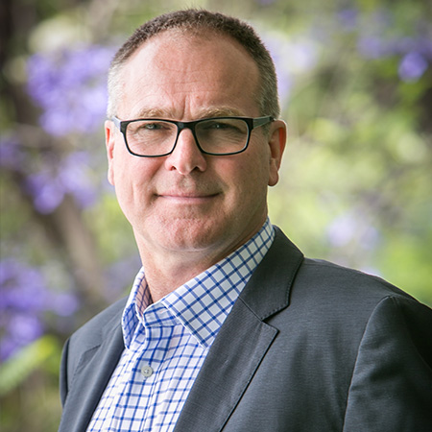
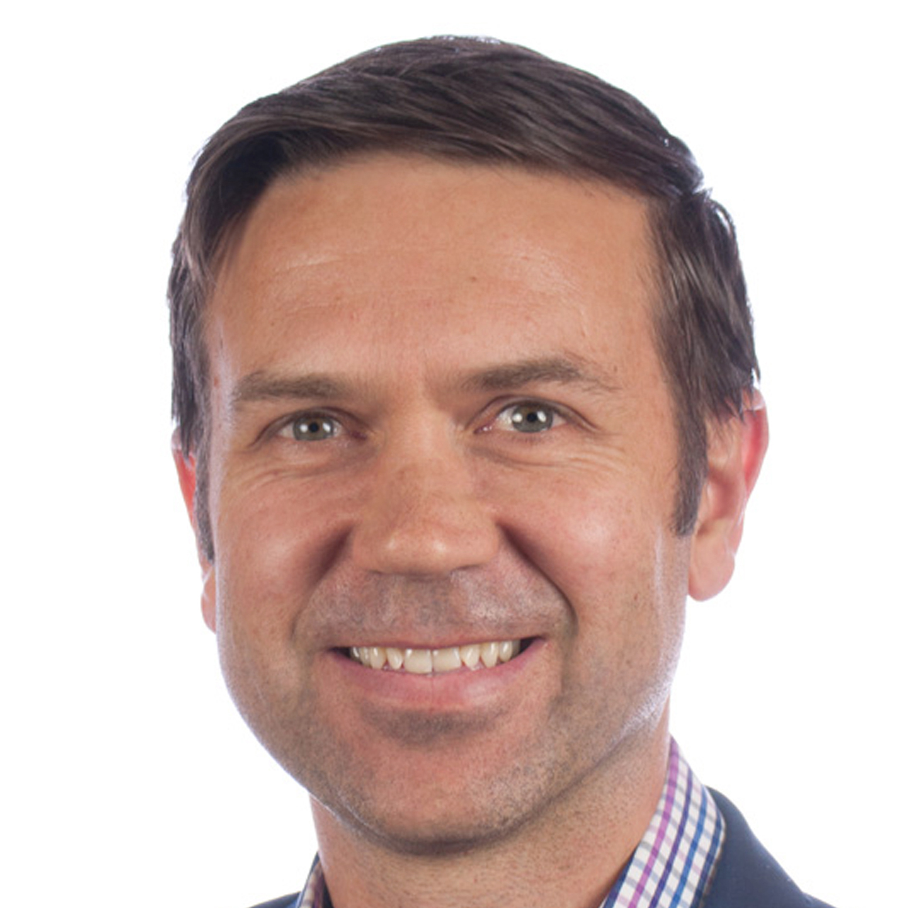
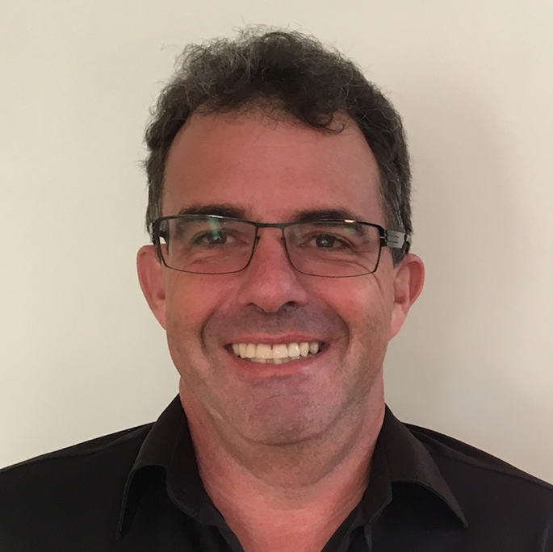
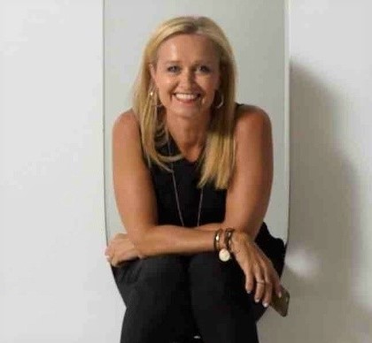

ODIN360 Project Team
The project will be overseen by a team of three highly experienced consultants. Each of the Project team have been heavily involved in the development of the Gulf Station Masterplan feasibility study. They will complete the entire project and it will not be delegated to junior staff. Erin Lightfoot, the newest member of the ODIN360 team is an attractions specialist and will act as a general advisor to this project.
Project Team
Project Advisor
Karl Flowers
Economic Analysis,
Investment Attraction
Steven Wright Project Leader, Strategic Planning,
Analysis
Mike Billing
Project Manager Strategic Planning, Stakeholder Engagement,
Research
Erin Lightfoot is the newest member of the ODIN360 team and as an attractions specialist, she will be a general advisor to this project. She has a long standing and varied career across the private and public sectors of tourism, events, marketing, and advertising.
Erin is an advisor to HERO Creative Marketing and was formerly CEO of Magnum Opus Partners, as well as VTIC. Prior to that she was GM Marketing for the Melbourne Aquarium and Underwater World on the Sunshine Coast. She is presently Vice-Chair of Cultural Attractions Australia and a non- executive director of Zoos Victoria. She holds a Bachelor of Business, Tourism and Information Systems and qualifications through AICD.
The team will be supported by our leading market research partner:

Slide 12
ODIN360 Project Team: Steven Wright - Project Manager
Steven Wright is the founder and MD of ODIN360. He is an extremely experienced consultant and leader in strategy, tourism, economic development and business planning. He has held Board, CEO and private consulting roles in well-known organisations in the public and private sector for over 25 years. He has the unique skill of being able to balance the often conflicting commercial / economic imperatives with community needs, social licence and public policy.
    Career Highlights
    Current
      MD & Founder - ODIN360 management consulting
      Chairman - South East Leisure Pty Ltd / City of Greater Dandenong
      Advisory Board Member - Delaware North Australia
      Director - East Gippsland Water Corporation
      Director - Blackburn Community Bank – Bendigo Bank Franchisee
    Previous Board
    BIG4 Holidays Parks of Aust – CEO
    Tourism & Events Qld – CEO : Qld Government Authority
    Brisbane Lions - CEO (interim) : AFL Club
    Richmond Football Club – CEO : AFL Club
    Aust Grand Prix Corp – CEO : Vic Govt Authority for F1
    Australian Grand Prix and MotoGP
    Herbert Smith Freehills, Commercial Solicitors - senior associate
Steven Wright
As a consultant specialising in destination planning and former Director of the Victorian Tourism Industry Council (VTIC), CEO of Tourism & Events Queensland and BIG4 Holiday Parks, Steven has extensive knowledge of regional issue and needs. Steven is the lead consultant on the NTV Gulf Station project as well as the DMP and Workforce Plan for Yarra Ranges Tourism.
Across these varied roles, he has managed complex stakeholder and government relationships to achieve successful outcomes. As a qualified lawyer, accountant and AICD Graduate, Steven has the academic, legal and practical governance, commercial, financial and operational experiences to ensure project success.
ACHIEVEMENTS:
Developed and successfully implemented corporate and tourism strategy across many large organisations and destinations including Yarra Ranges.
Created sustainable model and framework for tourism activities in National Parks.
Introduced Tourism Management Planning across each Regional Tourism Board in Queensland.
Created numerous masterplans for major tourism attractions and accommodation products
Developed national tourism and accommodation strategies for multiple clients.
Researched developed tested commercialised and implemented new tourism products
Creator and Founder of Korin Gamadji Institute for indigenous leadership development. Over 2,500 indigenous teens and adults have now attended courses at with KGI.
Previous relevant board and advisory roles
    Non Executive Director - Victoria Tourism Industry Council
    Member - Aust Govt Standing Committee on Tourism (ASCOT)
    Director - Surfers Paradise Alliance – a Gold Coast City Council Economic Development Authority
    Founder & Director - Australian & NZ Sports Law Assoc
    Director - Australian MotorSport Foundation
    Founder – Korin Gamadji Institute
      Awards & Qualifications
    Master of Laws – Monash University
    Bachelor of Economics – Monash University
    Harvard Business School Online – Disruptive Strategy
    Australian CEO of Year 2018 – Finalist
    Australian Tourism Executive of Year 2017 – Finalist

Slide 13
ODIN360 : Mike Billing – Tourism Marketing Specialist
Mike Billing is a highly experienced business professional having worked in a diverse range of roles both in Australia and internationally.
He brings a broad skill set to projects with 20 years' experience. Mike has significant experience in the tourism, local government, sport, major events and venue management industries.
    Career Highlights
Current
ODIN360 Consultant
Director – Captura Group
Previous Roles and Clients
Interim Commercial and Marketing Manager – Federation Square
Interim Marketing Manager – Western Bulldogs
Marketing Director – Melbourne Storm
Senior Client Manager – Sport England
Clients include:
  Nillumbik Shire Council, Australian Football League, Basketball Australia, IAG Insurance, Federation Square and more
Qualifications
Bachelor of Arts (Queensland University, 1997)
Master of Arts – Leisure Management (Griffith University, 1998)
PRINCE 2 and Managing Successful Programs (2008)
Mike Billing
Having been recognised as one of Australia’s top 50 Chief Marketing Officers, Mike brings commercial and business acumen to help achieve the best results for the tourism marketing projects in which he is involved.
He has worked with Federation Square to review their marketing and commercial approaches to destination activations. Mike undertook a strategic review of the newly created Business, Tourism and Marketing function for Nillumbik Council and developed an action plan for the business unit to work to. This required an analysis of existing data, research and other information that Council held as well as collating other sources that helped in evaluating the issues that were faced at Nillumbik.
He has worked on the Yarra Ranges Destination Management Plan delivered by ODIN360 where he oversaw the community engagement and development of the Local Area Action Plans and Destination Management Plan. Mike is also currently working on the Gulf Station Project with National Trust Victoria. Previously he has worked for Nillumbik Shire Council where he has undertaken feasibility and service reviews for major assets owned by Council such as the review of Yarrambat Golf Couse that realised multi-million-dollar savings for Council. Other projects included undertaking a service review of Edendale Community Environment Farm that saw an issues and options paper presented to Council for the future of this facility and setting up and delivering the procurement approach for Council’s five leisure facilities.

Slide 14
ODIN360: Karl Flowers - Visitor Economy Specialist
Karl Flowers is a nationally recognised expert in economic market analysis and industry economics. He has undertaken significant work in visitor attraction feasibility studies. .
Karl has 30 years experience in tourism market analysis in visitation forecasting and economic impact assessment associated with tourism development projects. He also brings extensive experience in industry economic analysis and evaluation as a former senior executive in the Australian Government. He has held the position of Director of Investment for the Commonwealth Department of Tourism and Tourism and Aviation Economist in Tourism Australia having started his career as a Research Economist specialising in industry and financial economics in the Commonwealth Treasury.
Career Highlights
Current
ODIN360 Consultant
Managing Director – Decisive Consulting Pty Ltd
Previous Roles and Clients
Director Investment, Commonwealth Department of Tourism
Director Service Industry Policy, Commonwealth Department of Industry, Technology and Commerce
Tourism and Aviation Economist, Tourism Australia
Acting Director Strategy, Tourism Australia
General Manager, Policy and Research TTF Australia
Research Economist, Department of Treasury
Project Clients through Decisive Consulting include:
  Committee for Mornington, Hepburn Shire, VTIC, Tourism Research Australia, Yarra Ranges Tourism, Hepburn Bathhouse, Visit Victoria
Qualifications
Masters of Economics (ANU)
MBA (AGSM)
Economics Honours (Newcastle)
Karl Flowers
Economist specialising in Tourism and the Visitor Economy
He has also undertaken many consultancy projects focussing on investment attraction, regional industry analysis, destination development, visitor profiling, and business cases for LGAs, Government Departments, Regional Tourism Organisations, major attractions and private enterprises. He is working on the NTV Gulf Station ODIN360 project and is the lead economist on the development of the Yarra Valley and Dandenong Ranges DMP. He has worked as a key team member on feasibility studies for the Shepparton Art Gallery and Warrnambool Art Gallery and on a feasibility for better preservation and presentation of Norfolk Island historic buildings and collections.
From his extensive work across the visitor economy, Karl has a deep understanding of the tourism and broader industry profile.
His detailed market analysis, industry economics, tourism and destination knowledge will provide an extremely solid economic foundation upon which to build the feasibility. His knowledge and expertise will play a crucial role in ensuring the success of this project.

Slide 15


Slide 16
Situation Analysis
Market Research
Issues & Opportunities
Financial Analysis
Final report
3. Methodology and Outputs

Slide 17
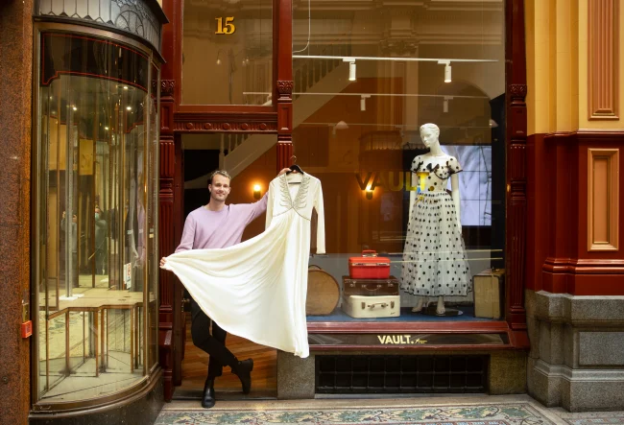
Methodology – Situation Analysis
1. Overview
To ensure a clear understanding of the current situation facing NTV in regards to its Fashion Collection, as well as identification of issues and opportunities that might help inform the future approach to the Costume Collection, a situation analysis will be undertaken.
This will include an initial desk top review of NTV documentation and other related aspects that will help to identify existing solutions for other collections managed by the NTV across Australia as well as other international examples that are seen as exemplars for the management of historical collections.
A mapping process to identify existing and potential supporters of the Costume Collection and NTV more broadly will be undertaken. This will hopefully identify opportunities for closer partnerships into the future. Alongside this we will look wider afield and identify other partners that have close affiliation with the fashion industry in Victoria, and Australia wide, that could be potential supporters into the future.
Identification of the key players that may be able to assist in providing solutions for the future preservation and presentation of the Costume Collection will be important at this stage. A review of the available tourism and visitor demand analysis for fashion related topics will also be undertaken as well as identification of existing policies and plans that are related to the project. This may identify potential funding support opportunities from government at all levels. The City of Melbourne will be a key stakeholder due to their stated ambition to reinvigorate Melbourne City.
A key part of the project will be to engage broadly with key stakeholders that are actively engaged with NTV as well as those that have potential for the future. This will include discussions with up to 15 key contacts as outlined below and will include additional site visits where required:

Slide 18
Methodology – Situation Analysis
1. Overview
Desk top review and analysis
Review NTV Vision documentation
Stakeholder Engagement –
Up to 15 key contacts
Visit Victoria
Bendigo and Geelong Gallery
Site Visits - Up to 8 site visits
Tourism Australia
Review Significance Assessment of the Costume Collection
Review Preservation Needs Assessment and how the collection is currently used
NTV collection experts and other key staff
Possible CBD venue owners and property experts
Property reports for rental and storage opportunities
NTV Costume Collection locations
Potential NTV sites in Melbourne
Other Melbourne CBD or nearby locations (2 or 3)
Issues Workshop with NTV Staff
University fashion course contacts
University locations
Case studies for collection management & display (see below)
Museum and collection managers
Partner mapping including major donors and supporters
Melbourne City Council and Merri-Bek Council
Tourism demand analysis
Strategic alignment with existing government or private sector plans eg. Experience Victoria Masterplan for 2033, Destination Management Plans, Creative Victoria etc..
Application of sustainability principles
Project Inception
One of the first steps in a project such as this is to bring the Project Control Group together asap and conduct a comprehensive Project Inception meeting.
This meeting would involve a detailed discussion across all key elements of the project to ensuring each member of the PCG and ODIN360 all have the same project understanding around the Who, What, Where, When, Why and How.

Slide 19

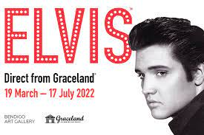
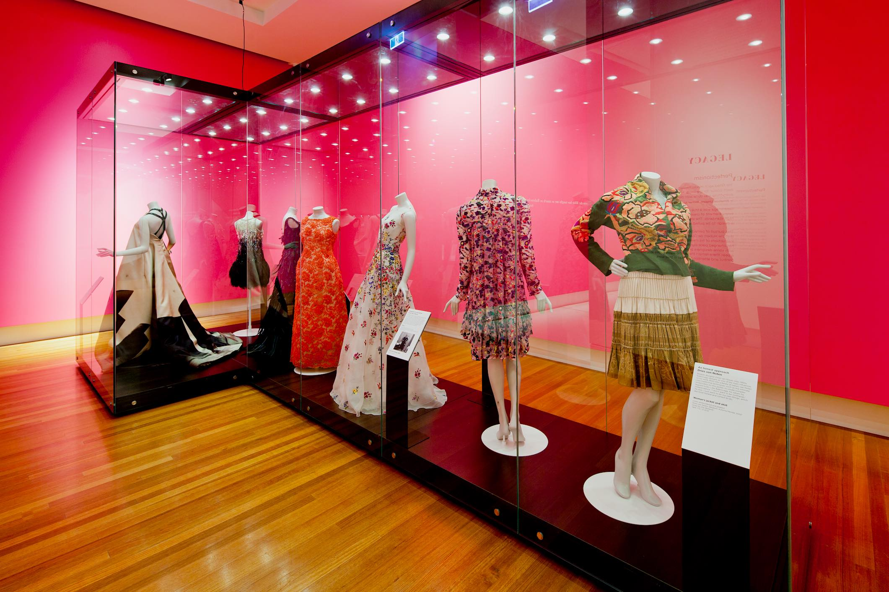
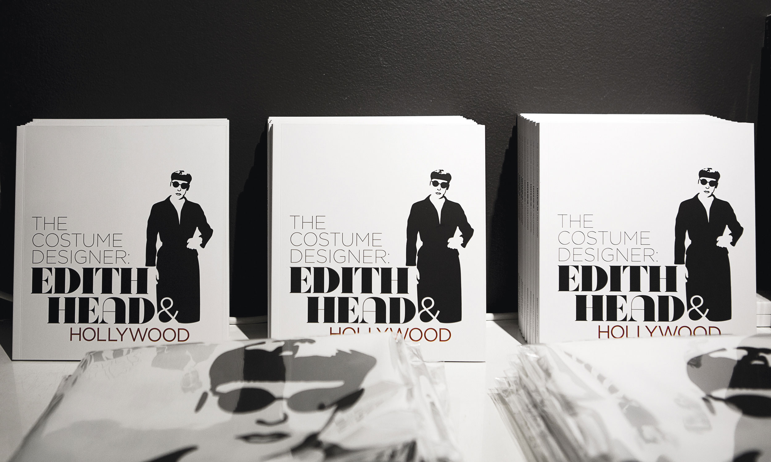
Case Study – Fashion exhibitions at Bendigo Art Gallery
As noted above, we will undertake case studies of other fashion conservation and visitor activation options. One example is the high profile regular exhibitions by the Bendigo Art Gallery where ‘celebrity’ fashion has been a popular drawcard. Bendigo Art Gallery has specialised in fashion exhibitions.
The Marilyn Monroe exhibit at the Bendigo Art Gallery was from March to
July 2016.
The Elvis: Direct from Graceland exhibition was in March to July 2022
(mostly clothes he wore).
The On tour | Piinpi: Contemporary Indigenous Fashion exhibition was from 26 Feb 23 - 30 Apr 23.
The Mary Quant: Fashion Revolutionary exhibition from 20 Mar 21 - 11 Jul 21,.
The Balenciaga: Shaping Fashion 17 Aug 19 - 10 Nov 19.
The Costume Designer: Edith Head and Hollywood exhibition from 29 Sep 17 - 21 Jan 18.
Insights and Performance
From March 2015 to March 2023, or over 8.25 years, there were 842,000 domestic day trips (more than 50kms return) to East Bendigo-Kennington SA2 (where the Bendigo Art Gallery is) who had the activity of visiting an art gallery or museum or around 100,000 a year. This estimate was based on a sample of nearly 100,000 Australians who made this trip in these eight years.
Over the eight years ending March 2023 there were also just over 1 million overnight domestic adult visitors to Bendigo Region who visited an art gallery or museum during their stopover, an estimate derived from 400,000 surveys.
Together these data sets will allow us to look at domestic visitors to Bendigo who are likely to have visited the Bendigo Art Gallery on their visit by, Gender, Age, Travel Party Type, Household income, Home Region. This would provide a further profile for people actively interested in fashion. A high-level snapshot is below.

Slide 20
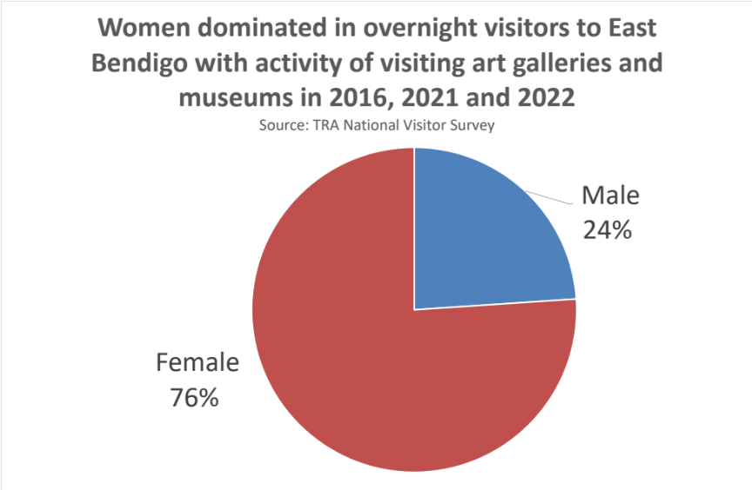
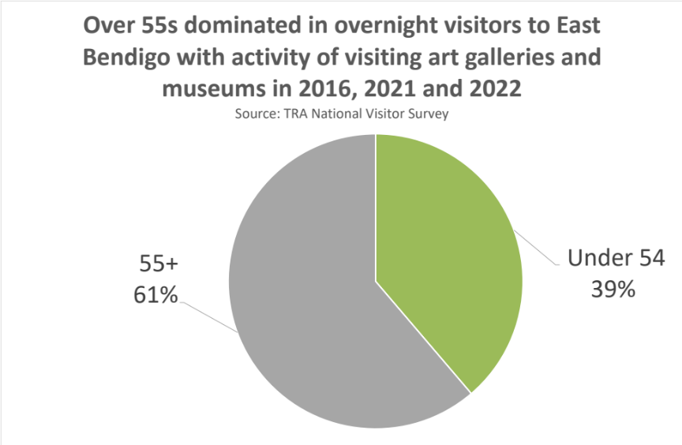
Case Study – Profile of Bendigo Art Gallery and Museum visitors during fashion exhibitions
As one way of providing a guide to potential visitors to a NTV Fashion facility we profiled the domestic visitors to Bendigo who visited an art gallery or museum on their visit. To focus more intensively on fashion-oriented visitors, we focused data analysis to only the second quarter of the year in 2016 and 2021 to 2022 the period in which three of the six Bendigo Art Gallery fashion exhibitions in recent years were held.
In these three quarters domestic overnight visitors to East Bendigo who visited an art gallery or museum were a total of 169,000 or more than double this class of domestic visitors in the second quarter of 2017-2019 (79,000) when no fashion exhibits were held. In the three June quarters in years 2016, 2021 and 2022 of total overnight visitors to East Bendigo, 27% had the activity of visiting an art gallery or museum – a very high market share.
Women provided more than 75% of domestic overnight visitors to East Bendigo (who visited an art gallery or museum during their stay) in the June quarters of 2016, 2021 and 2022. In contrast, in 2017-19 June quarters the share of women in these visitors was only 54%. Over 55s provided 61% of domestic overnight visitors (15+ in age) to East Bendigo who visited an art gallery or museum during their stay in 2016, 2021 and 2022. In contrast, in 2017-19 the share of 55+ in these visitors was lower at 53%. Women over 55 represented 40% of all domestic overnight visitors to East Bendigo who had the activity of visiting art galleries and museums in the June quarters of 2016, 2021 and 2022 of fashion exhibitions but only 25% in the non-fashion exhibition June quarters of 2017-2019.
Fashion exhibits have been highly popular at Bendigo Art Gallery. On the Bendigo experience, women and over 55-year-olds and particularly women over 55- years-old are expected to be the key markets for NTV fashion presentations.

Slide 21
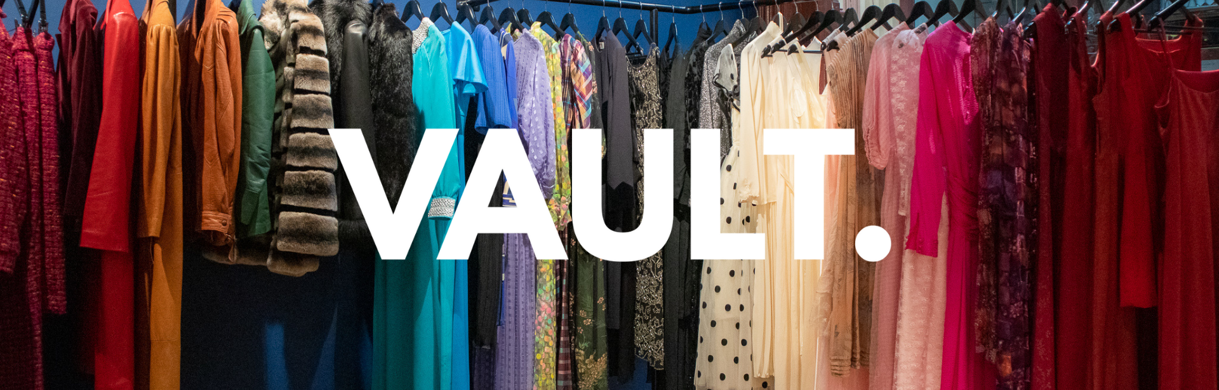
Methodology – Market Research
Quantitative Representative Sample – Consumer Research Online Survey
This research is designed to gather a clear understating of the percentage of Victorians who would be interested in attending an exhibition focusing on Australian fashion styles (with hundreds of actual costumes and garments on visual display) from the 1850s to the present day. Various new exhibition experience concepts can be tested through this research via imagery and descriptors. It will identify the key drivers and the key barriers for attendance and provide guidance for future marketing opportunities.
We recommend that an online sample survey be undertaken across Victoria to assess interest and levels of appeal. A sample size of 500 of those who would not rule out attending an exhibition focusing on Australian fashion styles from the 1850s to the present day, across Victoria will provide statistically reliable data (to a 95% confidence level -+4.5%) and will be of critical value in assisting the exhibition’s product development. It will also clearly articulate their demographic profiles and what key drivers may lead to attendance. This type of survey is the ‘purest’ in the sense that it will be entirely representative of the views, attitudes, perceptions, and willingness to attend without any bias, and is therefore ideal for determining:

Slide 22
Methodology – Market Research
National Trust
Awareness of NTV and its roles
Future intention of attendees to a fashion / history exhibition
Potential Audience
Product Development
Specific testing of a selection of concepts and likelihood to pay to experience them
Appeal of proposed new NTV exhibition and experiences
Identifying key target markets via demographic profiling
Potential market sizing
Consideration and interest in NTV
Key drivers of future attendance
Key barriers to future attendance
Fashion
Key preferred activities
Experience preferences of attendees by type of visitor (e.g. family market v. seniors etc.)
We would work with Dynata, a global leader in online research panel sampling. The upside of this type of unbiased research is that it provides key insights as to the opinions of a highly representative sample of potential target attendees. Further refinement of the market research areas of focus will be undertaken with NTV to ensure that the survey captures the required outputs for the project.
Key Deliverables – A detailed consumer research study of 500 Victorian consumers who have a least some level of interest in attending an exhibition focusing on Australian fashion styles from the 1850s to the present day.

Slide 23
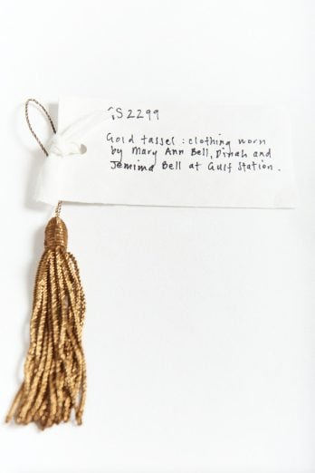
Methodology – Market Research
Research without Insights is Pointless
Our remit is to ensure that our clients have an in-depth understanding of which questions were asked, why they were asked, how they were asked, which people and groups were asked, and most importantly, what we learned and what the key next steps and actions are.
Critically, we will first work closely with the NTV to ensure any previous consumer and market research results are considered and improved wherever possible as well as how we best utilise consumer research to cover off initial concept testing. This will ensure that key data can be benchmarked, and comparisons made on areas that are critical to NTV.
Methodology Overview
We believe the best and most accurate visitor profiling requires a comprehensive quantitative research methodology solution.
We will use an online permission-based panel sample to source a representative sample of research participants across Victoria
Dynata our Global Online Research Panel Provider
We will work with our digital marketing research partner Dynata, to access the targeted panel of Australian consumers. Dynata is a global leader in online data sampling and a trusted provider of comprehensive consumer data collection solutions.
With 11 million panelists worldwide, Dynata has the capability to capture data from highly targeted audiences.
Dynata is a proud member of the ESOMAR community and only uses its panels for market research, preventing potentially biased responses and ensuring the validity of the samples delivered.

Slide 24
Methodology – Issues and Opportunities
After completing the situation analysis and analysing the market research, we will prepare an issues and opportunities report which will identify the key challenges (issues) and potential opportunities that arise.
The report will identify several options for NTV to consider for the future of the Costume Collection. We will then meet with NTV to discuss the issues and opportunities and any potential options. NTV will be asked to choose two of these options so that a high level financial feasibility can then be undertaken.
A set of assumptions in respect of both options will also be agreed with NTV for use in the financial feasibility, in a similar format to that included in the Gulf Station masterplan project .
Whilst at this stage we cannot provide a definitive list of the issues and opportunities they are likely to include:
Issues
Collection Storage and Preservation
Preferred Locations
Opportunities
Collection Restoration
Public Exhibition
Volunteers program
Open access
Site Location
Infrastructure
Research & Education
Storage, & preservation, restoration
Funding
Potential target markets
Volunteer program
Collection Display
Research & Education
Display
Retail
Visitor Experiences and products
Restoration
Retail
Revenue model
Management Models
Potential Options
Central Vision

Slide 25
Methodology – Financial Analysis
As detailed above two options for financial feasibility will be assessed with assumptions agreed with NTV.
Based on those agreed assumptions and the market research, product testing, stakeholder engagement and situation analysis we will develop a likely revenue model for each option as the key line in the financial feasibility.
The second key part of the analysis is the cost data. As we are not cost consultants, we will rely upon the advice of experts within or recommended by NTV in respect of operational and capital costs and the necessary infrastructure required for preservation etc. No allowance for the costs of obtaining this advice is included in the project fee.
The financial feasibility will consider the multiple revenue streams available for this project and apply them against the costs estimates to provide an indicative analysis of the financial viability of each model.
Revenue
Collection Storage and Preservation
Storage, & preservation,
Costs
(If not publicly available, then to be provided by NTV or third party appointed by NTV)
Collection Restoration
Public Exhibition
Research & Education
Volunteer program
Collection Display
Research & Education
Display
Visitor Experiences and products
Restoration
Retail
Staffing
Volunteers program
Retail
Grant Funding
Membership
Partnerships
Retail
Capital

Slide 26
Methodology – Final report
Once each of the above stages has been completed, we will prepare a final report that encompasses the details and insights from the project with key recommendations on the overall feasibility of the project.
Situation Analysis
Market Research
Issues & Opportunities
Financial analysis
Recommendations

Slide 27
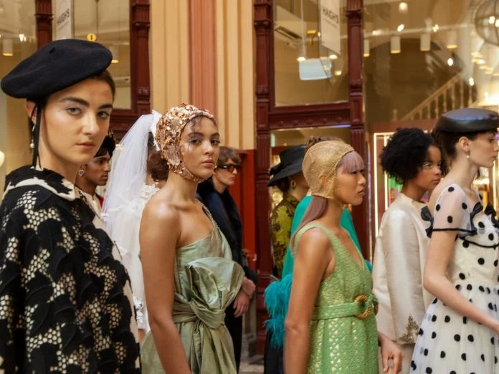

Slide 28


One of ODIN360 core principles is that tourism and tourism products must be sustainable. Sustainability in that context means ensuring adherence to world’s best practice in regenerative and sustainable tourism. We know that NTV also supports that philosophy.
In our tourism feasibility work we align with the guidelines of the Global Sustainable Tourism Council (GSTC) and Ecotourism Australia who has adapted those GSTC guidelines into an Australian context .
4. Sustainability
    The role of GSTC is to enhance the creation of sustainable tourism destinations and products around the world. In particular, its aim is that:
    Tourism fulfils its potential as a vehicle for social, cultural, and economic good while removing and avoiding any negative impacts from its activities in terms of environmental and social impacts.
    To do this it has created a four pillar model that includes:
    Demonstration of effective sustainable management.
    Maximizing social and economic benefits to the local community and minimize negative impacts.
    Maximize benefits to cultural heritage and minimize negative impacts.
    Maximize benefits to the environment and minimize negative impacts.
    This GSTC framework has become the leading framework for sustainable tourism around the world, with local nuances adopted by regional ecotourism bodies such as Ecotourism Australia.
    We will apply this model throughout this project.

Slide 29
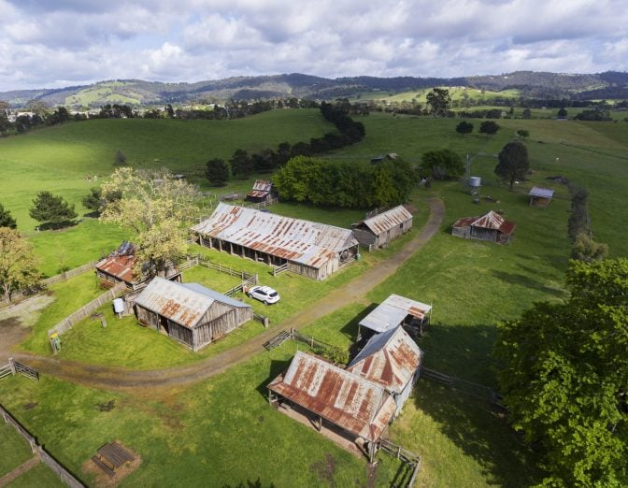
ODIN360 is currently undertaking the Gulf Station Masterplan assessment for NTV. The ODIN360 project team members that are undertaking that project are the same as the proposed members of the project team to undertake this Fashion and Dress Resource Feasibility Assessment. This means that the synergies between the two projects will be able to be maximised.
Whilst the Gulf Station project is focussed on the creation of a sustainable farm and this project is about the creation of a centre for the heritage costume collection, there are a number of synergies.
They both are focussed on the feasibilty and viability of new products for NTV.
The methodology being proposed for this project is similar to Gulf Station albeit with significantly more market research, product development and product testing.
We will also generally follow the same process across both projects which has met NTV requirements to date.
As a consequence of the Gulf Station Project, we have developed a good understanding of NTVV and its governance structure, operational model and core objectives. Pleasingly, we have also developed a good operating rhythm with the NTV team and work well collectively, which is one of the most important aspects of any project management.
In addition to the Gulf Station project, the ODIN360 project team has undertaken numerous other relevant projects in the past 2 years. A brief snapshot of several of those projects is detailed below. We would be pleased to provide further details as required.
5. Relevant Experience

Slide 30
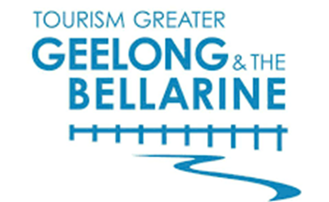

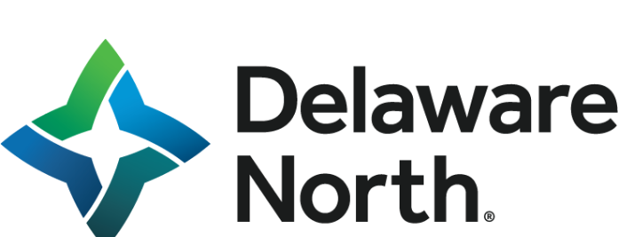
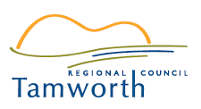




  Snapshot of relevant recent projects undertaken by project team in last 2 years
Multiple projects for GORCAPA on accommodation planning and experience development including;
Extensive market research to determine consumer needs
Extensive stakeholder engagement including with First Peoples
Product concept development and market testing
Site location analysis and selection
Financial feasibility assessment
Developing events strategy for the Tamworth Regional Council and reviewing the iconic Tamworth County Music Festival. Key tasks include:
Economic analysis of the region and analysis of competitor visitor economies
Review of commercial opportunities to broaden revenue base for events
Review of governance structure and processes for the management of events
Delivering a new governance model for Bellarine Railway and developing new products with a more commercial focus;
Audit of existing product, analysis of markets and exploration of potential new experience opportunities;
Extensive testing of new product concepts through market research
Financial overview of new proposed products
Development of new national tourism strategy including
Extensive market research to determine consumer needs
Visitor profiling and customer persona development
Product concept development and market testing
Site location analysis and selection
Financial feasibility assessment
Economic analysis, trends analysis, mobility data analysis, performance measurement, target audiences and gaps analysis of local visitor economy
Product and experience development
Stakeholder engagement
Attraction management modelling It also included regular council briefings and working with several levels of govt including DELWP.
Advising and assisting TWPZ with JMP in the development of a new masterplan
High level feasibility report on the future options for the zoo from a tourism, investment and infrastructure perspective.
Project included product development, infrastructure, services review, economic modelling, visitor profiling, job estimation and product experience needs analysis.
Iconic product development strategy for the Shipwreck Coast , Great Ocean Road, Victoria was undertaken by Karl Flowers
The objective of this project was to refine a Strategy for a prioritised set of iconic products that would maximise potential visitation using the infrastructure improvements proposed within the Shipwreck Coast Masterplan.
With JMP we have undertaken market research, analysis and strategic planning for Reflections Holidays Parks group, which comprises 45 parks owned by the NSW Govt. including
detailed visitor profiling,
brand and destination satisfaction, reason for travel,
awareness, intention, preferences,
product development and
demand drivers.

Slide 31
Stage | Indicative Date
Project Inception | 10 September 2023
Situation Analysis | 27 October 2023*
Market Research | 27 October 2023
Issues & Opportunities | 17 November 2023
Economic and Accounting Analysis | 1 December 2023
Final Report | 15 December 2023
6. Project Timeline
*Some elements of the situation analysis may take longer
eg. site visits and consultation

Slide 32
Stage | $ (ex GST)
Situation Analysis | 25,500
Market Research | 20,000
Issues & Opportunities | 11,500
Economic and Accounting Analysis | 15,500
Final Report | 7,000
TOTAL | 79,500
7. Project Costs
Travel to and from the sites is excluded and will be chargeable at 78c per km for own car travel

Slide 33
ODIN360 Insurance
Type | Insurer | Policy No | Value | Dates
Public Liability | Allianz | 132SV07541COM | $20m | 16/08/2023 16/08/2024
Professional Indemnity | AIG Australia | BZF2012997 | $10m | 16/08/2023 16/08/2024
Workers Compensation | DXC | 16205268 | Statutory policy | 01/07/2023 30/06/2024
8. Insurance

Slide 34
9. Contact Details
If you have any questions in relation to this submission,
please do not hesitate to contact:
Steven Wright
Managing Director
ODIN360
E: steven.wright@odin360.com.au
M: +61 407 800 518
W: www.odin360.com.au
ODIN360 Locations: Melbourne, Sydney, Brisbane, Perth, Gold Coast, Hobart

