Slide 1

Advice and Counsel through email
Chris Foster for ABC LawFirm P.C.
Go to www.pollev.com/chrisfoster988
Notes:
Roadmap

Slide 2
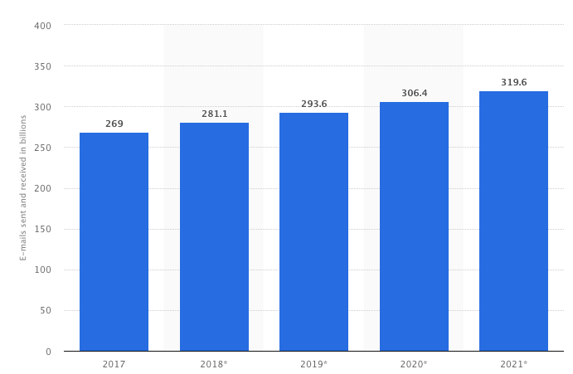
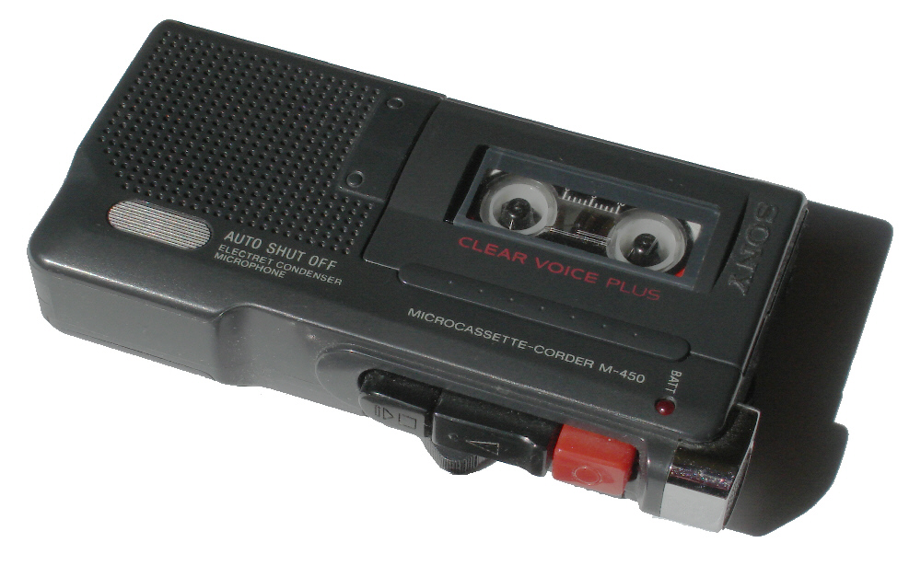
Email overload: Why!
According to The Radicati Group, in 2022 333.2 billion emails were sent per day
In 2018, the number of emails received per day by average worker: 121
Tremendous improvement over communications in mid-1990s
Easy to produce, cheap storage, efficient delivery
This Photo by Unknown Author is licensed under CC BY-SA
Notes:
Important to understand the environment.
Tell story of how I communicated as a young lawyer in 1995. Dictated into a tape recorder. Mention that Chief Justice John Roberts was a young partner at the firm.

Slide 3
To | ABC on Demand
From | Tom Gardener Associate Counsel, Employment Law MB Enterprises
Subject | Medical Marijuana
Our HR VP wants us to eliminate the company’s practice of allowing employees to use marijuana at home or at work upon the employee’s attestation of a medical need for medical marijuana. Some executives have complained to HR that marijuana use at work is degrading productivity and damaging our reputation with clients and potential clients.
By the way, I don’t allow any employees in the corporate compliance department to use marijuana under any circumstances, no matter where the employee is located. We randomly test them and fire anyone who fails the test.
We want to be as restrictive as possible and make a complete 360-degree change, while complying with applicable federal and state laws. Please answer a narrow question with these facts in mind. Can we maintain a marijuana-free company? If not, what’s the most we can do to duplicate my department’s practice throughout the rest of the company?
I have a meeting next week with the HR VP who wants to move in this direction, and I’d like to have an answer then. Can you get back to me by tomorrow?
Tom

Slide 4

Agenda
Preparation and process
Audience and purpose
Characteristics of a quality response
  Quick
  Clear
  Concise

Slide 5

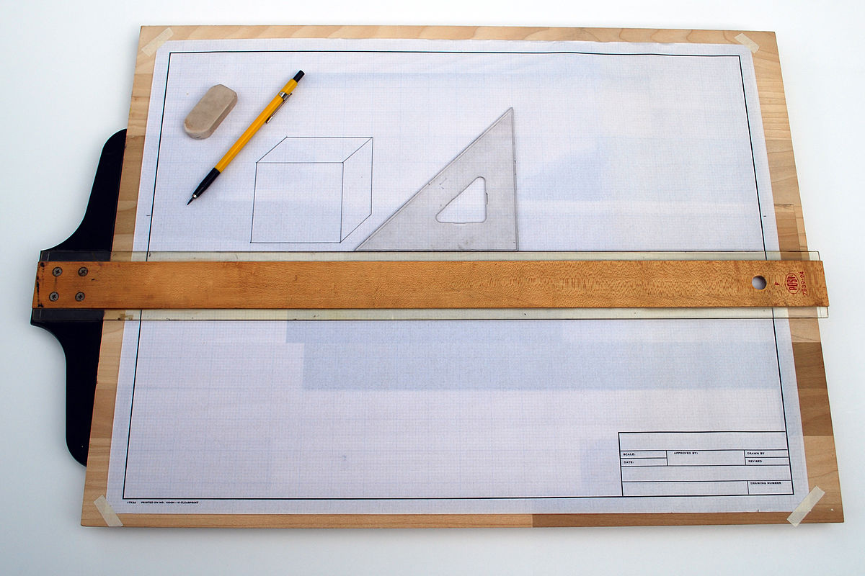


Four stages of the writing process
Madman, the creative force who generates the ideas
Architect, the planner who builds the structure for the document
Carpenter, the craftsman who writes a draft
Judge, the reviewer who edits the draft

Slide 6

Clarify the question and the timing
Sometimes a little clarity is required
Seek clarity in, egads, a phone call or a short email
Then confirm the scope of the inquiry in an email
  In scope: Address ability to restrict marijuana use in six states
  Out of scope: consequences of past practices in compliance department
  Timing
Notes:
Very sensitive information. Too complicated to explain in an email. Really want to understand how the other person is thinking or feeling.

Slide 7
To | ABC on Demand
From | Tom Gardener Associate Counsel, Employment Law MB Enterprises
Subject | Medical Marijuana
Our HR VP wants us to eliminate the company’s practice of allowing employees to use marijuana at home or at work upon the employee’s attestation of a medical need for medical marijuana. Some executives have complained to HR that marijuana use at work is degrading productivity and damaging our reputation with clients and potential clients.
By the way, I don’t allow any employees in the corporate compliance department to use marijuana under any circumstances, no matter where the employee is located. We randomly test them and fire anyone who fails the test.
We want to be as restrictive as possible and make a complete 360-degree change, while complying with applicable federal and state laws. Please answer a narrow question with these facts in mind. Can we maintain a marijuana-free company? If not, what’s the most we can do to duplicate my department’s practice throughout the rest of the company?
I have a meeting next week with the HR VP who wants to move in this direction, and I’d like to have an answer then. Can you get back to me by tomorrow?
Tom

Slide 8
Agenda
Preparation and process
Audience and purpose
Characteristics of a quality response
  Quick
  Clear
  Concise
Notes:
What is your audience? What are the implications of that audience?
What is your purpose? What are the implications of that purpose?

Slide 9

nature of Audience
Size
Knowledge
Concerns
Role
Relationship
Notes:
Who is your reader? Who are your READERS?

Slide 10

Notes:
Poll Title: Do not modify the notes in this section to avoid tampering with the Poll Everywhere activity.
More info at polleverywhere.com/support
Who is your audience? Who reads the documents your write? Be specific.
https://www.polleverywhere.com/free_text_polls/LGxuboSwvmAatEUnDhr8m

Slide 11

Readers of your guidance
Initial recipient of your email
Employment or labor lawyer of client
Other lawyers in the client’s legal department
Human resources professionals
Executives at your client
Subject matter experts at ABC
All of the above but one year later
Notes:
Readers will have varying levels of legal expertise. Varying levels of understanding of the factual background. Varying levels of interests in the specifics of the question and the answer. Varying levels of expertise.

Slide 12

purpose
Information in response to a specific request
Limitations
  Not persuading, not entertaining
  Request must be appropriately specific
  Answer must be within your knowledge
  Answer must meet the deadline
Notes:
Three types of writing: persuasive, entertaining, informative.

Slide 13
To | Tom Gardener MB Enterprises
From | ABC on Demand
Subject | Medical Marijuana
Thank you for your question. My apologies for the tardy response. Unfortunately, eliminating employee use of marijuana throughout the entire company may be more easily said than done, implicating as it does a complicated patchwork of federal and states laws that affect employee use of medical marijuana, including but not limited to states with explicit laws granting employees with a documented medical need for marijuana use to engage in that use and other states that have indirect protections for employee use of medical marijuana in certain circumstances. Nevada is instructive. There, Nevada state law (NRS 678C.850(3), a statute in the NRS Chapter on the Medical Use of Cannabis) requires employers to make reasonable accommodations for employees with medical marijuana cards, and the state’s supreme court recently recognized a private right of action under NRS 678C.850(3) to enforce that statue. Nevertheless, in the time allotted for the response you have requested, we are unable to give you a state-by-state primer on the legality of extinguishing the permissibility of rampant marijuana use among your workforce. You won’t be able to prohibit it everywhere, that much is certain, even though you apparently prohibit it throughout your department (let’s discuss). Why? Because some states have established laws that prohibit a company from forbidding employees with a medical need for marijuana use to use marijuana. These laws probably exist in some of the states in which you operate and in which you will have employees. Can you send me a list of your states?
Regards,
Cliff
Notes:
Poor response to client’s request. Then will look at a more effective response to the request.

Slide 14
Agenda
Preparation and process
Audience and purpose
Characteristics of a quality response
  Quick
  Clear
  Concise

Slide 15
Characteristics of a quality response: Quick
Time
On time (after shaping and meeting the expectations)
Identify
Identify the question (critical for clarity)
Answer
Answer the question right away

Slide 16
To | Tom Gardener MB Enterprises
From | ABC on Demand
Subject | Medical Marijuana
Thank you for your question whether MB Enterprises may discipline employees who use marijuana (even to treat a medical condition) in the six states where it operates. You may, except in Colorado or Nevada.
…
Restate question
Quick answer

Slide 17

Email openers
You asked whether ….
This email responds to your question whether …
You requested guidance on the ability of …
In your email last week, you explained that …
Two of your businesses, I understand, would like to …
I have prepared guidance on your proposal to …

Slide 18
Characteristics of a quality response: CLEAR
Use short paragraphs
Use cues (bullets, numbers, headings, subheadings)
Topic sentences – consistently
Include information in descending order of importance
Identify any assumptions and key facts

Slide 19
To | Tom Gardener MB Enterprises
From | ABC on Demand
Subject | Medical Marijuana
Thank you for your question whether MB Enterprises may discipline employees who use marijuana – even to treat a medical condition -- in the six states where it operates. You may, except in Colorado or Nevada.
MB Enterprises, I understand, employs personnel in Alabama, Colorado, Florida, Mississippi, Louisiana, and Nevada. This advice does not address whether the Company’s past or current practices concerning marijuana use comply with federal or state law.
Prohibition Allowed in Alabama, Florida, Mississippi, and Louisiana. In these four states, you may prohibit employees from appearing at work under the influence of marijuana or using marijuana at work. To enforce that rule, you may randomly test your employees and discipline those who fail a test, provided that the Company implements an appropriately designed testing program. We can help you develop a drug testing program; just let us know.
  The laws in three of these states – Alabama, Mississippi, and Louisiana – do not permit the recreational or medical use of marijuana. Florida citizens may use marijuana to treat a medical condition, but they are not entitled to work under the influence of marijuana.
…
Assumed facts
Out of scope
Cues
Topic sentence
Short paragraphs

Slide 20
Use structural Cues
Before
Individual Work Habits: As noted in your performance evaluation and as discussed, significant improvement must be made in this area. The professionals you assist must feel comfortable delegating projects/matters to you and they need to know you will take care of whatever is required efficiently and effectively, with minimal follow up on their part. You must increase their confidence in your ability and willingness to assume responsibility, to complete and follow through on assignments without close supervision, to effectively meet deadlines, and in your attention to detail and your organizational skills.
It is essential that you minimize your time on the telephone and away from your desk in order to maximize your efficiency and productivity, particularly as the workloads of the professionals you assist have increased and they need to rely more and more on the availability of their secretary. As noted, your performance has created reluctance on their part to delegate responsibilities and tasks to you and has resulted in their holding back due to lack of confidence and trust in your ability to manage and complete assignments successfully. You must take the initiative to change this perception of your responsiveness by improving your performance and regaining their confidence.

Slide 21
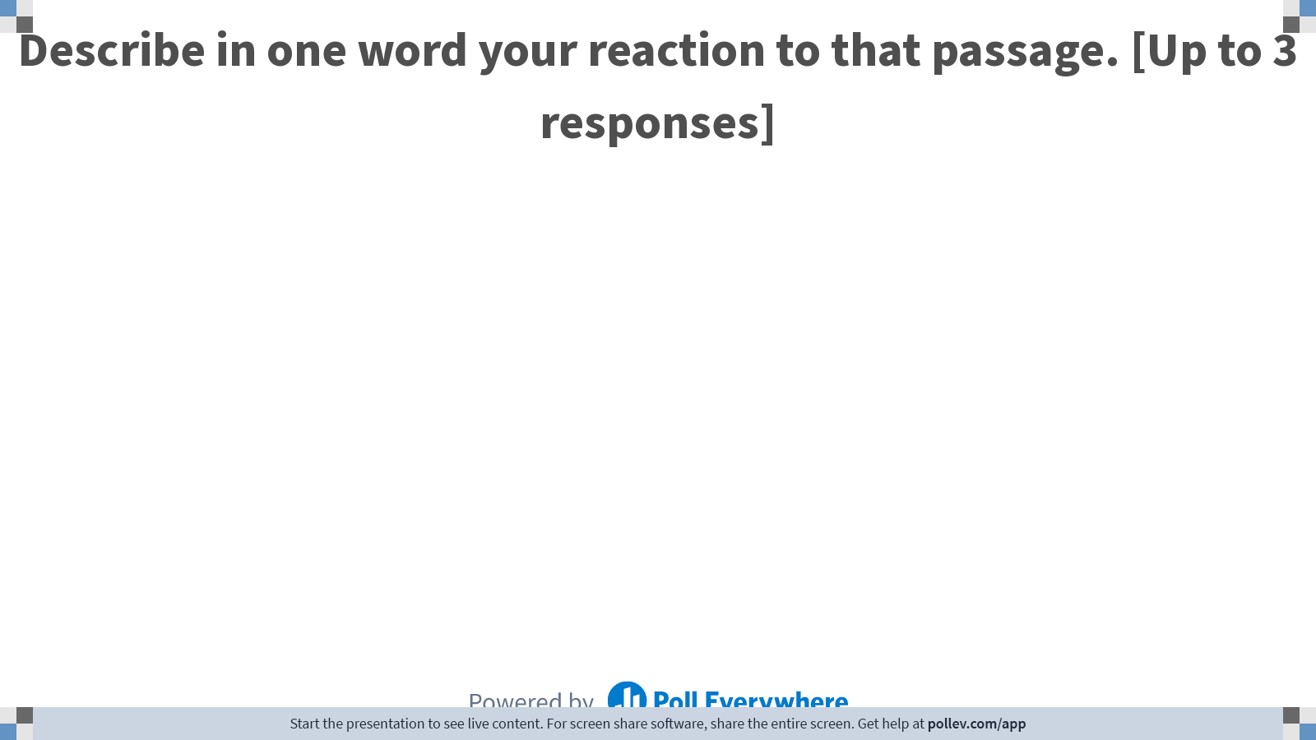
Notes:
Chris
Poll Title: Describe in one word your reaction to that passage:
https://www.polleverywhere.com/free_text_polls/fzTA0vpxiX5CQzZjMf7rK

Slide 22
Use Structural Cues
AFTER (with Headings, Paragraphs and Bullets)
Individual Work Habits:
As noted in your performance evaluation and as discussed, significant improvement must be made in this area as follows:
Independence and professionalism: The professionals you assist must feel comfortable delegating projects/matters to you. You must increase their confidence in your ability and willingness to assume responsibility, to complete and follow through on assignments without close supervision, to effectively meet deadlines, and in your attention to detail and your organizational skills.
Availability: It is essential that you minimize your time on the telephone and away from your desk in order to maximize your efficiency and productivity.
Responsiveness: Since there has been an ongoing issue with your responding quickly and accurately to requests from all with whom you work, as we have discussed in the past, special attention must be paid to opening and responding to emails promptly.
Notes:
See how it’s easily revised to be more accessible.
Subheadings, bullets, and numbers help with reading digestion.
Can make a huge difference.
Tragically underutilized by lawyers.

Slide 23
Characteristics of a quality response: concise
Use plain language
1
Reduce zombie nouns
2
Limit strings of prepositional phrases
3
Limit linking verbs (“to be” verbs)
4
Limit subject-verb-object interrupters
5
Prefer active not passive voice
6
Avoid expletives
7

Slide 24

Three skills involved
Identifying a sentence that can be improved
Identifying the problem
Revising the sentence
Trust your instincts!
Notes:
Identifying a poor sentence: Trust your instincts!

Slide 25

Use plain language
It is incumbent upon us
In the vicinity of
In order to
In light of the fact that
On two different occasions
Conducted an interview
The intention of the Legislature
Rate of pay
Clearly and unequivocally satisfies
The order should be granted by the Court
And no legal jargon!
Notes:
Use plain language.
Look for wordy phrases and terms.
We must
Near
To
Because
Twice
Interviewed
The legislature intended
Pay
Clearly
The Court should grant

Slide 26
Reduce Zombie nouns
Words that end in –ion that began as verbs
They leak energy from your writing. Change these nouns into verbs.
Three benefits:
  Eliminate prepositions;
  Eliminate “be” verbs; and
  Specify who does what.
Are in mitigation of
Conduct an examination of
Make accommodation for
Make provision for
Provide a description of
Submit an application
Take into consideration

Slide 27
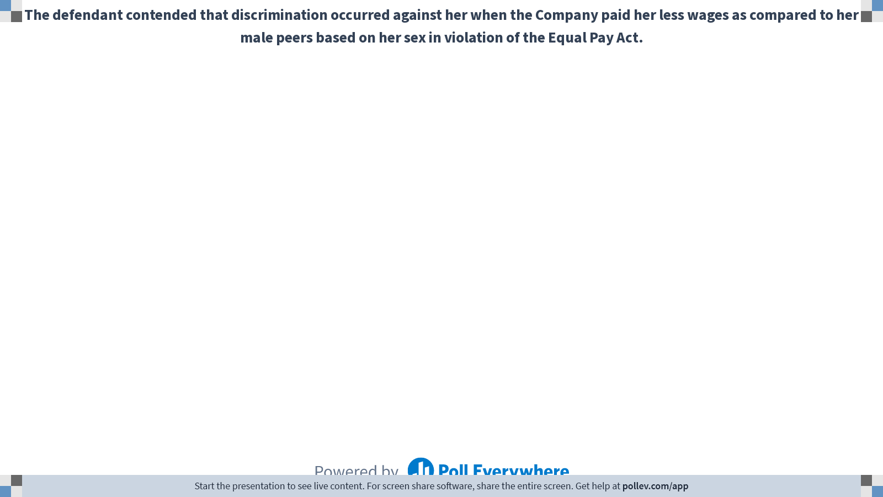
Notes:
Poll Title: Do not modify the notes in this section to avoid tampering with the Poll Everywhere activity.
More info at polleverywhere.com/support
In the event of termination of this Contract by the Company before expiration of the term, Contractor must pay all costs that the Company has incurred as of the date of termination.
https://www.polleverywhere.com/free_text_polls/6LoBkMTjX9iF1yFD42l5z

Slide 28

Rehabilitate “Of’s”
Whenever you can, revise prepositional phrases using the preposition “of”.
Reducing the use of these phrases usually adds energy and pace and decreases the number of words.

Slide 29
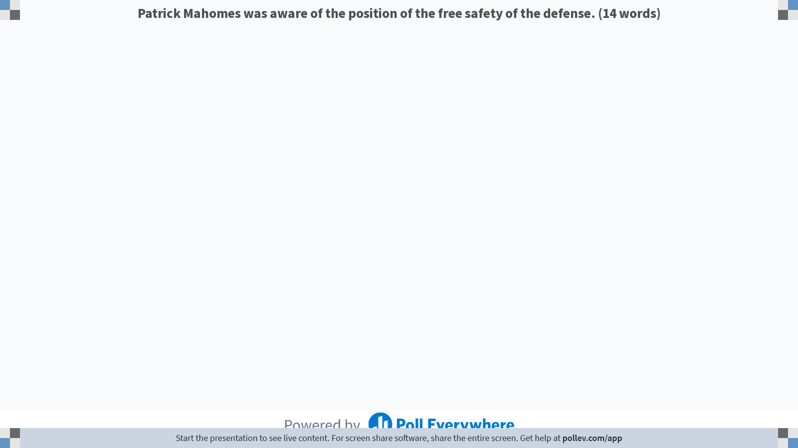
Notes:
Poll Title: Do not modify the notes in this section to avoid tampering with the Poll Everywhere activity.
More info at polleverywhere.com/support
Mahomes was aware of the position of the free safety of the defense.
https://www.polleverywhere.com/free_text_polls/Oi7R2MHCwUlMubgkGhoDm

Slide 30

Notes:
Poll Title: Do not modify the notes in this section to avoid tampering with the Poll Everywhere activity.
More info at polleverywhere.com/support
The combination of these three reforms -- regulation of the insurance markets, a mandate for coverage, and credits for taxes -- enabled a drastic reduction by the State of Massachusetts in the number of its uninsureds.
https://www.polleverywhere.com/free_text_polls/HQ8cL1bJOpdaYCI3Rfdre

Slide 31

The combination of these three reforms—insurance market regulations, a coverage mandate, and tax credits—enabled Massachusetts to drastically reduce its uninsured rate.
King v. Burwell, 576 U.S. 988 (2015)

Slide 32

Answer: Not “To Be”
Change linking verbs such as “be” verbs into powerful, active verbs.
Is, am, are, was, were, be, been, being, etc.
Not equivalent to passive voice, but they lack energy.
Exercise: highlight every “be” verb in your document.
The statute is clear that an employer may not prohibit the use of medical marijuana.
The statute clearly prohibits employers from banning the use of medical marijuana.

Slide 33

Notes:
Poll Title: Do not modify the notes in this section to avoid tampering with the Poll Everywhere activity.
More info at polleverywhere.com/support
The professional charges in this contract are dependent on the estimations that the engineers are in agreement must be completed first.
https://www.polleverywhere.com/free_text_polls/Ln1G4o0QsTzhq2okzJXSi

Slide 34
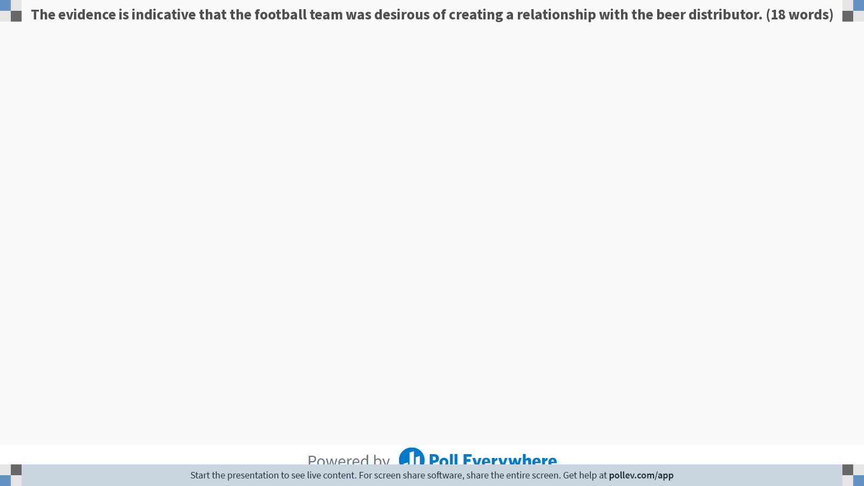
Notes:
Poll Title: Do not modify the notes in this section to avoid tampering with the Poll Everywhere activity.
More info at polleverywhere.com/support
The evidence is indicative that the football team was desirous of creating a relationship with the beer distributor.
https://www.polleverywhere.com/free_text_polls/L8KltppiGbupsZYiyjzC9

Slide 35

Sentence Structure: Sentence Basics
Place the subject close to the verb
Place them both near the beginning of the sentence.
Experiment with keeping the verb and object close together.
The boy threw the ball.
Keep “modifiers” near the words they modify.
  Joan, the quintessential organizer of company events, recently left the company where she had worked for seven years.

Slide 36

Subject - Verb – Object Interrupters
By letter dated November 10, 2003, a copy of which is attached as Exhibit A (the “Request Letter”), Mr. Silverton, of Silverton Commodities, LLC (“The Company”), requested that, in connection with your examination of the financial statements of the Company as of March 10, 2003, we furnish you with a description and evaluation of certain matters with respect to which we have been engaged and to which we have devoted substantive attention in the form of legal consultation on behalf of the Company. (83 words)
Notes:
Have someone read this
Why is this hard to process?

Slide 37

Subject - Verb – Object Interrupters
By letter dated November 10, 2003, a copy of which is attached as Exhibit A (the “Request Letter”), Mr. Silverton, of Silverton Commodities, LLC (“The Company”), requested that, in connection with your examination of the financial statements of the Company as of March 10, 2003, we furnish you with a description and evaluation of certain matters with respect to which we have been engaged and to which we have devoted substantive attention in the form of legal consultation on behalf of the Company.
Notes:
Apply techniques to decipher and rephrase this awful sentence.

Slide 38

Subject - Verb – Object Interrupters
In his letter on November 10, 2003 (“Exhibit A”), Mr. Silverton with Silverton Commodities, LLC asked us to describe and evaluate the legal advice we have given to the Company. The request relates to your recent examination of the Company’s financial statements. (About 50% of the original)
Notes:
In a letter dated November 10, 2013 (“Exhibit A”), Mr. Silverton with Silverton Commodities, LLC asked us to describe and evaluate for you our legal advice to the Company. The request relates to your works to examine the financial statements of the Company as of March 10, 2003.

Slide 39
Passive Voice
Active voice
The arbitrator resolved the dispute.
Subject → verb → object
Passive voice
The dispute was resolved by the arbitrator.
Object → verb → subject
Absent-actor passive voice
The dispute was decided.
Object → verb
Notes:
Identify passive voice: 1) form of verb to be 2) past tense verb, and 3) preposition “by”

Slide 40

Active Voice
Why use active voice?
  Promotes brevity
  Promotes clarity
  Uses more vigorous verbs
  Combats logical haziness
When to use passive voice?
  The actor is unknown or unimportant
  The emphasis is on the object

Slide 41
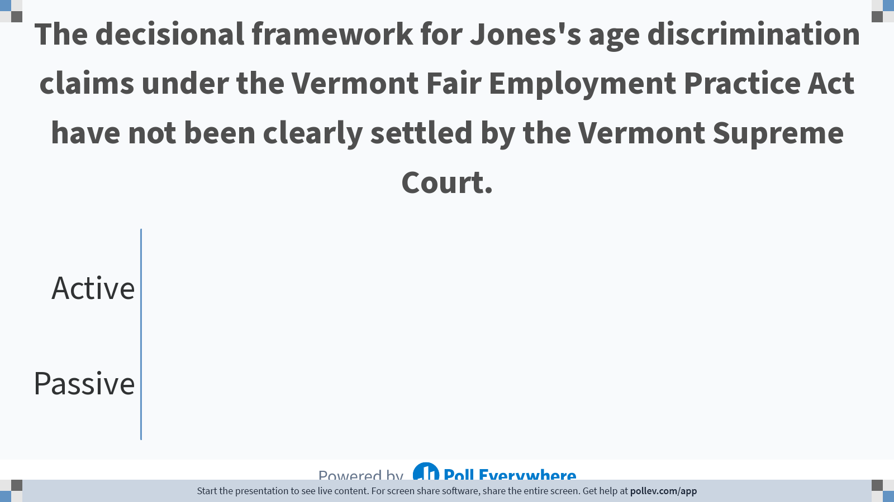
Notes:
Poll Title: Do not modify the notes in this section to avoid tampering with the Poll Everywhere activity.
More info at polleverywhere.com/support
We were invited by our neighbors to attend their party.
https://www.polleverywhere.com/multiple_choice_polls/12TAcf8hlZ7YLJ6gcjFJ5?flow=Default&onscreen=persist

Slide 42
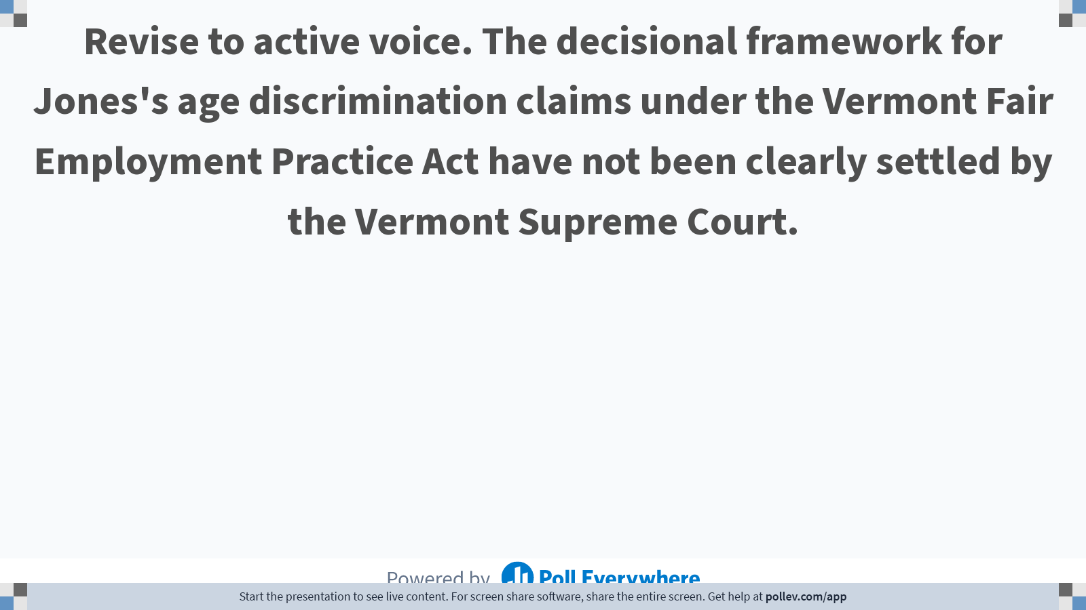
Notes:
Poll Title: Do not modify the notes in this section to avoid tampering with the Poll Everywhere activity.
More info at polleverywhere.com/support
Revise to active voice. We were invited by our neighbors to attend their party.
https://www.polleverywhere.com/free_text_polls/LE42ZITqLJ8OHZOO9KDJJ

Slide 43
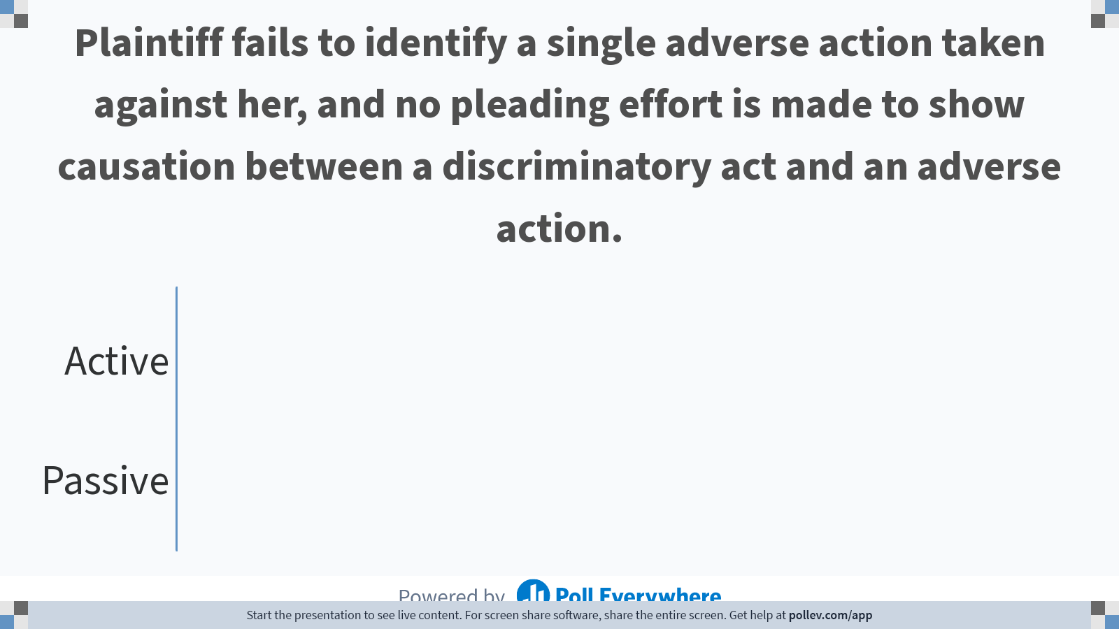
Notes:
Poll Title: Do not modify the notes in this section to avoid tampering with the Poll Everywhere activity.
More info at polleverywhere.com/support
The proposed rule will be strongly opposed.
https://www.polleverywhere.com/multiple_choice_polls/hkWVXj4fTHF3w9l6EZ7Xs?flow=Default&onscreen=persist

Slide 44
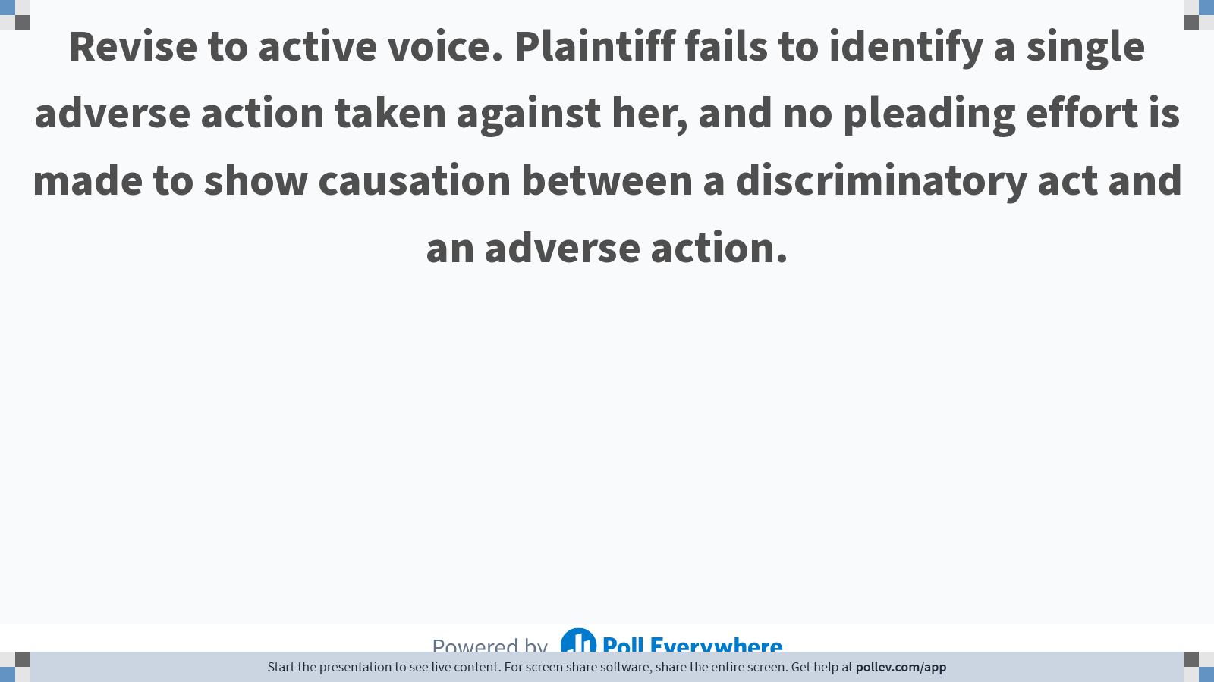
Notes:
Poll Title: Do not modify the notes in this section to avoid tampering with the Poll Everywhere activity.
More info at polleverywhere.com/support
Revise to active voice. The proposed rule will be strongly opposed.
https://www.polleverywhere.com/free_text_polls/1SGyH5307XzbhDi6Ei7cQ

Slide 45

Brevity: Eliminate Expletives
Avoid expletives: there is, there are, here is, it is, it was
Creates wishy-washy sentences
Find the hidden verb
It was never the Trustee’s intention to distribute the funds.
The Trustee never intended to distribute the funds.
Notes:
These are called expletives, Generally to be avoided. Can almost always say it better.

Slide 46
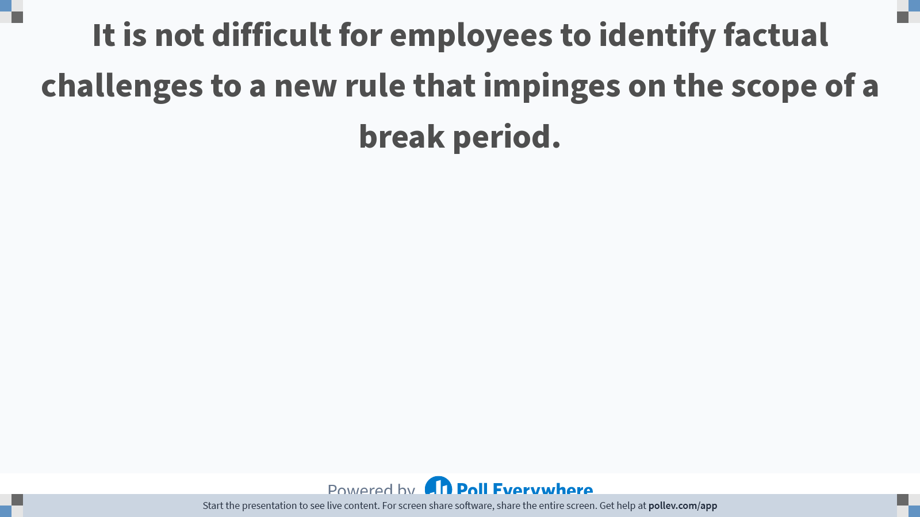
Notes:
Poll Title: Do not modify the notes in this section to avoid tampering with the Poll Everywhere activity.
More info at polleverywhere.com/support
There are four other social media platforms we should engage.
https://www.polleverywhere.com/free_text_polls/ULFuI6mEeiMWlHWcOUg8i

Slide 47
Characteristics of a quality response: concise
Use plain language
1
Reduce zombie nouns
2
Limit strings of prepositional phrases
3
Limit linking verbs (“to be” verbs)
4
Limit subject-verb-object interrupters
5
Prefer active not passive voice
6
Avoid expletives
7

Slide 48
Agenda
Preparation and process
Audience and purpose
Characteristics of a quality response
  Quick
  Clear
  Concise

Slide 49
Advice and Counsel through email
This Photo by Unknown Author is licensed under CC BY
Chris Foster for ABC LawFirm P.C.

