Slide 1
Changes we’d like to see. Comments are based on 31574283
Thank you for your work on the latest draft. We’re getting close. Here are the changes we’d still like:
Please with your next edits provide us the information in a PowerPoint so we can see how the designs will be incorporated into documents we’ll use.
For the Table of Contents, we are still looking for the designs to be shifted to the left so that the chapter information has a left alignment.
Cover and Back - Please respond in messages about how we can ourselves replace the pictures that are used in the cover and back photos.
Main body slides –
  Please move the title text up to be at the same level as the logo to the right. We want the text box to go across the top and stop a little before the logo and for the title text box to have room for two rows of title text (see slide 2)
  Please delete the green line under the logo but keep the one on the left and place it so two rows of text will fit. (see slide 2)
  For the footer:
    do not include the thick parts at the beginning and end of the line
    do keep a gap (not an arrow)
    add a little more white space on the bottom part of the arrow so it’s clearer that it is an arrow, and move the page number down, within the arrow, to be at the same level as the other footer font. (see slide 3)
  The bullet types you’ve provided are too flashy for us. Could you please change to just a dot (circle filled in), a square, and a circle not filled in? (see slide 4)
For colors, see the following (see slide 5)
For the final salutation (thank you) slide, we don’t like the multiple pictures – and would prefer something similar to the example we provided (slide 6)

Slide 2
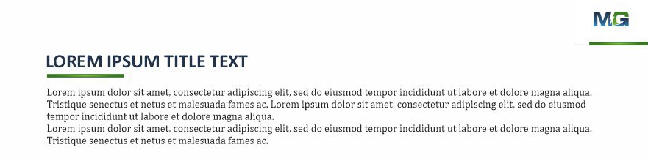
delete
Move this up

Slide 3


Slide 4
We are used to fairly plain bullets, such as the following:
Level 1
  Level 2
    Level 3
      Level 4

Slide 5
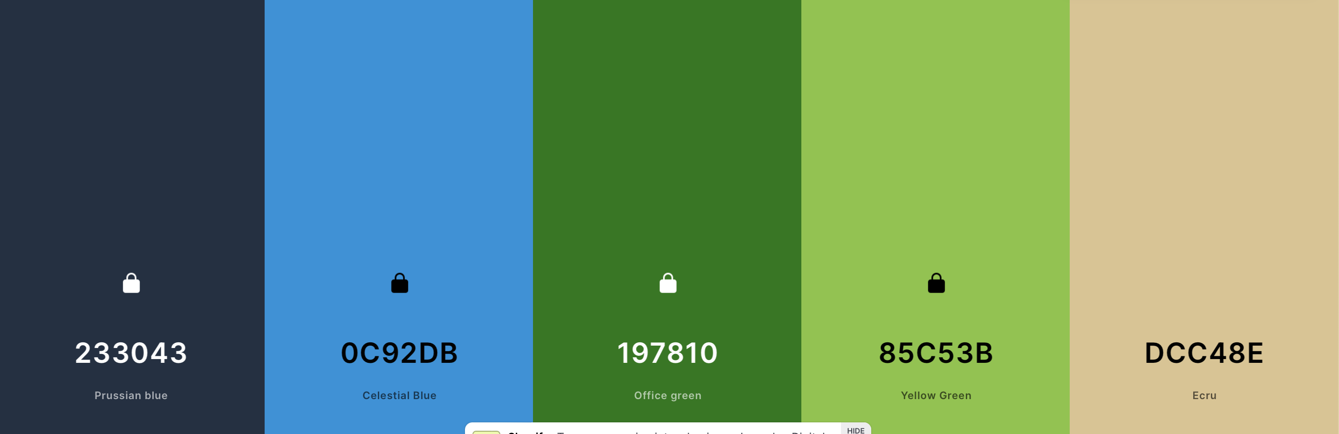
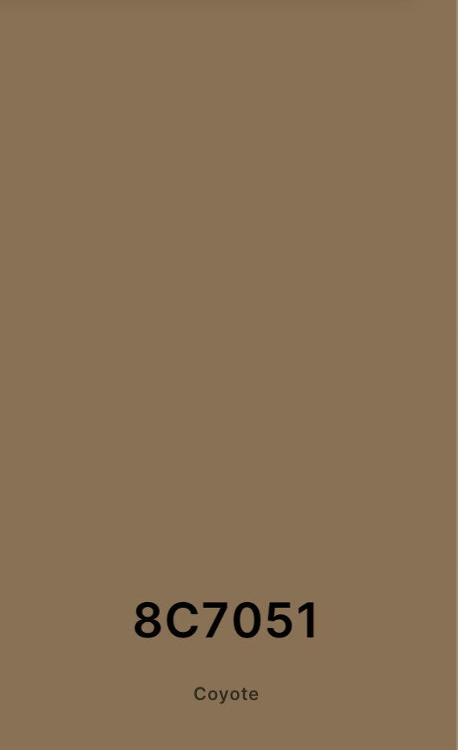





Colors – Please use these.

Slide 6

Would like something like this as an additional ending slide. Stylized consistent with the way you have done things.

