Slide 1
The following are our initial thoughts on what we would like for the PPT template. Of course, we welcome your insights and can provide additional feedback during the design process.
We are looking for professional and clean presentations (not a lot of extra graphics or unnecessary design elements)
Many of our slides use bullets to convey information in a simple and brief format.
  For bulleted text slides, we would like a standard hierarchy of font sizes and different bullet point styles for each level (see example that follows on slide 2)
  Such a slide may include a non-bulletized paragraph at the beginning of the slide
  Slides with bullets may or may not include space for graphics/photos
  Slides with bullets may be single or double-columned
Graphics in our presentations generally have specific purposes or are used to convey information (e.g. charts).
  Slides 6-20 below provide examples of the types of graphics we would like incorporated into a template for possible customization and use.
  We are not asking that you create slides with these exact graphics, but rather that your template, colors, and any other “tools” allow us to create these types of slides in a consistent manner.
  When used, graphics may be standalone or incorporate text (as most of the slides 6-20 are) OR they may be included on a slide that also has text (bulleted or not). Thus, the template should include slides that are:
    All graphics
    Graphic on the bottom half
    Graphic on the left half
    Graphic on the right half
While we may use photos for illustration purposes, we generally do not add them simply for style
Color separator in footer with standardized text to the left and numbering to the right
Use of our logo and color scheme (page 3 – we can supply all the graphical options and associated files)
We would like a color pallet (like Slide 21) that we can use for adding slides, graphics, etc. in the future

Slide 2
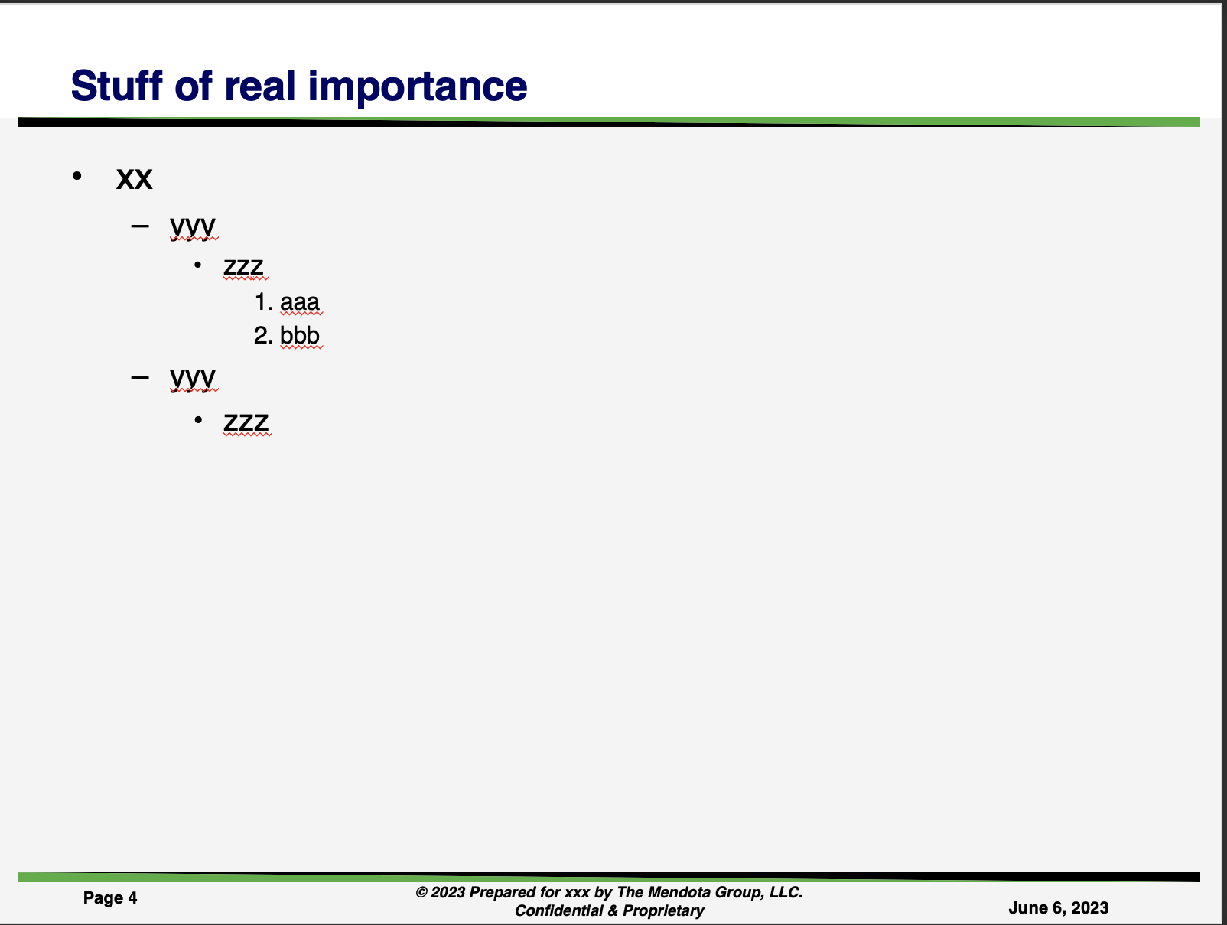

Slide 3


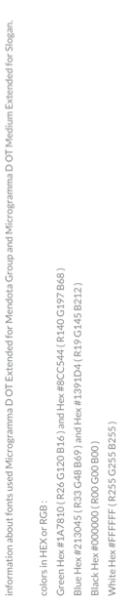


Slide 4
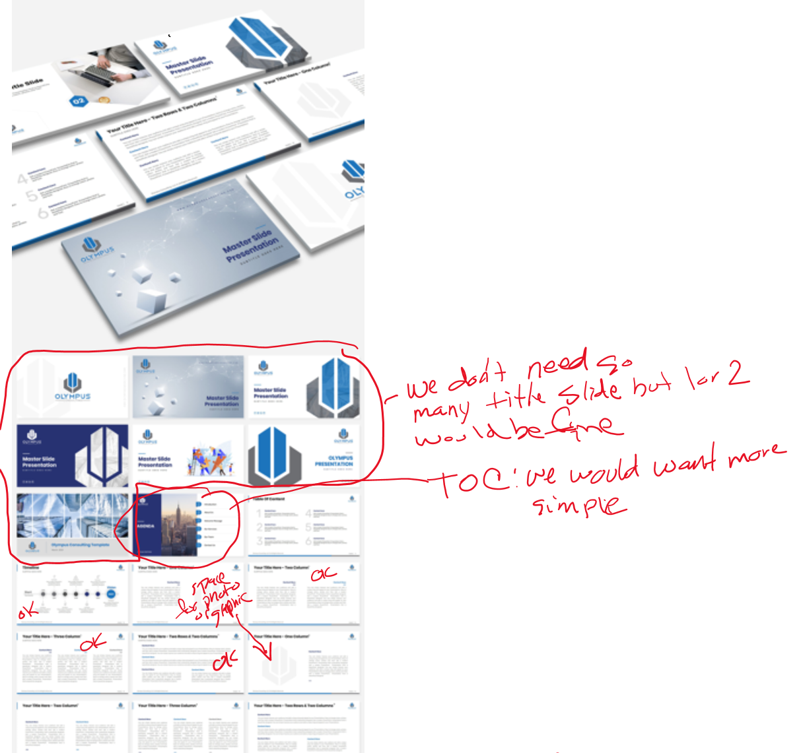
Here are some notes related to the design you did for Olympus.

Slide 5
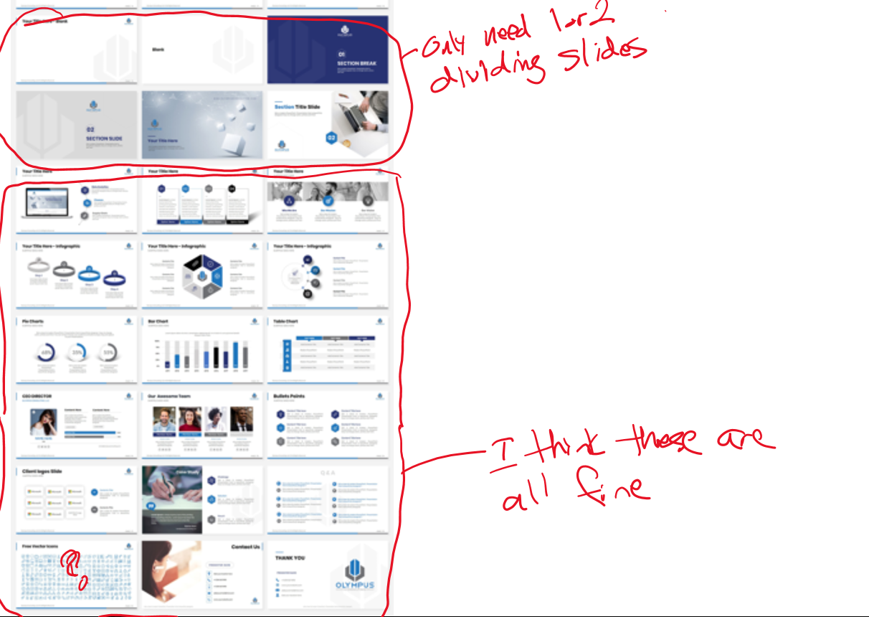

Slide 6
Title
Example of types of graphics we would like incorporated into a template for possible customization and use.
Phase I
Phase II
Phase III
Phase IV
Phase V
Review and Confirm Market Projections & Trends
Test Preliminary Market Proposition
Develop
Go-to-Market Options
Evaluate and Recommend Best Option
Outline Selected Go-
to-Market
Strategy
Review Analysis
Customer centric product capabilities & assessment
Ancillary equipment
Market research, analysis, and estimate
Identify information gaps
global objectives
Assess Outlook and Trends for Distributed Power
US and Canada
Worldwide
Project Market Size
Confirm spark spread
Map spreads
Analyze Competitors
Identify competitors
Analyze strengths and weaknesses
Measure against
Identify Customer Needs
Identify industries that likely need distributed power
Identify likely customers within identified industries
Develop interview instruments
Conduct interviews
Delineate value proposition
Assess Others’ Go-to-Market Strategies
Competitors’ go-to-market strategies
  Sales
  Distribution
  Service
Analogues in other industries
Develop Go-to-Market Options
Matrix of options for
  Sales
  Distribution
  Service
Develop
Appropriate evaluation criteria
Evaluate Key Elements
Options against criteria
The sales, delivery & service value chain for distributed power
I-R’s leveragable capabilities
Recommend
Most attractive option
Refine
Selected market proposition
“Go-to-market” strategy
  Sales
  Channels
  Service
Develop
Enablers across value chain
Organizational capabilities
Action plan to implement

Slide 7
Title
Example of types of graphics we would like incorporated into a template for possible customization and use.
Middle
Market
C&I
Mass Market
Transportation
Retail
Various Channels
Gas
E&P
Distribution
Distribution
Trading & Risk Management
Electric
Fuel
Sourcing
Generation
Trans-
mission
Increasing focus on satisfying customer needs and preferences
Increasingly liquid energy markets, enabled by easily-flowing information
Increasing competition from new entrants with diverse strengths
Integration of Gas and Electric value chains as gas fuels most new plants
Shifting balance of power providers to customers
Disaggregation and reaggregation
Refocusing of offerings to meet end-user and channel needs
Integrated trading of and between energy assets and markets of all types
Increasing clarity of business focus while business models proliferate
More M&A activity, creating more large dual-fuel companies and mega-entities
From generation to traders to large customers groups and affinity providers
Reaggregation based on economics and customer needs

Slide 8
Title
Example of types of graphics we would like incorporated into a template for possible customization and use.
Possible X Target Segments
All potential segments
Customer Interviews will provide information vital to the development of an effective go-to-market strategy for X
Select key target segments that have greatest market potential
True customer needs and preferences
Willingness to accept inherent characteristics of microturbines
Perceived image of Ingersoll-Rand and its competitors
Preference for owning vs leasing vs buying kWh
Price points
5 segments
Likely X Target Customers
Select companies to interview based on tiering, location, and fit with preliminary set of market propositions
Customers Interviewed
5 segments, 5 companies each in the US and Canada
10 interviews in each of the 2 international markets
45 companies

Slide 9
Title
Example of types of graphics we would like incorporated into a template for possible customization and use.
Potential Applications
Base Load
Peak Shaving
Cogeneration
Improved Reliability
Improved Power Quality
Deferral of Transmission and Distribution Expenditures
Ancillary Service
Strong
Name
Name
Aggressively Pursue
Implication for go-to-market strategy
MicroTurbine Competitive Position
Respond Opportunistically
Name
Name
Name
De-emphasize
Name
Weak
Low
High
Market Size and Growth Potential
Name
Market Application
Size of Circle equal to estimated 5 year Risk- Adjusted NPV

Slide 10
Bridging The Performance Gap
Example of types of graphics we would like incorporated into a template for possible customization and use.
The proposed program of change will significantly stretch X performance on all five elements.
Strategy
Process
Organization
Technology
Performance Management
Strategy
5
4
3
Performance
Management
2
Process
1
0
Technology
Organization
Baseline Company Performance
"Recommended" Performance
Best Practice Performance

Slide 11
We will then define the value chain and organization requirements to implement the selected strategy
Example of types of graphics we would like incorporated into a template for possible customization and use.
Illustrative
Source
Manufacture
Market
Sell
Distribute
Service
Requirements
Key Capabilities
Processes
IT Systems
KPI / Performance Systems
Staff/Structure
Skills
Ability to develop and implement marketing plan targeted towards PowerWorks target segments
Ability to manage relationship with target customers
Ability to physically distribute microturbines
Ability to provide superior customer service
Specific marketing processes to ensure marketing plan is delivered
Specific sales process to cover this market (call frequency, call coverage, accounting plan process, etc.)
Measurement systems to access share volume, actual pricing, and marketing spending vs. the competition
Sales coverage of target customers
Marketing KPI’s link with marketing staff’s performance evaluation systems
Sales organization performance measurement and objectives
Define reporting relationship and size of group responsible for PowerWorks marketing
Structure, size, and reporting relationship of sales group
Hire marketing people with knowledge/experience of PowerWorks’ target industries and customer segments
Hire sales people with utility and end-user industry knowledge

Slide 12
Managing for Value drives a shareholder value agenda through the organization
Example of types of graphics we would like incorporated into a template for possible customization and use.
Organizational Responsibility
Example
Metric
Decision Focus
Decision Type
Strategic
Portfolio analysis
Target setting
M&A
Business organization
Market participation strategy
Core competency/capability development
Product-level decisioning
Product/service attributes
Performance monitoring
Functional-level decisioning
Evaluation of business enablers (e.g., IT, BPO)
TSR
Internal businesses value
Business unit return
Free cash flow growth
Competitive position vs. peers
Process/ operational KPIs
Project NPV
Corporate
Resource/ Capital Allocation
Business Unit/ Divisional
Performance Management
Functional/ Business Processes
Behavioral Enablers
Compensation Linkages/Communications/Value Mindset

Slide 13
Portfolio decisions must be aligned with value creation
Example of types of graphics we would like incorporated into a template for possible customization and use.
Is there an opportunity
for UtilityCo to trade share for profitability in the unprofitable segment?
Can UtilityCo more aggressively grow Business2 through incentives, advertising and pricing?
Illustrative
VALUE-
CREATING
12%
Business 1
Business 3
Business 2
Business 4
Business 1
MARKET ECONOMICS
(SEGMENT PROFITABILITY)
REVENUE GROWTH
(4-YEAR CAGR)
Business 4
5%
(GNP and
Inflation)
Business 5
Business 2
Business 3
VALUE-
DESTROYING
VALUE
NEUTRAL
-2 %
- - - -
0
++++
-1700
0
1700
RELATIVE
COMPETITIVE POSITION
Would a more aggressive strategy more effectively exploit Business 4’s attractive market segment?
ECONOMIC PROFIT PER UNIT
(5-YEAR AVERAGE)
Comments:
Bubble size indicates each unit’s relative share of UtilityCo’s YTD1998 $sales
Comments:
Bubble size indicates each unit’s relative share of UtilityCo’s invested capital (of those items included)

Slide 14

Stock price reflects current market expectations of future cash flows vs. internal expectations
Example of types of graphics we would like incorporated into a template for possible customization and use.
Shareholder Value
Expectation Gap
Illustrative
$ B
Operating Margins
$6,000
$5,000
40%
Value Gap
35%
$4,000
30%
$3,000
25%
20%
Analysts
$2,000
15%
X
10%
Expectation Gap
$1,000
$0
5%
X
Analysts
1998
1999
2000
2001
2002
2003
2004
2005
2006
2007
Impact on X’s Shareholder Value by Improving
Value Driver Performance by + One Percent
Revenue Growth
4.5%
20.0%
17.0%
4.0%
18.0%
16.0%
13.1%
3.5%
14.0%
Valuation Sensitivity
12.0%
7.6%
3.0%
10.0%
6.1%
Analysts
8.0%
2.5%
6.0%
X
4.0%
0.4%
2.0%
Expectation Gap
2.0%
0.0%
1.5%
Revenue
EBITDA
Cash Tax
Working
CapEx to
Y axis clean
up scale
Growth Rate
Margin
Rate
Capital to
Sales
1.0%
Sales
1998
1999
2000
2001
2002
2003
2004
2005
2006
2007
Per Y analysis
Value Driver- external analysis

Slide 15
The business can be disaggregated to identify the areas of value creation and destruction
Example of types of graphics we would like incorporated into a template for possible customization and use.
Illustrative
Value
(Bn)
Invested
Value added/
Segment
Capital
Invested Capital
Generation
$ 11.8
$ 5.4
1.19
Distribution
$ 14.0
$ 6.7
1.09
1
Marketing
$ 6.1
$ 5.3
0..15
Non-Reg.
$ 2.6
$ 4.1
(0.37)
Nuclear
$ (2.6)
$ 2.1
(2.24)
Value Added*
Generation
Distribution
Marketing
Total
$ 34.3
$ 23.6
0.45
/ Invested
Capital
0
$4
$8
$12
$16
$20
Nuclear
Invested Capital
Non-Reg.
-1
-2.24
*Value Added = (Value / Invested Capital)-1

Slide 16
Required Information for Managing for Value Diagnostic
Example of types of graphics we would like incorporated into a template for possible customization and use.
FINANCIAL
INFORMATION
STRATEGIC
INFORMATION
OPERATIONAL
INFORMATION
HISTORICAL RESULTS
MARKET ISSUES & TRENDS:
ORGANIZATIONAL CHART:
Sales (by LOB, product, customer, etc.)
Profitability (by LOB product, customer, etc.)
Operating costs and capital (by product, function)
Share breakdown within markets (products, customer segments, etc.)
Product pricing
Size, growth & profitability of markets (LOB, products, customer segments, etc.)
For key management
For key functional & support areas
MGMT PLANNING PROCESSES:
FUTURE EXPECTED RESULTS:
END USER ISSUES & TRENDS:
Corporate strategy planning process (flow diagram)
Capital planning process (flow diagram)
Product strategy planning process (flow diagram)
Key process stakeholders
Performance Measures & Goals (overall, by LOB product, by functional unit)
Sales (by LOB, product, customer, etc.)
Profitability (by product, customer, etc.)
Operating and capital costs (by LOB, product, function)
Market segmentation
Market research
  Customer descriptive information
  Customer purchase behavior
  Customer perception/satisfaction
  (vs. competition)
SUPPLY CHAIN FUNCTIONALITY:
CAPITAL SPENDING:
COMPETITIOR COST & CAPITAL POSITION:
Plant descriptions, geographical locations, etc.
Plant operating capacities
Business Process Flow Diagrams
Other cost & capital information (not included in “Financial” Data)
Past initiatives & results
Current initiatives & expected results
Future planned initiatives & expected results
Competitive cost position information
Competitor supply chain data
Key competitive initiatives & investments

Slide 17
Several well-recognized CarCo nameplates destroy value
Example of types of graphics we would like incorporated into a template for possible customization and use.
Shareholder Value Added by Brand/Vehicle Platform
(including AutoParts and FinanceArm)
The value destroyed by SMALL12 more than negates the value created by the SUV1, SUV3 and SUV6 brands combined.
$4
$2.9
$2
$1.4
$1.3
$1.1
$0.8
$0.5
($ in Millions except Value Added)
$0.2
$0.1
$0.1
$0.0
Value Added /
Invested Capital
$0
Segment
Value
Invested
Value
$(0.2)
Capital
Added/IC
($0.5)
($0.5)
AutoParts
5,807
1,485
$2.91
-$2
SUV 1
2,470
1,012
$1.44
($2.0)
SUV2
10,480
4,521
$1.32
PU3
5,570
2,621
$1.12
($3.5)
MVAN4
9,409
5,346
$0.76
-$4
FinanceArm
4,880
3,366
$0.45
LARGE5
2,969
2,525
$0.18
SUV6
869
778
$0.12
-$6
$0
$15
$30
SPORT7
508
468
$0.08
SUV2
PU3
X
SUV8
1,303
1,297
$0.00
SUV1
MVAN4
LARGE5
SUV6
SUV8
PU11
X
785
969
($0.19)
SPORT7
SPORT13
AutoParts
FinanceArm
MED10
SMALL12
MED10
865
1,570
($0.45)
PU11
358
688
($0.48)
SMALL12
(2,248)
1,899
($1.95)
SPORT13
(210)
84
($3.49)
Cumulative Invested Capital ($ in Billions)
On the other hand, AutoParts generates $2.91 in value for every dollar invested
Figures based on internal business plans/forecasts for period 1998-02. Internal business plans may be overly optimistic. External market valuation of the business is 45% lower than valuation based on internal business plans
$6.5B in Capital
Source: CarCo 1998-02 internal business plans; Y analysis. Invested capital figures based on year-end 1997 business plan data.
Vehicle platform valuation estimates include allocations of AutoParts profits/capital per internal business plans.

Slide 18
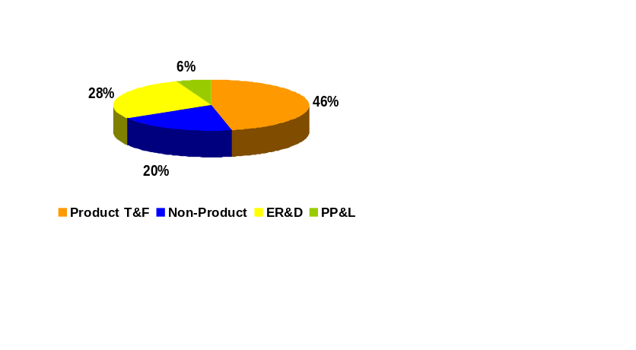
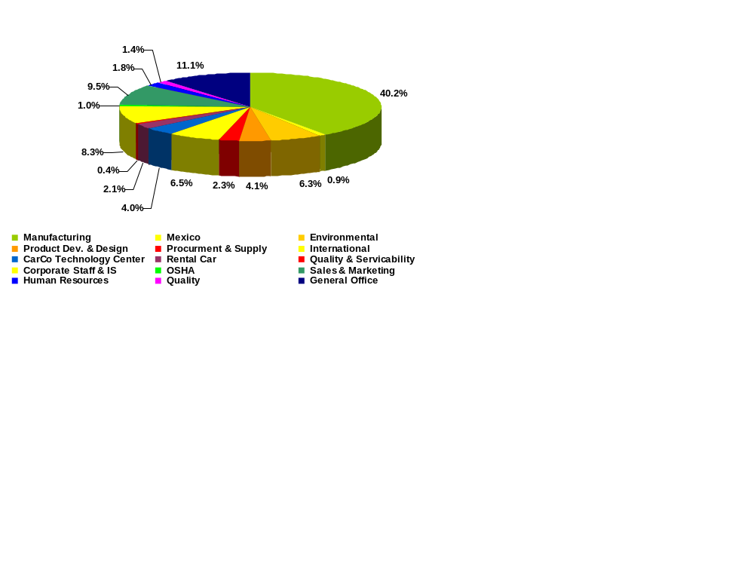
Despite significant investment in non-product areas . . .
Example of types of graphics we would like incorporated into a template for possible customization and use.
Non-Product Capital Expenditures by Type
(1998-2002)
Does non-product spending benefit products?
“Pure” Non-Product Capital Spending by Function
(1998-2002)
$ Millions % Total
Quality $835 10%
Mfg./Procure/Prod Dev. $5,377 64%
Regulatory $615 7%
Sales and Marketing $797 9%
Other $831 10%
Total $8,454 100%
How much non-product spending is related to replacement of equipment versus cost/quality improvement?

Slide 19
Examining X’s competitive/differentiation position
Example of types of graphics we would like incorporated into a template for possible customization and use.
X’S
DIFFERENTIATION POSITION:
IMPORTANCE OF
“DIFFERENTIATION DIMENSIONS”
CarCo’S PERFORMANCE
DRIVERS
OF X’S
RELATIVE TO PRICE:
VS. COMPETITION:
DIFFERENTIATION POSITION:
Price
CarCo
Chrysler
Ford
GM
Toyota
Isuzu
234
Design
208
12
Convenience
16
Perf
./
Eng
.
Prod. Quality/
86
Reliability
60
Safety
Fuel
Service Quality
19
21
Economy
Fuel Economy
21
29
Service
Safety
25
Quality
22
Convenience
Perf
./
Eng
.
25
30
Prod. Quality/
Design
42
34
Reliability
.
Design
./
Eng
Safety
Convenience
Peer
Perf
Fuel Economy
Service Quality
Product Quality
CarCo
Average
Importance Rating
Source: AAPA
Source: JD Powers & Associates, NHTSA, Consumer Reports, Automotive News
Final scores represent performance ratings
multiplied by importance scores
X’S
- -
X has a weak differentiation position -- which is largely driven by inferior product quality
DIFFERENTIATION
POSITION SCORE:

Slide 20
Staffing, Schedule & Fees, Cont.
Example of types of graphics we would like incorporated into a template for possible customization and use.
Project Week
1 2 3 4
5 6 7 8
9 10 11 12
13 14 15 16
17 18 19 20
21 22 23 24
25 26
0. Mobilize
1. Review and Confirm Market Trends & Projections
2. Test Preliminary Market Proposition
3. Develop Go-to-Market Options
4. Evaluate and Select Best Option
5. Outline Selected Go-to-Market Strategy
W
M
W
M
W
W
M
Working Session =
Review Meeting =
M
W
M
A reasonably aggressive schedule indicates project completion in 25 weeks

Slide 21
Color Pallet
This is not our color pallet but, rather, an example of a slide we would request that shows what colors were used in the template.
Black Type
White Type
Black Type
White Type
Black Type
White Type
Black Type
White Type
APX Green
R51, G153, B51
APX Blue
R0, G0, B102
APX Line Grey
R153, G153, B129
White
R255, G255, B255
Black Type
White Type
Black Type
White Type
Black Type
White Type
Black Type
White Type
Bordeaux
R120, G40, B42
PMS 697
Ocean
R49, G68, B115
PMS 534
Terracotta
R163, G93, B0
PMS 160
Wheat
R209, G164, B0
PMS 12456
Black Type
White Type
Black Type
White Type
Black Type
White Type
Black Type
White Type
Earth
R89, G57, B0
PMS 161
Sand
R214, G178, B122
PMS 465
Olive
R141, G122, B0
PMS 385
Black
R0, G0, B0
PMS 5

