Slide 1
Company Background – We are a U.S.-based small consulting company that provides services to electric and gas utilities in support of their sustainability efforts (mainly, encouraging their customers to save energy and buy renewable energy, and helping the utility reduce its carbon emissions). https://mendotagroup.com
What We Need – We need a stylized PowerPoint template that leverages our logo and colors, designed to be professional and clean. Our clients are big companies and governments and, therefore, we need our presentations to be professional-looking. Specifics:
  We use and would like you to use PowerPoint’s Slide Master and incorporate colors into the Slide Masters’s Colors, Fonts and Themes
  Our logo has several variations – see slide 2 – we defer to you in terms of which logo variants to use and how (we have no general preference other than calling one version our “main” logo;
  We prefer not to have a lot of extra graphics or unnecessary design elements on the slide master slides;
  Please expand our color palette as you see fit with neutral tones that fit with our primary colors (see primary colors on slide 3);
  Many of our slides are bulleted text used to convey information in a simple and brief format;
    For bulleted text slides, we would like a standard hierarchy of font sizes and different bullet point styles for each level (see example that follows on slide 4)
    Such a slide may include a non-bulletized paragraph at the beginning of the slide
    Slides with bullets may or may not include space for graphics/photos
    Slides with bullets may be single or double-columned.
  Graphics in our presentations generally have specific purposes or are used to convey information (e.g. charts).
    Slides 5-13 provide examples of the types of graphics we would like incorporated into a template for possible customization and use;
    We are not asking that you create slides with these exact graphics, but rather that your template, colors, and any other “tools” allow us to create these types of slides in a consistent manner
    When used, graphics may be standalone or incorporate text. Thus, the template should include slides that are:
      All graphics
      Graphic on the bottom half
      Graphic on the left half
      Graphic on the right half
  We generally do not use photos
  Would like a color separator in the footer with standardized text to the left and numbering to the right
  We do not like and do not use PowerPoint “autofit” for text that automatically adjusts font size

Slide 2





Logo variants (we also have Black and White and Clear)
Primary Logo

Slide 3
These are primary colors used in our logo.
We would like this expanded to include neutrals and other colors that fit.
We need a sufficient number of colors for pie charts and line graphs with many (8-10) data elements.
Color Palette
Black Type
White Type
Black Type
White Type
White Type
Black Type
White Type
MG Primary Green
R26, G120, B16
MG Green Accent
R140, G197, B68
MG Primary Blue
R33, G48, B69
MG Blue Accent
R19, G145, B212

Slide 4
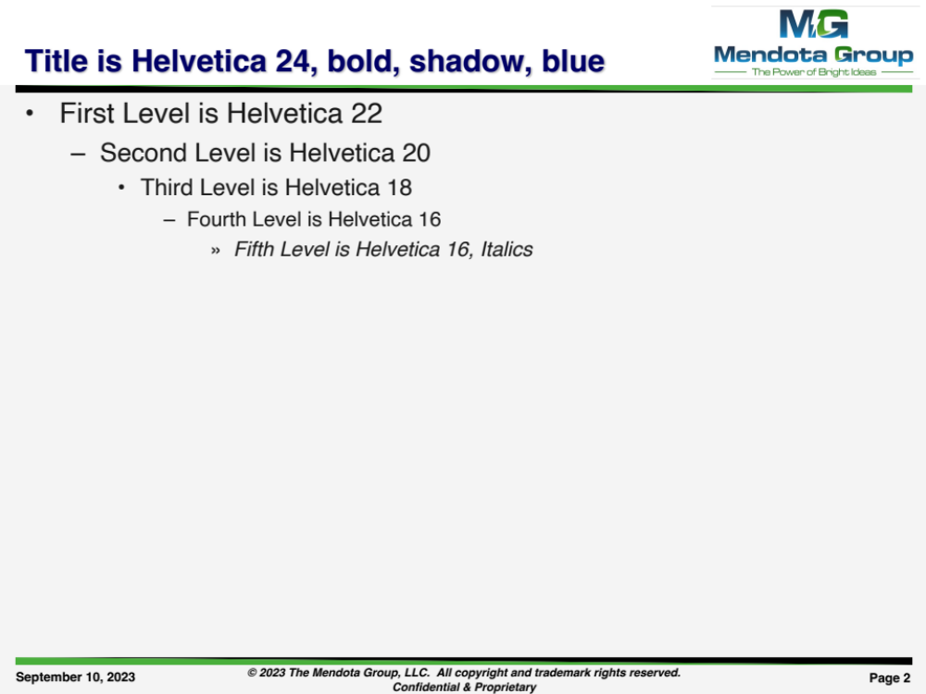
This is just an example to show what we are referring to when we talk about a hierarchy of bullets. We defer to you on font style and sizing.

Slide 5
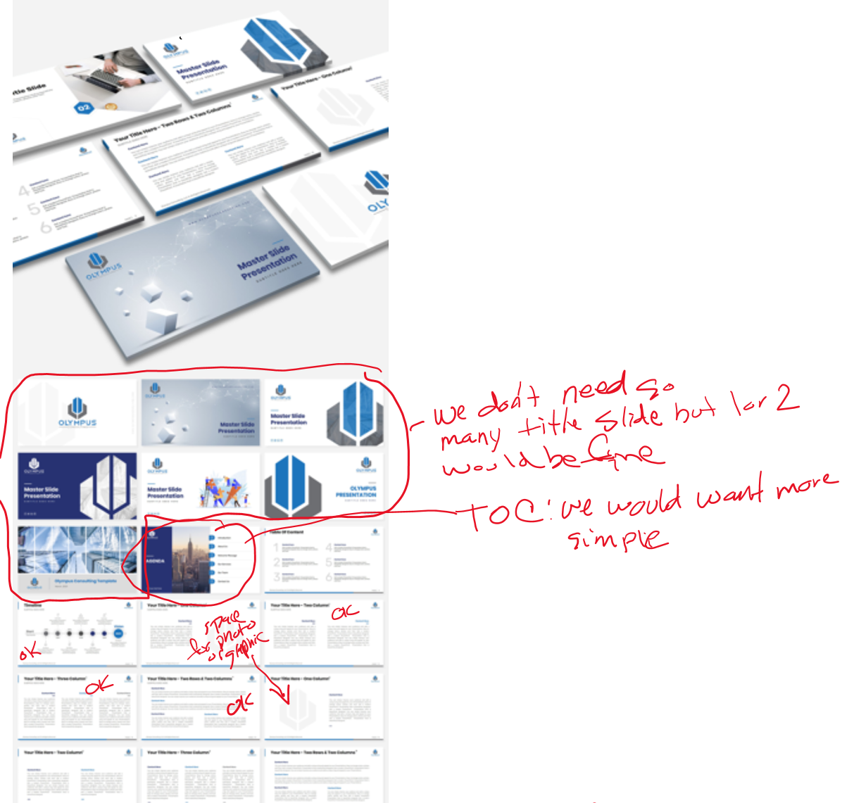
Here are some notes related to a design done for Olympus.

Slide 6
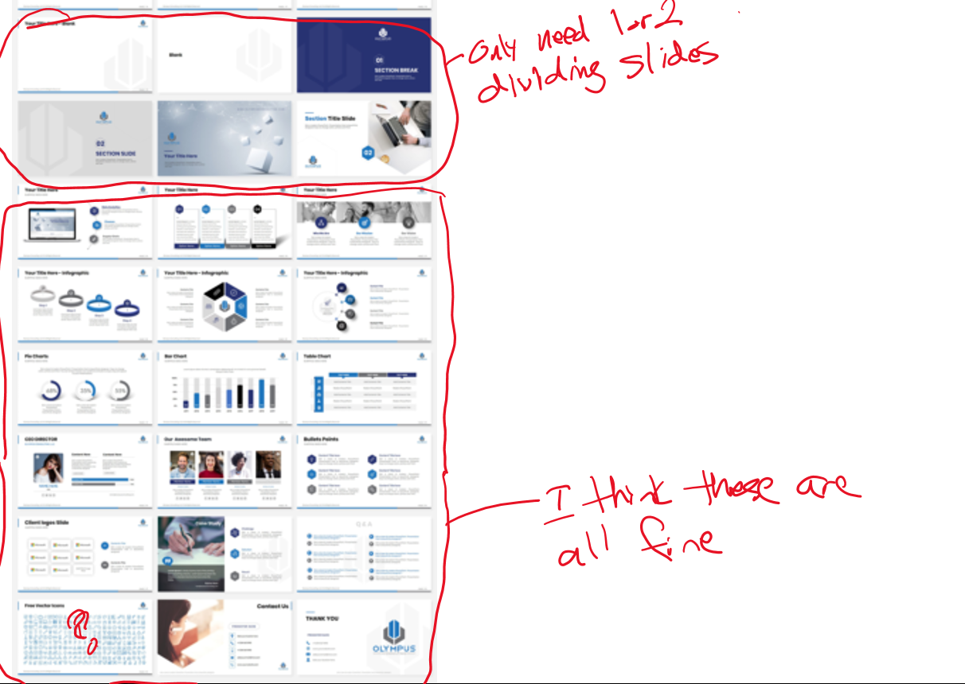

Slide 7
Title
Example of types of graphics we would like incorporated into a template for possible customization and use.
Phase I
Phase II
Phase III
Phase IV
Phase V
Review and Confirm Market Projections & Trends
Test Preliminary Market Proposition
Develop
Go-to-Market Options
Evaluate and Recommend Best Option
Outline Selected Go-
to-Market
Strategy
Review Analysis
Customer centric product capabilities & assessment
Ancillary equipment
Market research, analysis, and estimate
Identify information gaps
global objectives
Assess Outlook and Trends for Distributed Power
US and Canada
Worldwide
Project Market Size
Confirm spark spread
Map spreads
Analyze Competitors
Identify competitors
Analyze strengths and weaknesses
Measure against
Identify Customer Needs
Identify industries that likely need distributed power
Identify likely customers within identified industries
Develop interview instruments
Conduct interviews
Delineate value proposition
Assess Others’ Go-to-Market Strategies
Competitors’ go-to-market strategies
  Sales
  Distribution
  Service
Analogues in other industries
Develop Go-to-Market Options
Matrix of options for
  Sales
  Distribution
  Service
Develop
Appropriate evaluation criteria
Evaluate Key Elements
Options against criteria
The sales, delivery & service value chain for distributed power
I-R’s leveragable capabilities
Recommend
Most attractive option
Refine
Selected market proposition
“Go-to-market” strategy
  Sales
  Channels
  Service
Develop
Enablers across value chain
Organizational capabilities
Action plan to implement

Slide 8
Title
Example of types of graphics we would like incorporated into a template for possible customization and use.
Middle
Market
C&I
Mass Market
Transportation
Retail
Various Channels
Gas
E&P
Distribution
Distribution
Trading & Risk Management
Electric
Fuel
Sourcing
Generation
Trans-
mission
Increasing focus on satisfying customer needs and preferences
Increasingly liquid energy markets, enabled by easily-flowing information
Increasing competition from new entrants with diverse strengths
Integration of Gas and Electric value chains as gas fuels most new plants
Shifting balance of power providers to customers
Disaggregation and reaggregation
Refocusing of offerings to meet end-user and channel needs
Integrated trading of and between energy assets and markets of all types
Increasing clarity of business focus while business models proliferate
More M&A activity, creating more large dual-fuel companies and mega-entities
From generation to traders to large customers groups and affinity providers
Reaggregation based on economics and customer needs
8

Slide 9
Title
Example of types of graphics we would like incorporated into a template for possible customization and use.
Possible X Target Segments
All potential segments
Customer Interviews will provide information vital to the development of an effective go-to-market strategy for X
Select key target segments that have greatest market potential
True customer needs and preferences
Willingness to accept inherent characteristics of microturbines
Perceived image of Ingersoll-Rand and its competitors
Preference for owning vs leasing vs buying kWh
Price points
5 segments
Likely X Target Customers
Select companies to interview based on tiering, location, and fit with preliminary set of market propositions
Customers Interviewed
5 segments, 5 companies each in the US and Canada
10 interviews in each of the 2 international markets
45 companies

Slide 10
Title
Example of types of graphics we would like incorporated into a template for possible customization and use.
Potential Applications
Base Load
Peak Shaving
Cogeneration
Improved Reliability
Improved Power Quality
Deferral of Transmission and Distribution Expenditures
Ancillary Service
Strong
Name
Name
Aggressively Pursue
Implication for go-to-market strategy
MicroTurbine Competitive Position
Respond Opportunistically
Name
Name
Name
De-emphasize
Name
Weak
Low
High
Market Size and Growth Potential
Name
Market Application
Size of Circle equal to estimated 5 year Risk- Adjusted NPV

Slide 11
Bridging The Performance Gap
Example of types of graphics we would like incorporated into a template for possible customization and use.
The proposed program of change will significantly stretch X performance on all five elements.
Strategy
Process
Organization
Technology
Performance Management
Strategy
5
4
3
Performance
Management
2
Process
1
0
Technology
Organization
Baseline Company Performance
"Recommended" Performance
Best Practice Performance

Slide 12
We will then define the value chain and organization requirements to implement the selected strategy
Example of types of graphics we would like incorporated into a template for possible customization and use.
Illustrative
Source
Manufacture
Market
Sell
Distribute
Service
Requirements
Key Capabilities
Processes
IT Systems
KPI / Performance Systems
Staff/Structure
Skills
Ability to develop and implement marketing plan targeted towards PowerWorks target segments
Ability to manage relationship with target customers
Ability to physically distribute microturbines
Ability to provide superior customer service
Specific marketing processes to ensure marketing plan is delivered
Specific sales process to cover this market (call frequency, call coverage, accounting plan process, etc.)
Measurement systems to access share volume, actual pricing, and marketing spending vs. the competition
Sales coverage of target customers
Marketing KPI’s link with marketing staff’s performance evaluation systems
Sales organization performance measurement and objectives
Define reporting relationship and size of group responsible for PowerWorks marketing
Structure, size, and reporting relationship of sales group
Hire marketing people with knowledge/experience of PowerWorks’ target industries and customer segments
Hire sales people with utility and end-user industry knowledge

Slide 13
Staffing, Schedule & Fees, Cont.
Example of types of graphics we would like incorporated into a template for possible customization and use.
Project Week
1 2 3 4
5 6 7 8
9 10 11 12
13 14 15 16
17 18 19 20
21 22 23 24
25 26
0. Mobilize
1. Review and Confirm Market Trends & Projections
2. Test Preliminary Market Proposition
3. Develop Go-to-Market Options
4. Evaluate and Select Best Option
5. Outline Selected Go-to-Market Strategy
W
M
W
M
W
W
M
Working Session =
Review Meeting =
M
W
M
A reasonably aggressive schedule indicates project completion in 25 weeks

