Slide 1




Unleash Untapped
POWER and POTENTIAL
SwopeLight U²P² Leadership Program
Notes:
SwopeLight helps leaders unleash creativity and innovation by developing skills in compassion, purpose, courage, inclusiveness, and decisiveness. We believe in the unlimited potential of individuals and organizations and that inspired, self-aware leadership is key to unlocking it.

Slide 2
THE OBJECTIVE
To unleash untapped power and potential within individuals, teams and the organization.
UNLEASH:
  More engagement
  More connection
  More collaboration
  More creativity
  More innovation
  Connection = collaboration = creativity = INNOVATION
Notes:
At SwopeLight, we believe there is tremendous untapped potential in
organizations; potential for deep human connection, collaboration and innovation.
​
We believe in the unlimited human capacity for creativity. And therefore, we believe in unlimited organizational capacity for creativity.
​
We believe in inspiring people to believe in and pursue the highest version of themselves.
​
We believe exceptional leadership is the key to this inspiration and to accessing this unlimited well of creativity and innovation.
Marcus Buckingham research - people want meaningful connections at work.
Demise of teams - humans do their best work with teams, with other people, teams are natural human state of working healthfully, engagement is highest among people that feel connected to a team
Too much focus on conformity - all kinds of tools tha many of us at work aren't seen as individuals, for who we really are and what we can create
My personal why – to inspire people to believe in and pursue the highest version of themselves, the path of that being one of perseverance, resilience and grace and I am to model the way of that

Slide 3


The U²P² Process
              Unleashing power and potential
            Safety, trust and connection
          Authenticity and vulnerability
        Courage and confidence
      Understanding ourselves
    Individual inner work
Notes:
Arrows illustrate
You can think of The UUPP process as a sort of scaffolding that starts at the bottom and builds consistently higher levels of capability. Foundational to the overall process starts with our own individual work
The scaffolding to build a deeper understanding our ourselves and our connection to each other and the power and potential that results from that.
Individual – ”Change at the YOU-suite” - build self-awareness, understand beliefs, getting very clear and intentional about values, purpose,
Understanding our selves prepares us to be more present to create space for understanding others, it als builds our courage and confidence so we are better prepared to have hard conversations, make decisions, be more authentic and vulnerable,
Which leads to psychological safety, engendering trust and connection, which leads to

Slide 4
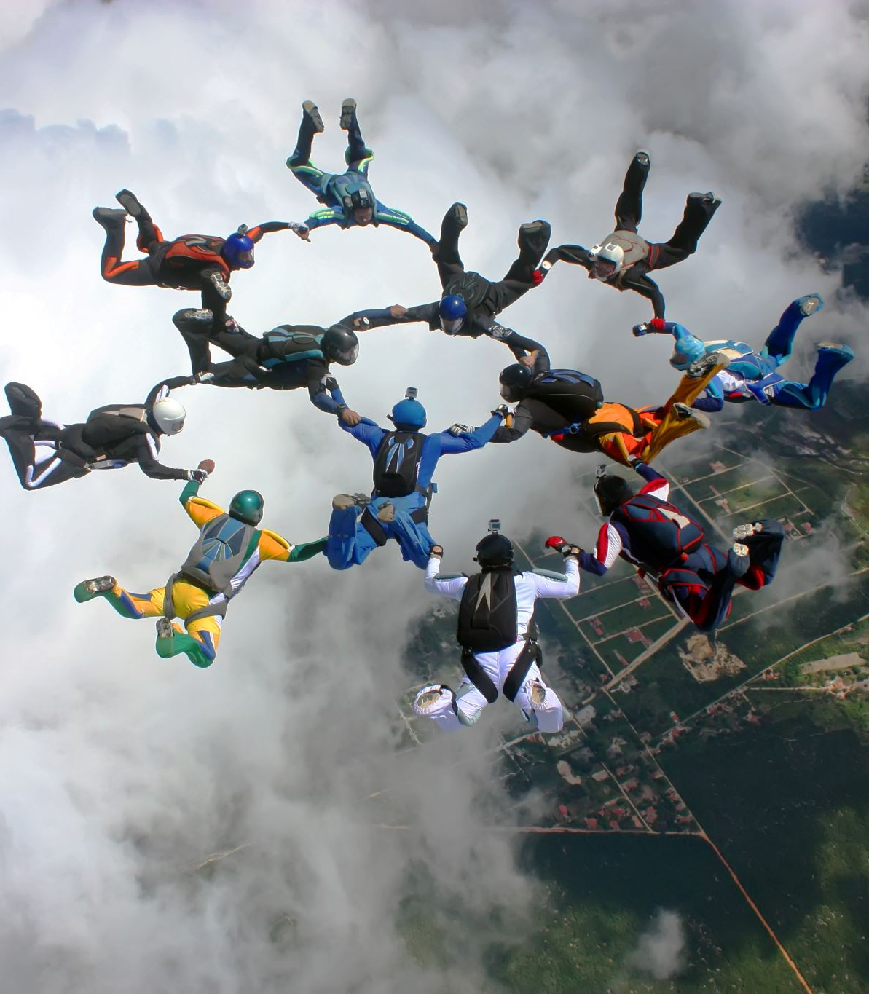

Who is U²P² for:
anyone currently leading organizations, teams, people
anyone aspiring to lead organizations, teams and people
anyone aspiring to bring their whole-heart to work
anyone aspiring to unleash untapped power and potential in themselves and others
Anyone looking to scale their business with empowered people

Slide 5
U²P² Program Modules
Individual (Change at the “You” Suite)
Developing self-awareness
Identifying values and purpose
Uncovering unconscious beliefs
Teams (Change at the “Us” Suite)
Conscious listening
Developing compassion
Building trusting relationships
Organization (Change the Suite)
Building safety
Creating a shared vision
Putting learning into action

Slide 6
Individual (Change at the ”You” Suite)
Becoming aware of our thoughts, emotions and associated behaviors
Learning to be in control of our reactions
Purpose and Values
Identifying values and purpose
Identifying what is most important to us
Learning how to live in our values
Identifying what light’s us up; why we’re here; what we have to give
Beliefs
Uncovering unconscious beliefs
Identifying behaviors that don’t serve us
Pulling back the curtain on the underlying beliefs that drive those behaviors
Learning to control the narrative in our head
Self-Awareness

Slide 7
Teams (Change at the “Us” Suite)
Conscious communication
Listening w/the intent to understand
Suspension (judgement, response, knowing)
Finding our voice (courage)
Developing compassion
Building capacity for connection
Building trust
Questioning what we think we know
Acknowledging what we don’t know
Being receptive to another way
Courage
Authenticity
Willingness
Notes:
Listening exercise/role play

Slide 8
Organization (Change the Suite)
Culture
Building safety
Culture of authenticity, vulnerability, courage
Culture of learning
Culture of connection; space for connection
Vision
Creating a shared vision
Driving results
Using new skills to drive results
Identifying org values
Identifying Org Why
Connection
Collaboration
Innovation

Slide 9
U²P² Program*
Cohort-based program
Cohorts include 4 people each (cohorts are assigned by leadership)
Bi-weekly cohort meetings (60 mins)
  Months 1 - 2: 4 meetings - Individual (inner skills)
  Months 3 - 4: 4 meetings - Team (interpersonal skills)
  Months 5- 6: 4 meetings - UUPP (putting skills to work) - role-playing/real-world problem solving
Monthly 1:1 coaching session for each member
Final live or Zoom video recording for each person
*Fully customizable

