Slide 1

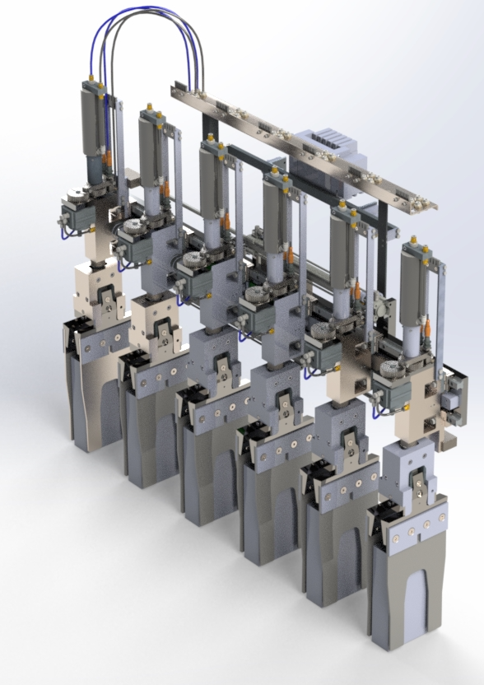
Introducing the world’s most accurate and efficient Automotive COS machine
The COS8S
0.1mm accuracy at every process station
Up to 5 automotive batteries per minute
>95% Operating efficiency
Up to 10% top lead savings
Eliminates daily drossing of lead pots, pumps and moulds
COS8S Machine Image
More batteries, less lead and reduced downtime; 3 compelling reasons why the COS8S should be your only choice for automotive battery assembly!
Front Cover

Slide 2
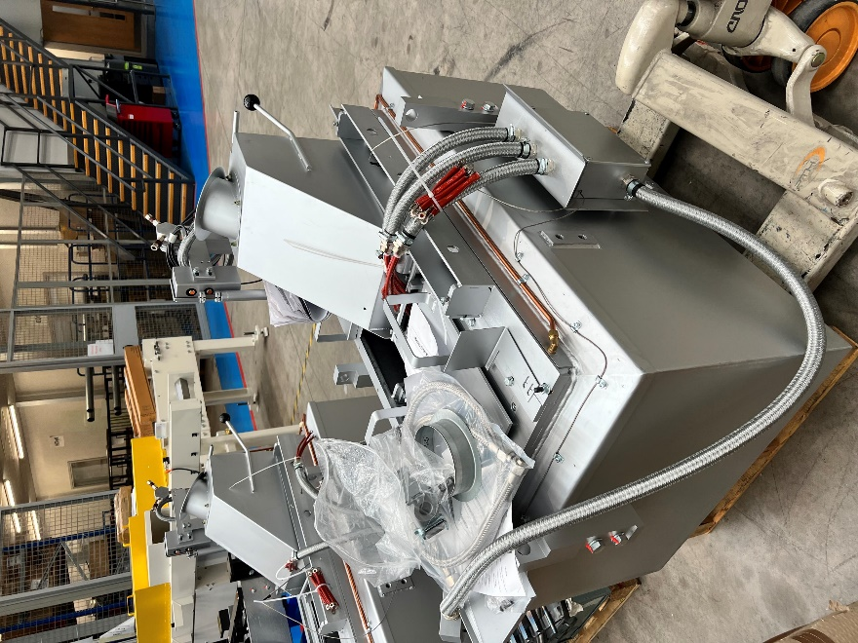
More reasons why the COS8S is by far the most
Potential Lead Savings
With lug position accuracy of 0.1mm your strap thickness can be significantly reduced without compromising your quality/OEE, producing typical lead & weight savings of up to 10%!
More Batteries
Servo driven table combined with our market leading mould technology offers you unrivalled cycle times and operating efficiency capabilities to transform your production outputs!
Reduced Downtime
Servo engineered precision offers smoother operation resulting in less maintenance and downtime. Improved changeover times and the elimination of daily drossing will push your COS operating efficiency over 95%
Aligned Straps in a case
Page 2
the world leader in automated machinery for the lead acid battery industry

Slide 3
advanced COS machine in the market today…
Servo Table cycle time reduced to cooling time + 3 seconds; enhanced safety interlocks; localised extraction
Jig Boxes now cover complete L range of batteries; 2 minute changeovers; home position for accurate calibration, HMI recipe setup
Lug Alignment accuracy now 0.1mm from 0.5mm; fixed position to avoid adjustment errors; servo positioning; changeover in under 4 minutes
Auto Unload servo controlled gripper positioning – no changeovers required; air cooled PE stuffing; 2 tons force AGM stuffing with position and torque monitoring
Tin Bath dip height accuracy of 0.1mm; rotary pumped; reduced splashing; ease of maintenance improved
Flux Station recirculating flux maintains level; refilling outside the machine whilst running; reduced spillages
TBS market leading, patent protected Mould Technology
  incredible pour accuracy
  reduced cooling time (PE & AGM 8 seconds)
  water cooled post inserts
  bond between lug and strap in 1.5 seconds
  AGM low headroom flags patented overfill protection to avoid shorts and extend battery life
MOULD IMAGE
Page 3
the world leader in automated machinery for the lead acid battery industry

Slide 4
Introducing the world’s first Dross Reduction system
Our new TBS Dross Reduction system is an enclosed lead pot that delivers a blanket of Nitrogen to virtually eliminate the oxidation process and minimise the build up of dross. Not only does this reduce time consuming drossing of the pot, but it also keeps your pump and mould clean as well, resulting in less maintenance and a more consistent cast on process…
Dross reduction of up to 90%
Leadpot drossing reduced to once every 2 weeks
Saves over 1 hour/day in mould and pump cleaning – increased uptime means more batteries!
Eliminates mould weir cleaning during a shift
Reduces Operator exposure to dangerous lead oxides
Particularly beneficial for lead alloys with High Tin content
System standard on all new TBS COS machines
System requires an inhouse Nitrogen supply, with Nitrogen consumed at 20 liters per minute at 60psi
For more information and advice please contact cos8s@tbseng.co.uk
Visit: https://tbseng.co.uk Tel: +44 01242 229610 TBS Engineering, Gloucester, UK

