Slide 1


Service Introduction

Slide 2
Outline
01
Why EI
02
ITSM Transformation & Maturity
03
Continuous Improvement Framework
04
EI Service Towers Overview

Slide 3


25+ years of IT Management Solutions Expertise
More than 80,000 devices under management Globally
Service Desk handles over 7,500+ phone calls a month and close to 20,000 tickets.
Partner to Fortune 500 and mid-market companies
Serving diverse industries including:
  Non-Profit
  Transportation & Logistics
  Financial & Banking
  Insurance
  Healthcare
  Manufacturing
  Real Estate
  And More

Slide 4
Managed Services
Professional Services
Staffing Services
Procurement Services

Slide 5
EI Managed Services
Service Desk
  24x7x365 IT Service Desk
  Incident, Request, Problem, Change
  Security Access Control
  Level II Remote Support
  Major Incident Management
NOC Services
  24x7x365 Network Operations Center
  Infrastructure Monitoring & Alert Response
Field Services
  On-site support via dispatch of vetted network of field techs
  Full time support Desktop Engineering, syndicated team, centrally managed by EI Field Management team.
Endpoint Management
  Image management
  Workstation patching
  Deployment
Cyber Security Services
  24x7x365 Security Operations Center
  Managed EDR
  Managed SIEM
  Firewall Management
  Vulnerability management
  v-CISO Services
  Security Awareness Training
Network Management
  24x7x365 network monitoring
  Configuration and backup management
Infrastructure Management
  On-premise and cloud server management
  Managed backup and restore services / disaster recovery
  OS patch management
  M365 User Environment Management
Managed IT Solutions
  Auvik
  N-Able N-Central
  SentinelOne & CrowdStrike
  Proofpoint Professional
  ConnectWise Cloud ITSM
  ConnectWise Automate
ITSM Services
  Incident, Request, Problem, and Change Management
  CAB Management
  Major Incident Management
  Reporting and MPR Tracking
Depot Services
  Storage, Inventory, and Centralized management
  Full Lifecycle management
  Warranty management

Slide 6
Why EI?

Slide 7











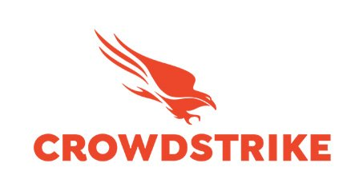



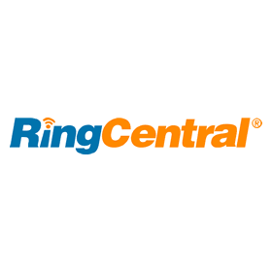









Why EI?
Strong Partnerships

Slide 8
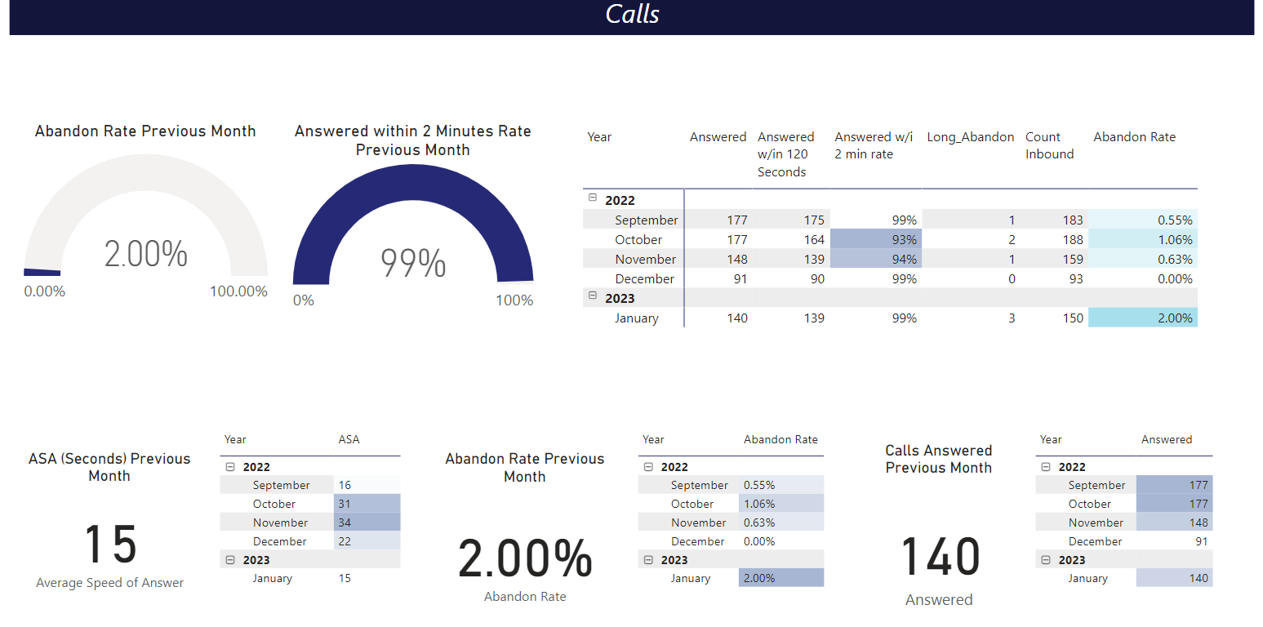
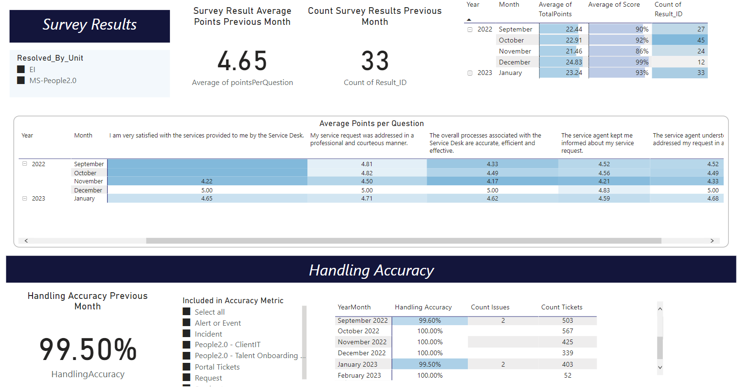
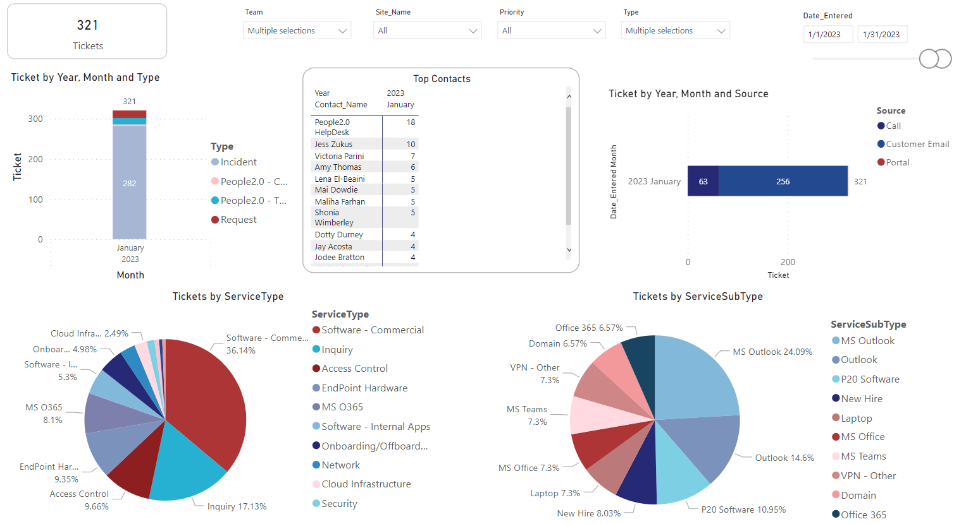
Why EI?
Measured, Managed & Mature
Business Analytics
Trend Analysis
Continuous Improvement

Slide 9
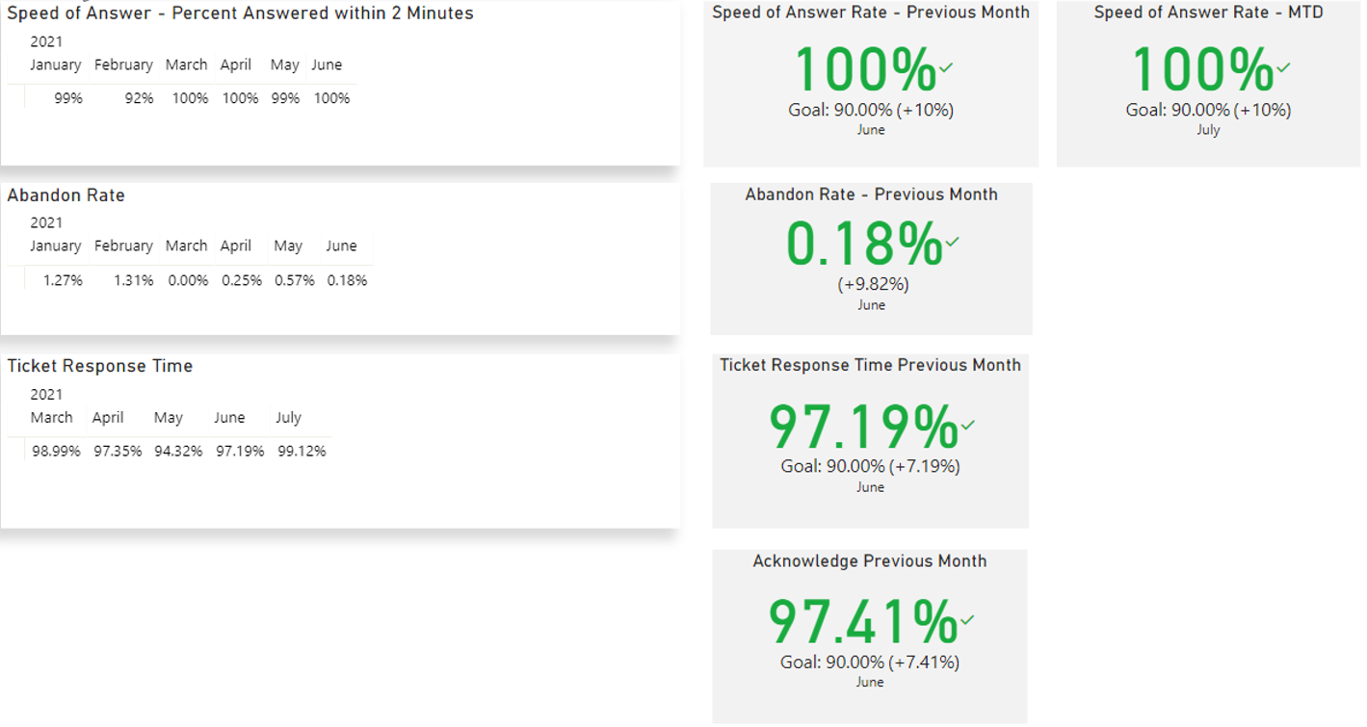
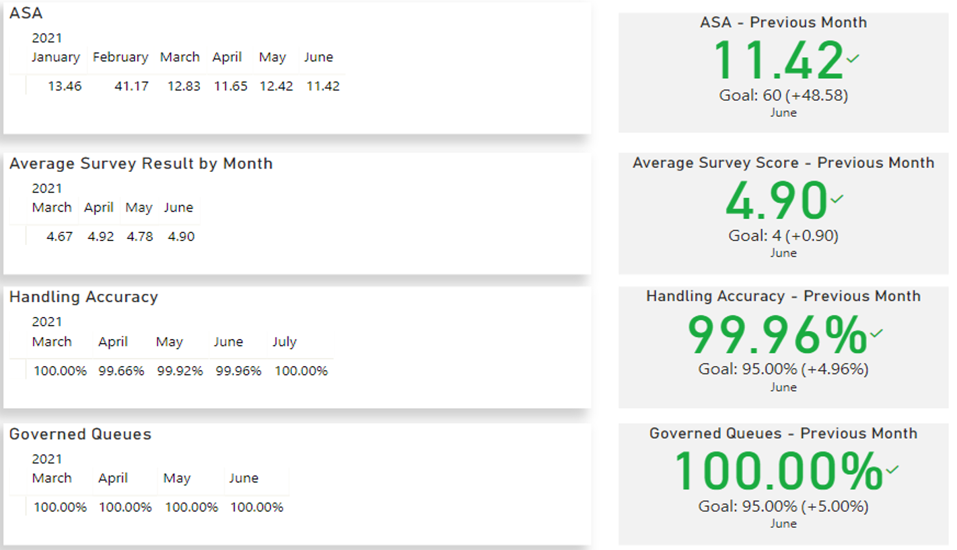
Why EI?
Measured, Managed & Mature
Our ability to enable your business is predicated on well-defined and measured success criteria.
Critical Service Levels:
Speed of Answer- 90% of phone calls answered within 120 seconds
Average Speed of Answer- Average answer time of all answered phone calls of less than 60 seconds
Abandonment Rate- <5% of inbound calls abandoned by caller after holding for at least 60 seconds
Ticket Response time- 90% of initial user contact tickets acknowledged, triaged, and resolved as per the priority matrix
Customer Satisfaction- Average CSAT score of 4.0 on a scale of 1 to 5
Handling accuracy- Less than 5% of tickets handled incorrectly by EI per defined operating procedures in the Knowledge Base

Slide 10
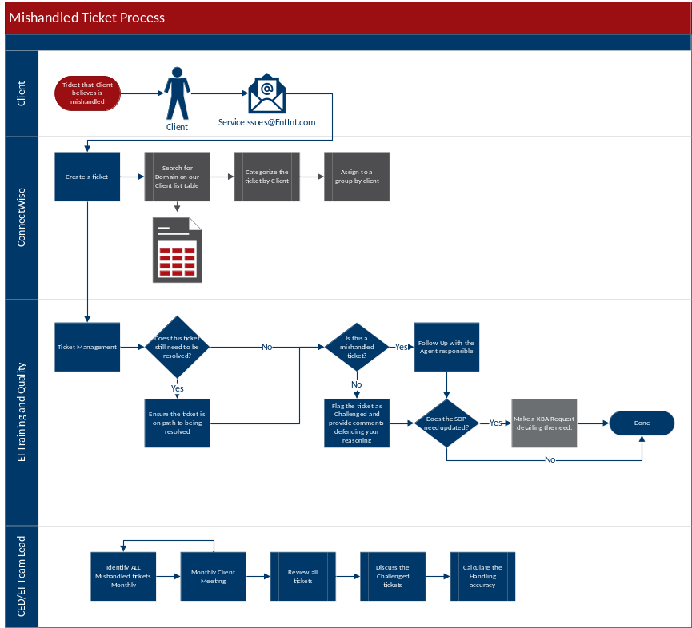
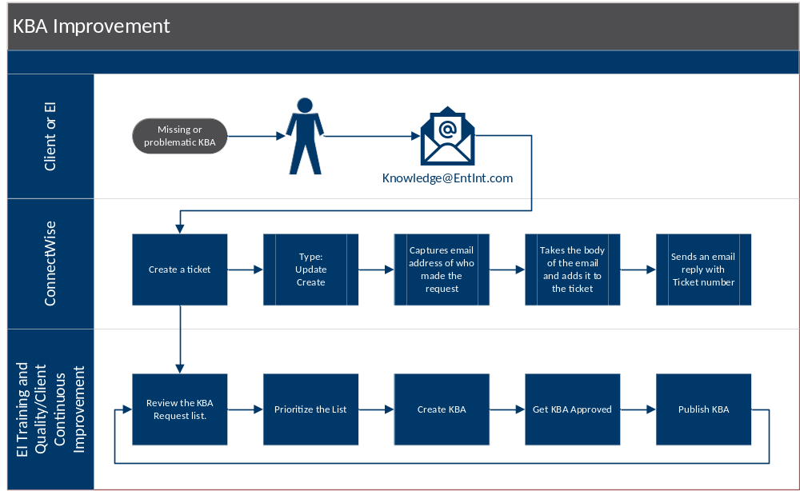
Why EI?
Process Driven
Continuous Service Improvement
Service Quality Process
Knowledge Management Process
Mature Onboarding Process

Slide 11
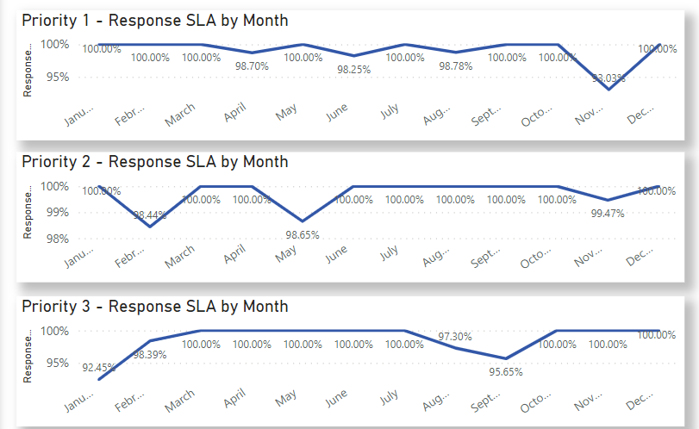
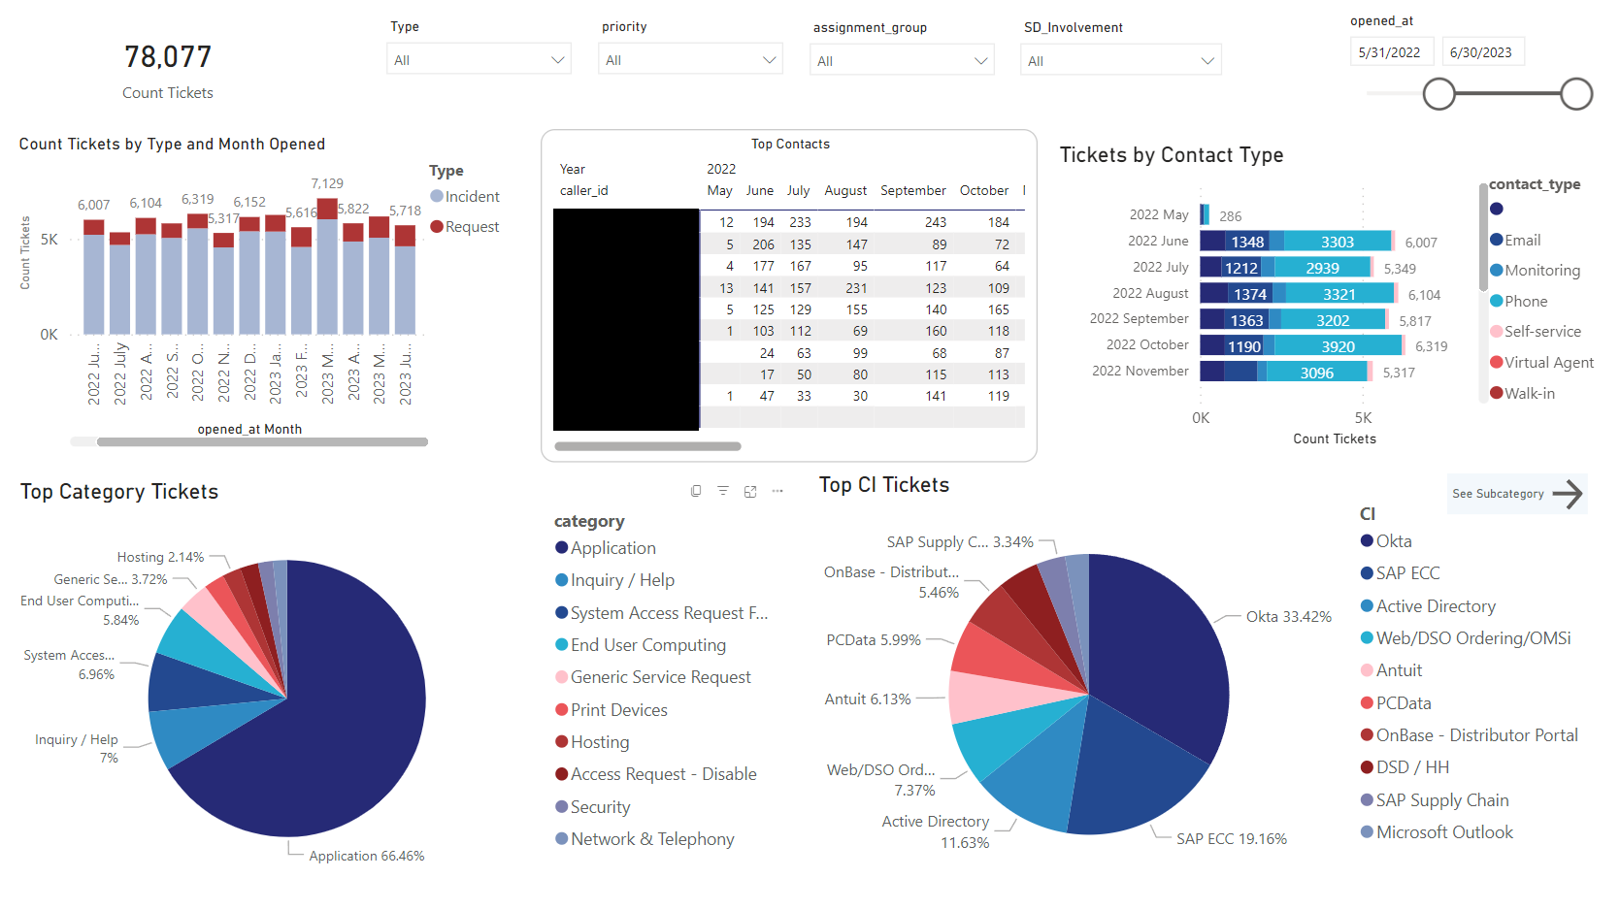
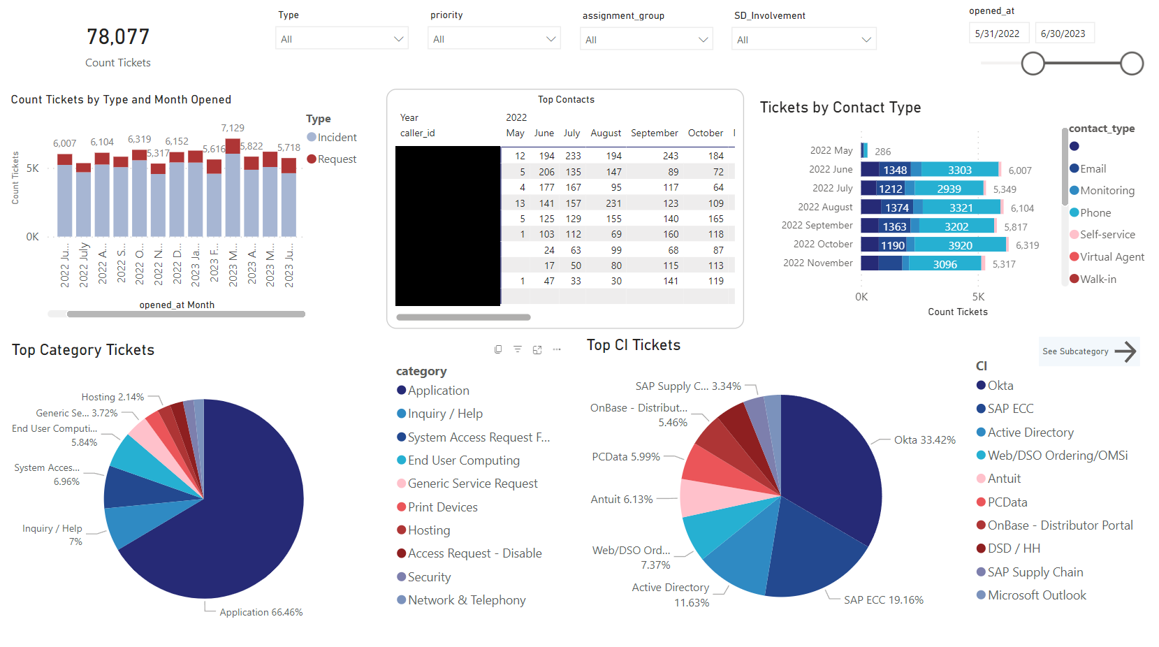
Why EI?
Data Driven Excellence
Mature dashboards, trend analysis, and thought leadership to drive improvements

Slide 12
ITSM Transformation

Slide 13
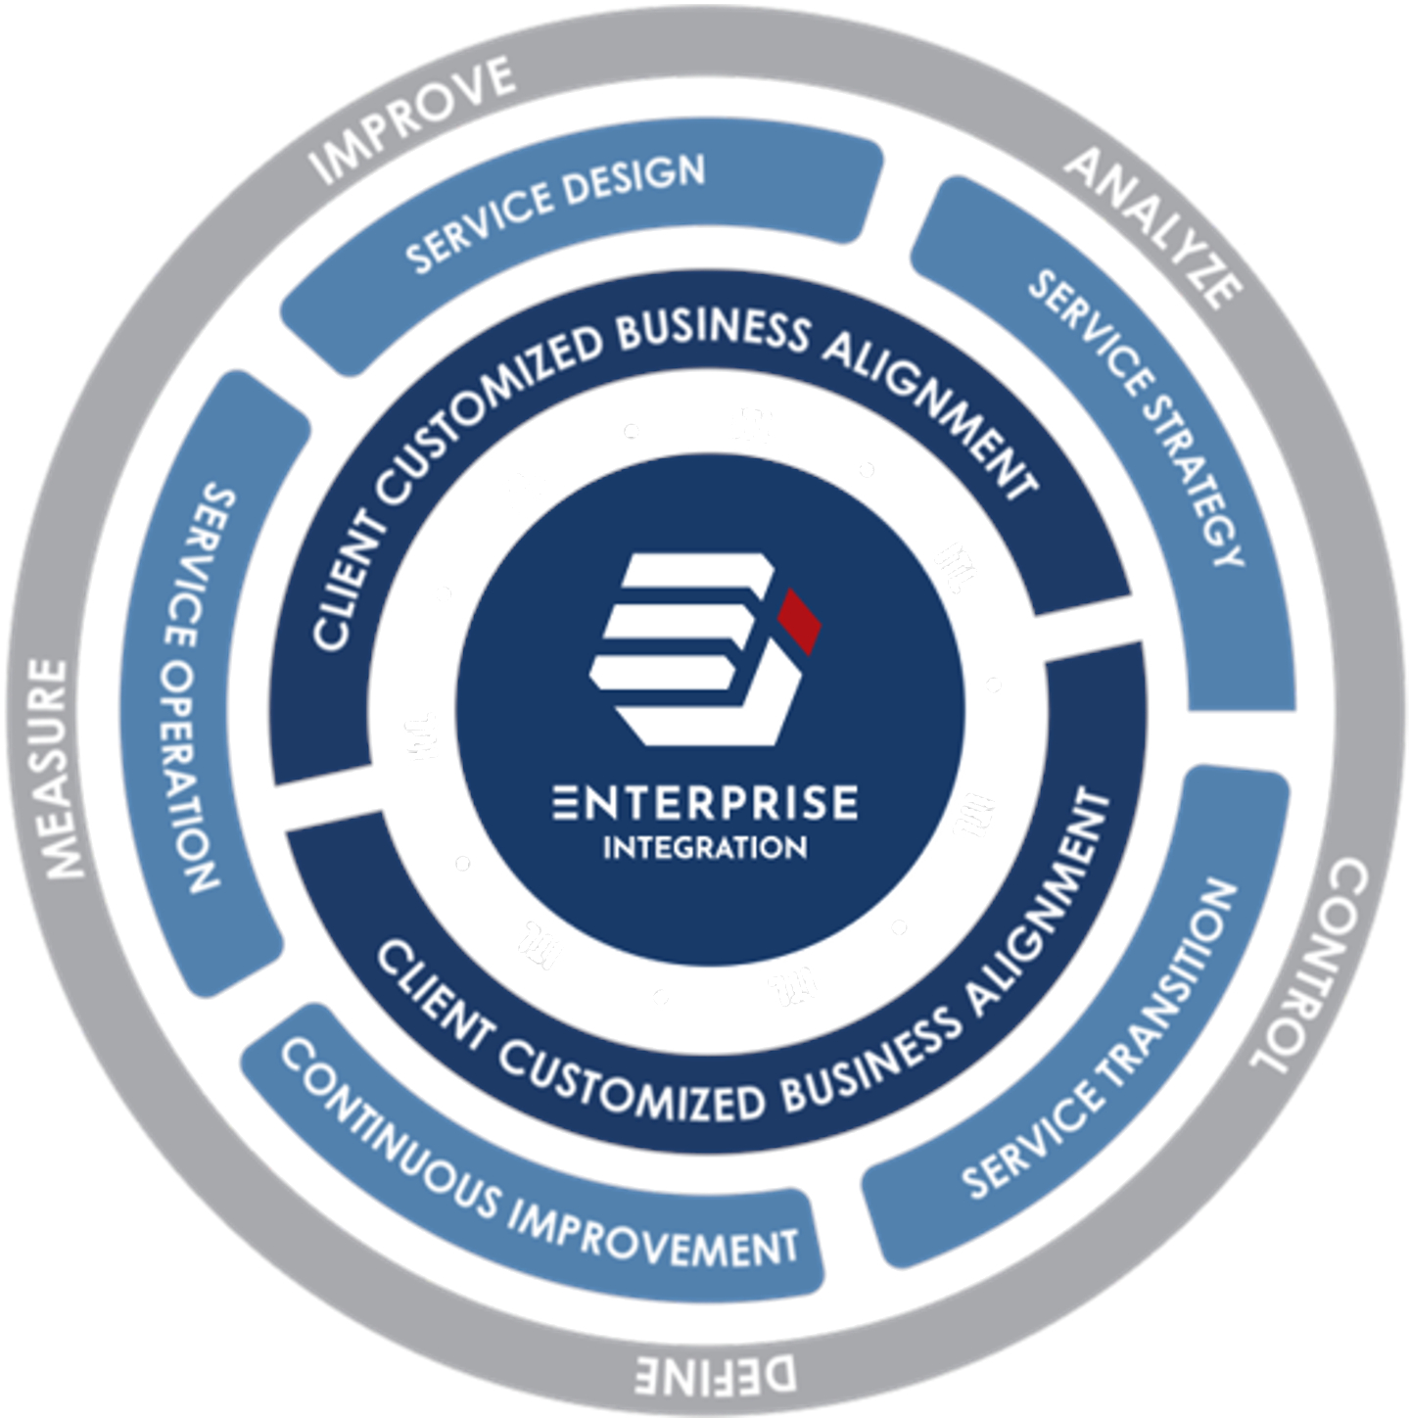
ITSM Process Transformation
We meet customers where they are on their journey to ITSM Maturity.
We map customer ITSM processes to EI Processes for tight integration.
ITIL Process Areas in Focus
Major Incident Management
Major Incident Communications
Problem Management
Knowledge Management
Incident Management
Request Management
Change Management
Event Management
ITIL Certified Resources
Focused on Continuous Improvement

Slide 14
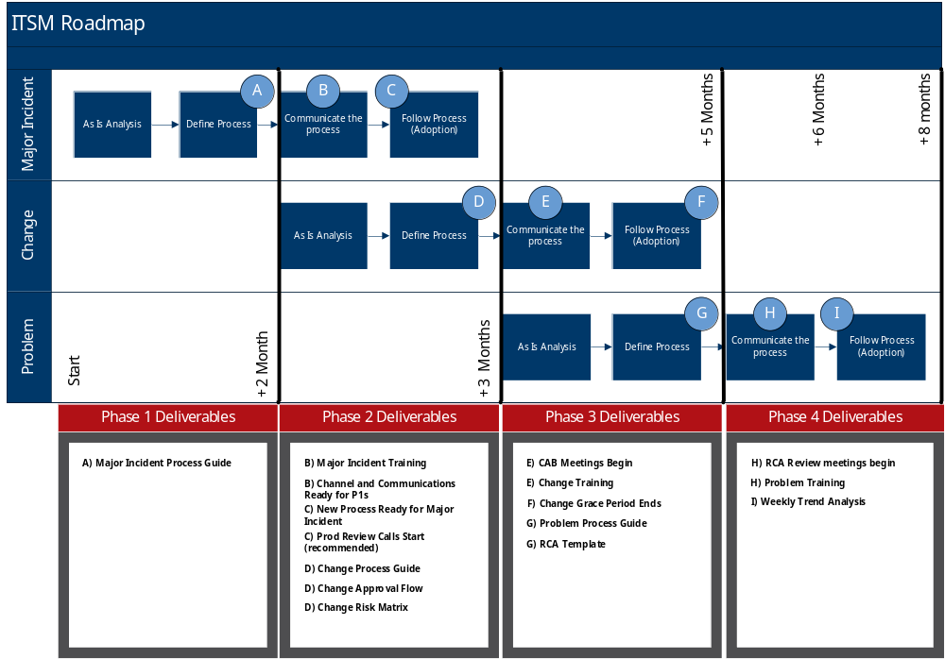
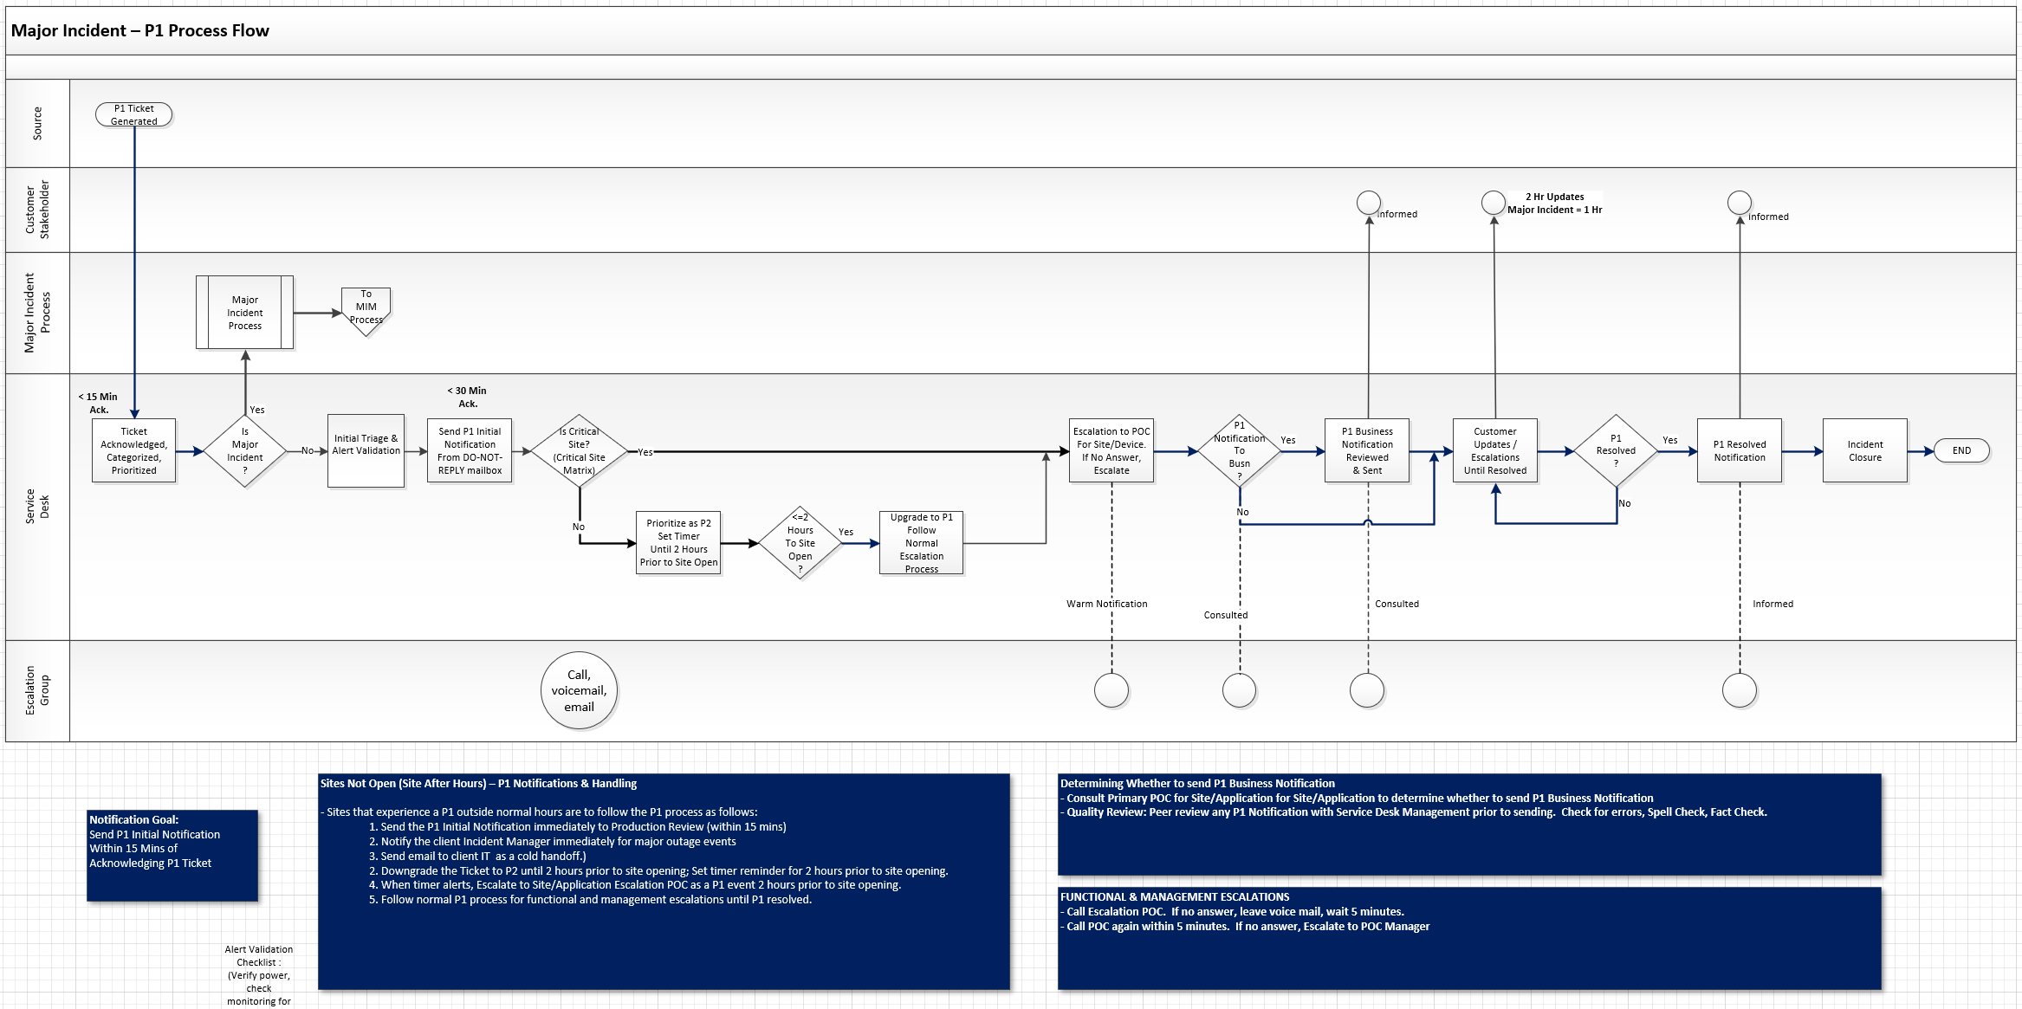
ITSM Transformation
Map customer ITSM processes to EI Processes
Drive continuous improvement
Help customers mature their ITSM Processes

Slide 15
Continuous Improvement Framework

Slide 16


Continuous Improvement Framework
Data Driven Continuous Improvement
Client Engagement Manager
Accountable for Program Delivery
Thought Leadership & Analysis
Continuous Improvement Champion
Data
Analysis
Management Disciplines
Weekly Meetings to review trend analysis
Escalations & Resolution Analysis
Handling Accuracy
Service Quality Improvements
Knowledge Reviews
Monthly Management Reviews
SLAs and Contractual Measures
Program Governance
MSP Scorecard Review
Continuous Improvement
Continuous Improvement Processes
CSAT Improvement Process
Knowledge Improvement Process
Quality Improvement & Handling Accuracy Process
Resolution and Escalation Analysis Process
Call, Chat and Ticket Quality Reviews & Scoring
Agent Performance Scorecards & monthly incentive bonus based on performance

Slide 17
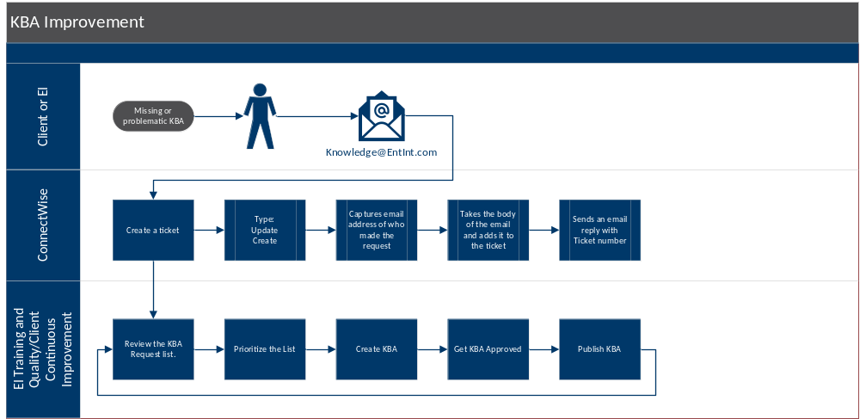
Knowledge Improvement Process
Striving for Improved Knowledge
Knowledge changes, it sometimes needs to be updated, modified, or removed
Our Knowledge Improvement Process allows customers and EI associates to flag knowledge that needs to be added, modified, or deleted
The team will review the knowledge process and work with customers to ensure that your body of knowledge is driving the best results

Slide 18
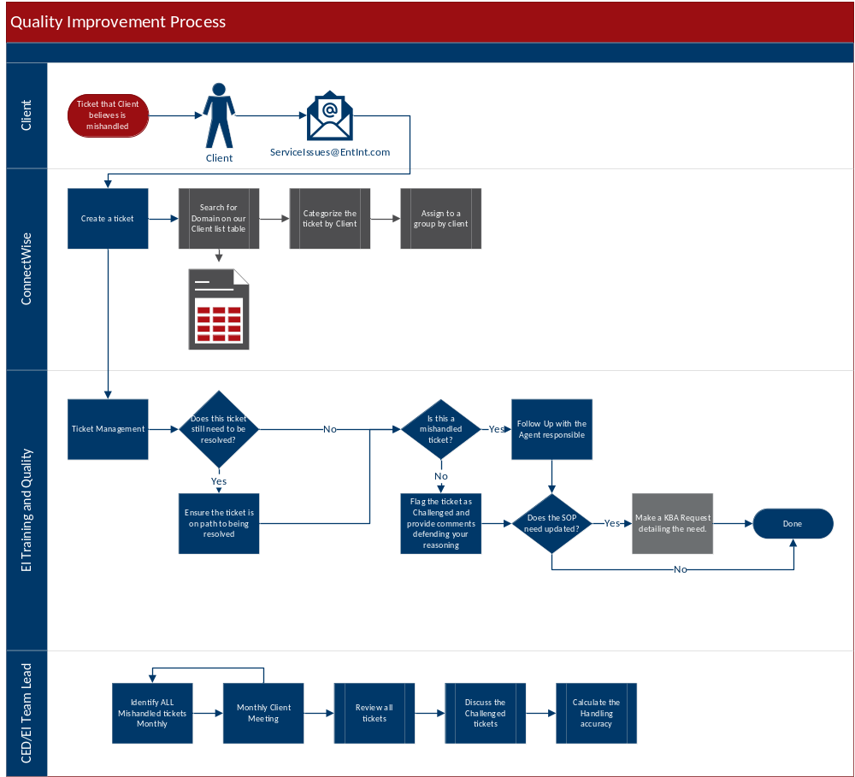
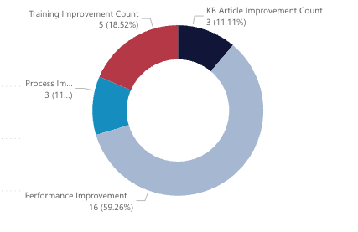
Quality Improvement Process
Handling Accuracy
Our Quality Improvement Process provides a method for you to let us know when we do not hit the mark. Submit a “Service Issue” which opens a ticket for investigation and corrective actions by our leadership.
Our process performs recurring random sampling of tickets to score handling accuracy and surface trends which need attention.
We report on trends which drive continuous improvement in our Knowledge, Training, Quality and Performance Management processes.

Slide 19
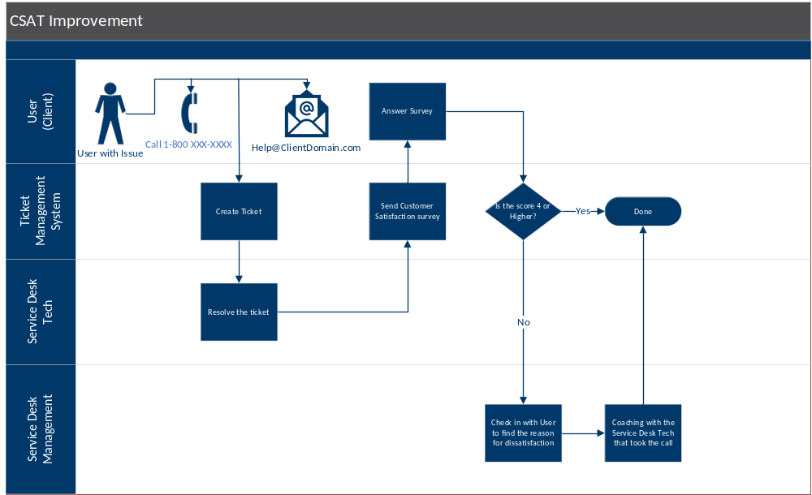
CSAT Quality Process
Driving Satisfaction
Each user interaction generates a brief survey offering customers the opportunity to provide feedback about their experience.
A low satisfaction score often represents a user without a fully resolved issue or a poor experience.
Our managers reach out to users with low scores to ensure that their issues are completely resolved and to find out what we can do differently in the future.
This feedback is used to drive improvements in our Knowledge, Training, Quality and Performance Management processes.
CSAT trends are reviewed with our customers at Monthly Management Reviews.
Notes:
June total = 15 4 are upcoming

Slide 20
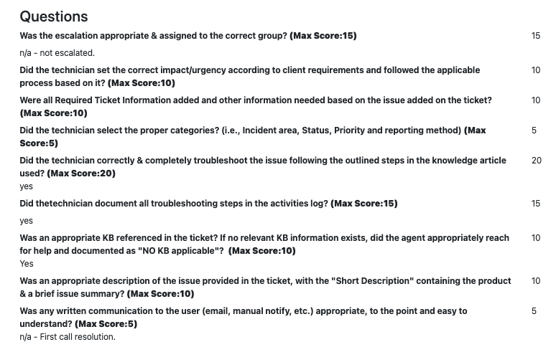
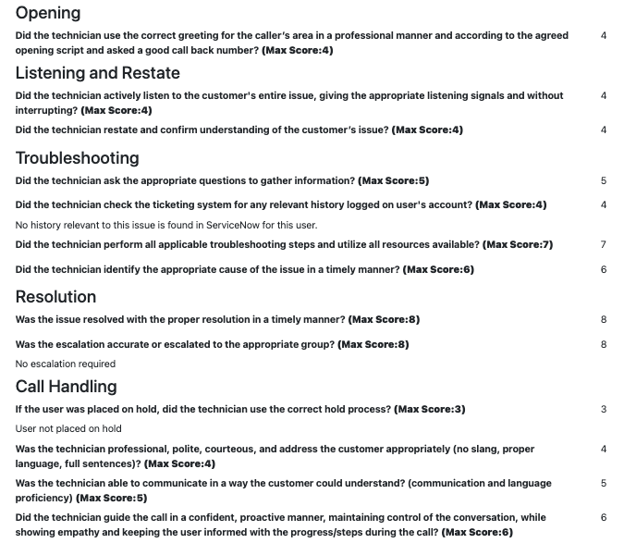
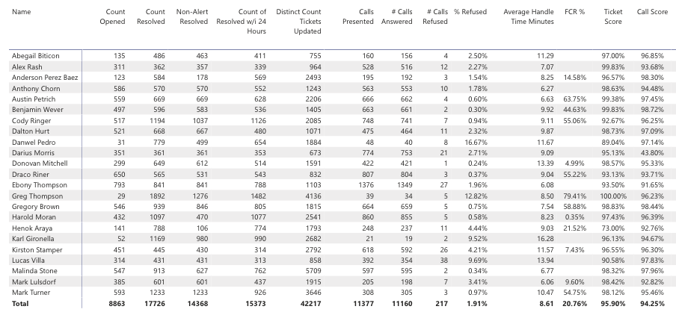
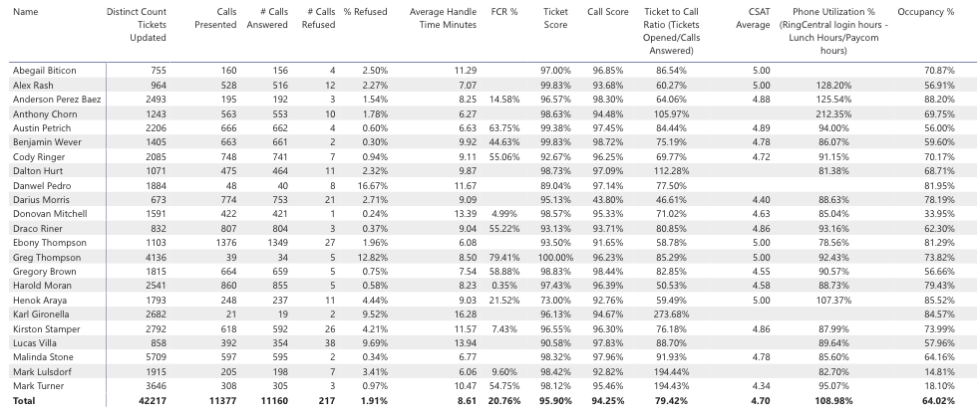
Performance Scorecards
Continuous Improvement: Call, Chat, and Ticket Quality Review Scoring
Ticket Quality Scoring
Management disciplines ensure our continuing focus on quality by performing quality reviews and scoring against standard criteria for Calls, Chats and Tickets.
We measure against defined quality standards and score each call, chat or ticket against these standards.
We use Productivity Performance Scorecards at a granular level identify performance by agent, with results used in coaching & feedback sessions and for incremental bonus compensation.
Call Quality Scoring
Agent Performance Scorecard

Slide 21
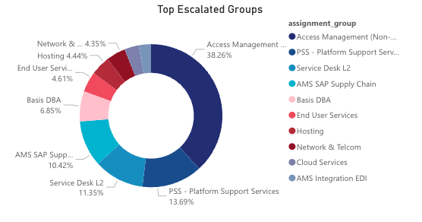
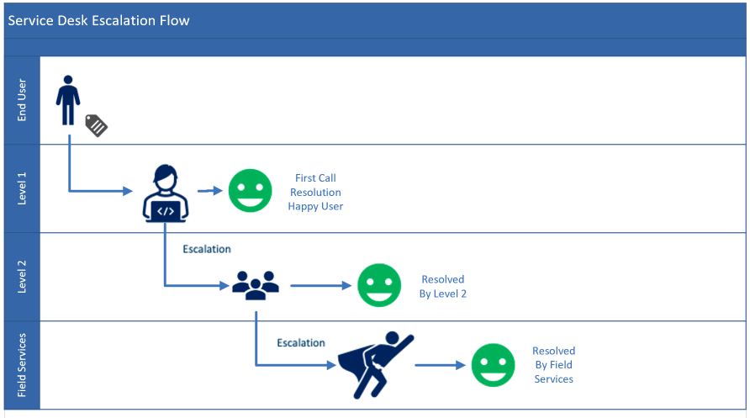
Escalation Analysis
Trend analysis Drives Continuous Improvement
Analysis
Why are we escalating
When do we escalate
Understanding
Lack of Knowledge
Lack of Access
Action
Build knowledge
Ensure the right level of access
Results
Increased first call resolution
Increased quality
Increased speed of resolution
Drive process improvements
How do we reduce escalations?

Slide 22
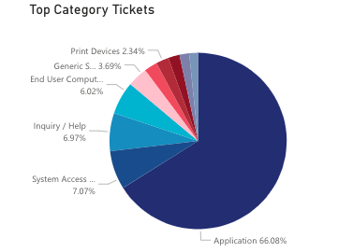
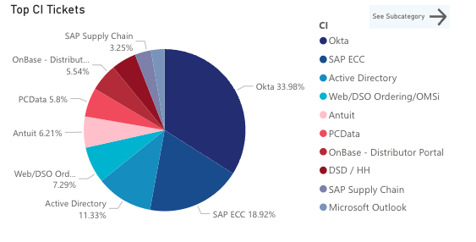
Resolution Analysis
Drive Continuous Improvement
Top Categories & Subcategories Analysis
Top Resolution Groups Analysis
Resolution Analysis
  Identification of core resolution stats by category and subcategory, and best targets for added knowledge or access to increase resolution rates at Service Desk
Example Areas of Focus

Slide 23
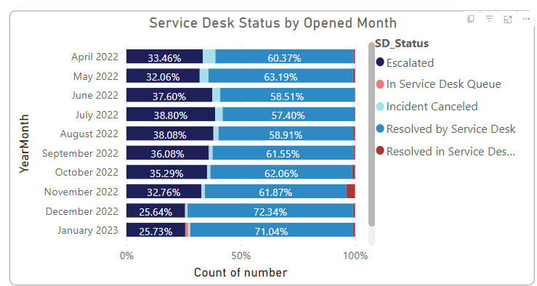
Service Desk Trends Example
Example - Driving Up Service Desk Resolution due to Continuous Improvement
  Service Desk Resolution and customer experience is highly managed from arrival of ticket to resolution
  Client Management team works with customer to drive CSI across the EI delivery organization
  Improved Knowledge, Access, Training and Expertise yields results.
Increased First-Call Resolution
Reduced Mean Time to Resolution
Improved Shift Left
RESULTS

Slide 24
Service Desk Services Overview

Slide 25
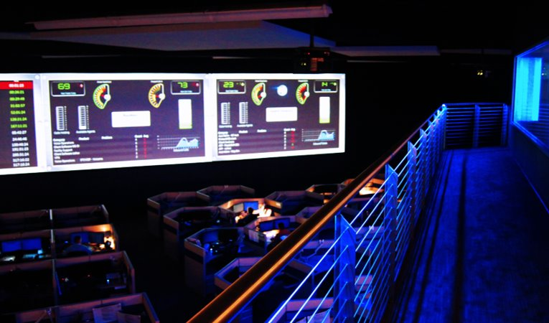
EI Service Desk Services
Service Desk
  24x7x365 IT Service Desk
  Incident, Request, Problem, Change
  Level II Remote Support
  Major Incident Management
Security Access Control
  Syndicated team
  Employee Onboarding and Offboarding
  Centrally managed and scheduled
  Audit for accuracy ensuring the right outcome is reached.
Service Desk Level II
  Remote Desktop Engineering team
  Complex Level II skill set

Slide 26
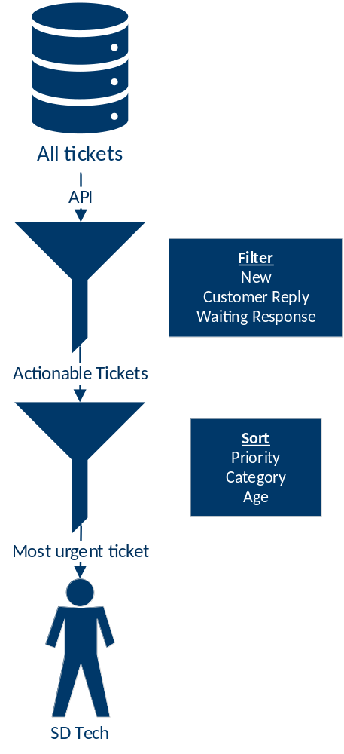
Service Desk Ticket Assignment
Proprietary Application for Ticket Optimization & Handling
People, Process and Technology combine to optimize ticket flow and reduce time to resolution
Automated identification of the ticket needing the next action from the desk and agent assignment expedites delivery, reduces time gaps to closure, and allows for flow-to-the-work staffing to smooth delivery timelines across ticket volume
Actionability is prioritized based on new arrivals, customer replies, and tickets awaiting action for an up- or down-stream action for longer than defined timeframe
Priority, category, and age are also used to organize pertinence of action by the desk

Slide 27
Service Desk Training
EI University – Mature Training & Certification Program
EI Basics
Expectations
Client Basics
Greetings
Escalations
Client Specifics
Applications
Major Incident
Phones
Account
Knowledge
HR Services
Knowledge
Communication
Ticket drivers
Tickets
Consistency of Training
Teach and test approach to training includes assessments and stage gates to ensure consistent delivery between agents
Agents master broad concepts before receiving training on client-specific requirements
Agents must complete EI practice and client specific assessments before being put into live service

Slide 28
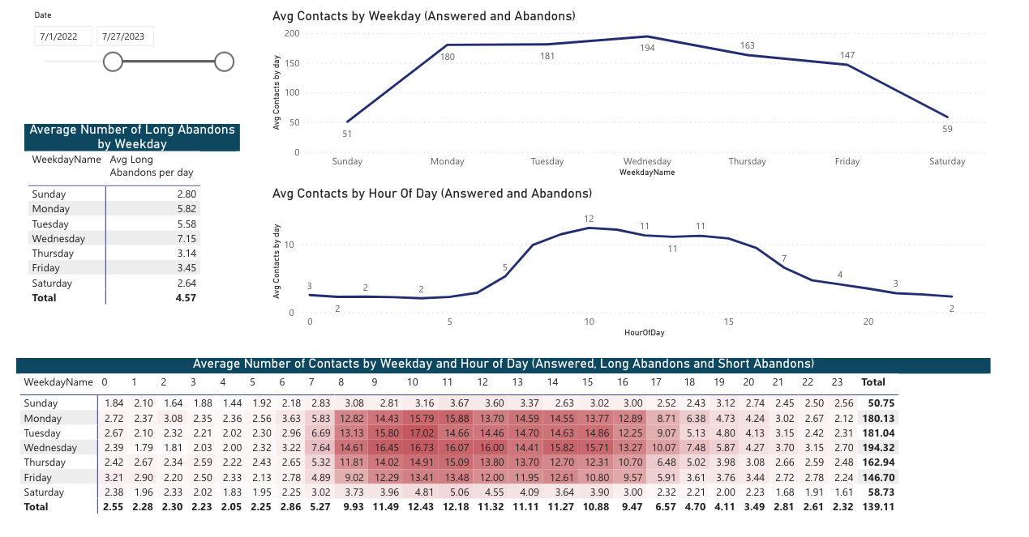
Data Driven Excellence
Mature call arrival analysis to drive appropriate staffing to meet demand

Slide 29
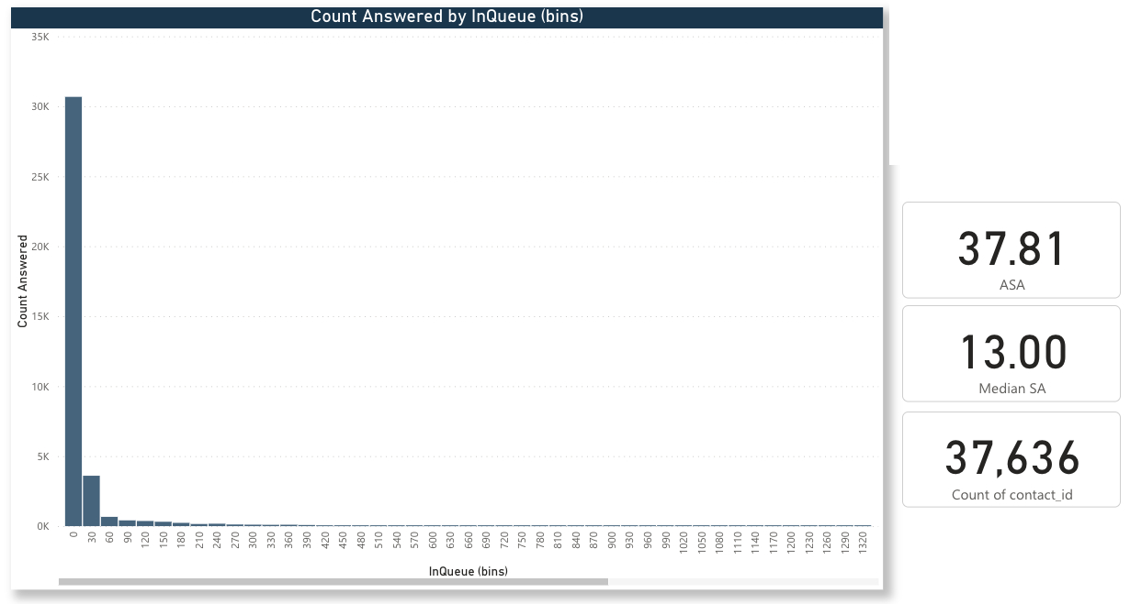
Data Driven Excellence
Example Statistical Analysis – Call Answer Time Frequency Distribution
High Frequency of ASA within 30 Secs
Median ASA 13 Secs
Across High Call Volumes

Slide 30
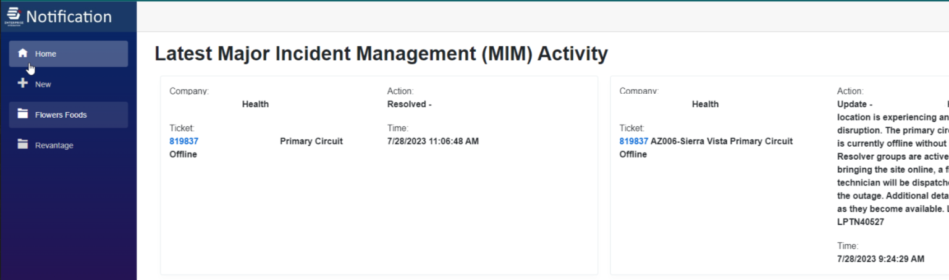
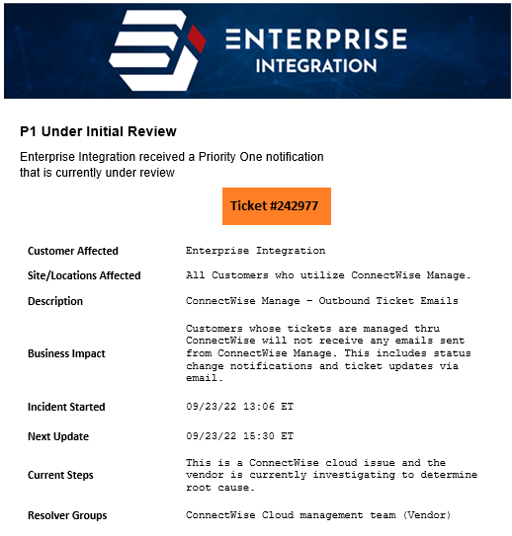
ITSM Process Example
Mature Major Incident Management Process with Business Communications
Custom Major Incident Notification Application
Major Incident Management
  Declaring and Managing Major Incidents
Major Incident Business Communications
  Managing Communications to Stakeholders
  MIM Communication App to drive consistency
Custom Major Incident Notification Templates
Brandable to BCH
  Initial MIM Notification
  Bridge Line Management
  MIM Update Notifications
  MIM Resolution Notifications

Slide 31
Cyber Security Services Overview

Slide 32
EI Cyber Security Services
Firewall Management
Security Awareness Training
Incident Response
Data Protection & Backup
Vulnerability Management
Next-gen Managed EDR
Vulnerability Research
Cyber Security Services
Infrastructure Security
24/7 SOC and SIEM
The Advantage
EI will meet you where you are to prioritize your security investments, optimizing risk management and progressing your organization’s maturity posture.
Remove the headache of managing to ever-evolving cyber insurance and compliance requirements.
  24x7x365 Security Operations Center
  Managed EDR
  Managed SIEM
  Firewall Management
  Vulnerability Management
  vCISO Services
  Security Awareness Training
  CyberSecurity Transformation Services

Slide 33

v-CISO Services
Comprehensive security leadership and program oversight made available for companies of all sizes. EI has over 20 years of experience managing security programs and consulting with Fortune 500 companies.
Enterprise Compliance and Risk Management focus
Security standards and framework selection, gap analysis and implementation
Security policy, process, and procedure development and implementation
Information security leadership
and guidance
Security posture assessment
Ongoing security compliance management
Internal audit support

Slide 34
Layered Security
Unprotected Experience
Prepared Experience
Description
Incident
Response
During an active threat scenario, trained security operations engineers are available to assess the situation, recommend and implement countermeasures, and close off the environment from the attacker.
Without a prearranged incident response provider, it can take hours or days to engage a third party MSSP to assist. Emergency engagements can last for several weeks and can reach costs in excess of $400 per hour.
With a security operations provider at the ready, even if all human and technology preventions fail and your environment is impacted, engineers will be deployed alongside your IT staff or MSP to help secure and clean the environment.
Security Information and Event Management software ingests and correlates data from EDR software, firewall logs, cloud software logs, and other sources to allow for a 24x7x365 Security Operations Center to evaluate potential unusual threat behavior – potentially even before malware gets deployed by a successful intruder. Additionally, the historical data allows for forensic evidence to be reviewed post-event.
Without a SIEM aggregating data which is reviewed by a 24x7 SOC, there is substantially less likelihood of identifying a threat actor prior to their delivery and activation of a malware payload. Additionally, expensive third party forensics may have to be engaged to determine any relevant reporting requirements – or, without evidence to the contrary, expensive reporting requirements may be inevitable.
By collecting, monitoring, and storing relevant log data from key elements of your environment’s perimeter and protection solutions, a 24x7x365 SOC/SIEM solution may identify when a bad actor is trying to breach your environment, or has breached it but hasn’t yet deployed a payload. And if you do have a breach, forensic data showing what was and wasn’t access may limit compliance costs.
SIEM and SOC
Unlike purely signature-based virus protection of the past, modern EDR software combines multiple modes of protection, including heuristic-based behavior analysis to halt programs engaging in, for example, rapid encryption of files, which occurs during a ransomware attack.
Older-generation, lower-tier, or the lack of proper endpoint protection solutions may not be effective at blocking the successful deployment and proliferation of malware throughout your environment. The average ransomware demand in 2021 grew to well into the millions of dollars per demand.
Next-gen EDR solutions are very effective at blocking and preventing the spread of even recently deployed or evolving malware, such as 0-day exploits. By having the right protections in place, even if your environment is breached, the chance of losing access to your data or operational systems is substantially reduced.
Next-gen EDR
Recurring, required, computer-based training to ensure employees understand the mechanisms of spam, phishing, spear phishing, malware, ransomware and social engineering and can apply this knowledge in their day-to-day job.
91% of successful breaches begin with a successful spear phishing attack. Companies without an effective program in place are far more likely to have an employee unwittingly give a bad actor a foothold in the environment.
Best-in-class security awareness programs can reduce the likelihood of a user falling for a bad actor’s phishing attempts by more than 80%. Without access, most attacks are prevented before they even get through the door.
Security Awareness Training

Slide 35
Compliance and Risk Services
Bridging the gap between risk, compliance, corporate governance, and information technology is a major objective in today's business climate. EI's Risk and Compliance Management practice helps clients build and manage ongoing programs to manage risk and meet regulatory standards while optimizing business operations.
Compliance & Regulations
Business
Requirements
Standards
Transparency
Rules
Policies
Law
Security Assessments (NIST CSF, NIST 800-171, NIST 800-53, CCPA, etc.)
Security Program Review
Security Policy Development
Security Roadmap Development
Security Controls Development
Compliance Gap Assessment

Slide 36
NOC Services Overview

Slide 37
EI NOC Services
WHY EI?
Our Network Operation Center (NOC) Services are a powerful combination of automation and expertise – a proven, fine-tuned monitoring system that eliminates distracting noise so our expert technicians can focus on triaging and resolving real alerts from knowledgebase-driven playbooks efficiently and effectively before they impact your business.
WHAT We Do
24x7x365 Network Operations Center
Real-Time Visualization
Live-Event Monitoring
Fault Isolation
Fully-Integrated, Closed-Loop Monitoring System
Knowledgebase-Driven Alert Triage
Insert Image

Slide 38
Infrastructure Engineering
Services Overview

Slide 39
EI Infrastructure Management
WHY EI?
We are thought leaders who maintain expertise across the entire technology landscape so you always have access to a partner with the skills you need.
WHAT We Do
Technology Roadmaps and Thought Leadership
On-premise and Cloud Server Management
Microsoft 365 User Environment Management
Managed Backup and Restore Services
Systems Management & OS Patching
Disaster Recovery & Business Continuity
Capacity Management & Optimization
Database Management
End-User Computing
Insert Image

Slide 40
EI Managed Network Services
WHY EI?
Our certified and experienced engineering talent coupled with best-in-class tools and EI management disciplines means you don’t have to worry about your network. Your Net works…
WHAT We Do
Comprehensive Data & Voice Managed Network Services
24x7x365 Network Monitoring
Configuration and backup management
Network Assessments - Data & Voice
VoIP Telephony & Call Center Solutions
Best-Practice Recommendations
Onsite and Remote Support
Network Visualization
Configuration & Firmware Management
Proactive Device Backups & Change Detection
Design, Procurement, Installation, Configuration, Management and Monitoring
Insert Image

Slide 41
End User Services Overview

Slide 42
EI Field Services
WHY EI?
Our Field Services Team is a seamless extension of our Service Desk, NOC, Network, Security, and Infrastructure Operations Teams, ready to take our expertise to you.
WHAT We Do
White Glove Service
Full-time or part-time support by onsite field technicians
Dedicated and syndicated staffing approaches
Nation-wide coverage area
Mature processes and management disciplines
Success measured by SLA performance
Insert Image

Slide 43
End User Services
WHY EI?
Whether we are helping your end users remotely or directly through hands-on End User Services, we own the outcome. We bring best-in-class technology and tools, backed by ITSM best practices, to deliver secure solutions that keep your users working and your business moving.
WHAT We Do
Desktop Engineering
Managed SaaS Services
  (Microsoft Intune, Autopilot, Autopatch, Update Rings, etc.)
EDR / Antivirus Management
Imaging Management
Deployment Management
Workstation OS Patching
Mobile Device Management
Virtual & Physical Desktop Management
Desktop Engineering & Configuration Management
Insert Image

Slide 44
EI Depot Services
WHY EI?
EI takes the stress out of managing your end user devices throughout their entire lifecycle so you can focus on driving your business forward.
WHAT We Do
Depot Services for Device Management
    Storage, Inventory, and Centralized management
    Full Lifecycle management
    Image Management
    Warranty management
  New hire equipment deployment
  Speedy device replacement
  Centralized device and deployment kit storage with reporting and inventory management
  Application of client-approved images for new and returned hardware
  Device kits shipped on or before next-business-day (same-day shipment possible)
    Volume limits apply for business-as-usual moves/adds/changes
    “Refreshes” or “deployments” can be accommodated with advance notice depending on volume
  Return kit delivery, warranty and out-of-warranty (paid) repair, cleaning and refurbishment of returns
  Full lifecycle management including secure data destruction and optional value-reclamation resale of sanitized devices
Insert Image

Slide 45
ITSM Services Overview

Slide 46
EI ITSM Services
WHY EI?
Our highly experienced and certified ITSM Consulting Team helps customers drive faster ITSM maturity no matter where you are on your journey. Achieve well-implemented ITIL best practices quickly.
WHAT We Do
  Event, Incident, Request, Problem, and Change Management
  CAB Management
  Major Incident Management
  Reporting and Major Problem Review Tracking
  Gap Analysis utilizing ITIL Maturity Models
  Develop Customized Documentation
  Deliver ITSM Training
Insert Image

Slide 47
Client Engagement

Slide 48
Client Engagement Director
Why EI?
We offer bespoke services guided by a Client Engagement Director providing thought leadership and VIP care centered on your success.
WHAT We Do
Assign a consistent, single-point-of-contact to your company
Give you an advocate with us you can always contact
Conduct Monthly/Quarterly Management Reviews to ensure consistent communication
Provide thought leadership & analysis
Deliver account governance
Ensure measured, client relationship satisfaction
Insert Image

Slide 49
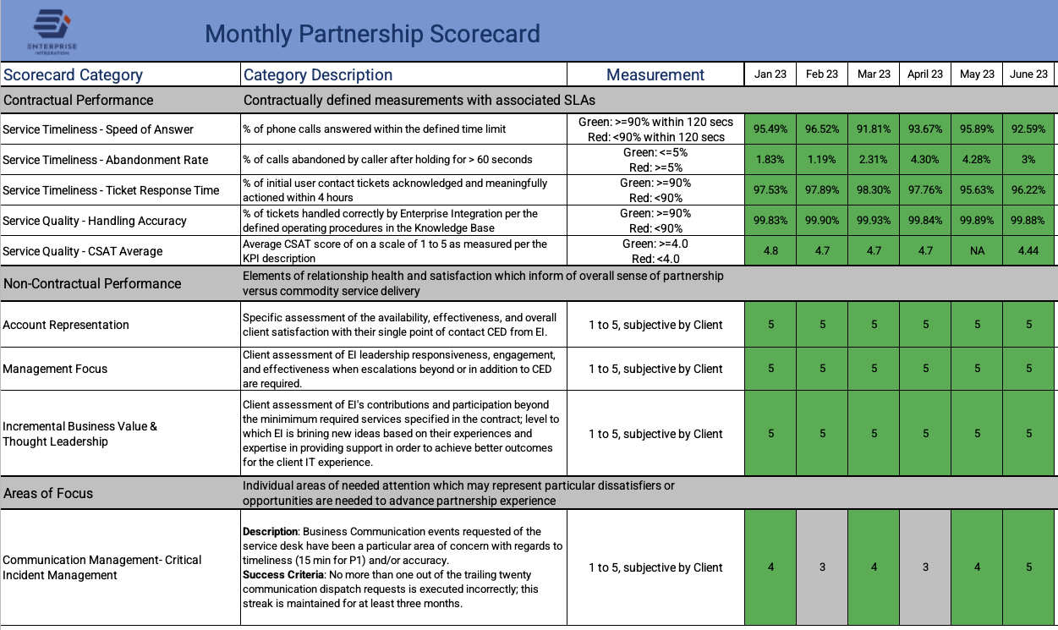
Partnership Scorecard
Partner feedback that measures both contractual SLAs and subjective measures important to our partners drive continuous improvement.
Notes:
June total = 15 4 are upcoming

Slide 50
Testimonials…
“EI has handled our IT collapse better than we could have imagined. They came into a VERY difficult situation, but because of the great Team at EI we are light years ahead of where we were. They’ve even helped outline a technology plan moving forward! Not having the stress of worrying about day-to-day IT issues allows us to focus on growing our business while all of our end users are 100% satisfied.”
ASHLEY LARSEN
CUSTOMER SERVICE CENTER DIRECTOR
HAMPTON GOLF
“Enterprise Integration has been an integral part of our technical infrastructure. From designing our Microsoft system platform in 2004 to transitioning our servers to a virtual environment in 2012, EI has been there every step of the way. We value our partnership with EI and continue to be impressed by their level of service and expertise.”
ANNMARIE NEMETH
CHIEF FINANCIAL OFFICER
MJW CONSOLIDATED, INC.
Notes:
June total = 15 4 are upcoming

Slide 51
Appendix

Slide 52


Example Onboarding Timeline
(Can accelerate based on customer requirements)
Technical Readiness Validation
Connectivity and telephony
Environment Access / Credential
Knowledge base
Operational reporting
Environment Access for EI
RFP Award
Transition Planning
Knowledge transfer/ Process planning
Post-launch Hypercare
Aug 2023
Sep 2023
Oct 2023
Nov 2023
Dec 2023
Jan 2024
Service desk staffing
Boot camp
Contracting,
Transition & Communications
Pre-Planning
Resource Alignment
External
Staffing Acquisition
ITSM Process Discovery & Planning
Tooling & API Integration
Access Provisioning
ITSM Process Finalization
Knowledge Discovery
Tooling Validation
Reporting Validation
Knowledge Validation
Run Book Documentation
Internal Staff Transition
Training Boot Camps
& Certification
On Knowledge
Transition Team Fully Assembled
With dedicated Project Manager
Cutover and Go-Live

Slide 53
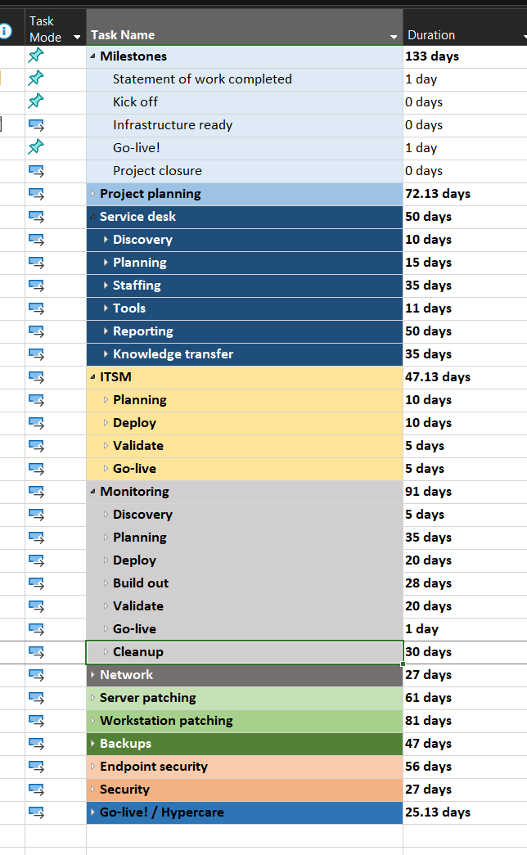
Managed Services Transition Plan
Repeatable, adaptable transition plan prepares environment, people, and processes by service delivery tower
Stage-gated, fully managed transition project with EI PMO (along with client transition team, where applicable) ensures, for each service:
  45 to 120 days from signing to go live depending on the existing design documents
  Environment documentation is complete and indexed for EI resource use
  SOPs are available for syndicated delivery teams
  Appropriate system access, constrained based on least-privilege-required framework, is in place for technical resources
  Instrumentation for remote monitoring and management, backup management, and security are in place and fully operational
  All necessary EI resource teams have been apprised and trained on client-specific systems, processes, and requirements as necessary
  End user communication, as necessary, is delivered in timely and appropriate media to ensure user understanding of changes (if any) in how they request and receive support

Slide 54
Professional Services
WHY EI?
We offer a mature Project Management Office with the proven processes and IT know how to deliver projects on time and on budget with successful measured outcomes.
WHAT We Do
IT Network Projects
Network Assessment
Network Refresh
Network Migration
Network Infrastructure Design
Network Optimization
SDWAN Solution
WN Optimization
Business Communications Systems
IT Security Projects
Compliance and Security Assessments
Compliance Risk Assessments
IT Security Audit
IT Security Policy Assessment
Physical Security Assessment
Security Incident Response Assessment
Security Risk Assessment
Vulnerability Assessment
IT Consulting Services
Architectural Services
Technology Roadmaps
Cyber Security Consulting
Database Consulting
ITSM Consulting
Migration Projects
Cloud Migration
Activate Directory Migration
Office 365 Migration
System Migration
Data Center Migrations
IT Infrastructure Projects
Hardware Maintenance
Technology Refresh
Technology Assessment
Hardware Refresh
Database Implementation
Database Assessment
End User Projects
PC Refresh
Building Moves
New Sire Turnups

Slide 55
EI Executive Placement & Staffing Services
Why EI?
Staffed with some of the most talented Technology Visionaries, Engineers, and Architects in the IT industry, Enterprise Integration is uniquely structured to source, recruit, and qualify candidates above and beyond other IT Staffing firms.
WHAT We Do
Retained Executive Search
Direct Placement
Staff Augmentation
Contract & Direct Hire Placement
RPO Services (Sourcing, Recruiting, Background/Reference Checks, Onboarding, etc.)
Professional/Technical Consulting Services
Predictive Index – Personnel Behavioral Assessments
Insert Image

Slide 56
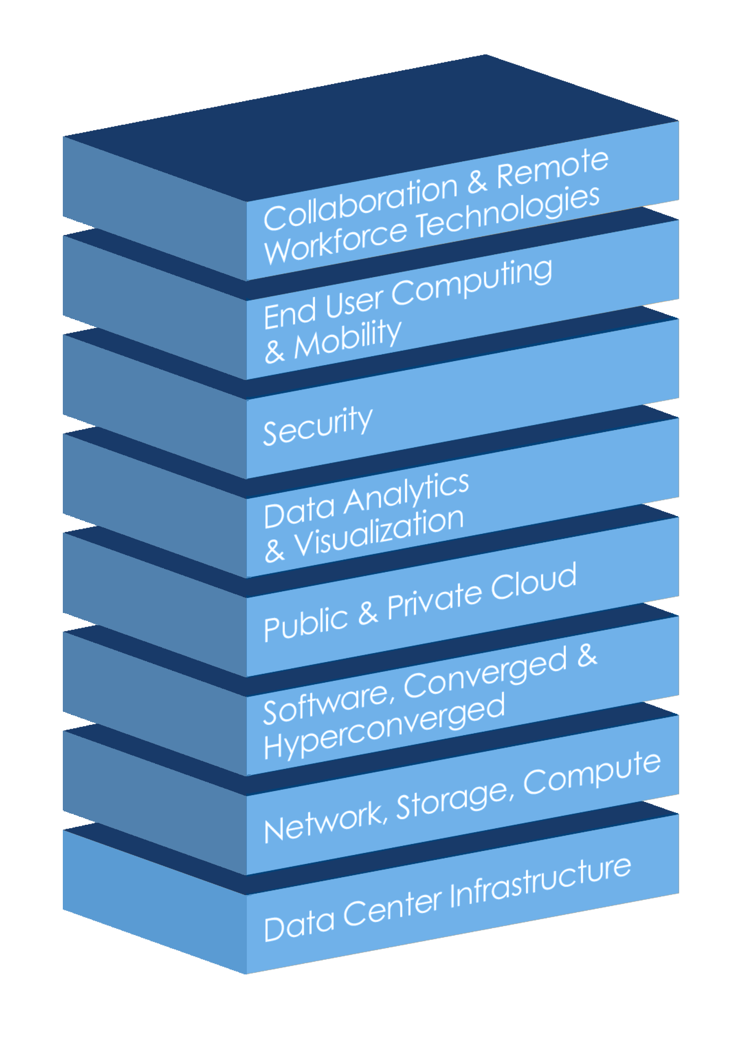
EI Procurement Services
Why EI?
With a portfolio of industry leading partnerships, we deliver a brand-agnostic approach to consulting, design and procurement services – giving our clients access to the entire IT supply chain.
WHAT We Do
IT Hardware & Software Procurement
Data Center Infrastructure
Network, Virtualization, Storage, and Compute
Converged & Hyperconverged
Private & Public Cloud
End User Computing & Mobility
Collaboration and Remote Workforce Technologies
Leverage our partner relationships
Financial Planning and Life Cycle Management

Slide 57
Solution Design Overview

Slide 58
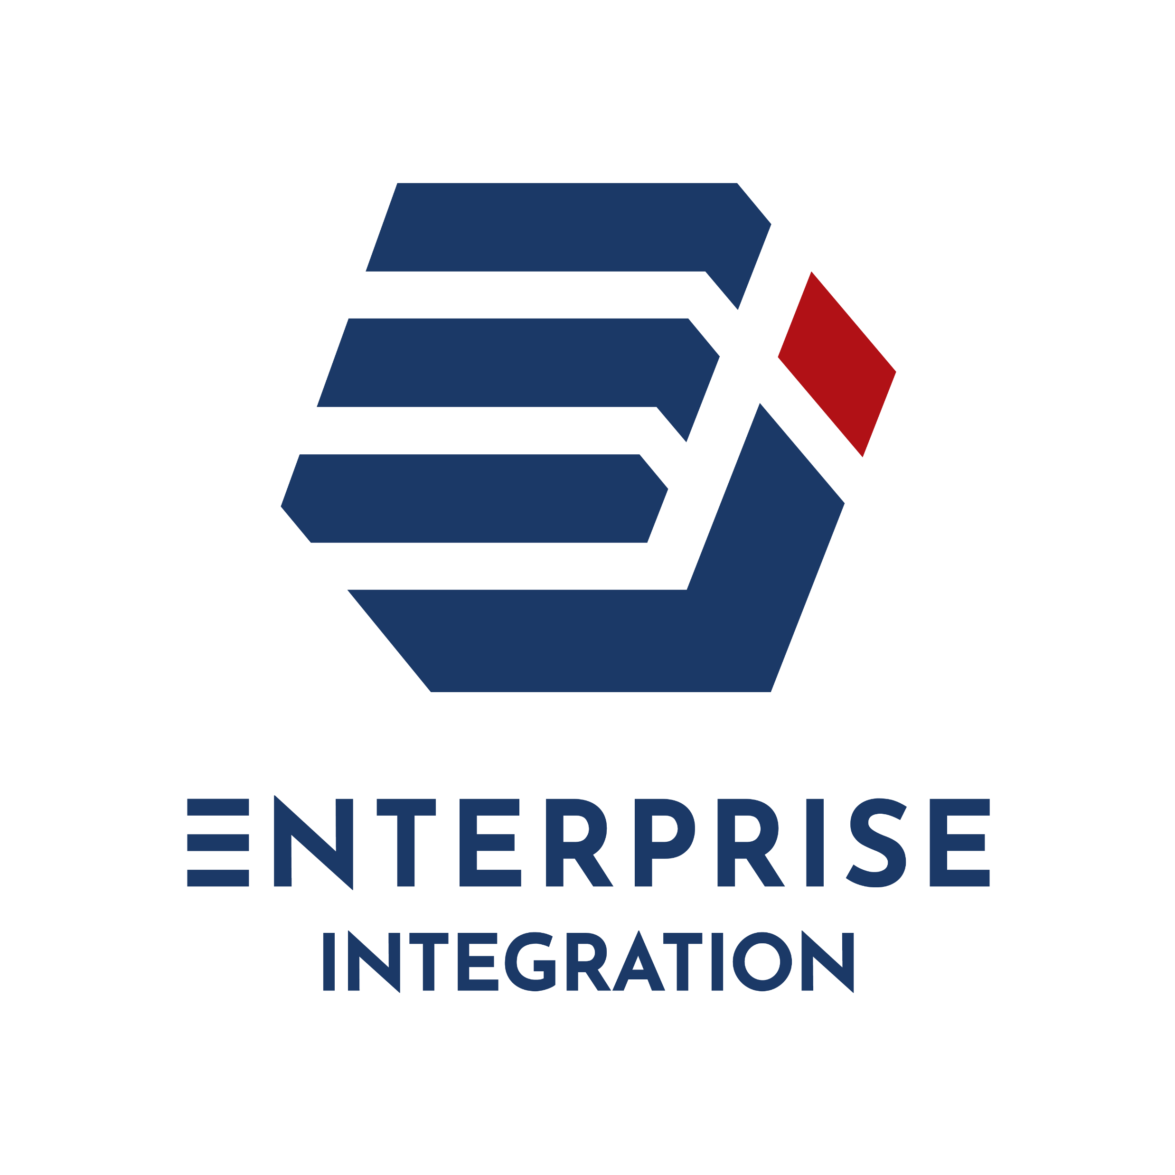




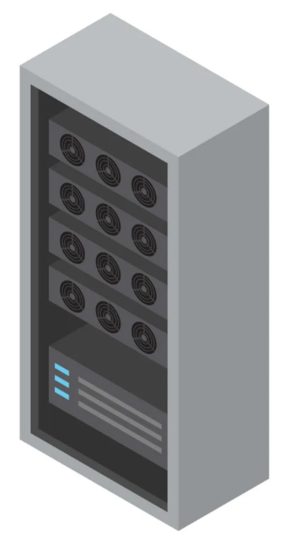
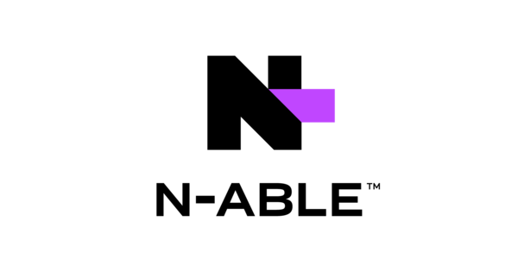

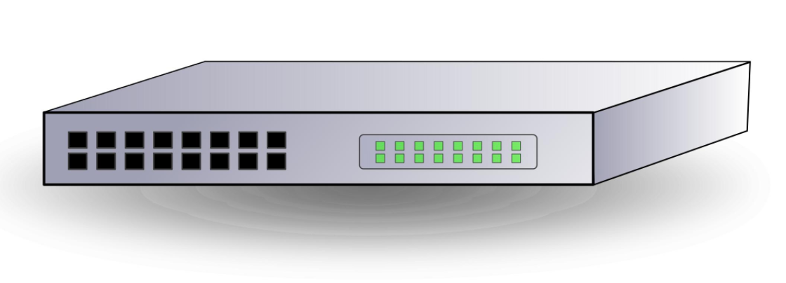







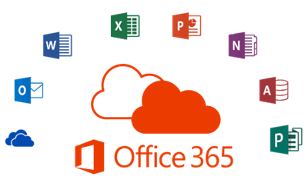


Solution Design
Instrumentation
Service Delivery
Z7
B1
IT Service Management
Z1
D6
D5
A5
D7
L3 Engineering
Client LOB System Support
Client Storage/Compute
L3
L4
A1
A3
B2
A2
Z2
A4
B3
Field Services
L2
Z3
Client Network
C1
D1
D3
B4
C2
D2
D4
24x7 SOC
CW SIEM
Z4
P1
24x7 NOC
24x7 Service Desk
L1
B5
Log Aggregation
DC / Firewalls / Etc
Z5
C3
B7
B8
B6
B9
B9
Z6
Managed Workstations
Client User Population

Slide 59
Tag | Description
A1 | Physical, virtual, and cloud server logs aggregated and sent to CW SIEM solution
A2 | SentinelOne software monitoring and protecting servers
A3 | N-Central software monitoring server environment
A4 | Auvik solution monitoring network environment, managing config backups, and managing network environment
A5 | Veeam backup solution maintains backups in accordance with server backup policies
B1 | Recurring environment maintenance / solution tasks assigned to L3 and tracked for SLA
B2 | Environment alerting sent from NCentral to 24x7 NOC
B3 | Environment alerting sent from Auvik to 24x7 NOC
B4 | SentinelOne security alerting sent to 24x7 Proficio SOC
B5 | Log aggregation and ingestion into CW SIEM generates event alerts
B6 | Office 365 integration into CW SIEM generates event alerts
B7 | Automate configured workstation alerting generates events sent to 24x7 SOC
B8 | Automate misconfigured / noncompliant workstation data generates Service Desk tickets
B9 | Automate enforces and distributes patching policies to workstations and servers
C1 | CW SOC escalates confirmed active security threats to EI L3 security engineering
C2 | CW SOC escalates confirmed active security threats to 24x7 NOC
C3 | Client user population submits service requests and reports incidents to 24x7 Service Desk
D1 | 24x7 NOC escalates confirmed outage or security events to L3 engineering
D2 | 24x7 Service Desk dispatches field services as required for on-site support
D3 | 24x7 Service Desk escalates unresolvable requests or incidents to appropriate L3 engineering
D4 | 24x7 Service Desk escalates unresolvable OOS tickets to L4 engineering / Client System Support
D5 | L3 engineering escalates OOS tickets to L4 engineering / Client System Support
D6 | L3 engineering leverages NCentral to configure monitoring thresholds and capacity-plan
D7 | L3 engineering leverages Auvik to configure network monitoring, manage configuration, and capacity-plan

