Slide 1
PRESENTATION
FOR ARTISTS

Slide 2
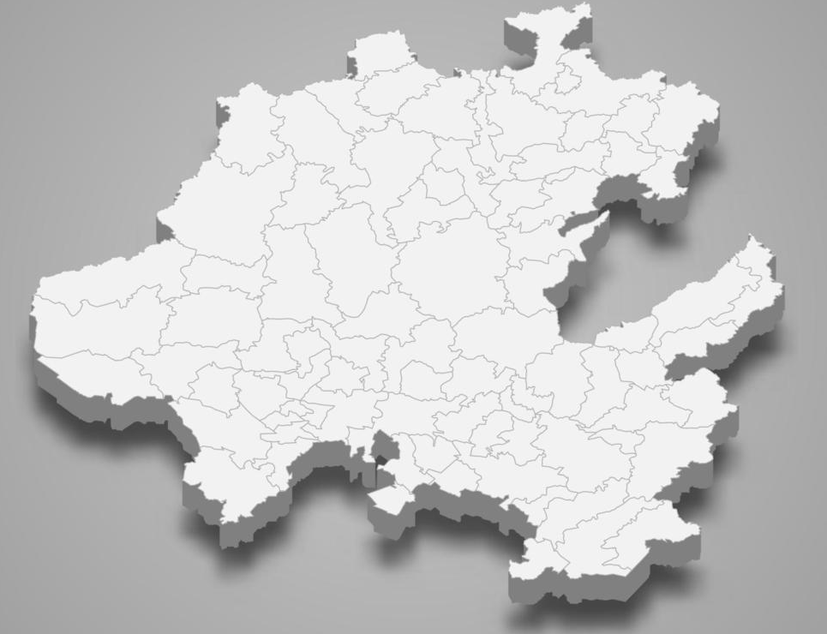

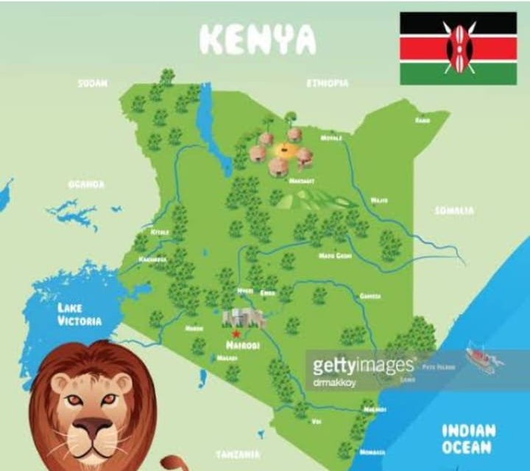
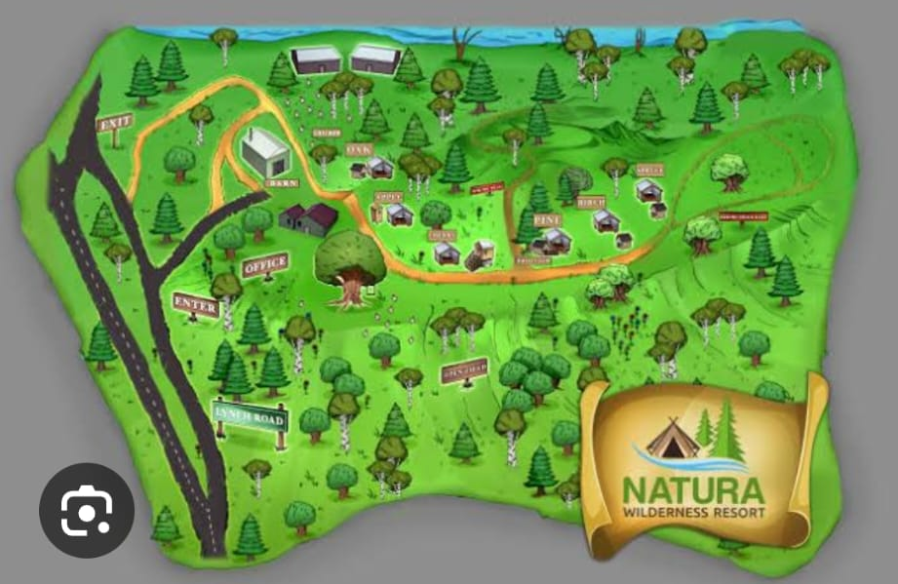
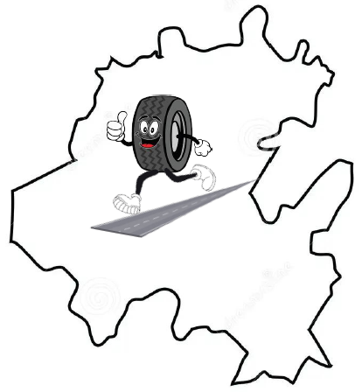
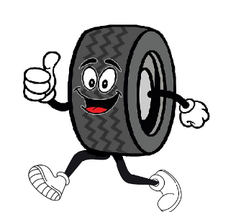
Project Concept
Tilted 3D map of the state of Hidalgo, Mexico.
Outline with the color of the local government including their logo.
Cartoon-like drawing within the outline of the map, following draft drawing (mountains, cactus, trees, and the curved road getting wider as it gets closer).
Motto: “Al futuro Reciclando” in the thick bottom line of the map.
Mr Tire will be the main character in the logo running down our road.

Slide 3
Hidalgo Map
Use the map of the state of Hidalgo, Mexico.
Tilted 3D map.
Thicker bottom layer.
2. Map Outline of this color 105, 27, 50 #691B32

Slide 4


Slide 5
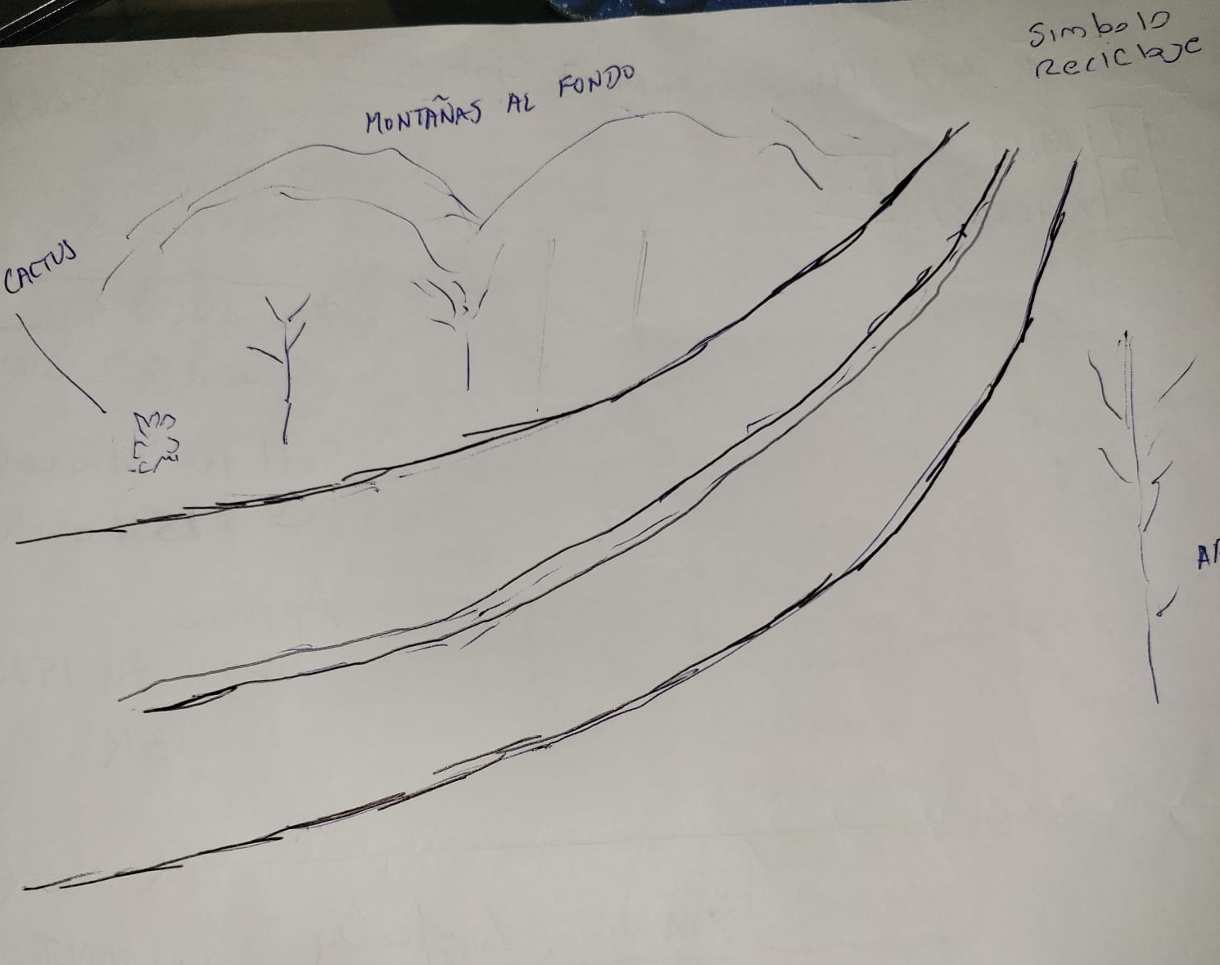

Appearance
Shape of Road

Slide 6
Can Change face
What / where did it come from ?
I saw it on way to airport in Mexico City
Can he look more Mexican ?

Slide 7

Cartoon Vegetation

Slide 8
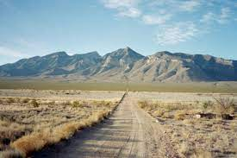
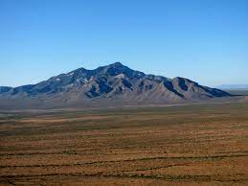
Background
Mountains in Background

Slide 9
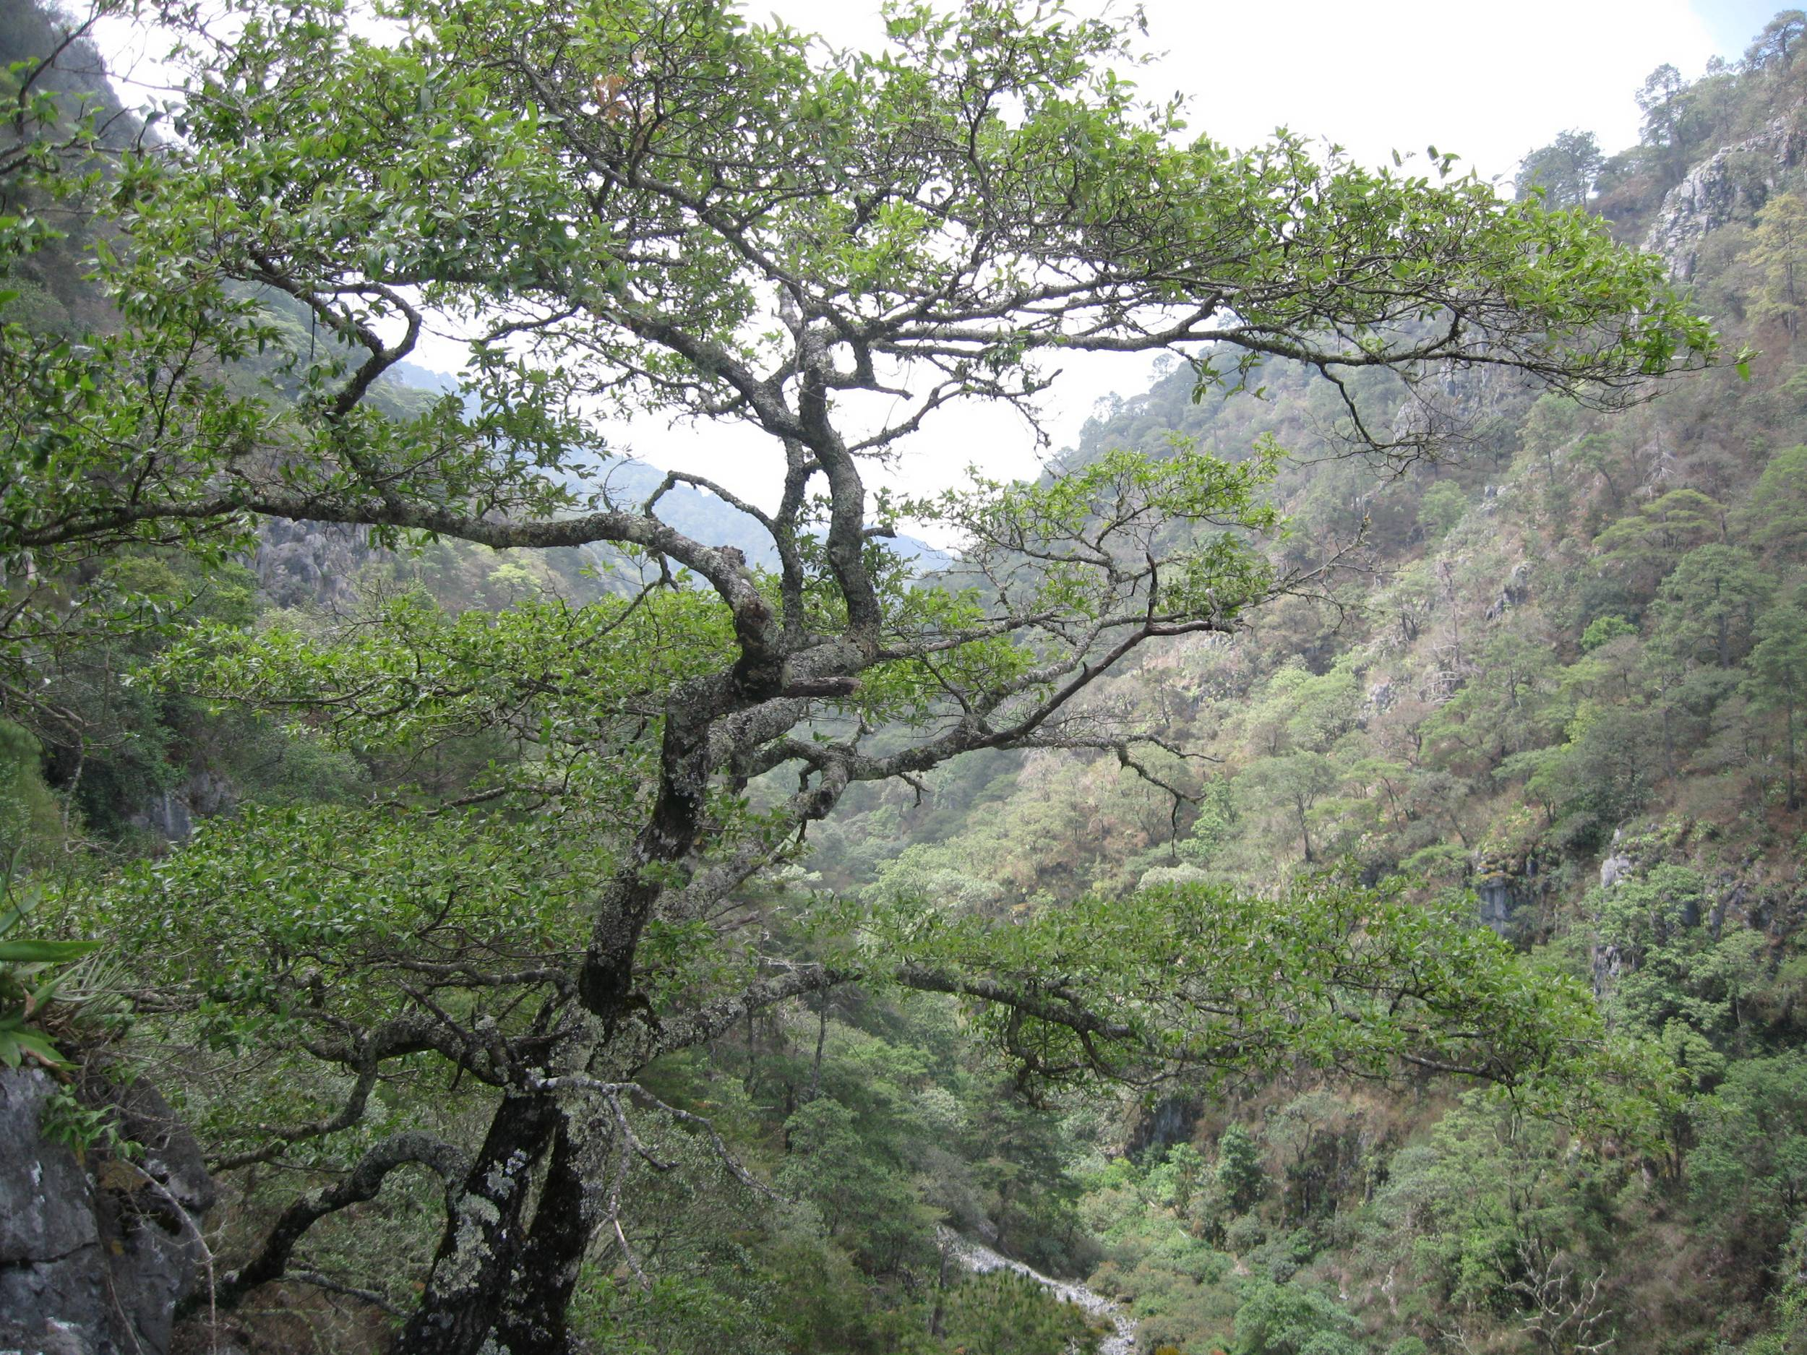
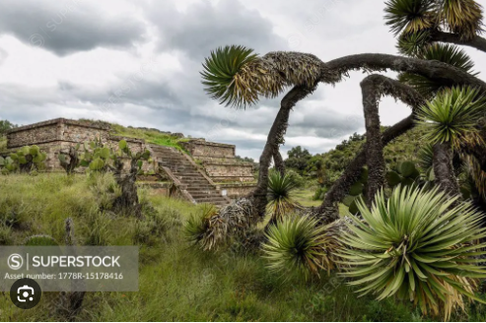
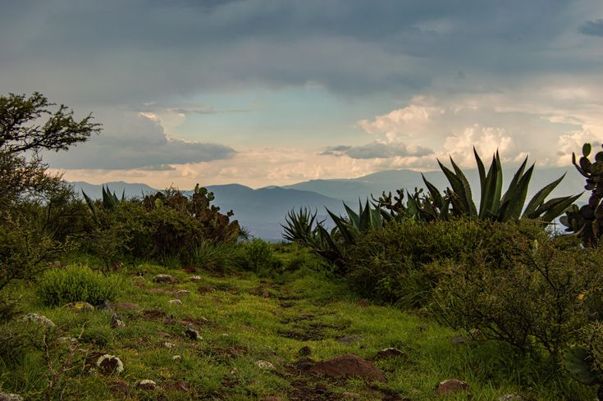
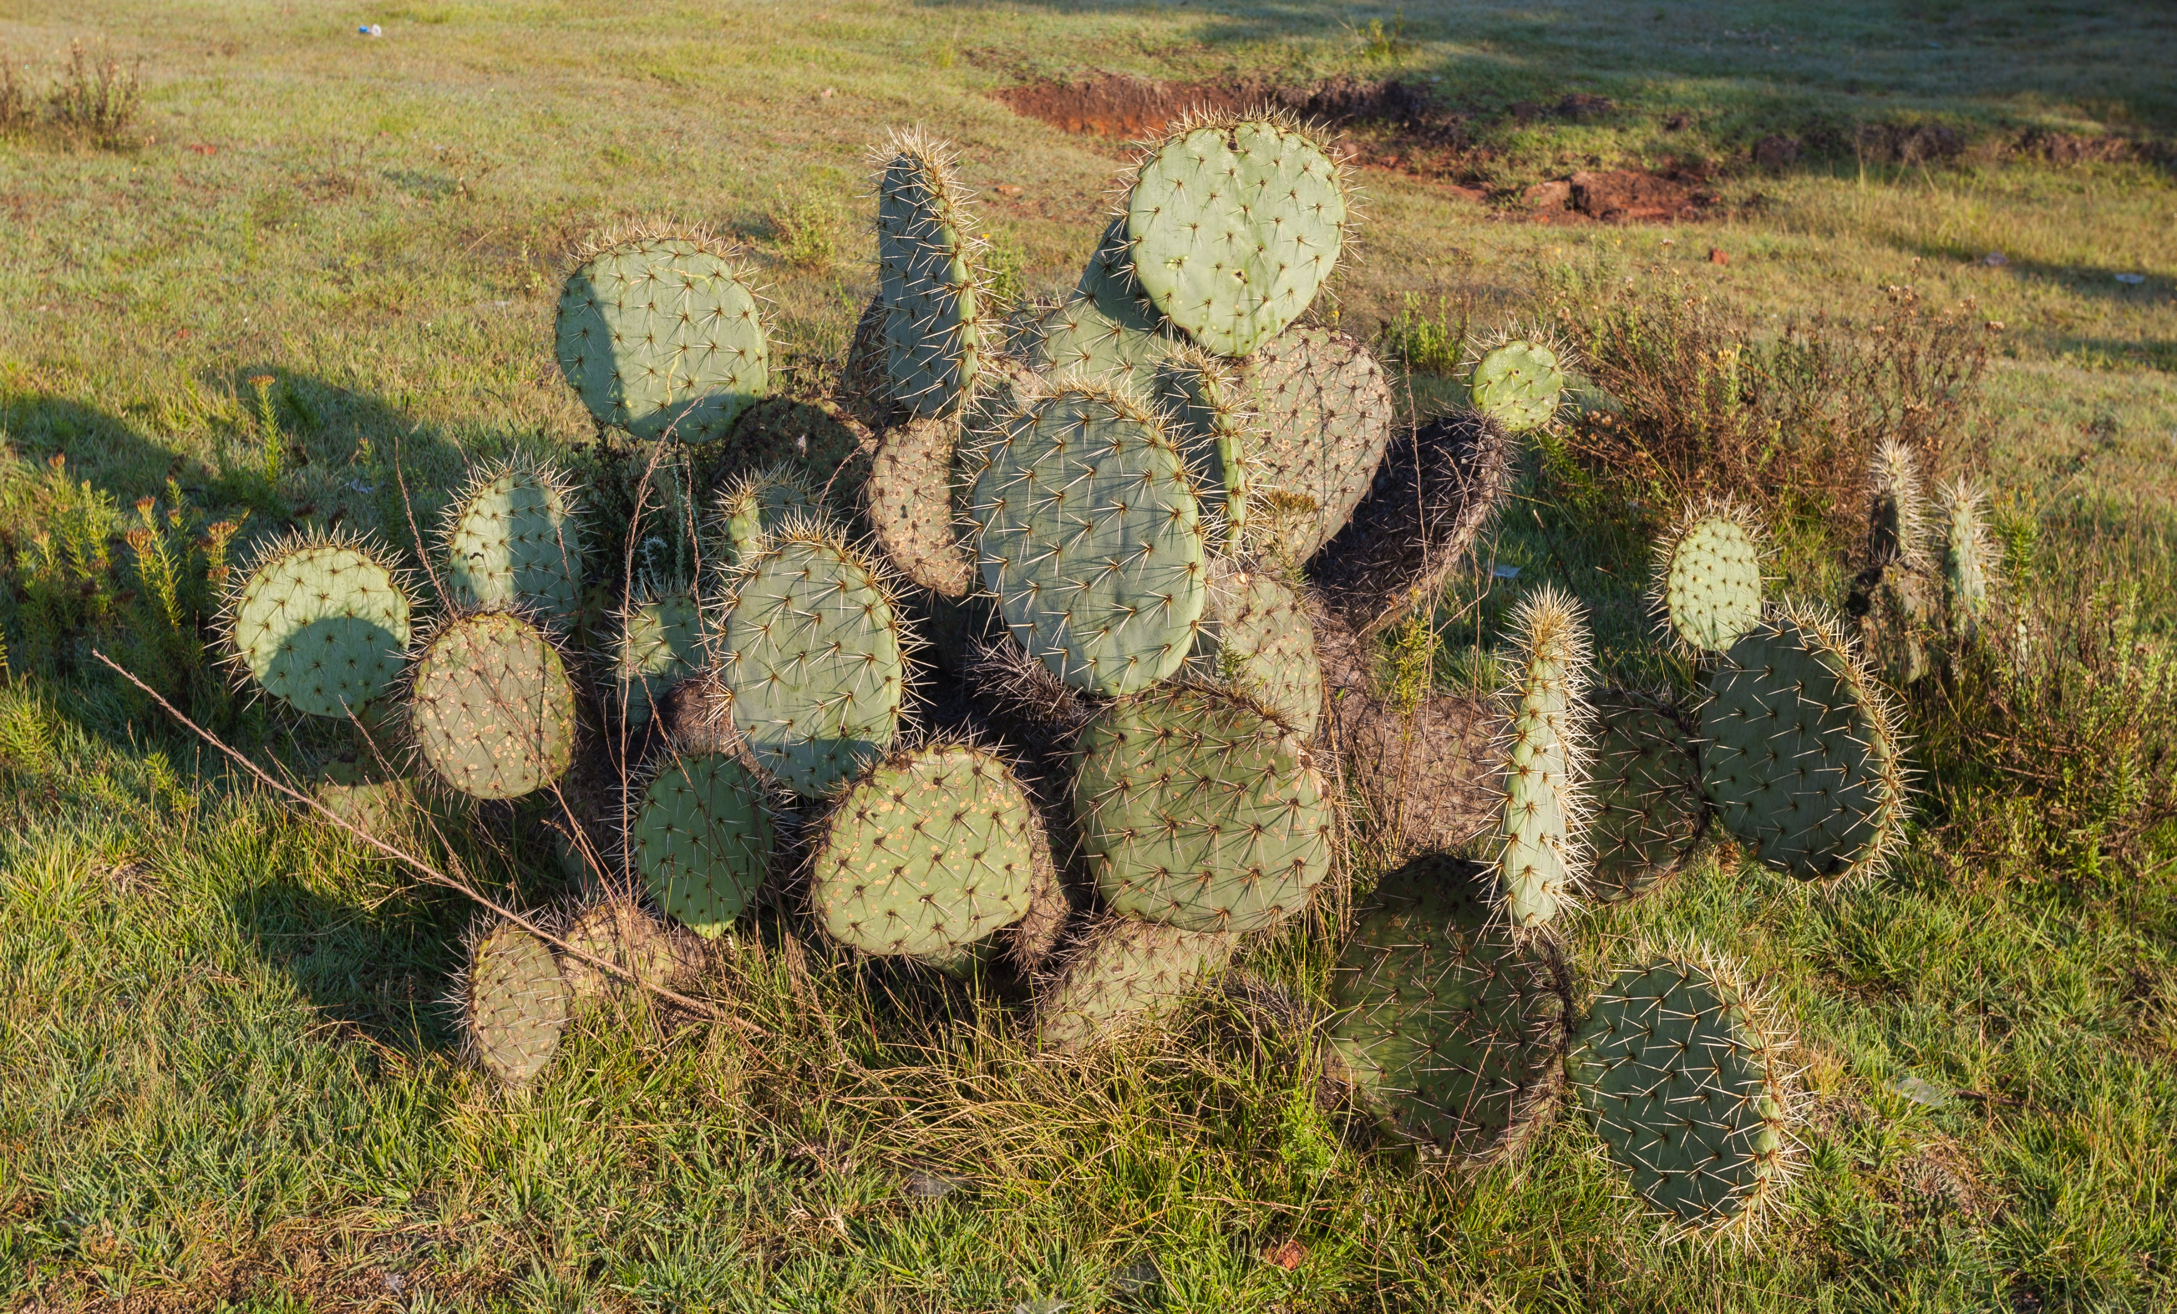
Local
Vegetation

Slide 10



Insert / incorporate Recycling Symbol
Possible Symbols to Use

Slide 11

Insert / Incorporate Hidalgo Slogan – One of the Following
El Pueblo Primero
El Futuro Reciclado en Hidalgo
Hidalgo Lider en Reciclar
El Pueblo Hidalguense Recicla
Reciclemos Hidalgo !
OR
El Futuro Reciclado (with Logo)
Reciclando para el Futuro (with Logo)
El Pueblo Recicla ! (with Logo)

Slide 12
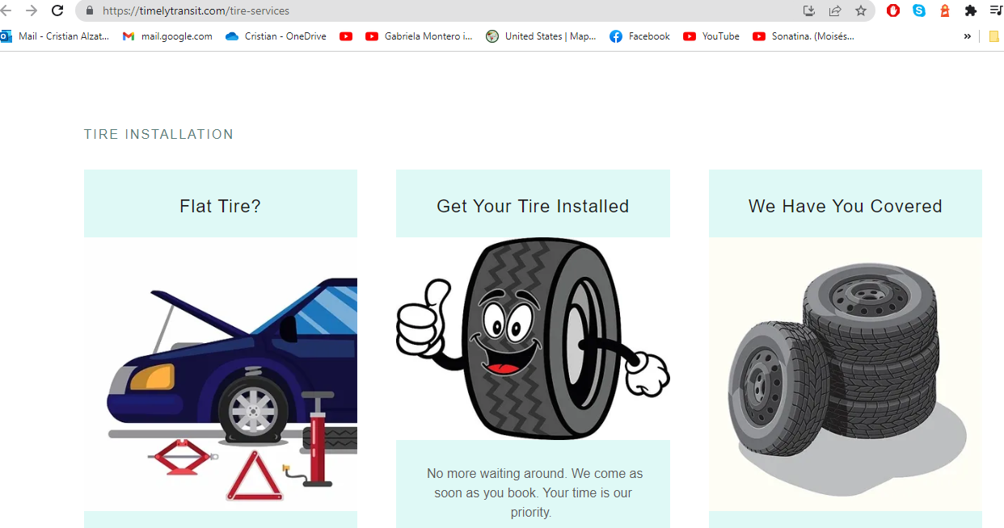
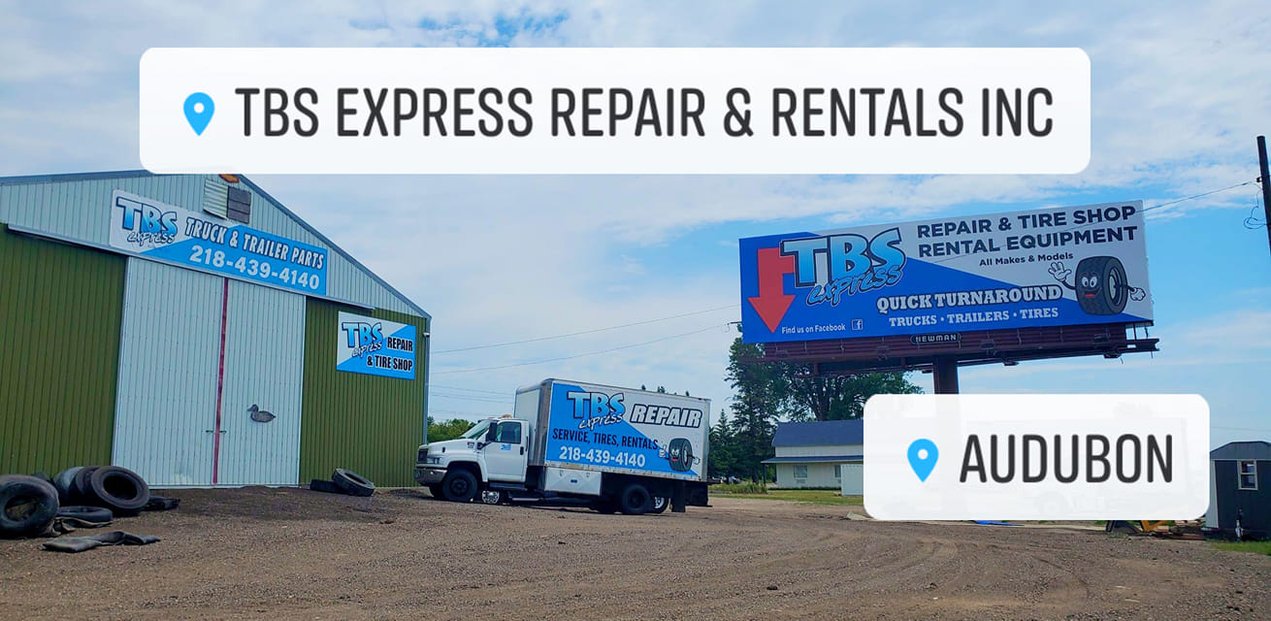
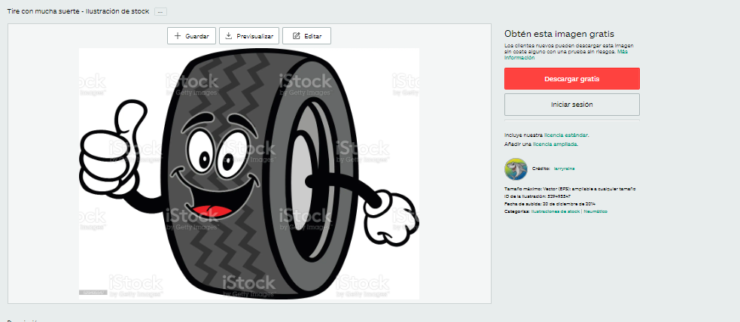
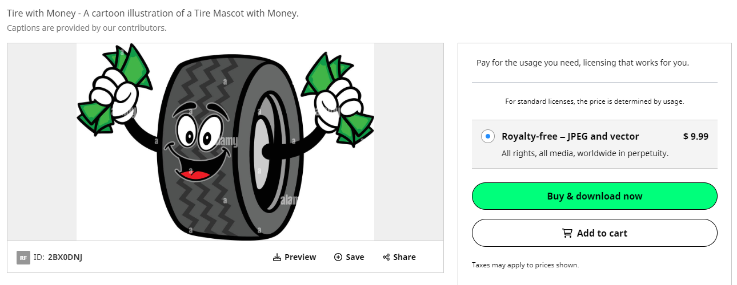
https://timelytransit.com/tire-services
https://www.facebook.com/TBSEXPRESSINC/
https://www.istockphoto.com/es/vector/tire-con-mucha-suerte-gm529495547-53981742
https://www.alamy.com/tire-with-money-a-cartoon-illustration-of-a-tire-mascot-with-money-image360199214.html

