Slide 1


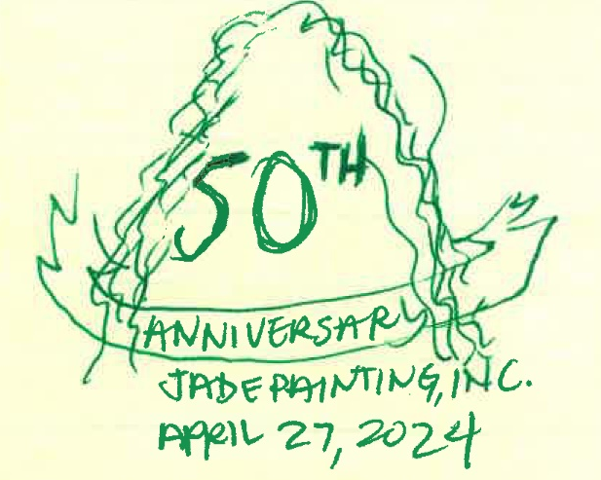
“Ola I ka Makana ma Ke Akua”
Me Ke Aloha
FRONT
BACK
“life is a gift from God”

