Slide 1
HYBRID RECRUITMENT
LOGO BRIEF

Slide 2
About Hybrid Recruitment
Hybrid Recruitment is a recruitment company that specialises in creating employment opportunities for young people, aged 19-30.
Brands to consider when thinking about the feeling of our new company:
Redbull
GoPro
Nike
When you think of these brands, you think of excitement, energy, extreme sports, young demographics.
This is us, but in recruitment form.

Slide 3
Key Characteristics
This logo must create a feeling of excitement, and represent a modern, youthful persona, yet somewhat professional.
This is to be represented through the use of vibrant, bright colours and sharp, straight edged text styles.
It must be easily recognizable and iconic. People should be able to recall it by design and colour.
Be daring, brave and courageous with design and colour choices.

Slide 4
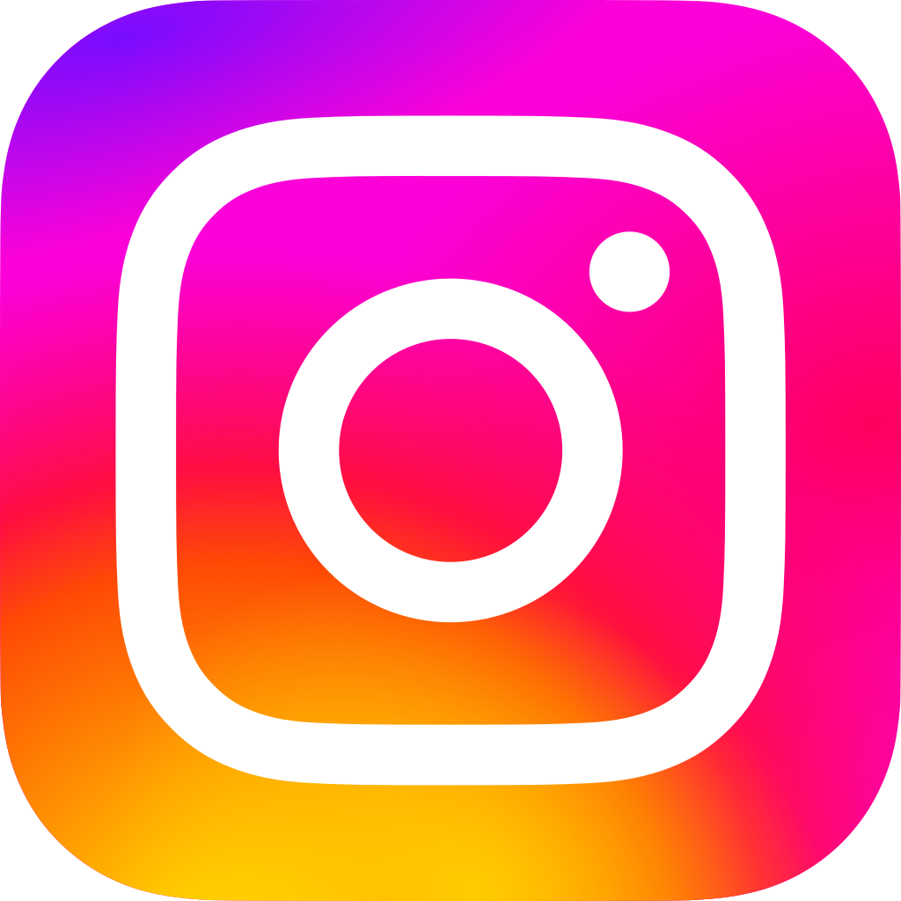
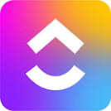
Colour Suggestions
Instagram gradient pink/purple into orange and yellow
Vibrancy of Instagram

Slide 5
Text Style Suggestions
Think:
Sleek
Contemporary
Futuristic
We are giving you full creative license

