Slide 1

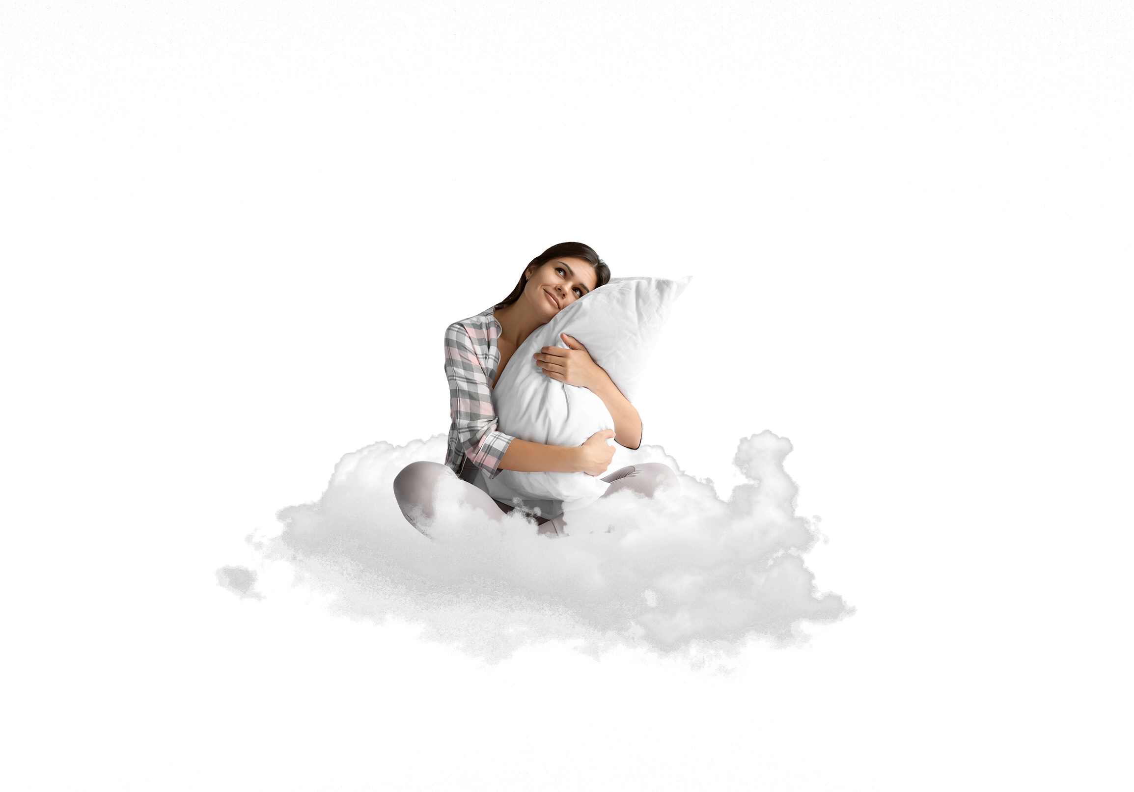
Cloud 9 Adjustable Pillow
LIKE SLEEPING ON A CLOUD
PERFECT FOR: Back, Side or Stomach Sleepers
Perfect For All Sleepers
Fully Adjustable for all sleeping positions
CLOUDcomfort™ Memory Foam
Provides cloud-like comfort & support
Eco Friendly
Hypoallergenic and CertiPUR-US® certified
Cool & Anti-Bacterial
Antimicrobial, ultra-soft & cool to the touch cover
QUEEN SIZE
20” x 30”

