Slide 1

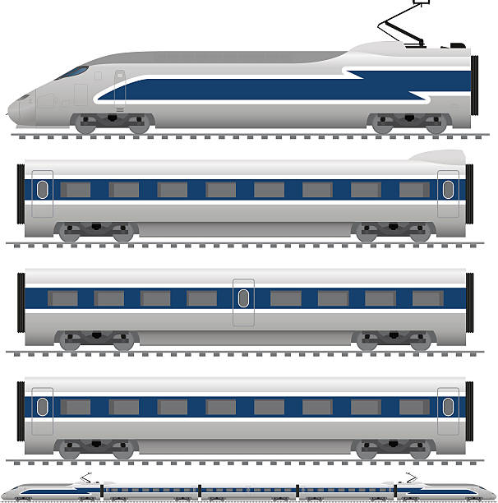


Iterative
Train Station
Train Station

Slide 2
Iterative
“with notes”
Stage 5
Train Station
Stage 4
Stage 3
Stage 1
Stage 2
Train Station
This axis shows how functional each stage is
All stages are functional and can work on their own

Slide 3





Everything at once
Train Station

Slide 4
Everything at once
“with notes”
Stage 5
Train Station
Stage 4
Stage 3
Stage 2
Stage 1
This axis shows how functional each stage is
First 4 stages are NOT functional or working
Stage 5 is now operational and working

