Slide 1
Ideation for Board Game Bar

Slide 2
Brand
Orange
Board Games
Craft Beer
Bourbon
Plants
Lit RPGs
Industrial
Dogs
Relaxation / Calm
Fun
Untappd

Slide 3
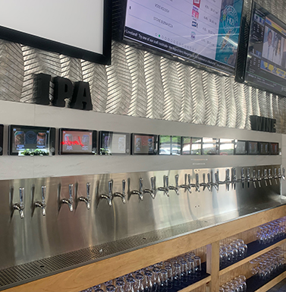
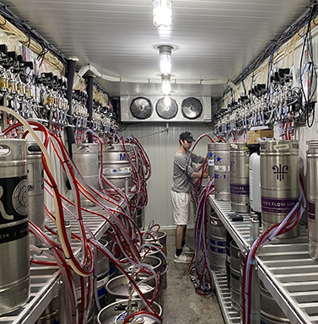
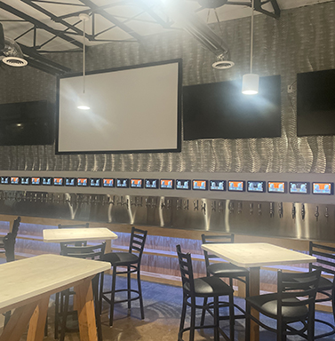
Tap System
Courtesy Hops & Berry Taproom
Loveland, OH
H&B Media – Hops and Berry Taproom

Slide 4
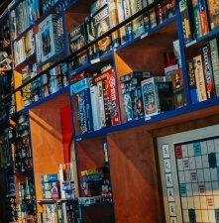
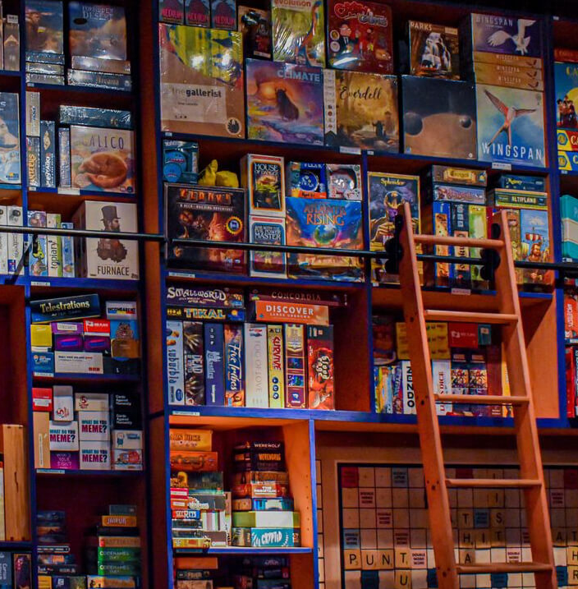
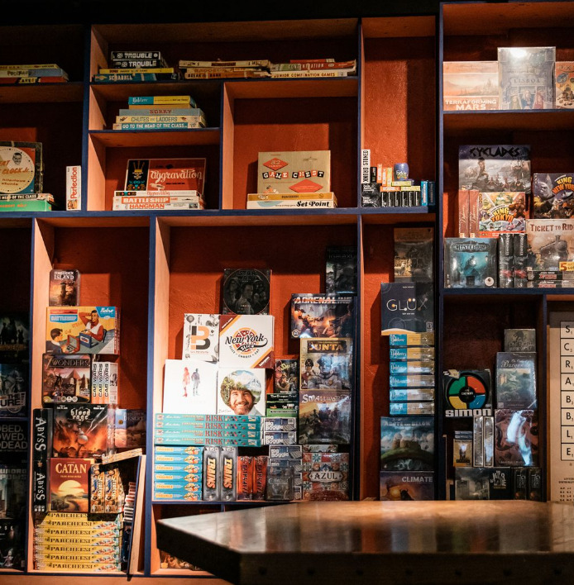
Board Game Shelves
Courtesy of The Corner Grill, Bar + Game Room
Detroit, MI
www.thecornerferndale.com

Slide 5
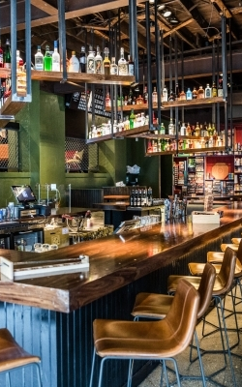
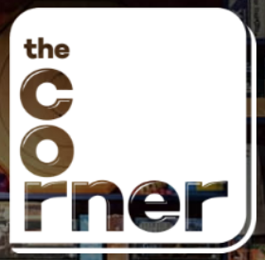
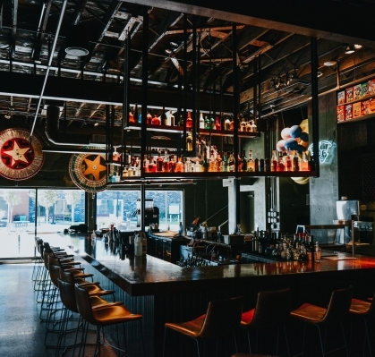
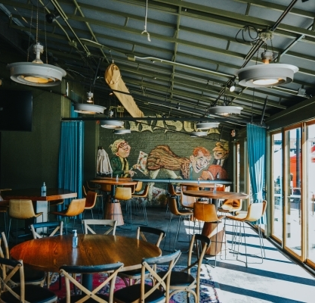
The Corner Grill
Detroit, MI
Restaurant and Gaming Ferndale, MI | The Corner (thecornerferndale.com)

Slide 6
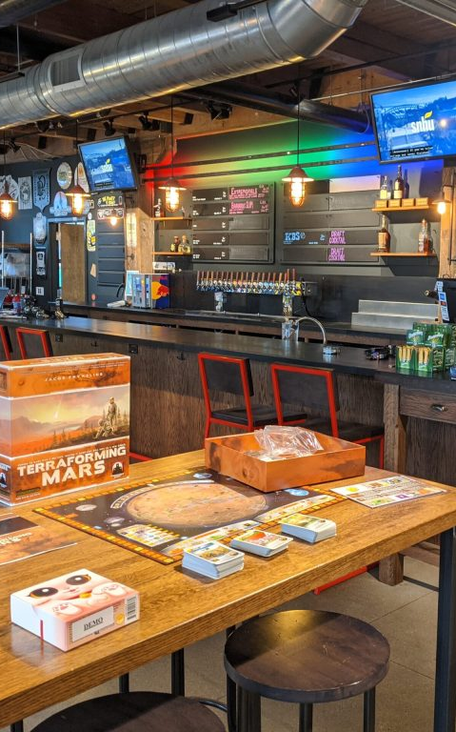
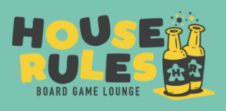
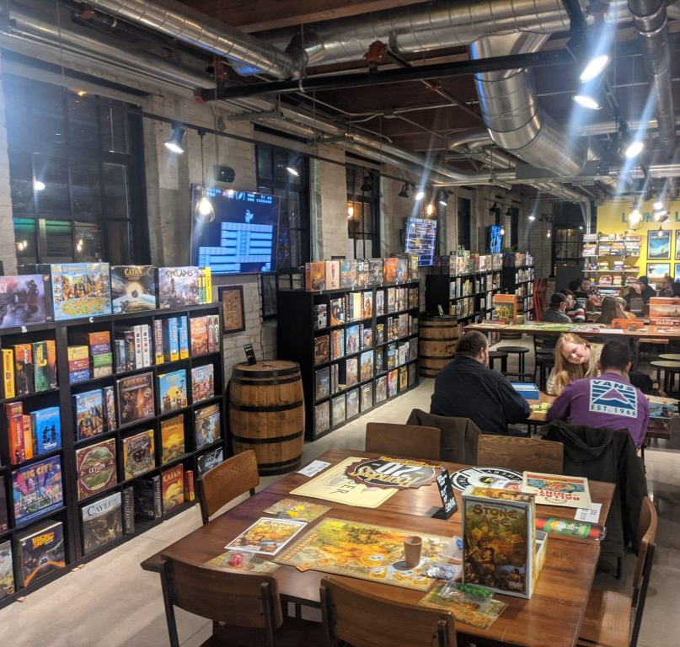
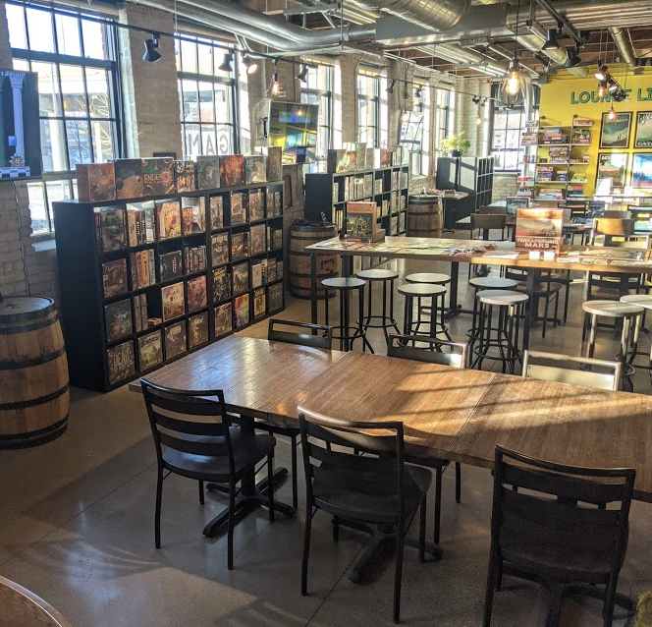
House Rules Board Game Lounge
Grand Rapids, MI
The Lounge - House Rules (houseruleslounge.com)

Slide 7
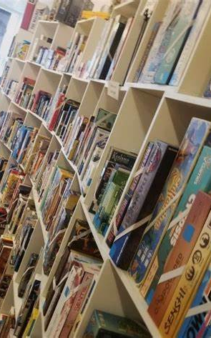

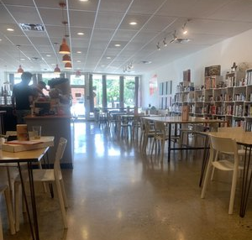
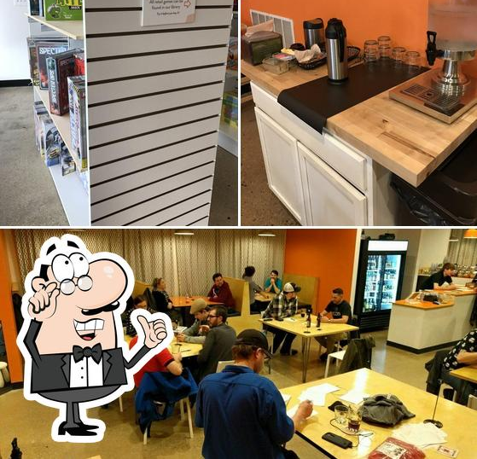
Tabletop Game Café
Columbus, OH
Tabletop Game Cafe

Slide 8
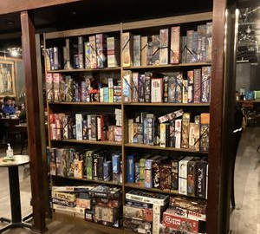
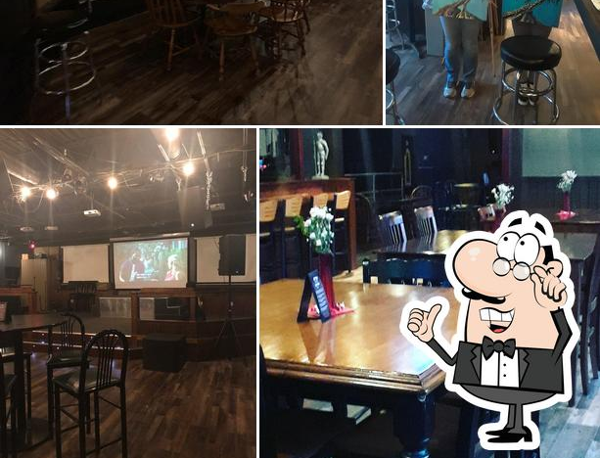
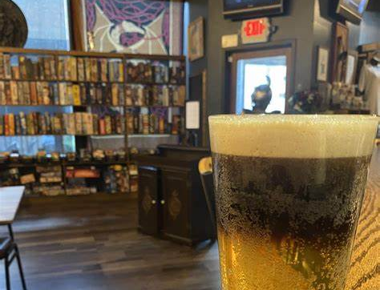
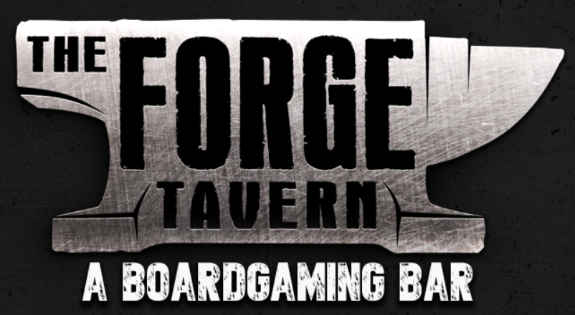
The Forge Tavern
Columbus, OH
The Forge Tavern – A Boardgaming Bar

Slide 9
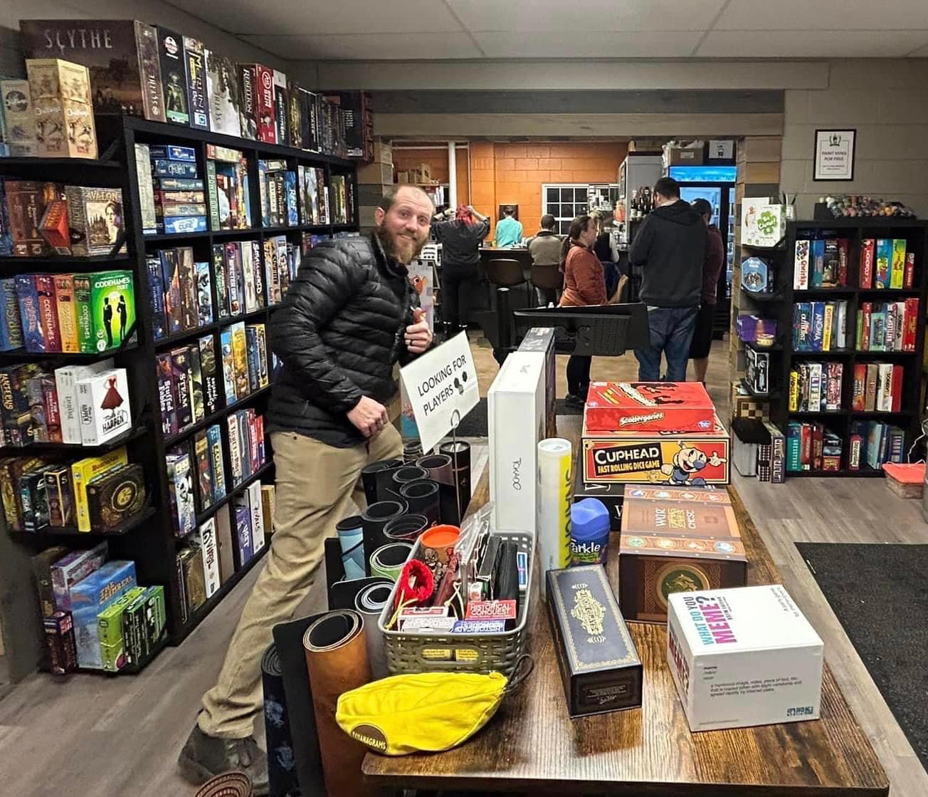
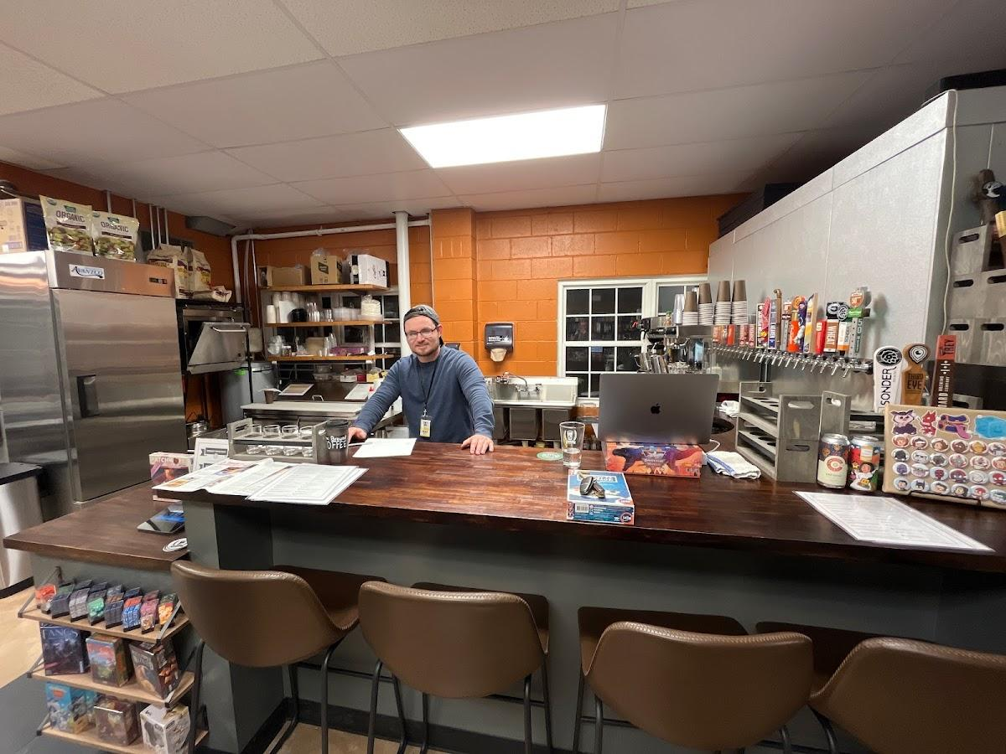
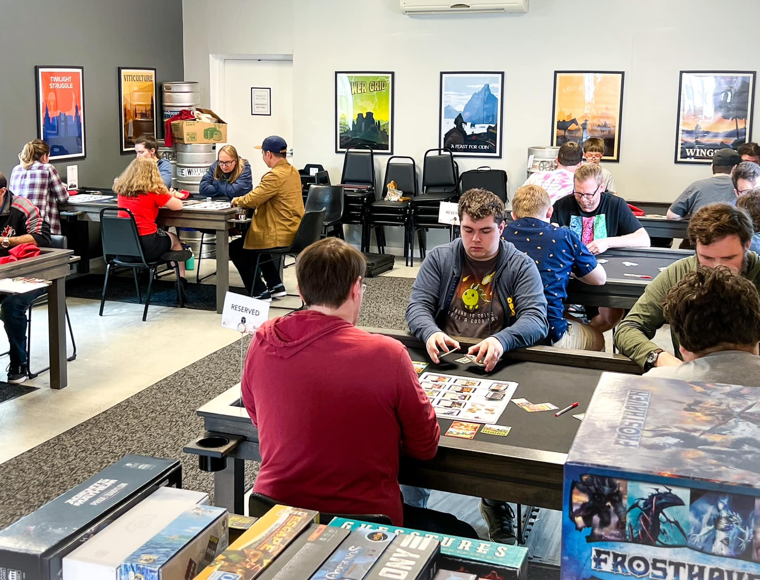
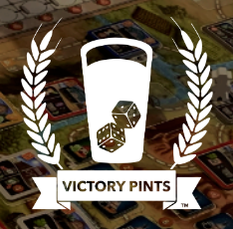
Victory Pints
Maineville, OH
VISIT (vpcincy.com)

Slide 10
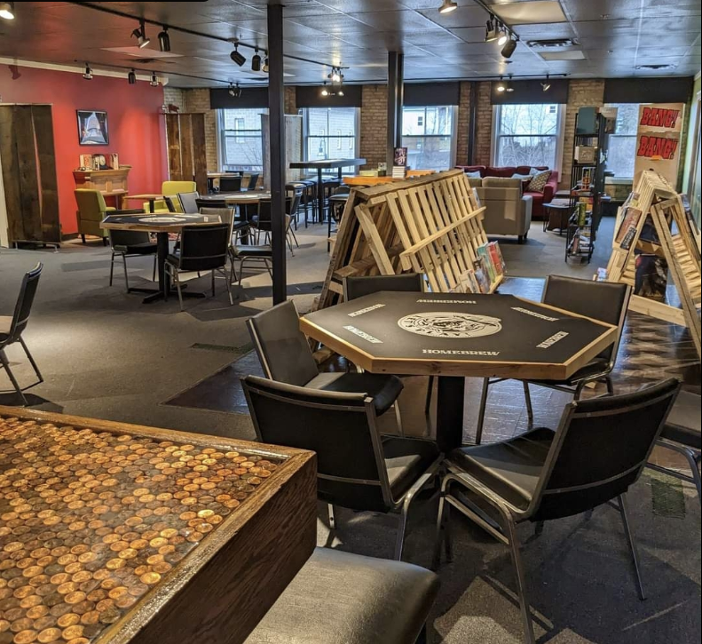
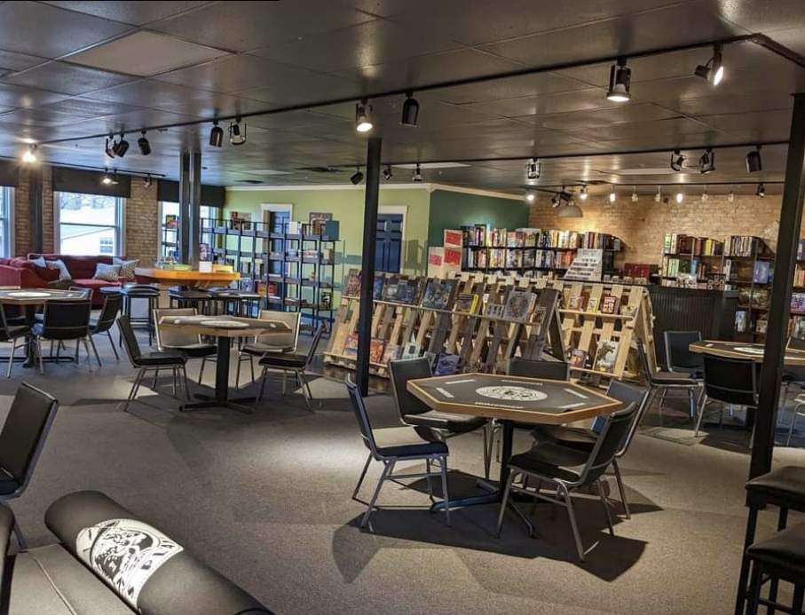
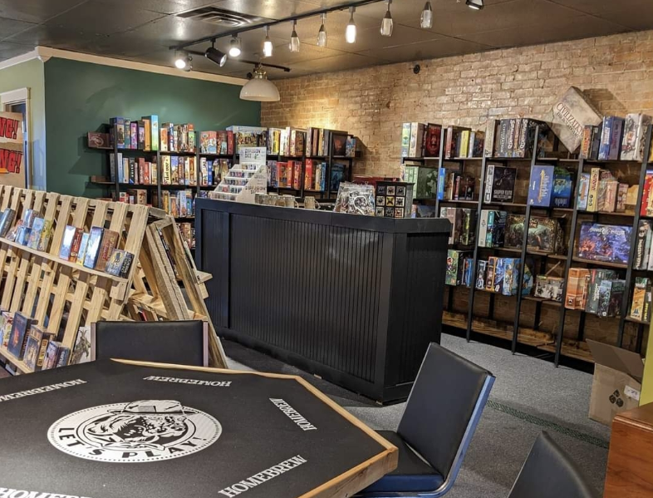

Homebrew Tabletop Game Lounge
Grand Ledge, MI
Homebrew (homebrewgamelounge.com)

Slide 11
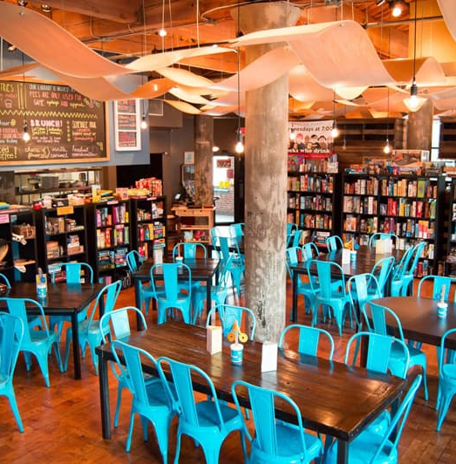
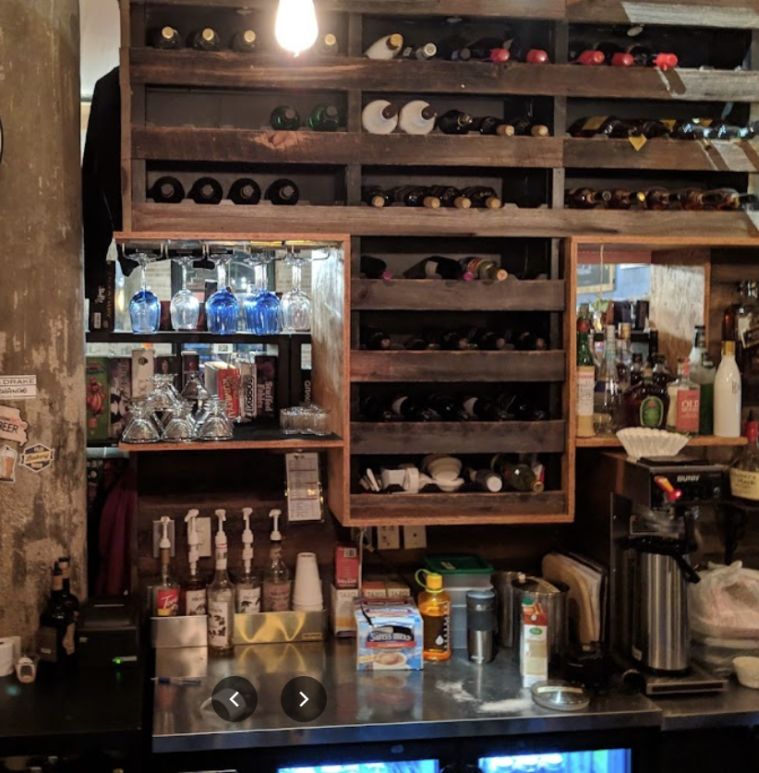
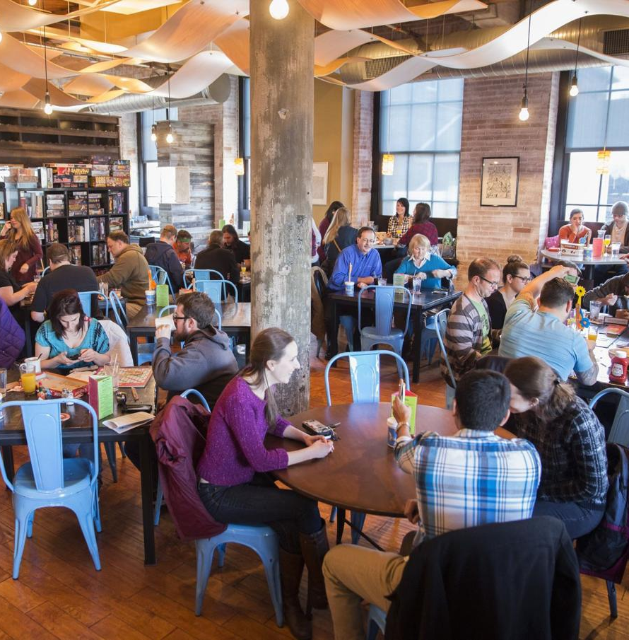
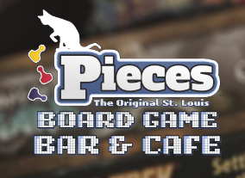
Pieces: The St. Louis Board Game Bar & Café
St. Louis, MO
St. Louis Board Game Bar and Cafe (stlpieces.com)

Slide 12
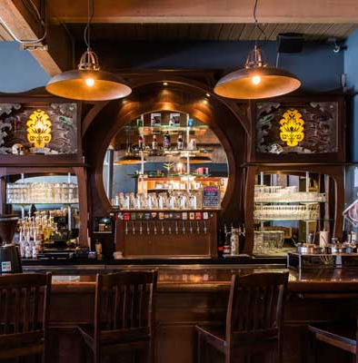
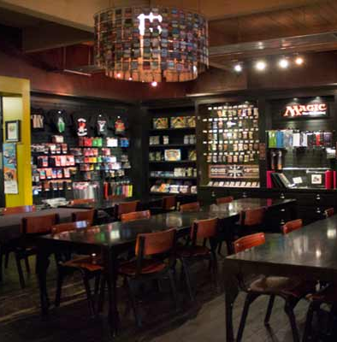
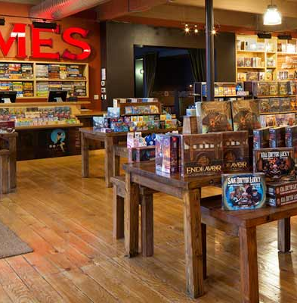
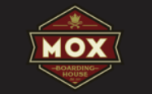
Mox Boarding House
Seattle, WA
Mox Boarding House | A Unique Gaming Experience Like No Other

Slide 13
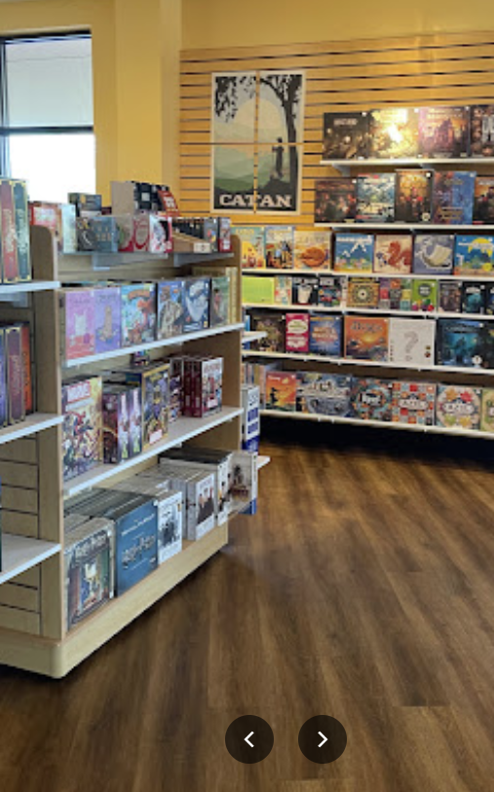
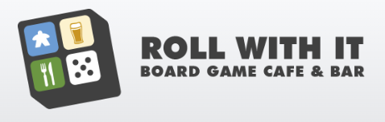
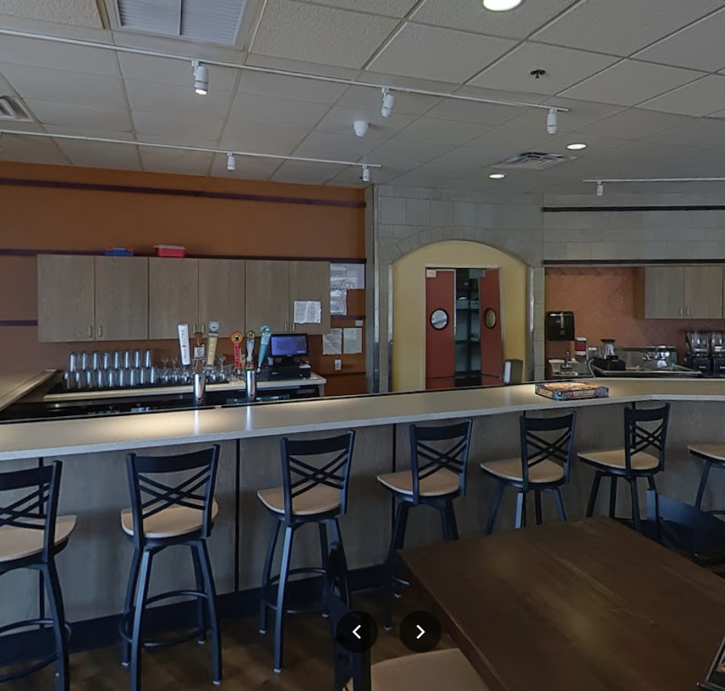
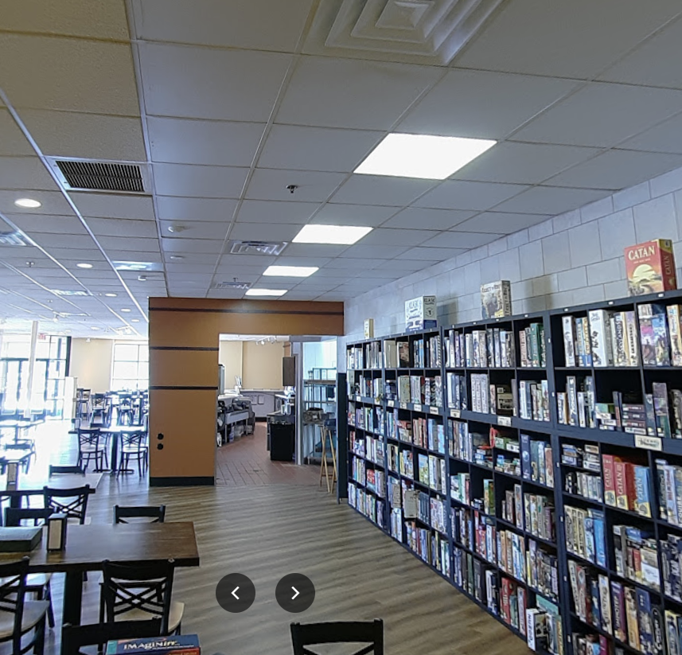
Roll With It: Board Game Café & Bar
Virginia Beach, VA
Virginia Beach Board Game Cafe & Bar - Roll With It (rollwithitbgcafe.com)

Slide 14
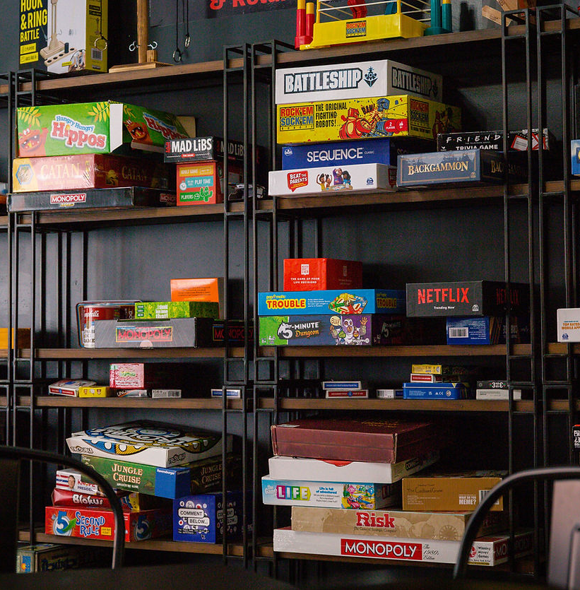
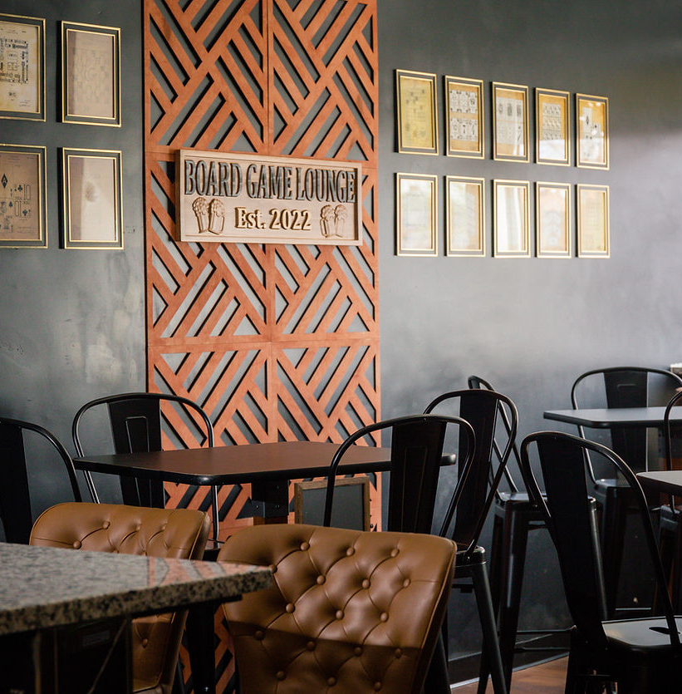
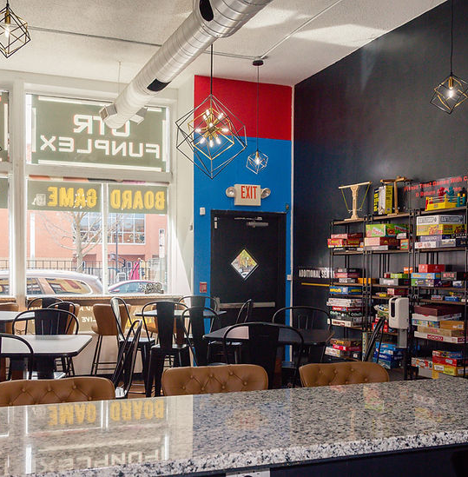

OTR Funplex: Game Board Lounge
Cincinnati, OH
Game Lounge | OTR FUNPLEX

Slide 15
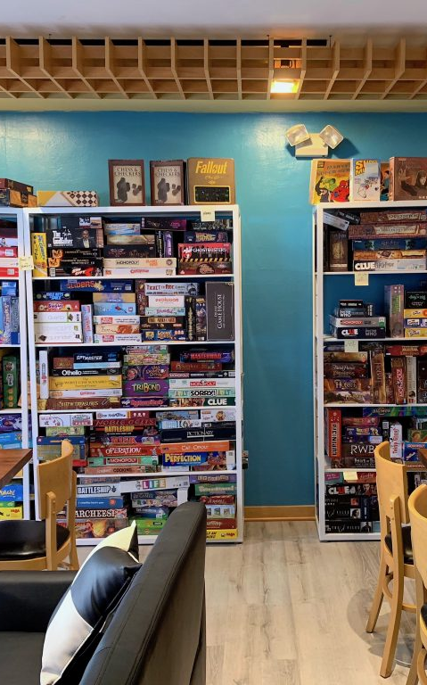
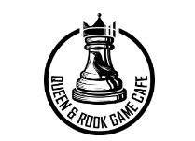
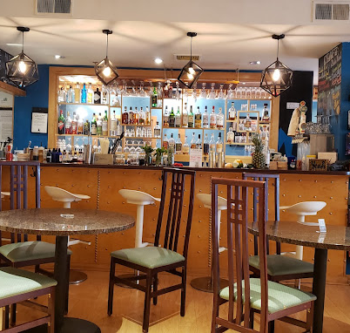
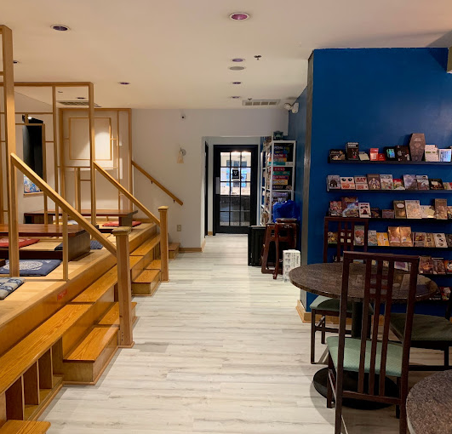
Queen & Rook Game Café
Philadelphia, PA
Queenandrookcafe.com

Slide 16
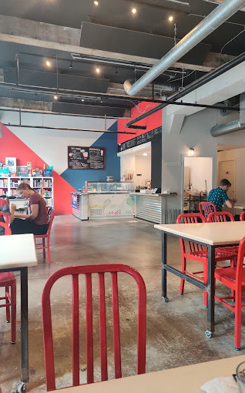
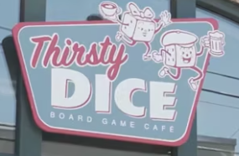
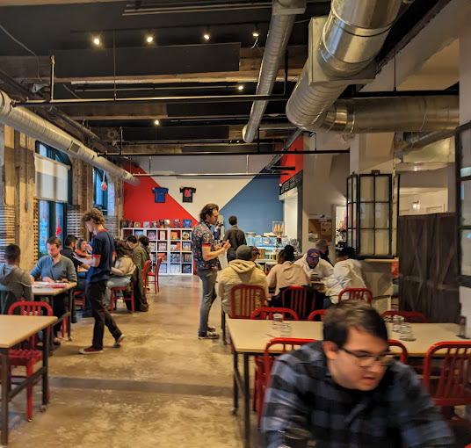

Thirsty Dice
Philadelphia, PA
Thirstydice.com

Slide 17




The Board Room
Arlington, VA
https://www.theboardroomva.com/

Slide 18




Vigilante Gastropub & Games
Austin, TX
https://vigilantebar.com/

Slide 19




Emerald Tavern Games & Café
Austin, TX
https://www.emeraldtaverngames.com/

Slide 20
Local Competition
OTR Funplex: Boardgame Lounge Game Lounge | OTR FUNPLEX
Victory Pints HOME (vpcincy.com)

