Slide 1
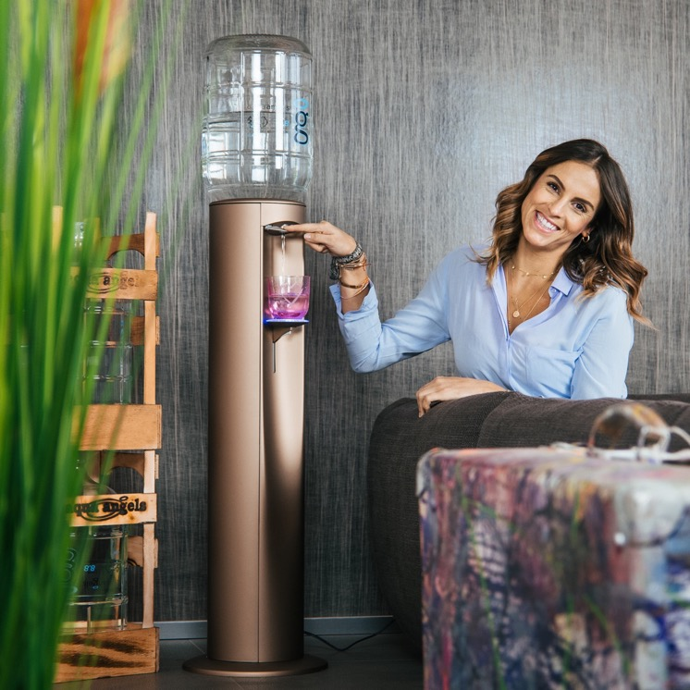
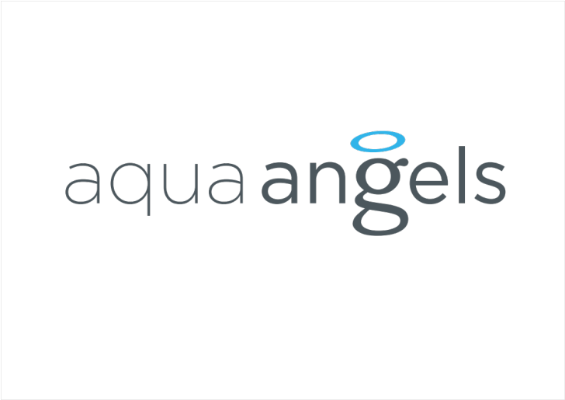

Slide 2
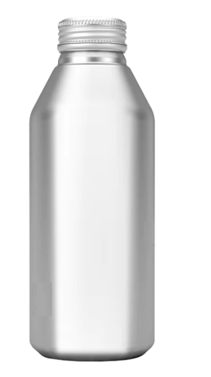
„WATER CAN“ PROJECT
We create water can - handy disposable metal packaging that can be closed with a cap and used for a long time. We want to stand out, look different from typical other water brands.
It is a product that the clients impulsively buys because the design attracts them. They want to take it out of their bag, they want to give it to their clients. They want to have the CAN with them all the time.
The packaging is great for kids, but we don't design product for kids. We create a tasteful luxury UNISEX design for parents who want to buy it for themselves and give it to their children at the same time.
The client will buy our product for the first time because of the design and type of packaging, the taste will make him a loyal client.
.

Slide 3
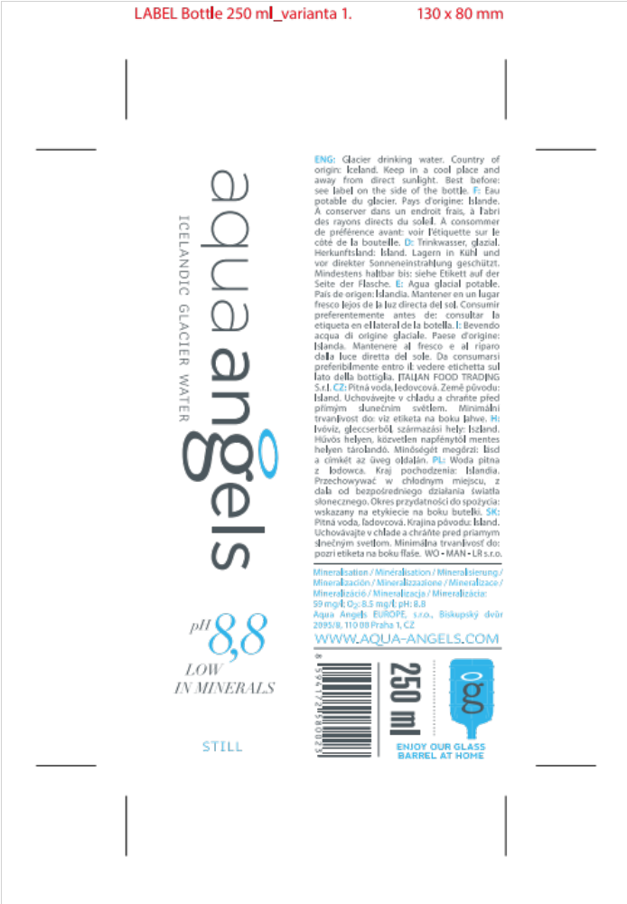
LABEL INFORMATION
2 main elemnets
Logo Aqua Angels
Word CAN
Another important information
ALKALINE PH
LOW IN MINERALS
ICELANDIC GLACIER WATER
STILL
We are available online in glass barrels for your home
Statutory information on the side of label

Slide 4
CHOICE
Most of water brands are generally tuned in white-blue style.
They all use images of nature, water.
We want to be different.
We are angelic water.
Minimalism describes us.
An important part of the Aqua Angels concept is wood (our glass barrel comes in a wooden case).
Our clients like gold and silver color.
The product name is CAN. And that word has a double meaning.
WATER CAN MAKE YOU HAPPY…
WATER CAN HELP YOU…
WATER CAN ENRICHE YOU…
We will play with it in future communication.
Notes:
Nelíbí se mi typ písma těla textu, ani

Slide 5
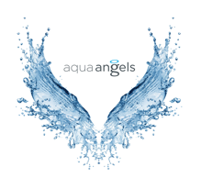
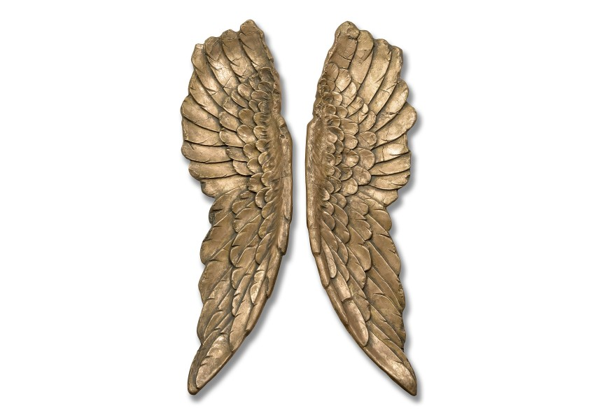
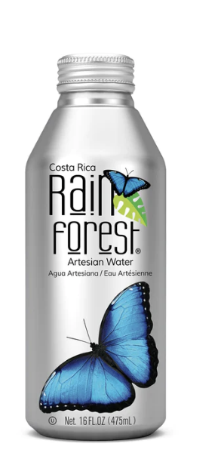
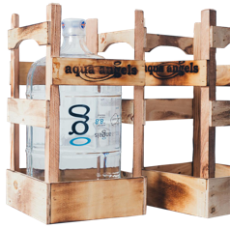
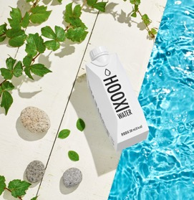
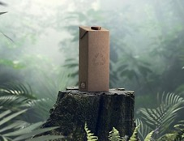
MOOD

