Slide 1
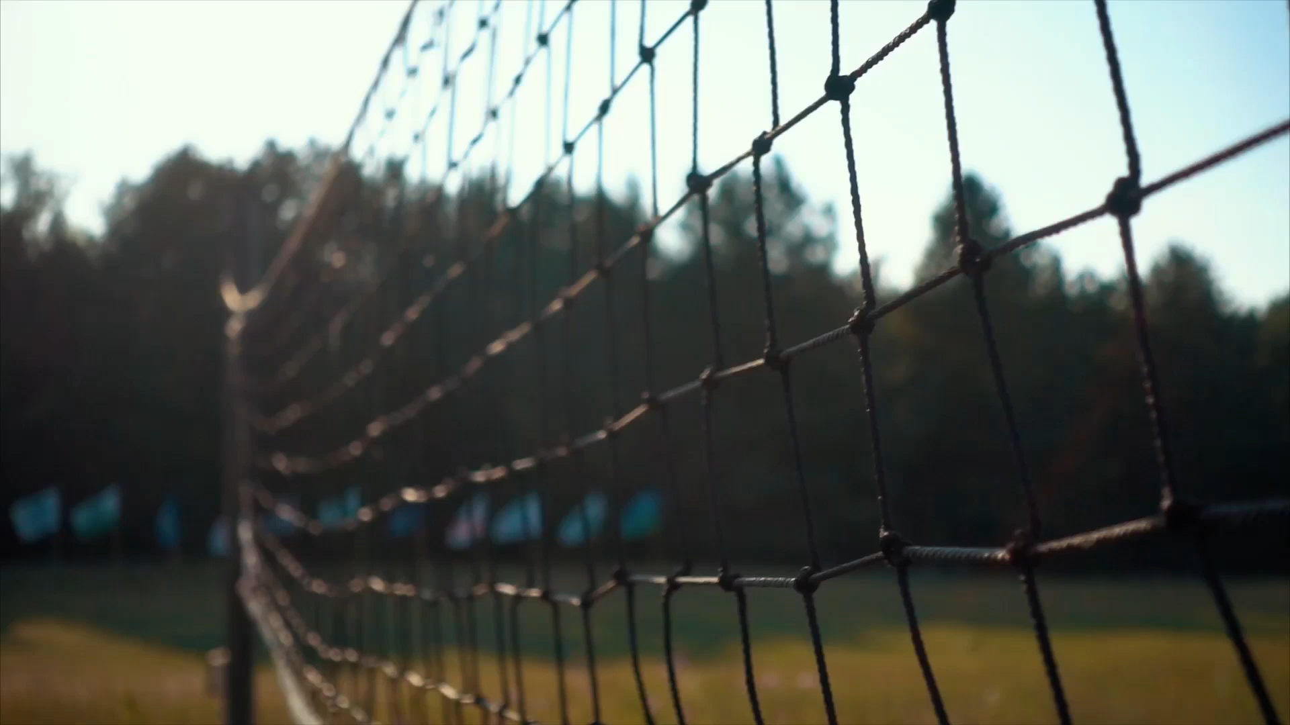
Mouthguards and Sports Safety

Slide 2
Make a mouthguard part of your uniform..
When it comes to protecting your smile during active sports, a properly fitted mouthguard is a key piece of athletic gear for children and adults

Slide 3
Mouthguards typically cover the upper teeth, which are more exposed than the lower teeth

Slide 4
Mouthguards cushion impacts that may otherwise cause broken teeth, jaw injuries, or cuts to your lips, tongue, or face.

Slide 5
Mouthguards are commonly used in contact sports. However, mouthguards help prevent mouth and jaw injuries even in non contact sports

Slide 6
Pick a mouthguard that:
Fits properly and is comfortable
Ideally has been custom made by a dentist
Has enough flex that it won’t tear or break, and is thick enough to hold up to a heavy hit
Is easy to clean
Doesn’t limit speech or breathing
Stays in place

Slide 7
We can make you or your child a custom mouthguard that is comfortable and protects the jaw.
Ready-made mouthguards may be cheaper, but they do not fit as well and can make it harder to speak or breath

Slide 8
The American Academy of Pediatric Dentistry says that most oral injuries among 13 through 17 year olds occur while playing basketball

Slide 9
Baseball accounts for most of the oral injuries in 7 through 12 year olds

Slide 10
Do
Clean your mouthguard after each use with a toothbrush and toothpaste or a denture cleaner. Rinse with cool water after cleaning.
Store in a firm non airtight container
Check for wear and replace when it no longer fits properly
Wear your mouthguard during both practice and games

Slide 11
Don’t
Don’t put your mouthguard in the sun or hot water – it could melt or lose its shape
Don’t wear removable appliances like retainers with your mouthguard
Don’t chew on your mouthguard or cut pieces off because it will change the fit.

Slide 12
Tooth Emergencies
Knocked out Permanent Tooth
  Keep the tooth moist – do NOT let it dry out!
  Hold it by the crown (the top part that you see)
  Rinse the root with lukewarm water. Do NOT scrub the tooth!
  Put the tooth gently in its socket
  If you can’t put it back in the socket, put it in a container with milk
  Talk to your dentist as soon as possible – ideally within 15-20 minutes.

Slide 13
Cracked or Broken Tooth
Rinse your mouth with warm water to clean the area.
Put an ice pack or washcloth with ice wrapped inside on your face to keep the swelling down.

Slide 14
Possible Broken Jaw
Put an ice pack on your jaw to control the swelling
Go to your dentist or hospital emergency room as soon as possible

Slide 15
Bitten Tongue or Lip
Clean the area with a cloth and put an icepack on it to keep the swelling down.
If the bleeding is heavy or doesn’t stop in a short amount of time, go to your dentist or hospital emergency room.

