Slide 1

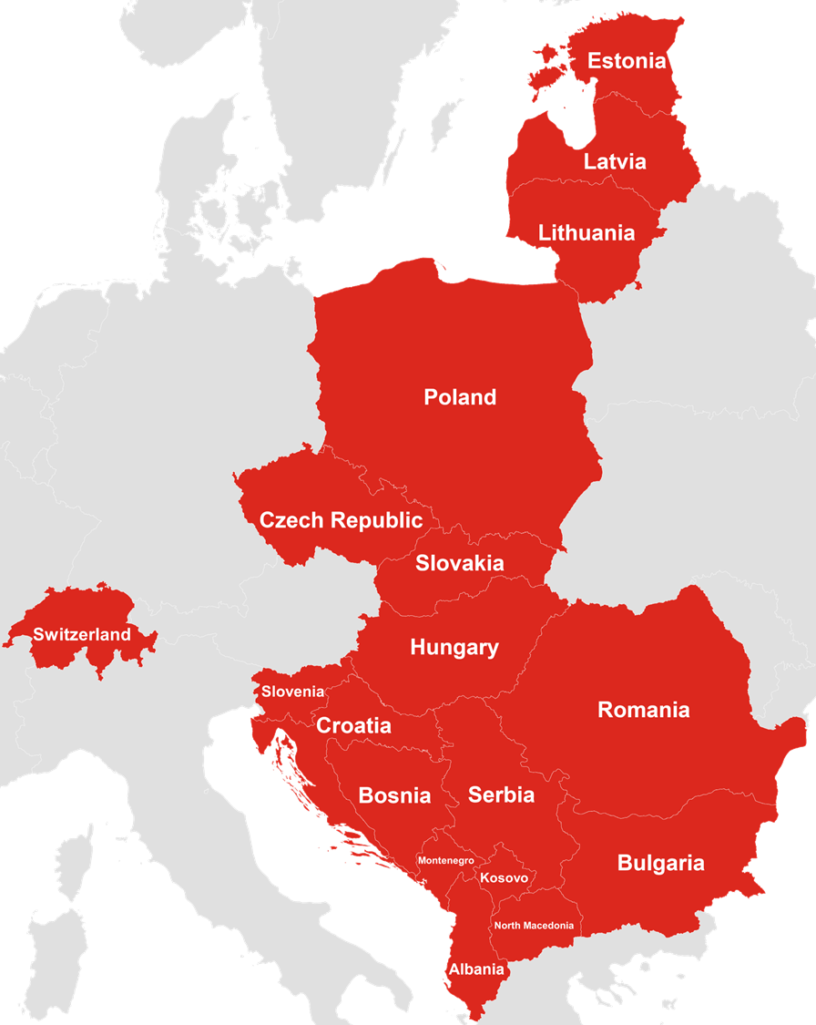
  Unlock your CEE-Swiss Potential with SEC
Discover the world of the Chamber of Commerce Switzerland Central Europe (SEC).
We are Switzerland’s most important non-profit organization committed to enhancing the relationships between Switzerland and the 17 countries across the Baltics, Central-, and Southeast- Europe (CEE). Our strength lies in a vibrant and continuously expanding community of influential and engaged individuals, companies, and institutions both in Switzerland and across the CEE region. Our two objectives are to improve relations in terms of business & trade, science & education, and society and to make our members, partners, and clients more successful.
We connect Switzerland and Central Europe
  What makes CEE so attractive?
  Strong Economic Importance: With Swiss exports to CEE having grown 2.5x from 2011-2021, and investments 4.5x from 2016-2022, CEE has emerged as Switzerland's indispensable growth hub in Europe for exports, sourcing, and investments.
  Switzerland’s Top Choice: The "SME Barometer" published by NZZ in 2022 for the Swiss Economic Forum highlights the crucial importance of Central Europe for Swiss businesses. In this survey, 616 Swiss C-Level managers identified Central Europe as their number one global region for enhanced focus on exports and sourcing.
  Biggest Swiss Diaspora Group: With over 1 million Swiss residents having familial ties to CEE, this extensive diaspora community serves as a rich cultural and economic link that drives mutual understanding and promotes business growth in both regions.
  Diverse and Growing Markets: CEE's 17 nations offer a broad economic spectrum, from mature to emerging markets. This diversity, along with consistent economic growth, opens up a myriad of opportunities for Swiss businesses of all types and objectives.
Add a map.

Slide 2






What we can do for you!
SEC serves as your partner in maximizing your business potential across Swiss and Central and Eastern European markets. Our comprehensive services include:
1. Empowering Your Business
Partner with top-tier experts to optimize your business's capacity to export, source, and invest efficiently. As a bilateral organization, our services span Swiss and CEE companies across the region and in Switzerland. This includes finding suitable business, IT-, and industrial sourcing partners, offering market research and comprehensive support for market entry, assisting in business setup, providing legal advice or mediation services, and more.
2. Building Your Network
Join our vibrant network of influential individuals and companies across Switzerland and CEE. Profit from our broad range of business and social events to expand and deepen your connections. Need to connect with specific people or organizations within our community? Just let us know.
3. Inspiring and Informing You
Stay on top of relevant news about the CEE – Swiss economy, trends, and business opportunities. Our newsletter "SEC Monthly", LinkedIn news, website, and the monthly "CEE Swiss Impulse Session", our TEDx-style webinars, keep you informed and inspired.
4. Tailored Support for You
Let us handle your projects. Beyond traditional services, we take on and manage projects aimed at fostering bilateral relationships. Whether it's organizing your events, running tailor-made trainings, coordinating delegation trips, or facilitating fact-finding missions, we ensure that your unique needs are always met.
  Join SEC: 7 Benefits that Make a Difference!
  Gain access to the largest and influential Swiss-CEE community in business, science and diplomacy
  Unlock your success in the hugely important and fast-growing Swiss-CEE markets
  Benefit from personalized support by our team and our first-class services regarding your import/export activities, IT- and industrial- sourcing needs and your investments.
  Support us as non-profit organization, so we can continue to do good for business & trade, science & education and the societies of the 17 CEE countries and Switzerland
  Enjoy relevant, high-quality business and social events and webinars by SEC and our partners
  Stay informed about important market insights and business opportunities thanks to our newsletters, SEC-LinkedIn News and our homepage
  Receive attractive member discounts and member-for-member benefits
  SEC offers yearly memberships for companies and individuals in Switzerland and abroad. We provide free memberships for start-ups and reduced rates for students and retired people.
  For more information
  Chamber of Commerce Switzerland Central Europe (SEC)
  Kasernenstrasse 11
  8004 Zürich
  Web: www.cee.swiss
  Email: info@cee.swiss
  Tel: +41 44 291 94 01

