Slide 1

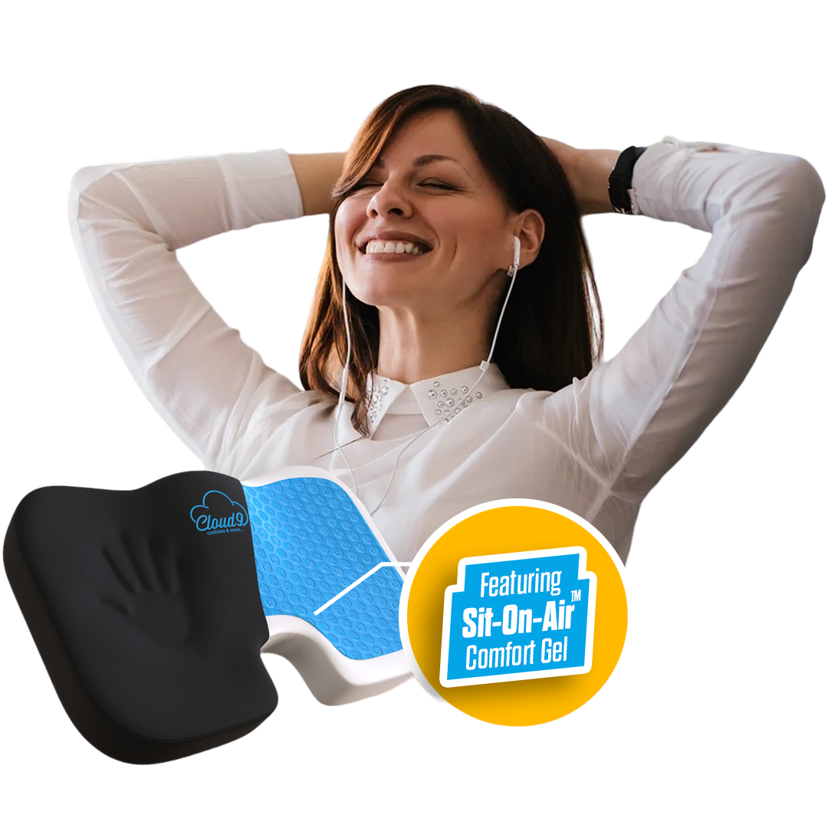
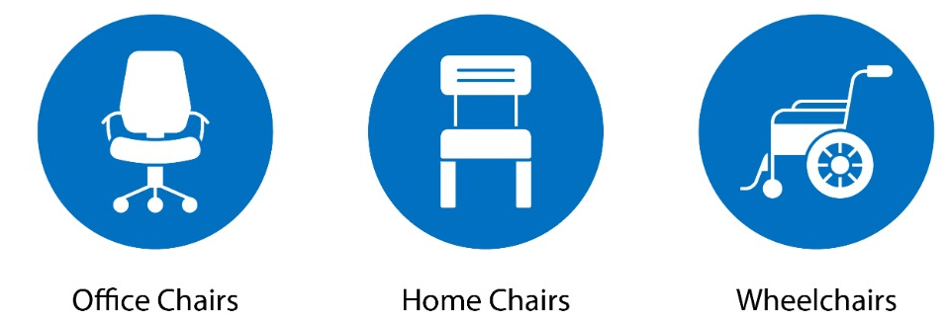
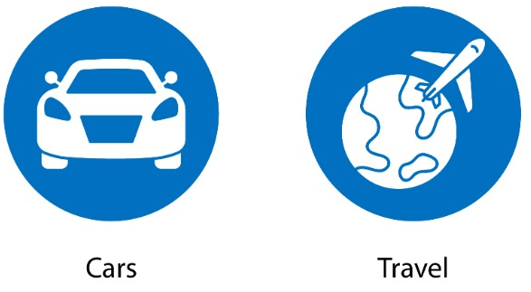
ORTHOPEDIC
SEAT CUSHION
Ergonomic Design
For Cloud-Like Comfort
Back Pain & Sciatica Relief
Promotes Healthy Posture
Eliminates Pressure Points
Improve Blood Circulation
Relieves Stress & Boost Energy
TRANSFORM ANY CHAIR INTO AN ERGONOMIC SEAT
So comfy, feels like you’re sitting on a cloud!
www.Cloud9SeatCushion.com

Slide 2
ORTHOPEDIC
SEAT CUSHION
Ergonomic Design
For Cloud-Like Comfort
Back Pain & Sciatica Relief
Promotes Healthy Posture
Eliminates Pressure Points
Improve Blood Circulation
Relieves Stress & Boost Energy
TRANSFORM ANY CHAIR INTO AN ERGONOMIC SEAT
www.Cloud9SeatCushion.com

Slide 3
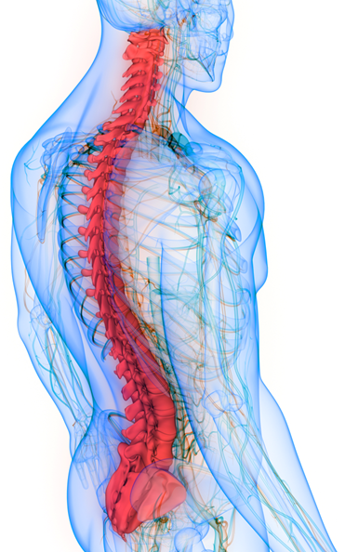
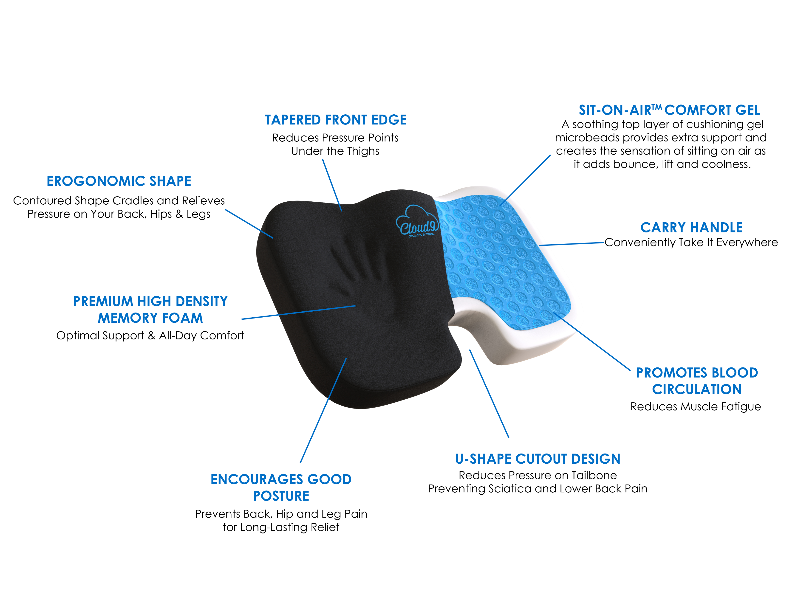
ORTHOPEDIC
SEAT CUSHION
Featuring
Sit-On-Air™ Comfort Gel
www.Cloud9SeatCushion.com

Slide 4

The Most Comfortable Seat Cushion Ever!
Back Pain & Sciatica Relief
Promotes Healthy Posture
Eliminates Pressure Points
Improve Blood Circulation
Relieves Stress & Boost Energy

Slide 5

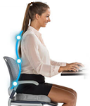
So comfy, feels like you’re sitting on a cloud!
THERAPEUTIC
Seat Cushion
With Sit-On-Air™ Comfort Gel
Ergonomic Design
For Cloud-Like Comfort
Back Pain & Sciatica Relief
Promotes Healthy Posture
Eliminates Pressure Points
Improve Blood Circulation
Relieves Stress & Boost Energy
www.Cloud9SeatCushion.com

Slide 6

THERAPEUTIC
Seat Cushion
With Sit-On-Air™ Comfort Gel

Slide 7
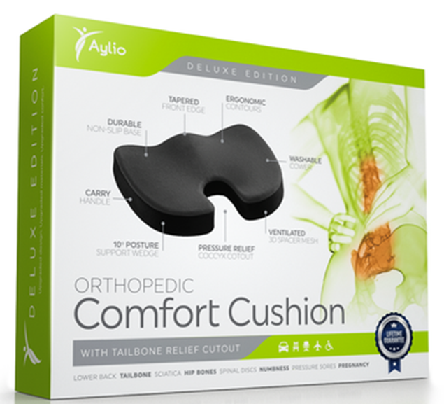

Slide 8
