Slide 1
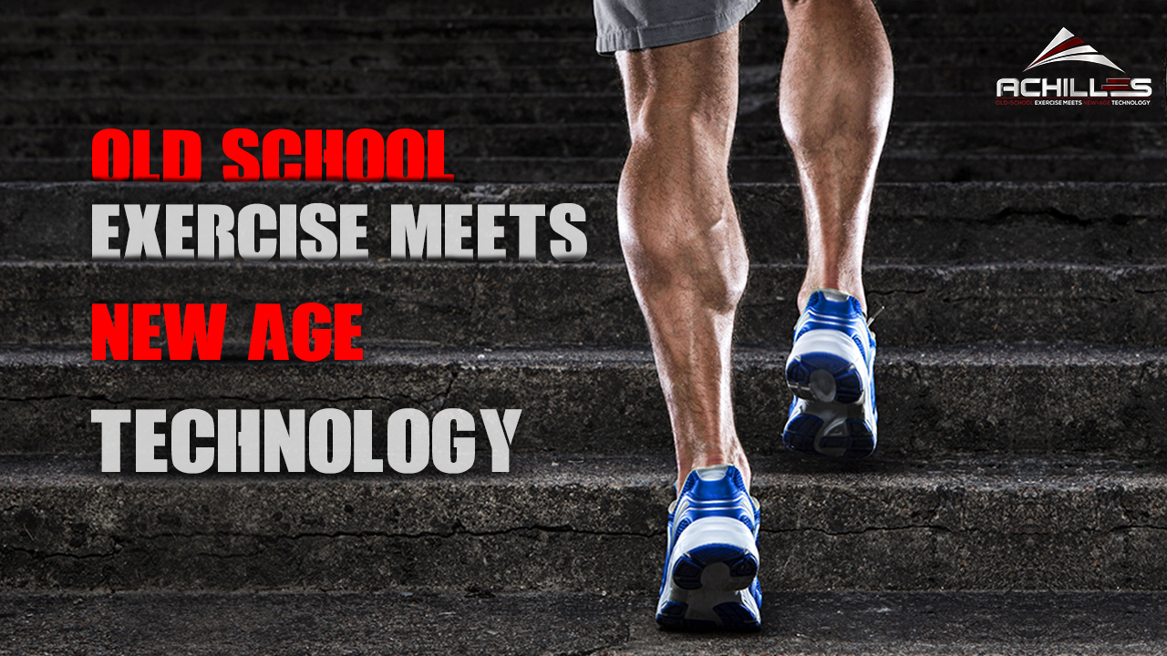

Slide 2
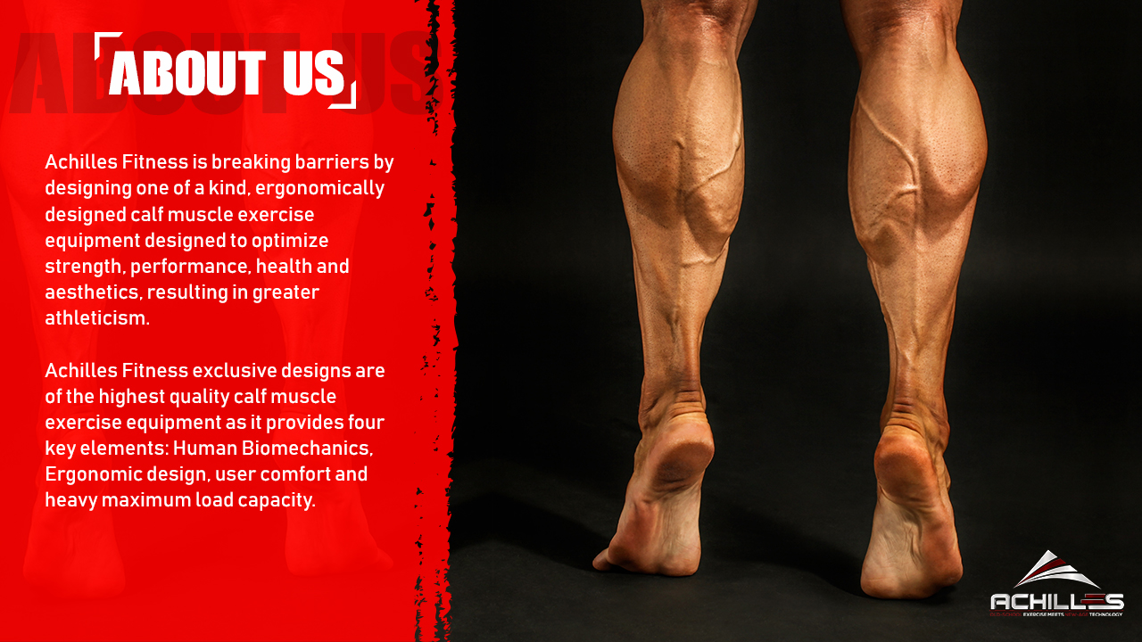

Slide 3


Slide 4
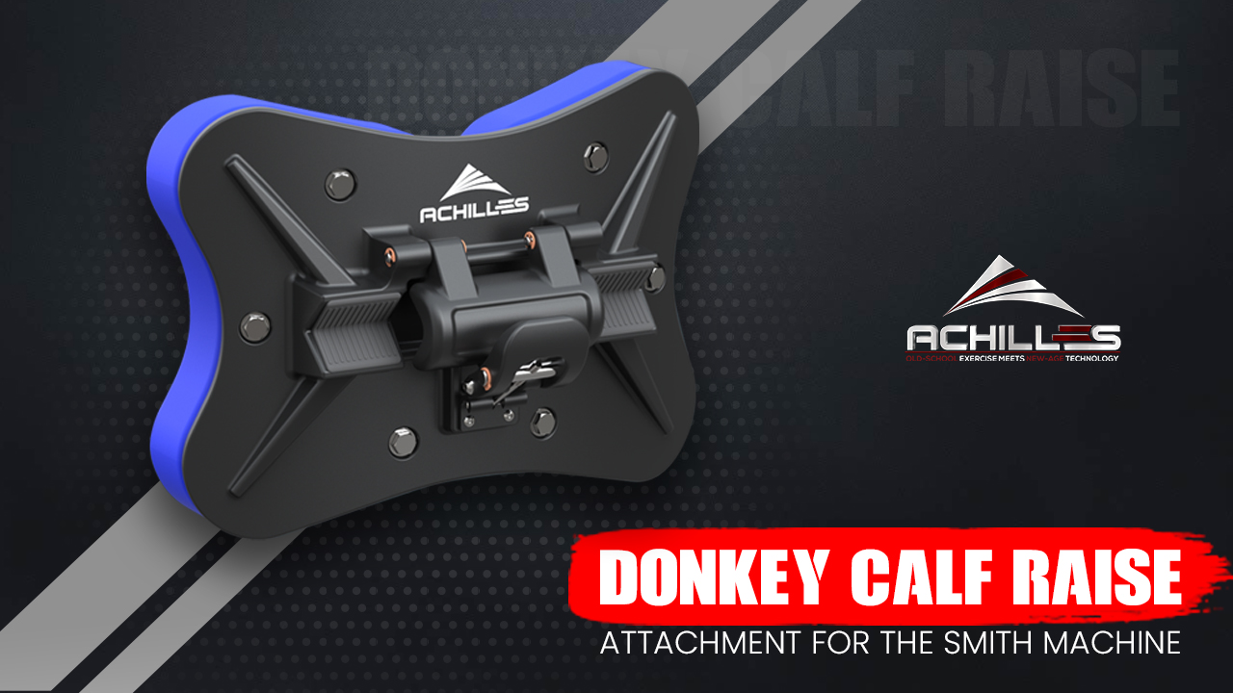

Slide 5
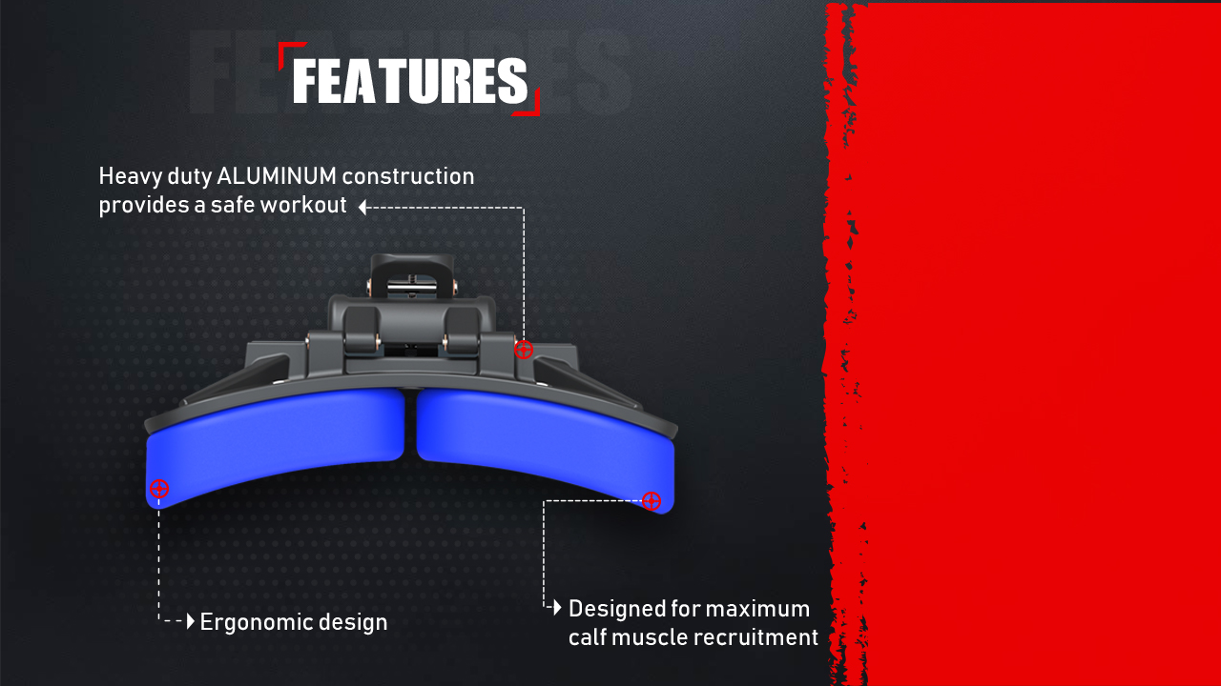
The Achilles Fitness Donkey Calf Raise attachment is the world 1st calf raise attachment for the smith machine. This patented commercial fitness Apparatus is Ergonomically designed to allow the user to exercise the gastrocnemius and the soleus calf muscles.
This training Method applies stress and elongation of the muscles of the hip, knee and ankle joint to generate greater power.
The donkey calf raise is the most effective exercise of strengthening and building the calf muscles..
Its strengthens and builds your calves.
It instantly attaches to a smith machine Olympic barbell
Can support up to 1200lbs.(544KG)
Fits up to 28mm to 38mmm diameter center knurl smith machine Olympic barbell
Heavy duty aluminum construction
Professional-grade comfort foam pads
Built to last and withstand the most intense training programs.

Slide 6
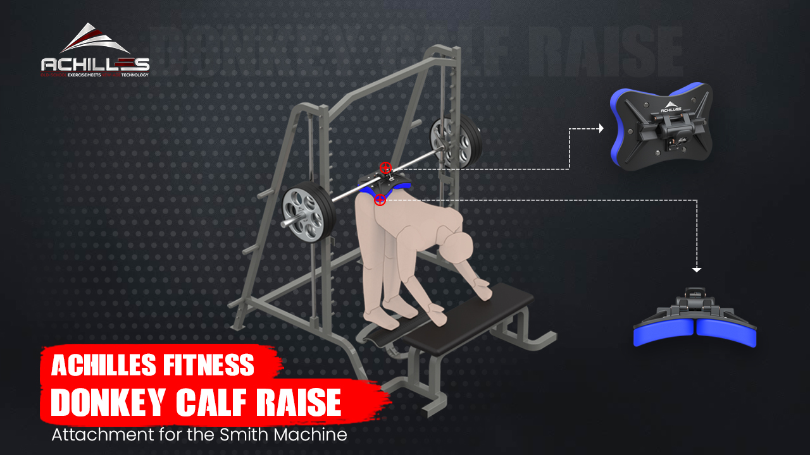

Slide 7
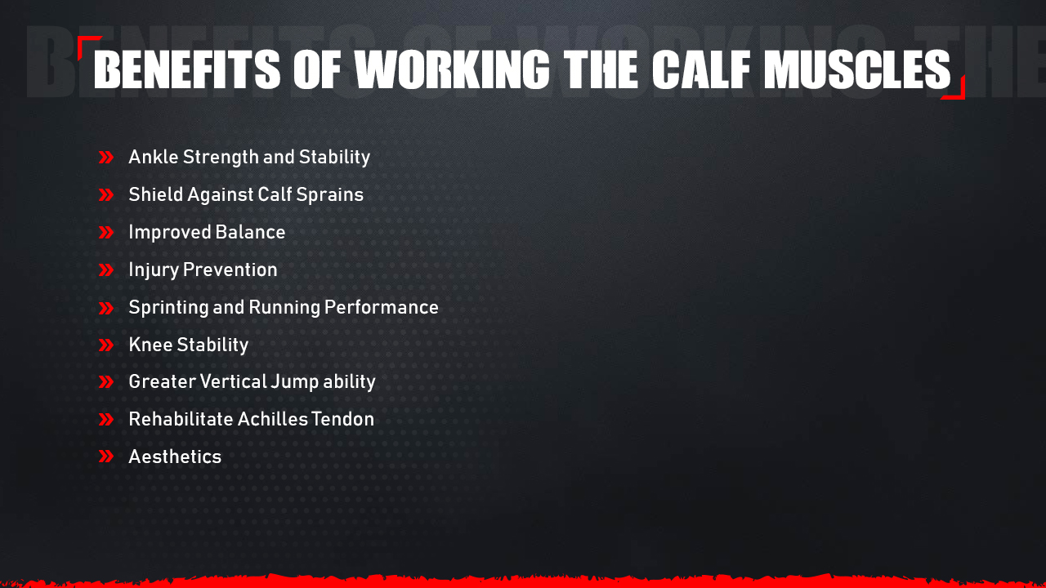

Slide 8


Slide 9


