Slide 1
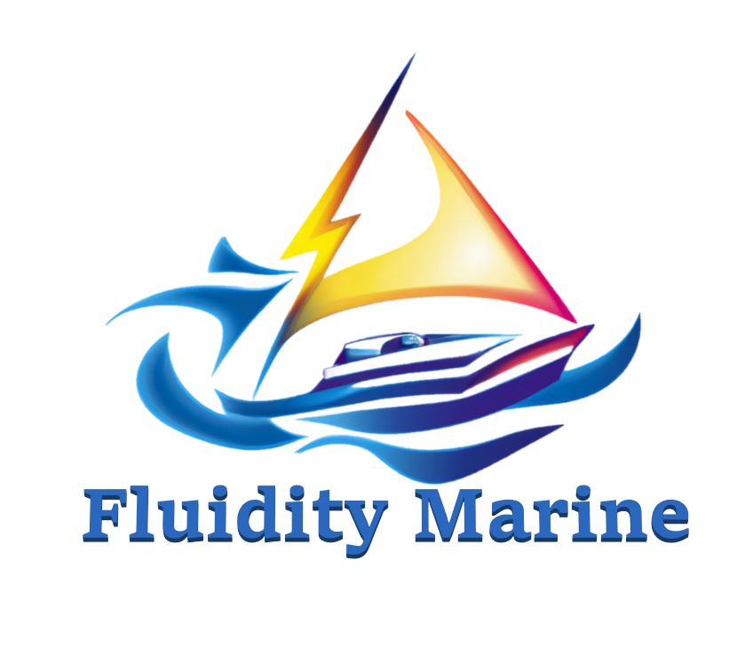
Modernizing Maritime Propulsion
Accelerating Eco-Sustainable
Design and Manufacturing

Slide 2
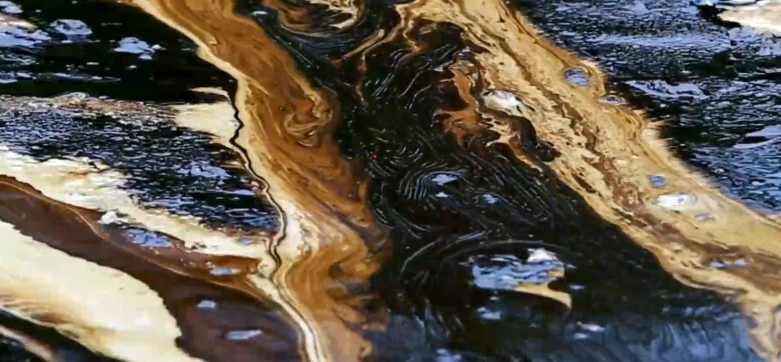

Current Propulsion
Taints Water Quality
Silent Poison: A Toxic Plague of Fossil Fuel Engines
Unseen Culprits: The Menace of Propeller and Rudder Damage
Sonic Sabotage: Disastrous Impacts of Noise Pollution on Marine Life

Slide 3


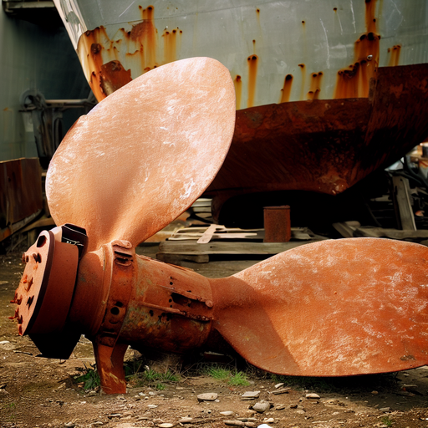
The Industry is…
Caught in Time:
With Stagnation of Propulsion Innovation
Fueling Boundaries:
Fuel Controls Marine Infrastructure and Access
Centralizing Cost:
Eco Impact Amplified by Manufacturing Practices

Slide 4

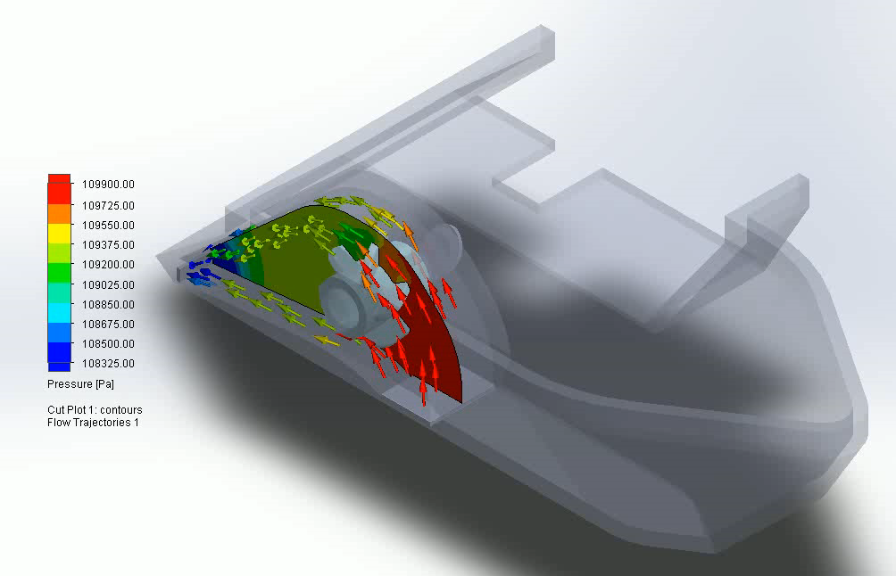
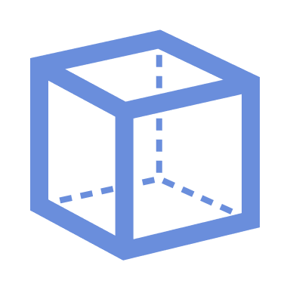


Fluidity Marine’s Solutions
Revolutionizing Hull Design with Innovative 3D Printing Technology
Turning Ocean Waste into Marine Marvels:
Utilizing Recycled Plastics for Sustainable Hulls
Unleashing the Power of 3D Printed Geometries:
Lightweight, Unsinkable, Unparalleled Performance
Breaking Boundaries in Design:
Unlocking Possibilities with Novel Construction
Engineering Excellence:
Structural Integrity thru Steel Wire 3D Printing
Notes:
Using Recycled Ocean Plastics compounds the ecological benefits. We encourage and participate in ocean cleanup programs and provide a functional use for the waste materials collected.
Honeycomb Infill of the Hull provides positive buoyancy even if the boat or component is completely submerged in water or compromised.
Novel Geometries only possible through 3D printing allow us to reimagine hull concepts and create integrated systems with ease.
Structural Components are integrated directly into the single-piece hull or scalable module component.

Slide 5
Fluidity Marine’s Solutions (cont’)
Versatile & Interchangeable Modular Product Line
Seamless Integration: Electric Motor Pods and Impeller Pods Form a Watertight Connection through Shaft Seals
Unlimited Possibilities: Standardized Components for Varying Boat Types, from V-Hulls to Flat Bottoms and More
Tailored Solutions for Every Need: Configurable Parts for Pontoon Boats, Barges, Mobile Docks, Working Platforms, and Beyond
Harnessing Nature's Power: Integrated Solar, Wind, and Marine Energy
Sustainable Off-Shore Charging: Weather Protection Structures Embed Flexible Photovoltaic Charge Systems and Wind Turbines for Continuous Power Generation
Tapping into Marine Energy: Deploy Wave & Current Turbines while Anchored or Moored
Unmanned Efficiency: Enables Automated & Drone Ship Operation without Intervention
Breaking Free from Fuel Depots: Eliminates the Need for Regular Visits to Centralized Fuel Stations, Unlocking Greater Autonomy, Sustainability & Utility
Notes:
Using Recycled Ocean Plastics compounds the ecological benefits. We encourage and participate in ocean cleanup programs and provide a functional use for the waste materials collected.
Honeycomb Infill of the Hull provides positive buoyancy even if the boat or component is completely submerged in water or compromised.
Novel Geometries only possible through 3D printing allow us to reimagine hull concepts and create integrated systems with ease.
Structural Components are integrated directly into the single-piece hull or scalable module component.

Slide 6
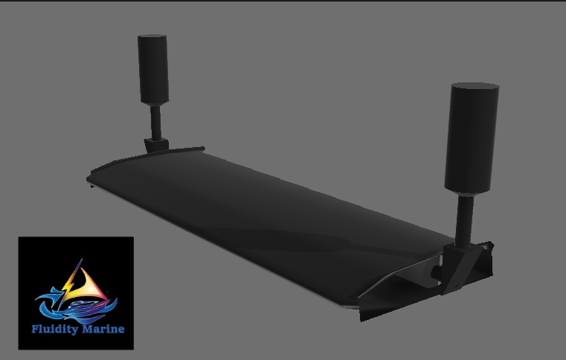
Fluidity Marine’s Solutions (cont’ again)
Seamless Integration and Optimal Performance:
Intelligent Array Controller with Self-Calibration
Effortless Configuration: Plug-and-Play Motor Pods with Intuitive Visual Configurator
Simply Drag and Drop the New Motor to its Installed Location
Self-Calibration for Precision: Calibration Mode Optimizes Power Distribution Curve
Ensures the Motor's Performance is Optimized to Match the Installed Configuration
Notes:
Plug and play Motors and Modular Components allow creation of custom marine transport platforms like lego blocks or an erector set
Machine Learning Models operating onboard can act as lookout and scout (identifying and categorizing floating objects in visual range), or captain and autopilot (navigating to waypoints assisted by object avoidance and autodocking)
Additional Sensor Data can be aggregated to produce underwater feature maps that gain accuracy with every pass. ML applications are numerous.

Slide 7
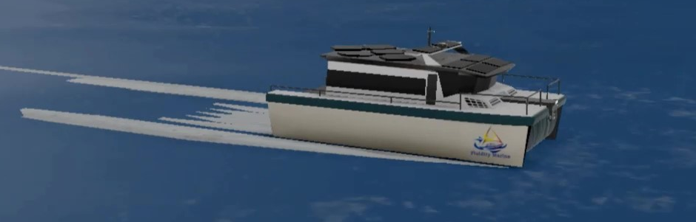
Fluidity Marine’s Solutions (cont’ Still)
Harnessing the Power of Integrated Graphene
Unleashing the Power of Computer Vision & Sensor Data
Graphene-Coated Hulls Generate Charge from Saltwater
Unleash the Potential of Graphene to Generate Electricity
Directed Flow of Charge into Battery Arrays
Maximize Energy Storage and Utilization
360º Camera with Advanced Sensors: Enhanced Vision and Perception
Object Recognition and Real-time Path Tracking
Avoidance of Obstacles for Safe and Reliable Operations
Embrace Autonomy: Enabling Autonomous and Semi-Autonomous Operations
Effortless and Efficient Navigation for Increased Productivity
Data for Optimization: Data Collection, Aggregation, and Exploitation
Unlocking Insights and Driving Continuous Improvement
Notes:
Flexible Solar Charging, Wind and Wave Turbines built into the shade structures or deployed while anchored or moored ensure off-grid operation capabilities and near zero ongoing operational costs beyond routine maintenance and occasional fast-charging when needed and available
Working with advanced tech educational programs on energy generation and materials science could one day allow us to print graphene structures on the exterior layer of our hulls and generate electricity from the salt water flowing past the hulls. New Saltwater charging generator technologies could be built into the structural elements of our products.

Slide 8
Fluidity Marine’s Solutions (Last One)
Empowering the Future with Solid State Battery Technology
Electrification Adoption through Innovative Retrofit Designs
Unleashing the Potential of Ancillary Marine Products
Revolutionary Solid-State Batteries: Redefining Energy Storage
Reduced Weight, Increased Capacities, and Enhanced I/O Rates
Embracing Safer and Environmentally Friendly Construction Materials
Modular Pods for Seamless Integration: Unlocking Retrofit Possibilities
Harnessing the Power of Interchangeable Components
Custom Geometries 3D Printed On-Demand for Hull-Specific Upgrades
Sustainability with Recycled Ocean Plastics: Turning Waste into Value
Upcycling Marine Waste into High-Quality Products
Building Strong Marine Support Infrastructure (Floating Docks & Buoys)
Notes:
New Electric Vehicle Batteries are being worked on that use less toxic materials and have higher energy densities and charge/discharge rates at lower weights. Working with University programs and companies with like minded goals we can help direct the development to suit marine specific applications
Aftermarket Products can help accelerate adoption by replacing only the polluting engine components of existing boats and leveraging a massive existing market for obsolescence.
Using our Industrial 3D Printers to print ancillary marine products that are often already made of plastic using recycled ocean plastics contributes to the narrative of our goals and increases awareness of our products and services.

Slide 9
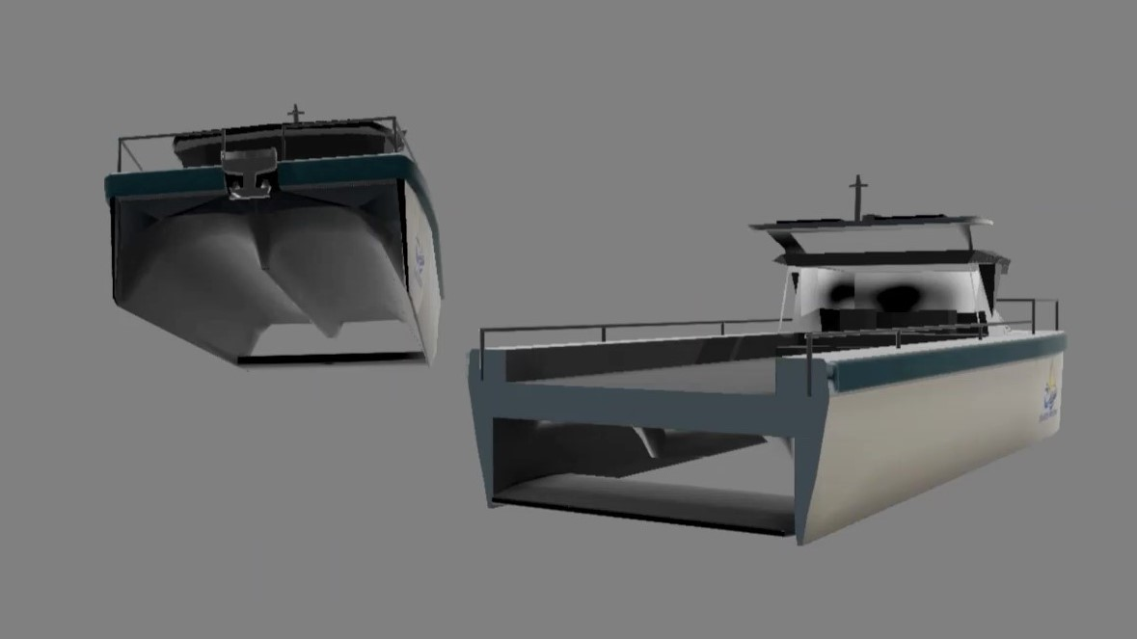
Why we are Better
Our local impact strategy is ideal for a location-based franchise model
Centralized Repository of Custom 3D models
Enables new validated designs to be available to all
Templatized Customization Requests handled centrally retaining IP
Additional Marine Products Made On-Demand removing twice the waste
Floating Docks, Construction Materials, Moorings, Aquaculture, Artificial Reefs, Surfboards, Novelties, Furniture, Spare Parts, Virtually Anything
Patent Pending High Flow Helical Impeller and Novel Nozzle Designs as IP
Source Locally and Manufacture Locally as needed
Notes:
Tell the investor what makes you so special, what makes this work, what your insights are. This might take more than one slide.

Slide 10
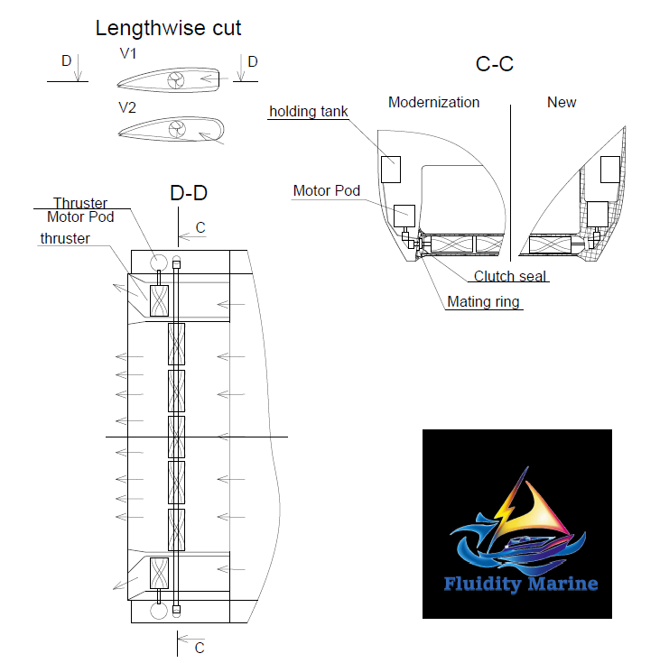
Redefining Propulsion
Helical Impellers:
Next-Level Efficiency and Performance
Unprecedented Thrust Generation
Patent Pending Flat Venturi Nozzles:
Horizontal Thrust Distribution
Unmatched Maneuverability & Stability
Thrust Vector Rudderless Steering
Navigate Without Traditional Rudders
the Freedom of Effortless Steering

Slide 11
Revenue Streams
Bespoke and Iteratively Improved Branded Product Lines
Fully 3D Printed Boat Hulls with Patent Pending Snave Propulsion
RetroFit Pods and Electrical Conversion Kits for Existing Hulls
On-Demand Manufacturing: Your Imagination, Our Creation
Enables Each location to design novel or client specific items
Loungers for Hotels, Household Items hard to get in Remote Locations, etc
Franchise Expansion Model - License Fees for each Printed Product
COTS Parts Reselling - Centralized Sourcing of Electronics
AI/ML Data Monetization
Tap into a Global Network of Innovative Entrepreneurs
Enhance Efficiency and Reliability of Manufacturing
Simplify Supply Chain Management
Unlock Hidden Treasures and Salvage Opportunities
Monetize Data through Valuable Insights and Analytics
Notes:
Business model is important. You probably don’t know all the details yet, but you should know a lot of them. Lay it out. If you need more space to dig into something complicated, add slides.

Slide 12
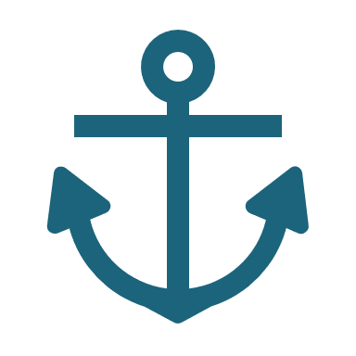

Future Growth - Market Potential
Marine Vessel Market:
A Massive $170 Billion Opportunity
We Do for Boats
What Tesla Did for Cars
Projected to Sustain 5% Annual Growth
  Excludes Marine Products & Services Segment
Prime Opportunity to Pioneer Electric Market with Eco-Tech, IOT, and AI/ML
  Carve out Space by Embracing Cutting-Edge Technologies Driving Transformation
Only with a much larger Ecological Impact
Notes:
What’s the market here? Is it going to be big? Will you make it big? How much money are you going to make off this thing? Convince the investor that they’re going to make lots of money with you

Slide 13

Founder
Aaron Evans, CTO, Inventor & Scientist
The “Mad Wizard”, he built his career on seeing things from new perspectives to find the right solutions for unsolved problems. His latest creations are so cutting edge, it makes clients wonder how they managed to stumble around for so long. A lifelong interest in social good has made him devote his time, energy, and interests to impactful solutions.

Slide 14





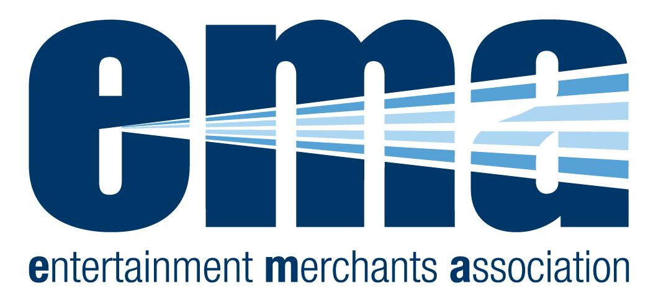

















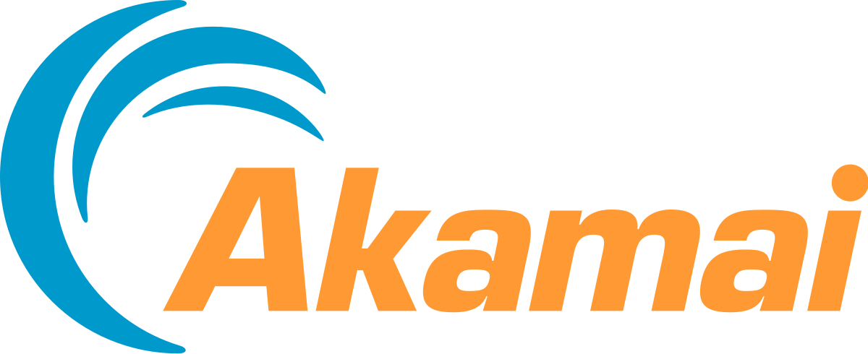

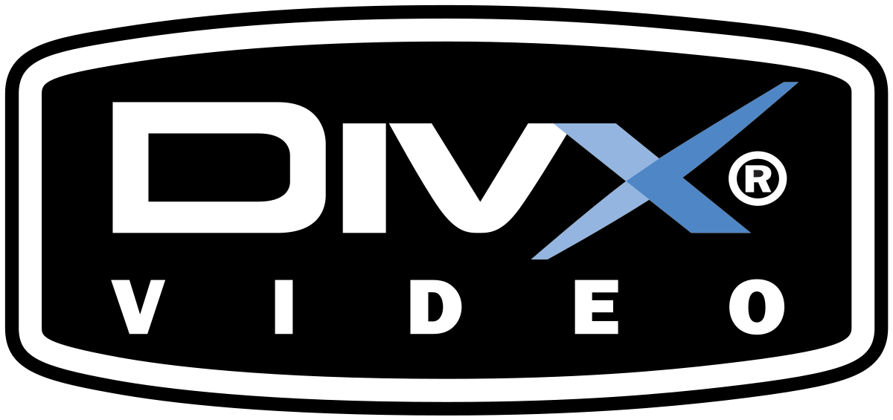






Founder Credentials
NOTABLE ACCOMPLISHMENTS & SPEAKING ENGAGEMENTS
Speaking Engagements: CES, NAB, Cable Labs, EMA, MESA, DEG, Dig Hollywood, UCLA Anderson
Co-Chair of Technical Working Group for DECE Ultraviolet (Digital Ent Content Ecosystem)
Principle Engineer on first IP streaming/download of Studio content
First Production Video CMS based on GraphQL
Pioneered Video distribution via CDN
Contributed to Blu-Ray Specification
Contributing Member of SMPTE
ASSOCIATIONS: STAFF POSITIONS
Principle E2E Architect NBC Universal Direct-to-Consumer - Peacock/Sky Media
Sr. Media Cloud Architect - AWS Professional Services - Media & Entertainment
Principle Engineer Sony Pictures Digital Authoring - Broadband Distribution
Founder Digital Revolution Enterprises - Media Technology Consulting
Director Engineering CinemaNow - Encoding & Content Distribution
Platform Architect - IBM Cloud Video/Watson Media
Microsoft Tech Support - Engineering
ASSOCIATIONS: CONTRACT & CONSULTING
Sony Pictures, Warner Bros, Verizon, Blizzard Entertainment,
Technicolor, Intel, LionsGate, Akamai, Deluxe Digital, MediaNavi M-Go,
Delivery Agent, Best Buy, Napster, Divx, Big Air Studios, Sonic
Solutions, Encompass Digital, Sonic Foundry and others

Slide 15



Attachments & Advisors
Gabriel Grünbaum,
Biz Dev & Management
With over 25 years in the media & entertainment technology space, he grew tired of seeing premium initiatives fail due to substandard vision — so he decided to make real change. Now he takes lessons learned and relationships established to make real and substantial impact for good.
TBD, Naval Architect
Naval Architecture Advisor Still being confirmed
TBD, Important Advisor
Stuff about Advisor and Picture

Slide 16
What We Need
Total Startup Expenses and Capitalization: $5,000,000
Capital Investments: $2,800,000
Equipment and machinery for 3D printing and other manufacturing processes: $1,000,000
Research and development expenses, including software and hardware as well as Snave Impeller and Rotor optimization and testing: $1,000,000
Facility build-out and renovations, including costs associated with creating a clean, environmentally controlled space for manufacturing: $500,000
Acquisition and installation of specialized equipment for electronics assembly and testing: $300,000
Operating Expenses: $2,200,000
Salaries and benefits for a team of approximately 15 employees, including naval architects, engineers, technicians, and administrative staff: $1,300,000
Materials and supplies for production, including recycled marine plastics, electronic components, and other necessary materials: $500,000
Marketing and advertising expenses, including trade show attendance and digital marketing campaigns: $250,000
Legal and regulatory expenses: $150,000

Slide 17
What That Gets Us
Seeking Seed Funding Via MFN SAFE
First Light Manufacturing Setup &
Capital Assets for Initial Location
Operating Expenses for 12 months
If Not Series A Ready by then:
Additional $3M Seed Raise (or debt financing) gives us 12 more months
Possibly Offset in Part by Revenue Generation

Slide 18
Thank You
Contact: Aaron@fluiditymarine.com

